Slide 1
College of Science,
Zoology Department

Slide 3
Teaching Strategy
A)- Description:
أ)- الوصف:
Course Designation | Zoo-109 | 109 حين | رقم المقرر ورمزه
Course Name | General Animal Biol. | بيولوجيا الحيوان العام | اسم المقرر
No. of Credits | 3 (2 + 1) | 3 ساعات (2 + 1) | عدد الوحدات الدراسية المعتمدة
Prerequisites | None | لا يوجد | متطلب سابق
Co-requisite Course | None | لا يوجد | متطلب مصاحب
B)- Assessments Timetable
ب)- الجدول الزمني لمهام التقويم
Assessment | Assessment tasks | Weeks | Final Assess. | Total marks
1 | 1st laboratory exam | Week 6 | 15/100 | 30 marks
2 | Final laboratory Exam | Week 12 | 15/100
3 | 1st theoretical exam | Week 7 | 15/100 | 30 marks
4 | 2nd theoretical exam | Weeks 12-14 | 15/100
5 | Final theoretical Exam | Week 15 | 40/100 | 40 marks
 |  |  | 100/100 | 100 marks

Slide 4
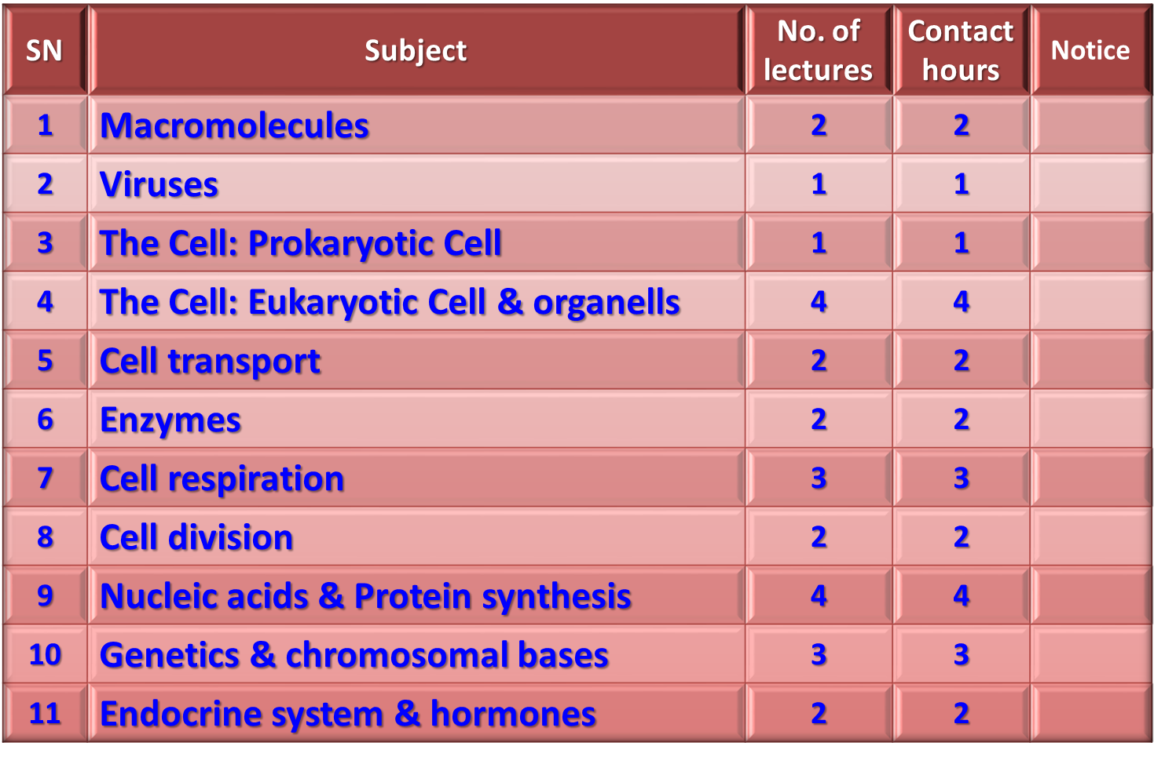
C)- Topics and teaching hours

Slide 5
D)- Knowledge to be acquired
Knowledge about the structure and properties of the living cell.
Knowledge about enzymes and there mode of action.
Knowledge about cellular respiration and energy production.
Knowledge about macromolecules and their types and importance.
Knowledge about DNA-RNA molecular bases and protein production
Knowledge about Mendel’s lows and genetic bases of inheritance
Knowledge about human endocrine system.

Slide 6
E)- Detailed Syllabus of Theoretical Zoo-109
Macromolecules:
Carbohydrates
Lipids
Proteins
Nucleic acids
Viruses
Prokaryotes
Bacteria & Archaea
Eukaryotes (Basics of cell Biology):
Cell types (plant & animal cell).
Cell organelles (animal cell)
Cellular transport (active & passive)
Enzymes and metabolic control

Slide 7
E)- Detailed Syllabus of Theoretical Zoo-109
Cellular respiration (production of ATP)
Cell division (cell cycle)
Mitotic division
Meiotic division (and sexual life cycle)
Molecular Biology (information codes and genes):
DNA and DNA-replication
RNA and RNA-transcription
From gene to protein (RNA translation)
Mendel and the gene idea:
First low of Mendel
Second low of Mendel
The genetic diseases, sex-linked disorders and mutations
The chromosomal bases of inheritance
Chemical signals in animals (endocrine system and hormonal regulation).

Slide 8
Campbell, N. A. and Reece, J. B. (2014). Biology (10th edition). Pearson Education. Inc. USA.

Slide 9
F)- Syllabus of Practical Zoo-109
Weeks | Description of exercise
1 | Microscope: To acquaint the student with the use and care of microscope. Preparation of slides to observe the animal and plant cells.
2 | Cell Structure: To familiarize the students with the general structure of the cell seen through the light microscope and acquaint them with some of the variations existing among cells (Size and shape).
3 | Mitosis: To aid the students in recognizing chromosomes and various stages in mitotic division.
4 | Meiosis: To study meiosis and compare it with meiosis with special emphasis on chromosome number and to explain the necessity for meiotic division in sexually reproducing organisms.
Histology
5 | Striated muscle, cardiac muscle, hyaline cartilage, neuron, T.S. in the spinal cord, artery and vein.
6 | Detail structure of: T.S. in the oesophagus stomach and liver of experimental rat.
7 | Detail histology of: T.S. in the testis ovary and kidney of experimental rat.
8 | FIRST EXAM
Dissection of the experimental rat and blood group
9 | To introduce the student to blood group serology in determining the ABO and Rhesus blood group systems. Determine the genotypes of different blood groups.
10 | External features and general viscera with special reference to alimentary canal.
11 | The reproductive system (male and female) including supporting glands.
12 | The venous circulatory system.
13 | The arterial circulatory system.
14 | Nervous system & endocrine glands (if there is time)
15 | SECOND (Final) EXAM

Slide 10
College of Science,
Zoology Department
General Animal Biology
(Zoo-109)
Zoology Department

