Slide 1
INTRODUCTION TO IHRM
Chapter 1

Slide 2
Objectives
Define IHRM and key terms
Domestic Vs. International
Variables That Moderate the Differences
Industry Type
Senior Management Attitude
Applying a Strategic view of IHRM
Changing Context of IHRM

Slide 3
Defining international HRM

Slide 4
Three broad approaches
The field of international HRM has been characterized by three broad approaches

Slide 5
we are interested in how HRM is practiced in multinational enterprises (MNEs).
Before we can offer a definition of international HRM, we should first define the general field of HRM. Typically, HRM refers to those activities undertaken by an organization to effectively utilize its human resources:

Slide 6
HRM activities
  Human resource planning
  Staffing: recruitment, selection, placement
  Performance management
  Training & development
  Compensation & benefits
  Industrial relations

Slide 7
The question is of course which activities change when HRM goes international? A model developed by Morgan5 is helpful in terms of answering this question. He presents IHRM on three dimensions:

Slide 8
The broad human resource activities of procurement, allocation and utilization. (These three broad activities can be easily expanded into the six HR activities listed above.)
The national or country categories involved in international HRM activities:
1-the host-country where a subsidiary may be located;
2-the parent-country where the firm is headquartered; and
3-‘other’ countries that may be the source of labor, finance and other inputs.
The three categories of employees of an international firm:
1- host-country nationals (HCNs);
2- parent-country nationals (PCNs); and
3- third-country nationals (TCNs).

Slide 9
Morgan’s “3-D” definition of IHRM
The HR activities of
procurement, allocation & utilization
The countries where IHRM occurs:
    Host-country where subsidiary may be located
    Parent-country where firm is headquartered
    Other-countries that may be
    source of labor, finance & other inputs
The employees of an international firm:
    HCNs (host country nationals)
    PCNs (parent .. .. )
    TCNs-Third Country Nationals (host country nationals)
In an international firm, a TCN is a person whose nationality is different from that of the firm, and of the country in which the firm is operating: for example, a UK manager working for an Australian-based subsidiary of a Japanese company.

Slide 10
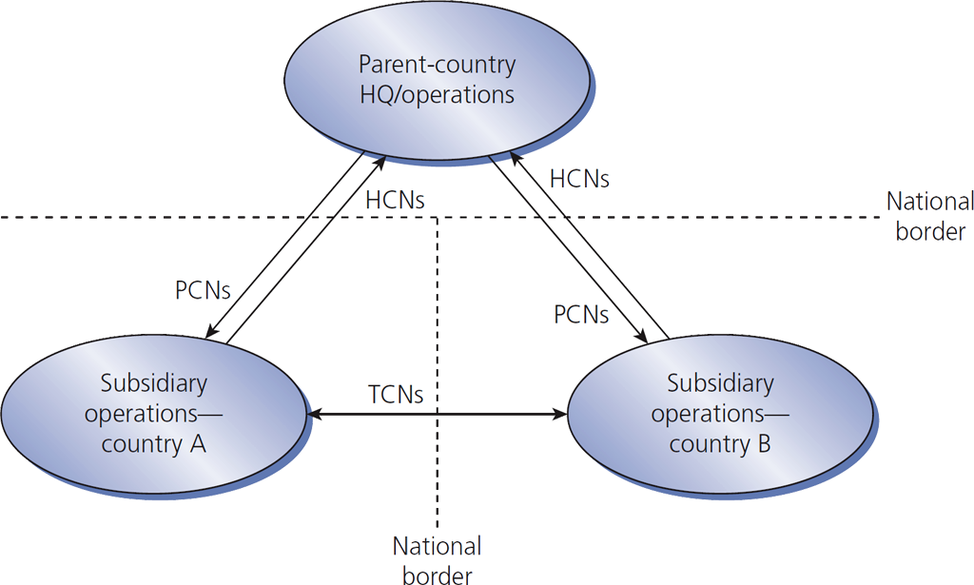

Figure 1.2
International assignments create expatriates

Slide 11
Stahl-Björkman-Morris def. of IHRM
The field of IHRM covers
All issues related to firm outcomes
A wide range of HR issues facing MNEs in different parts of their organizations
This definition includes comparative analyses of HRM in different countries.

Slide 12
Domestic vs. international

Slide 13
IHRM is more complex than domestic HRM
  IHRM has …
  more HR activities
  a need for a broader perspective
  more involvement in employees’ personal lives
  changes of emphasis as
  the mix of expatriates & locals varies
  more risk exposure
  broader external influences

Slide 14
IHRM has international HR activities
  International taxation
  International relocation & orientation
  Administrative services for expatriates
  Host-government relations
  Language translation services

Slide 15
International relocation involves:
  Arranging for pre-departure training
  Providing immigration & travel details
  Providing housing, shopping, medical care, recreation & schooling information
  Finalizing compensation details such as:
    Delivery of salary overseas
    Determination of overseas allowances
    Taxation treatment

Slide 16
Variables that moderate the differences

Slide 17
Four more moderators in addition to IHRM complexity
  The cultural environment
  The industry(ies) with which the MNE is primarily involved
  The extent to which the MNE relies on
  its HC domestic market
  The attitudes of senior management

Slide 18
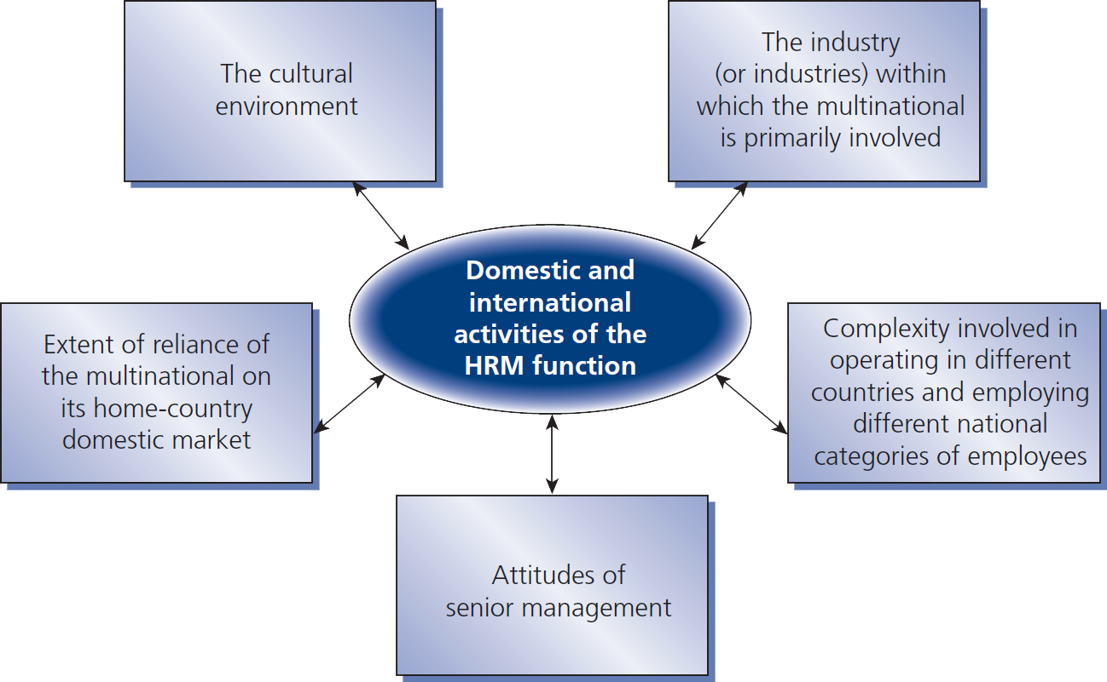
Figure 1.3
A model of all 5 variables that moderate the differences between domestic and international HRM

Slide 19
Industry type

Slide 20
The MNE industry type continuum
  An MNE performs somewhere in this range:
Multidomestic Industries |  | Global Industries
Examples retailing, distribution, insurance International strategy Collapses to a series of domestic strategies. |  | airlines, semiconductors, copiers Must integrate activities on a worldwide basis.

Slide 21
Laurent’s steps for true IHRM:
  Parent org. recognizes that its HRM reflects
  some assumptions & values of own home culture.
  Parent org. recognizes that its own peculiar ways are
  neither universally better nor worse than others –
  just different & likely to exhibit strengths & weaknesses, particularly abroad.
  Parent org. recognizes that its foreign subsidiaries may prefer other ways to manage people – ways that are neither intrinsically better nor worse, but possibly more effective locally.
  Headquarters is willing to acknowledge cultural differences & take steps to make them discussable & therefore usable.
  All parties build belief that cross-cultural learning invites
  more creative & effective ways of managing people.

Slide 22
Senior management attitudes

Slide 23
What does senior mgmt. think?
  Some of the changes required to truly internationalize HR
  have more to do with a global mindset
  than with behaviors.

Slide 24
MNEs fail primarily because of
a lack of understanding of
the
differences
in managing human resources
in foreign environments.

