Slide 1
Java Applets

Slide 2
Applets
The term Applet refers to a little application .
In JAVA the applet is a java program that is embedded within a HTML document and Executed by web browser.
Every applet is a subclass of java.applet.Applet ,So we should EXTEND the JApplet Class which is contained in javax.swing.
To use swing components, use javax.swing.JApplet

Slide 3
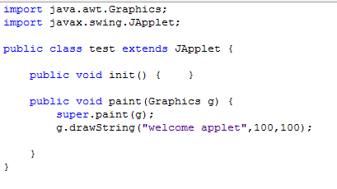
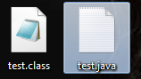
Getting started…
Create a new java class file
After that build the file … the you will get tow files

Slide 4
Getting started…
Now use the previous code in to a regular HTML document
<HTML> <HEAD> <TITLE> Welcome Applets </TITLE> </HEAD> <BODY> <OBJECT code="test.class" width="400" height="400" > </OBJECT> </BODY> </HTML>

Slide 5
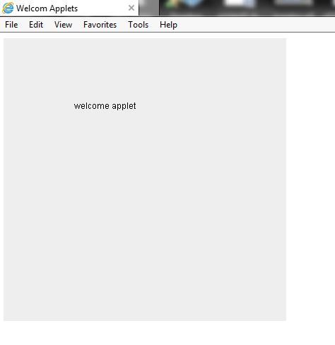

Slide 6
Developing Applets
Java applets do not need a ‘main’ method. they can run in a web browser environment
The applet have
Init()
Start()
Stop()
Paint( Graphics g)

Slide 7
init()
called by the browser or applet viewer to inform this applet that it has been reloaded to the system
We use init() to:
Initialize variables
Get data from user
Place various GUI component.

Slide 8
start() & stop()
Start() //called by the browser or applet viewer to inform this applet that it should start its execution
Stop() //called by the browser or applet viewer to inform this applet that it should stop its execution

Slide 9
paint( Graphics g)
is used to create the output .
whenever you override this method the first java statement is
super.paint(g);
To draw a string we use drawString method
Public abstract void drawstring(String str, int x, int y)

Slide 10
paint( Graphics g)
To change the text font
setFont(new Font(“font name”, ”font style”, font_size)
To chang the text color setColor(Color.red)
The available constant colors
White, Black , blue, cyan, darkGray ,gray ,lightGray ,red, yellow,pink, orange, magenta ,green
Using JDK guarantees the following fonts: | Font style
Serif | Font.PLAIN
Sanserif | Font.BOLD
Monospaced | Font.ITALIC
Dialog
DialogInput

Slide 11
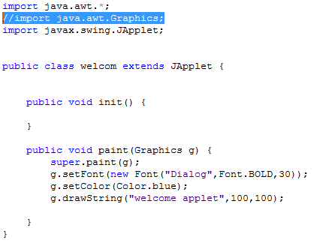
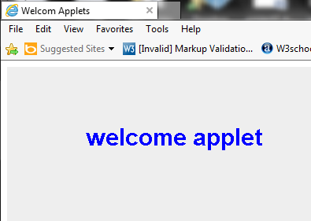
Example

Slide 12
JAVA application VS. applets
Java applications and Applets share some common programming features although they differ in some aspects
GUI | Applets
Is derived from class Jframe | Is derived from class JApplet
Have “MAIN” method | Do not have main method instead It have init(), start(), stop(), paint(..)
Uses the class constructor to initialize the GUI component and data members | Uses the init() method to initialize the GUI component and data members
Uses setSize(),setTitle(), setVisible() methode | don not use the because the HTML document do the job.

Slide 13
converting JAVA application to applets
Change the extends from JFrame to JApplets.
Change the constructor to method init().
Remove method calls like setSize(),setTitle(), setVisible() .
Remove the method main

Slide 14
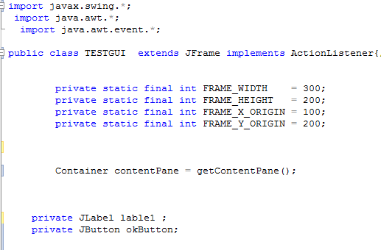
Simple application Example

Slide 15
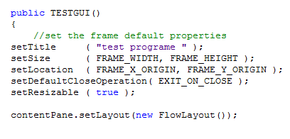
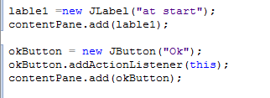
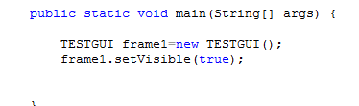

Slide 16
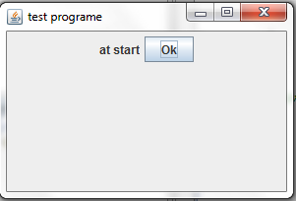
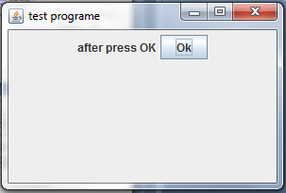

Slide 17
Convert to applet

Slide 19
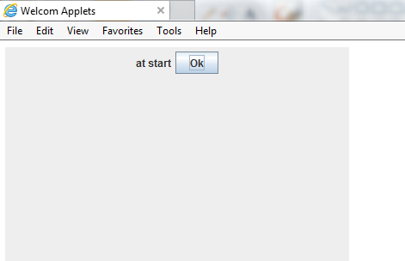
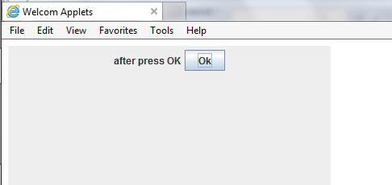

Slide 20
Mouse events
import javax.swing.*;
import java.awt.*;
import java.awt.event.*;
class Test extends JFrame implements MouseListener {
private Container contentPane;
private JTextField t1;

Slide 21
public Test() {
setTitle("Playing With The Mouse!");
setSize(400, 200);
setResizable(false);
setVisible(true);
addMouseListener(this);
setDefaultCloseOperation(EXIT_ON_CLOSE);
contentPane = getContentPane();
contentPane.setLayout(new FlowLayout());
t1=new JTextField (20);
contentPane.add(t1);
}

Slide 22
public void mouseEntered(MouseEvent me) {
t1.setText("Mouse entered at: ("+ me.getX() + ", " + me.getY() + ")");
}
public void mouseExited(MouseEvent me) {
t1.setText("Mouse exited at: ("
+ me.getX() + ", " + me.getY() + ")");
}
public void mouseClicked(MouseEvent me) {
t1.setText("Mouse clicked at: ("
+ me.getX() + ", " + me.getY() + ")");
}

Slide 23
public void mousePressed(MouseEvent me) {
t1.setText("Mouse pressed at: ("
+ me.getX() + ", " + me.getY() + ")");
}
public void mouseReleased(MouseEvent me) {
t1.setText("Mouse released at: ("
+ me.getX() + ", " + me.getY() + ")");
}
public static void main(String[] args) {
new Test();
}
} // End of Test class

Slide 24
