Slide 1
Global Edition Chapter Four
Managing Marketing Information to Gain Customer Insights
Copyright ©2014 by Pearson Education

Slide 2
Learning Objectives
Topic Outline
Marketing Information and Customer Insights
Assessing Marketing Information Needs
Developing Marketing Information
Marketing Research
Analyzing and Using Marketing Information
Other Marketing Information Considerations
Copyright ©2014 by Pearson Education

Slide 3
Marketing Information and Customer Insights
Customer Insights are:
Fresh and deep insights into customers needs and wants
Difficult to obtain
Not obvious
Customer’s unsure of their behavior
Better information and more effective use of existing information
Copyright ©2014 by Pearson Education

Slide 4
Marketing Information and Customer Insights
Customer Insights
Companies are forming customer insights teams
Include all company functional areas
Collect information from a wide variety of sources
Use insights to create more value for their customers
Copyright ©2014 by Pearson Education

Slide 5
Marketing Information and Customer Insights
Marketing Information Systems (MIS)
Marketing information system (MIS) consists of people and procedures for:
Assessing the information needs
Developing needed information
Helping decision makers use the information for customer
Copyright ©2014 by Pearson Education

Slide 6
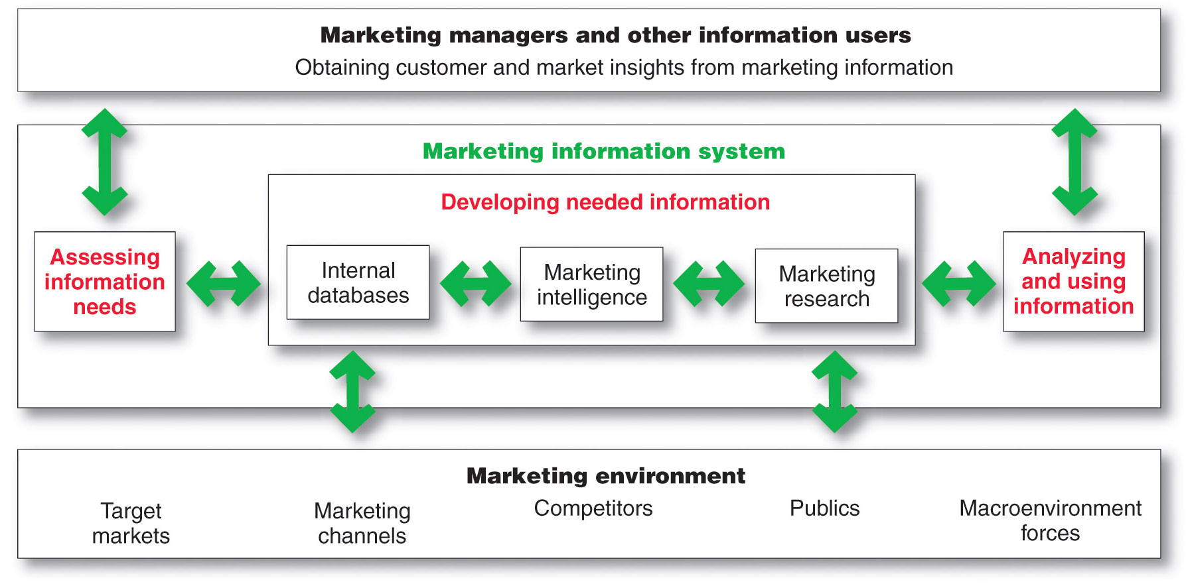
Marketing Information System
Copyright ©2014 by Pearson Education

Slide 7
Assessing Marketing Information Needs
MIS provides information to the company’s marketing and other managers and external partners such as suppliers, resellers, and marketing service agencies
Copyright ©2014 by Pearson Education

Slide 8
Assessing Marketing Information Needs
Characteristics of a Good MIS
Balancing what the information users would like to have against what they need and what is feasible to offer
User’s Needs
MIS Offerings
Copyright ©2014 by Pearson Education

Slide 9
Developing Marketing Information
Marketers obtain information from
Internal data
Marketing intelligence
Marketing research
Copyright ©2014 by Pearson Education

Slide 10
Developing Marketing Information
Internal Data
Internal databases are electronic collections of consumer and market information obtained from data sources within the company network
Copyright ©2014 by Pearson Education

Slide 11
Developing Marketing Information
Competitive Marketing Intelligence
The systematic collection and analysis
of publicly available information
about consumers, competitors
and developments in the marketplace
Copyright ©2014 by Pearson Education

Slide 12
Developing Marketing Information
Marketing Research
Marketing research
is the systematic design, collection, analysis, and reporting of data relevant to a specific marketing situation facing an organization
Copyright ©2014 by Pearson Education

Slide 13
Developing Marketing Information
Steps in the Marketing Research Process
Copyright ©2014 by Pearson Education

Slide 14
Developing Marketing Information
Marketing Research
Defining the Problem and Research Objectives
Exploratory research
Descriptive research
Causal research
Copyright ©2014 by Pearson Education

Slide 15
Developing Marketing Information
Marketing Research
Developing the Research Plan
Outlines sources of existing data
Spells out the specific research approaches, contact methods, sampling plans, and instruments to gather data
Copyright ©2014 by Pearson Education

Slide 16
Developing Marketing Information
Marketing Research
Written Research Plan Includes:
Management problem
Research objectives
Information needed
How the results will help management decisions
Budget
Copyright ©2014 by Pearson Education
Notes:
.

Slide 17
Developing Marketing Information
Marketing Research
Developing the Research Plan
Secondary data consists of information that already exists somewhere, having been collected for another purpose
Primary data consists of information gathered for the special research plan
Copyright ©2014 by Pearson Education

Slide 18
Developing Marketing Information Secondary Data
Advantages
Disadvantages
Current
Relevant
Speed
Cost
Could not get data otherwise
Accuracy
Impartial
Copyright ©2014 by Pearson Education

Slide 19
Developing Marketing Information
Marketing Research
Planning Primary Data Collection
Research approaches
Contact methods
Sampling plan
Research instruments
Copyright ©2014 by Pearson Education

Slide 20
Developing Marketing Information
Market Research
Research Approaches
Observational research involves gathering primary data by observing relevant people, actions, and situations
Ethnographic research involves sending trained observers to watch and interact with consumers in their natural environment
Copyright ©2014 by Pearson Education

Slide 21
Developing Marketing Information
Market Research
Research Approaches
Survey research is the most widely used method and is best for descriptive information—knowledge, attitudes, preferences, and buying behavior
Flexible
People can be unable or unwilling to answer
Gives misleading or pleasing answers
Privacy concerns
Copyright ©2014 by Pearson Education

Slide 22
Developing Marketing Information
Market Research
Research Approaches
Experimental research is best for gathering causal information—cause-and-effect relationships
Copyright ©2014 by Pearson Education

Slide 23
Developing Marketing Information
Marketing Research Strengths and
Weakness of Contact Methods
 | Mail | Telephone | Personal | Online
Flexibility | Poor | Good | Excellent | Good
Quantity of data collected | Good | Fair | Excellent | Good
Control of interviewer effects | Excellent | Fair | Poor | Fair
Control of sample | Fair | Excellent | Good | Excellent
Speed of data collection | Poor | Excellent | Good | Excellent
Response rate | Poor | Poor | Good | Good
Cost | Good | Fair | Poor | Excellent
Copyright ©2014 by Pearson Education

Slide 24
Developing Marketing Information
Marketing Research
Contact Methods
Focus Groups
Six to 10 people
Trained moderator
Challenges
Expensive
Difficult to generalize from small group
Consumers not always open and honest
Copyright ©2014 by Pearson Education

Slide 25
Developing Marketing Information
Marketing Research
Online Contact Methods
Internet surveys
Online panels
Online experiments
Online focus groups
Copyright ©2014 by Pearson Education
Notes:
.

Slide 26
Developing Marketing Information
Marketing Research
Online Contact Methods
Low cost
Speed
Higher response rates
Good for hard to reach groups
Advantages
Copyright ©2014 by Pearson Education

Slide 27
Developing Marketing Information
Marketing Research
Sampling Plan
Sample is a segment of the population selected for marketing research to represent the population as a whole
Who is to be studied?
How many people should be studied?
How should the people be chosen?
Copyright ©2014 by Pearson Education

Slide 28
Developing Marketing Information
Marketing Research
Sampling Plan – Types of Samples
Probability Sample
Simple random sample | Every member of the population has a known and equal chance of selection
Stratified random sample | The population is divided into mutually exclusive groups and random samples are drawn from each group
Cluster (area) sample | The population is divided into mutually exclusive groups and the researcher draws a sample
Nonprobability Sample
Convenience sample | The research selects the easiest population members
Judgment sample | The researcher uses their judgment to select population members
Quota sample | The researcher finds and interviews a prescribed number of people in each of several categories
Copyright ©2014 by Pearson Education
Notes:
.

Slide 29
Developing Marketing Information
Marketing Research
Research Instruments
Questionnaires
Most common
Administered in person, by phone, or online
Flexible
Research must be careful with wording and ordering of questions
Copyright ©2014 by Pearson Education

Slide 30
Developing Marketing Information
Marketing Research
Research Instruments—Questionnaires
Closed-end questions include all possible answers, and subjects make choices among them
Provide answers that are easier to interpret and tabulate
Open-end questions allow respondents to answer in their own words
Useful in exploratory research
Copyright ©2014 by Pearson Education

Slide 31
Developing Marketing Information
Marketing Research
Research Instruments
Mechanical devices
People meters
Checkout scanners
Neuro-
marketing
Copyright ©2014 by Pearson Education

Slide 32
Developing Marketing Information
Marketing Research
Implementing the Research Plan
Collecting the information
Processing the information
Analyzing the information
Interpret findings
Draw conclusions
Report to management
Copyright ©2014 by Pearson Education
Notes:
.

Slide 33
Analyzing and Using Marketing Information
Customer Relationship Management (CRM)
Managing detailed information about
individual customers and carefully
managing customer touch points to
maximize customer loyalty.
Copyright ©2014 by Pearson Education

Slide 34
Analyzing and Using Marketing Information
Customer Relationship Management
Touchpoints
Customer purchases
Sales force contacts
Service and support calls
website visits
Satisfaction surveys
Credit and payment interactions
Research studies
Copyright ©2014 by Pearson Education

Slide 35
Distributing and Using Marketing Information
Information distribution involves entering information into databases and making it available in a time-useable manner
Intranet provides information to employees and other stakeholders
Extranet provides information to key customers and suppliers
Copyright ©2014 by Pearson Education

Slide 36
Other Marketing Information Considerations
Marketing Research in Small Businesses and Nonprofit Organizations
International Market Research
Copyright ©2014 by Pearson Education

Slide 37
Other Marketing Information Considerations
Public Policy and Ethics
Customer privacy
Misuse of research findings
Copyright ©2014 by Pearson Education

