Slide 1
Databases and LINQ
Visual Basic 2010 How to Program

Slide 2
1. Introduction
A database is an organized collection of data.
A database management system (DBMS) provides mechanisms for storing, organizing, retrieving and modifying data.
Today’s most popular DBMSs manage relational databases, which organize data simply as tables with rows and columns.
In this chapter, we use Microsoft’s free SQL Server Express, which is installed with Visual Basic Express and Visual Studio.
It can also be downloaded separately from Microsoft (www.microsoft.com/express/sql).

Slide 3
1.Introduction
Previous chapter introduced LINQ to Objects and used it to manipulate data stored in arrays.
LINQ to SQL allows you to manipulate data stored in a SQL Server or SQL Server Express relational database.
This chapter introduces general concepts of relational databases, then explores LINQ to SQL and the tools for working with databases.

Slide 4
2. Relational Databases
A relational database organizes data simply in tables.
Figure 12.1 illustrates a sample Employees table that might be used in a personnel system.
The table stores the attributes of employees.
Tables are composed of rows (also called records) and columns (also called fields) in which values are stored.
This table consists of six rows (one per employee) and five columns (one per attribute).

Slide 6
2.Relational Databases
LINQ to SQL requires every table to have a primary key to support updating the data in tables.
The rows in Fig. 12.1 are displayed in ascending order by primary key.
But they could be listed in decreasing (descending) order or in no particular order at all.
You can use LINQ to SQL to define queries that select subsets of the data from a table.

Slide 7
3.LINQ to SQL
LINQ to SQL enables you to access data in SQL Server databases using the same LINQ syntax introduced in Chapter 3.
You interact with the database via classes that are automatically generated from the database schema by LINQ to SQL Designer.

Slide 8
3.LINQ to SQL
The most fundamental elements in the LINQ to SQL object model and their relationship to elements in the relational data model are summarized in the following table:
Relational data model | LINQ to SQL object model
Table | Entity Class
Column | Class member
Foreign key relationship | Association
Stored Procedure or Function | Method

Slide 9
3.LINQ to SQL
Objects are linked to relational data by decorating normal classes with attributes.
Two of the most important attributes are Table and Column:
The Table attribute is used to decorate the class (the name of the class will be used for the name of the table).
The Column attribute is used to decorate fields or properties of an entity class.

Slide 10
3.LINQ to SQL
DataContext Class
All LINQ to SQL queries occur via a DataContext class, which controls the flow of data between the program and the database.
A specific DataContext derived class, which inherits from the class System.Data.Linq.DataContext, is created when the LINQ to SQL classes representing each row of the table are generated by the IDE.
This derived class has properties for each table in the database, which can be used as data sources in LINQ queries.
Any changes made to the DataContext can be saved back to the database using the DataContext’s SubmitChanges method, so with LINQ to SQL you can modify the database’s contents.

Slide 11
3.LINQ to SQL
To simplify the steps of querying a database with LINQ consider a simple example Books database.
Books database contains three tables (Authors, AuthorISBN and Tiltles) as in the following figure:

Slide 12
3.LINQ to SQL
A database’s tables, their fields and the relationships among them are collectively known as a database schema.
LINQ to SQL uses a database’s schema to define classes that enable you to interact with the database.
Next, we show how to use LINQ to SQL to retrieve information from the Books database.
The database file—Books.mdf—is provided with this chapter’s examples.
SQL Server database files have the .mdf (“master data file”) file-name extension.

Slide 13
4.Querying a Database with LINQ
In this section, we demonstrate how to connect to a database, query it and display the results of the query.
The IDE provides visual programming tools and wizards that simplify accessing data in applications.
These tools establish database connections and create the objects necessary to view and manipulate the data through Windows Forms GUI controls—a technique known as data binding.

Slide 14
4.Querying a Database with LINQ
The basic steps are:
Connect to the database.
Create the LINQ to SQL classes required to use the database.
Add the table as a data source.
Drag the table data source onto the Design view to create a GUI for displaying the table’s data.
Add a few statements to the program to allow it to interact with the database.

Slide 15
4.Querying a Database with LINQ
Our first example performs a simple query on the Books database.
We retrieve the entire Authors table and use data binding to display its data in a DataGridView—a control from namespace System.Windows.Forms that can display data from a data source in tabular format.

Slide 17
4.1 Creating LINQ to SQL Classes
Step 1: Creating the Project
Create a new Windows Forms Application named DisplayTable.
Change the name of the source file to DisplayAuthorsTable.vb.

Slide 18
4.1 Creating LINQ to SQL Classes
Step 2: Adding a Database to the Project and Connecting to the Database
In Visual Basic 2010 Express, select View > Other Windows > Database Explorer to display the Database Explorer window.
Click the Connect to Database icon at the top of the Database Explorer. If the Choose Data Source dialog appears (Fig. 12.11), select Microsoft SQL Server Database File from the Data source: list. Click Continue to display the Add Connection dialog (Fig.12.12).
Notes:
To interact with a database, you must create a connection to the database.
By default, it appears on the left side of the IDE. If you’re using a full version of Visual Studio, select View > Server Explorer to display the Server Explorer. From this point forward, we’ll refer to the Database Explorer. If you have a full version of Visual Studio, substitute Server Explorer for Database Explorer in the steps.

Slide 19
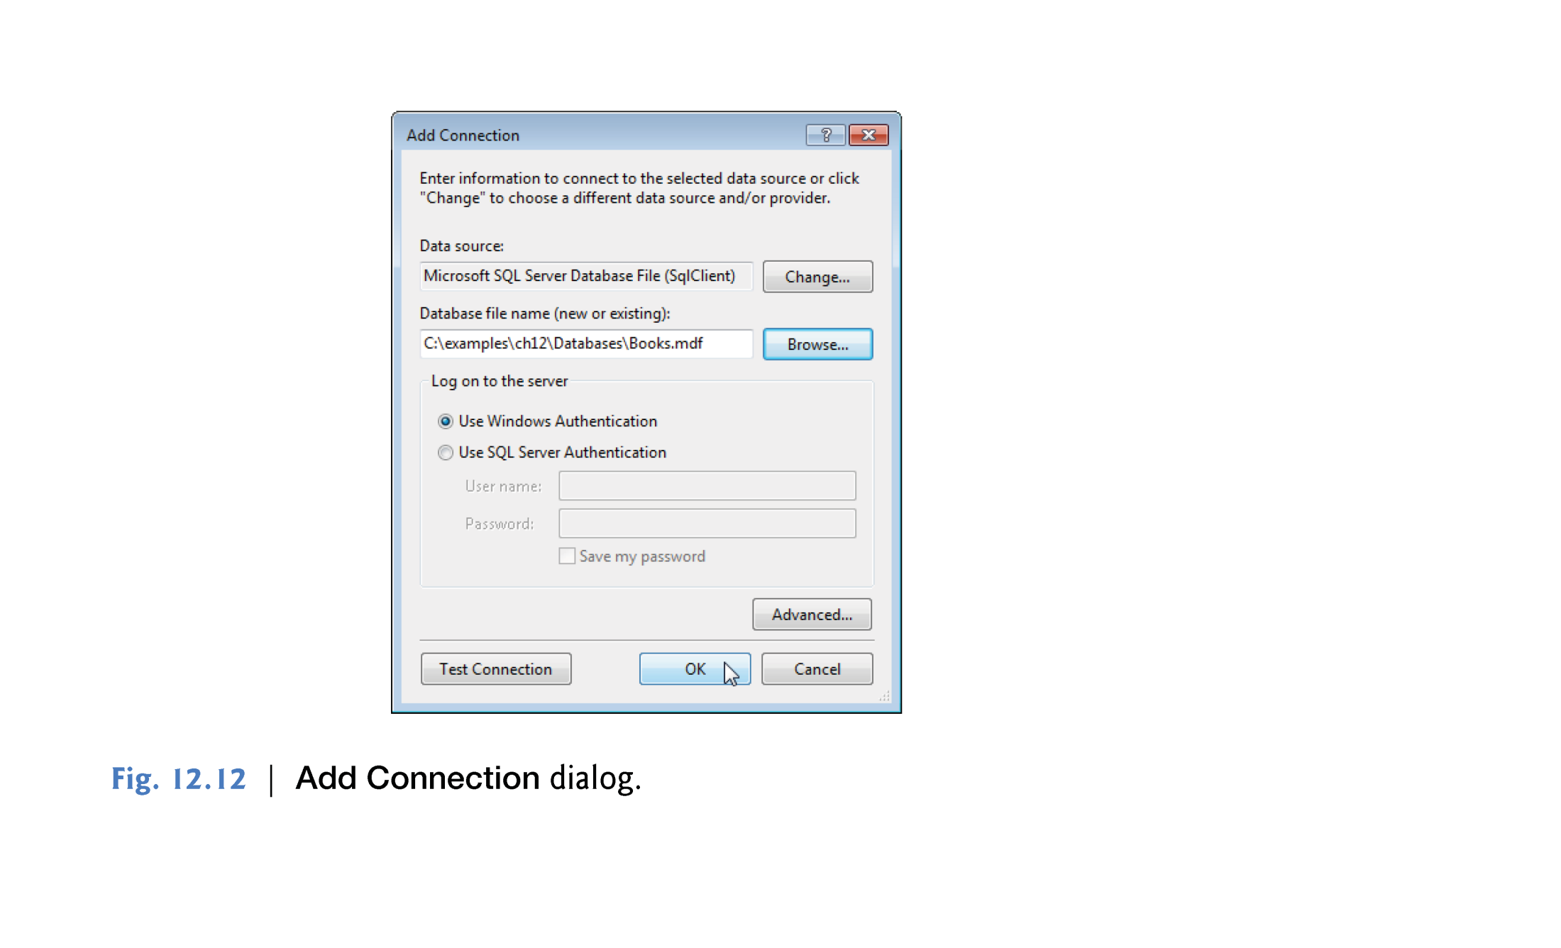
Choose database file (.mdf)
verify that the IDE can connect to the database through SQL Server Express.

Slide 20
4.1 Creating LINQ to SQL Classes
Step 3: Generating the LINQ to SQL classes
After the database has been added, you must select the database from which the LINQ to SQL classes will be created.
LINQ to SQL uses the database’s schema to help define the classes.
Right click the project name in the Solution Explorer and select Add > New Item. Select the LINQ to SQL Classes template, name the new item Books.dbml and click the Add button. The Object Relational Designer window will appear (Fig. 12.13).

Slide 21
4.1 Creating LINQ to SQL Classes
Expand the Books.mdf database node in the Database Explorer (or Server Explorer), then expand the Tables node. Drag the tables (Authors, Titles and AuthorISBN) onto the Object Relational Designer.
The Object Relational Designer will display the tables that you dragged from the Database Explorer.
Save the Books.dbml file.

Slide 22
4.1 Creating LINQ to SQL Classes
When you save Books.dbml, the IDE generates the LINQ to SQL classes that you can use to interact with the database.
These include a class for each table you selected from the database and a derived class of DataContext named BooksDataContext that enables you to programmatically interact with the database.

Slide 23
4.2 Data Bindings Between Controls and the LINQ to SQL Classes
The IDE’s automatic data binding capabilities simplify creating applications that can view and modify the data in a database.
To display the contents of the table (such as Authors table) in a GUI do the following steps:
Step 1: Adding the Author LINQ to SQL Class as a Data Source
Step 2: Creating GUI Elements
Step 3: Connecting the BooksDataContext to the AuthorBindingSource
Step 4: Saving Modifications Back to the Database

Slide 24
4.2 Data Bindings Between Controls and the LINQ to SQL Classes
Step 1: Adding the Author LINQ to SQL Class as a Data Source
To use the LINQ to SQL classes for data binding, you must first add them as a data source.
Select Data > Add New Data Source… to display the Data Source Configuration Wizard.
In the dialog, select Object and click Next >. Expand the tree view as shown in Fig. 12.15 and ensure that Author is checked. An object of this class will be used as the data source.
Click Finish.
The Authors table in the database is now a data source that can be used by the bindings.

Slide 25
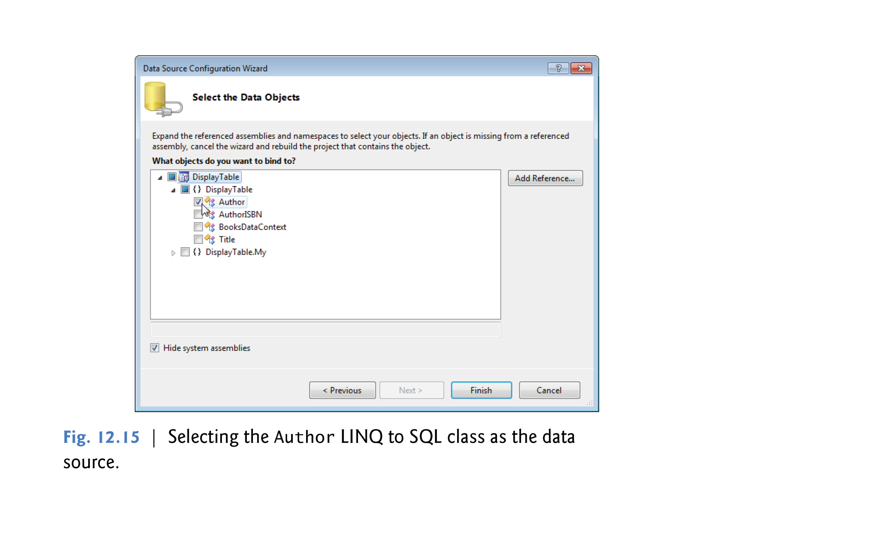

Slide 26
4.2 Data Bindings Between Controls and the LINQ to SQL Classes
Step 2: Creating GUI Elements
Use the Design view to create a GUI control that can display the Authors table’s data.
Switch to Design view for the DisplayAuthorsTable class.
Click the Author node in the Data Sources window—it should change to a drop-down list. Open the drop-down by clicking the down arrow and ensure that the DataGridView option is selected—this is the GUI control that will be used to display and interact with the data.
Drag the Author node from the Data Sources window onto the Form in Design view.

Slide 27
4.2 Data Bindings Between Controls and the LINQ to SQL Classes
The IDE creates a DataGridView (Fig. 12.17) with the correct column names and a BindingNavigator (AuthorBindingNavigator) that contains Buttons for moving between entries, adding entries, deleting entries and saving changes to the database.
The IDE also generates a BindingSource (AuthorBindingSource), which handles the transfer of data between the data source and the data-bound controls on the Form.

Slide 29
4.2 Data Bindings Between Controls and the LINQ to SQL Classes
Step 3: Connecting the BooksDataContext to the AuthorBindingSource
The final step is to connect the BooksDataContext (created with the LINQ to SQL classes in Section 4.1) to the AuthorBindingSource (created with in Section 4.2), so that the application can interact with the database.
Figure 12.18 shows the small amount of code needed to obtain data from the database and to save any changes that the user makes to the data back into the database.

Slide 32
4.2 Data Bindings Between Controls and the LINQ to SQL Classes
As mentioned in before, a DataContext object is used to interact with the database.
The BooksDataContext class was automatically generated by the IDE when you created the LINQ to SQL classes to allow access to the Books database.
Line 4 creates an object of this class named database.
Create the Form’s Load handler by double clicking the Form’s title bar in Design view.

Slide 33
4.2 Data Bindings Between Controls and the LINQ to SQL Classes
We allow data to move between the DataContext and the BindingSource by creating a LINQ query that extracts data from the BooksDataContext’s Authors property (lines 12–14), which corresponds to the Authors table in the database.
The AuthorBindingSource’s DataSource property (line 11) is set to the results of this query.
The AuthorBindingSource uses the DataSource to extract data from the database and to populate the DataGridView.

Slide 34
4.2 Data Bindings Between Controls and the LINQ to SQL Classes
Step 4: Saving Modifications Back to the Database
If the user modifies the data in the DataGridView, we’d also like to save the modifications in the database.
By default, the BindingNavigator’s Save Data Button is disabled.
To enable it, right click this Button’s icon and select Enabled.
Then, double click the icon to create its Click event handler.
Saving the data entered into the DataGridView back to the database is a three-step process (lines 22–24).

Slide 35
4.2 Data Bindings Between Controls and the LINQ to SQL Classes
First, all controls on the form are validated (line 22)—if any of the controls have event handlers for the Validating event, those execute.
You typically handle this event to determine whether a control’s contents are valid.
Second, line 23 calls EndEdit on the AuthorBindingSource, which forces it to save any pending changes in the BooksDataContext.
Finally, line 24 calls SubmitChanges on the BooksDataContext to store the changes in the database.
For efficiency, LINQ to SQL saves only data that has changed.

