Slide 1
Graphics and Multimedia
(Part III)

Slide 2
Outline
Drawing Polygons and Polylines
Advanced Graphics Capabilities

Slide 3
Drawing Polygons and Polylines
Polygons
Multisided shapes
Graphics methods used to draw polygons
DrawLines, DrawPolygon, and FillPolygon

Slide 4
Drawing Polygons and Polylines

Slide 5
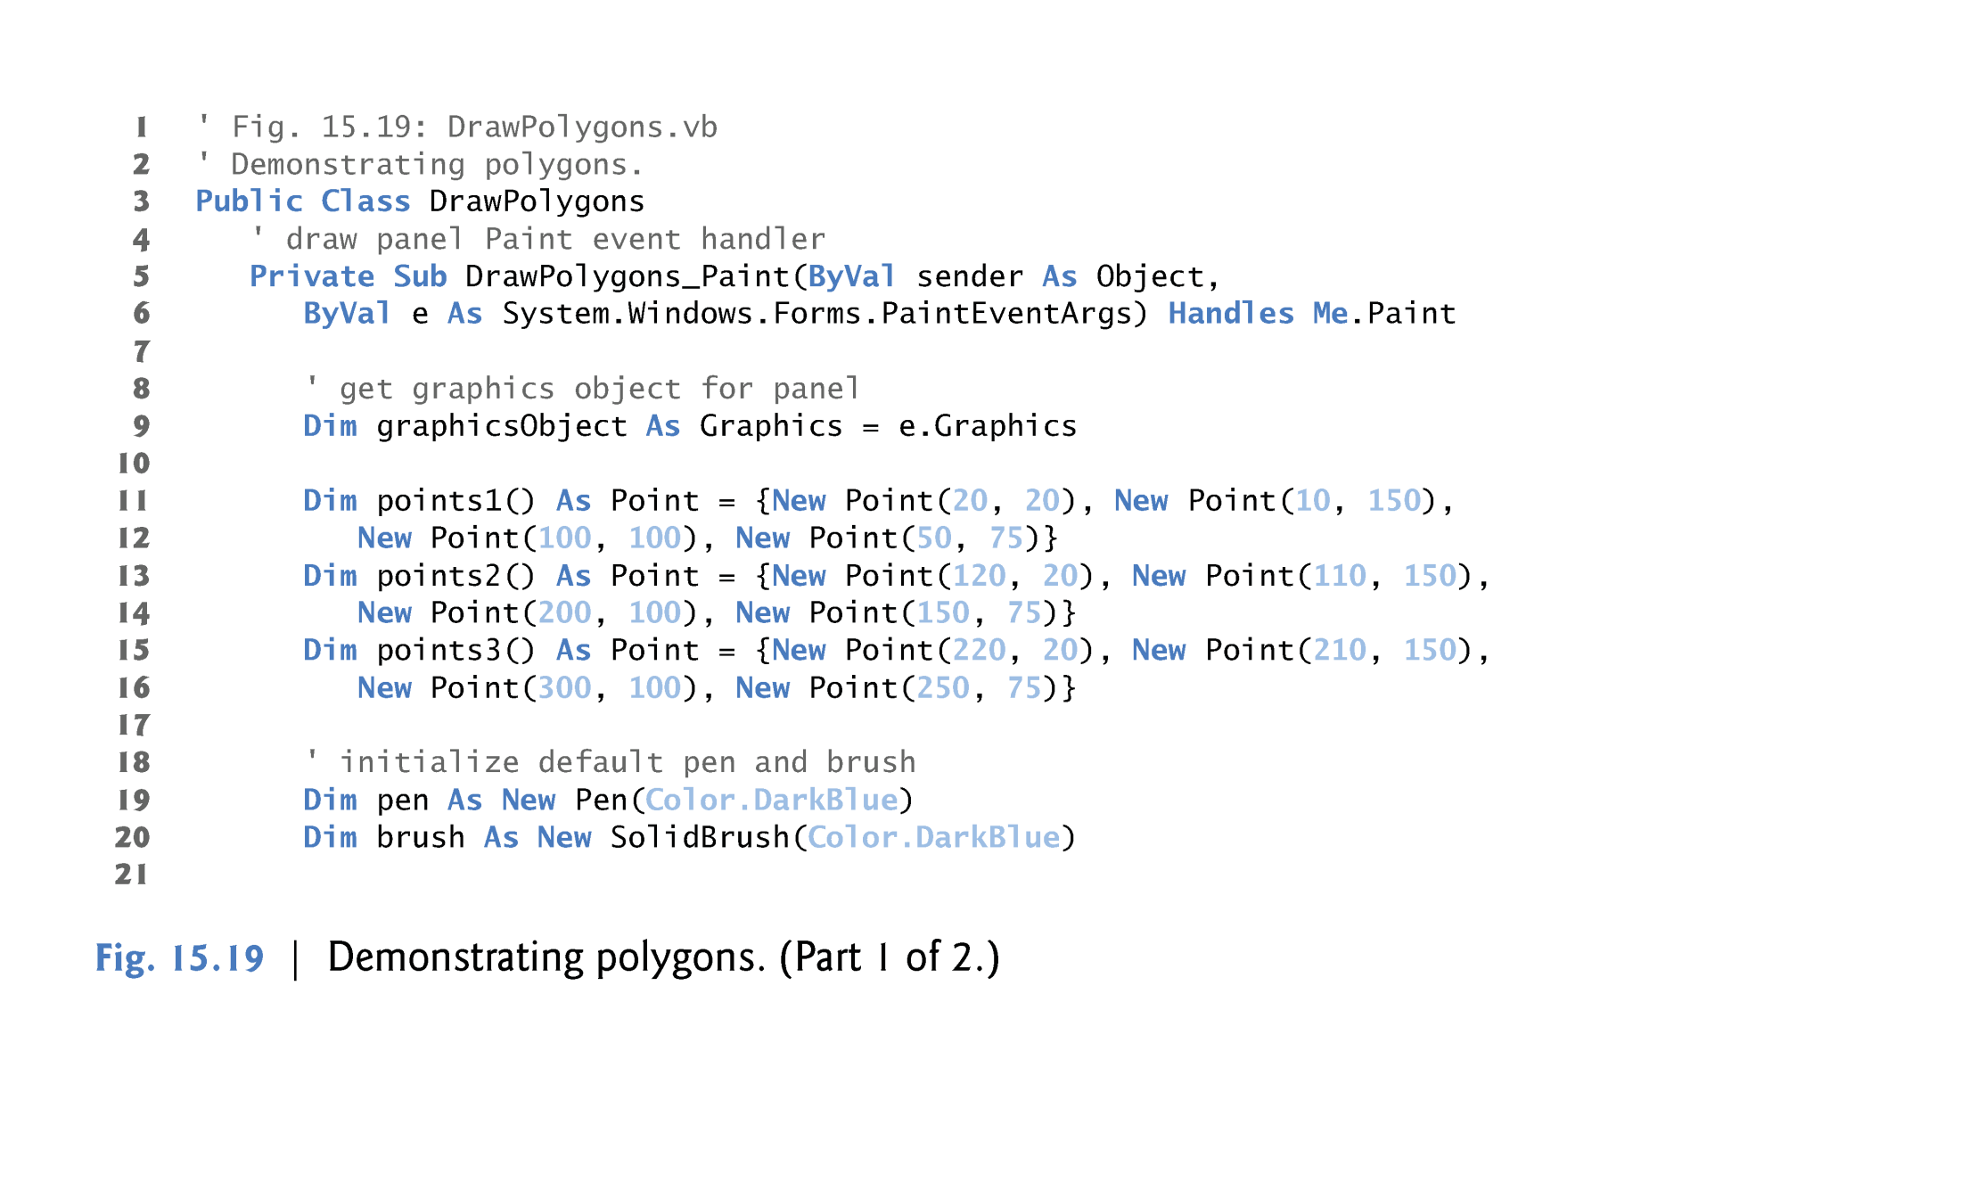
Example

Slide 7
Advanced Graphics Capabilities
Visual Basic offers many additional graphics capabilities
Examples
Brush hierarchy also includes:
HatchBrush, LinearGradientBrush, PathGradientBrush and TextureBrush
Additional graphics features
Dashed lines, thick lines, filling shapes with patterns, etc

Slide 8
LinearGradientBrush
LinearGradientBrush takes for arguments:
Rectangle
Two colors
Constant from LinearGradientMode
Examples
Dim Rec1 As New Rectangle(5,5,25,20)
Dim LGBrush As New LinearGradientBrush(Rec1, Color.White, Color.Blak, LinearGradientMode.ForwardDiagonal)

Slide 9
TextureBrush
TextureBrush is a brush that fills the interior of a shape with an image rather than a solid color.
TextureBrush takes Bitmap object as an argument.

Slide 10
TextureBrush
Bitmap Class
Produce images in color and gray scale with a particular width and height.
Used to work with images defined by pixel data.
How to use….
Dim graphicsObject As Graphics = e.Graphics
Dim BitmapVar As Bitmap = New Bitmap(width, height)
.
.
.
Dim BrushVar As TextureBrush = New TextureBrush(BitmapVar)
graphicsObject.FillRectangle(BrushVar, X, Y, width, height)

Slide 11
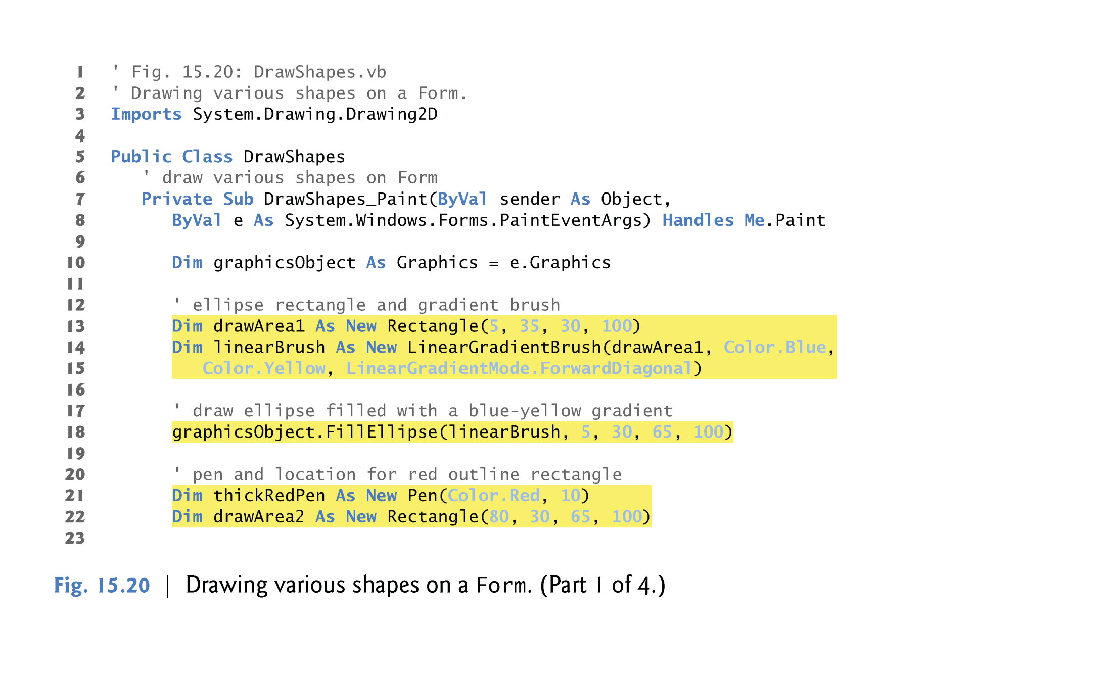

Slide 12
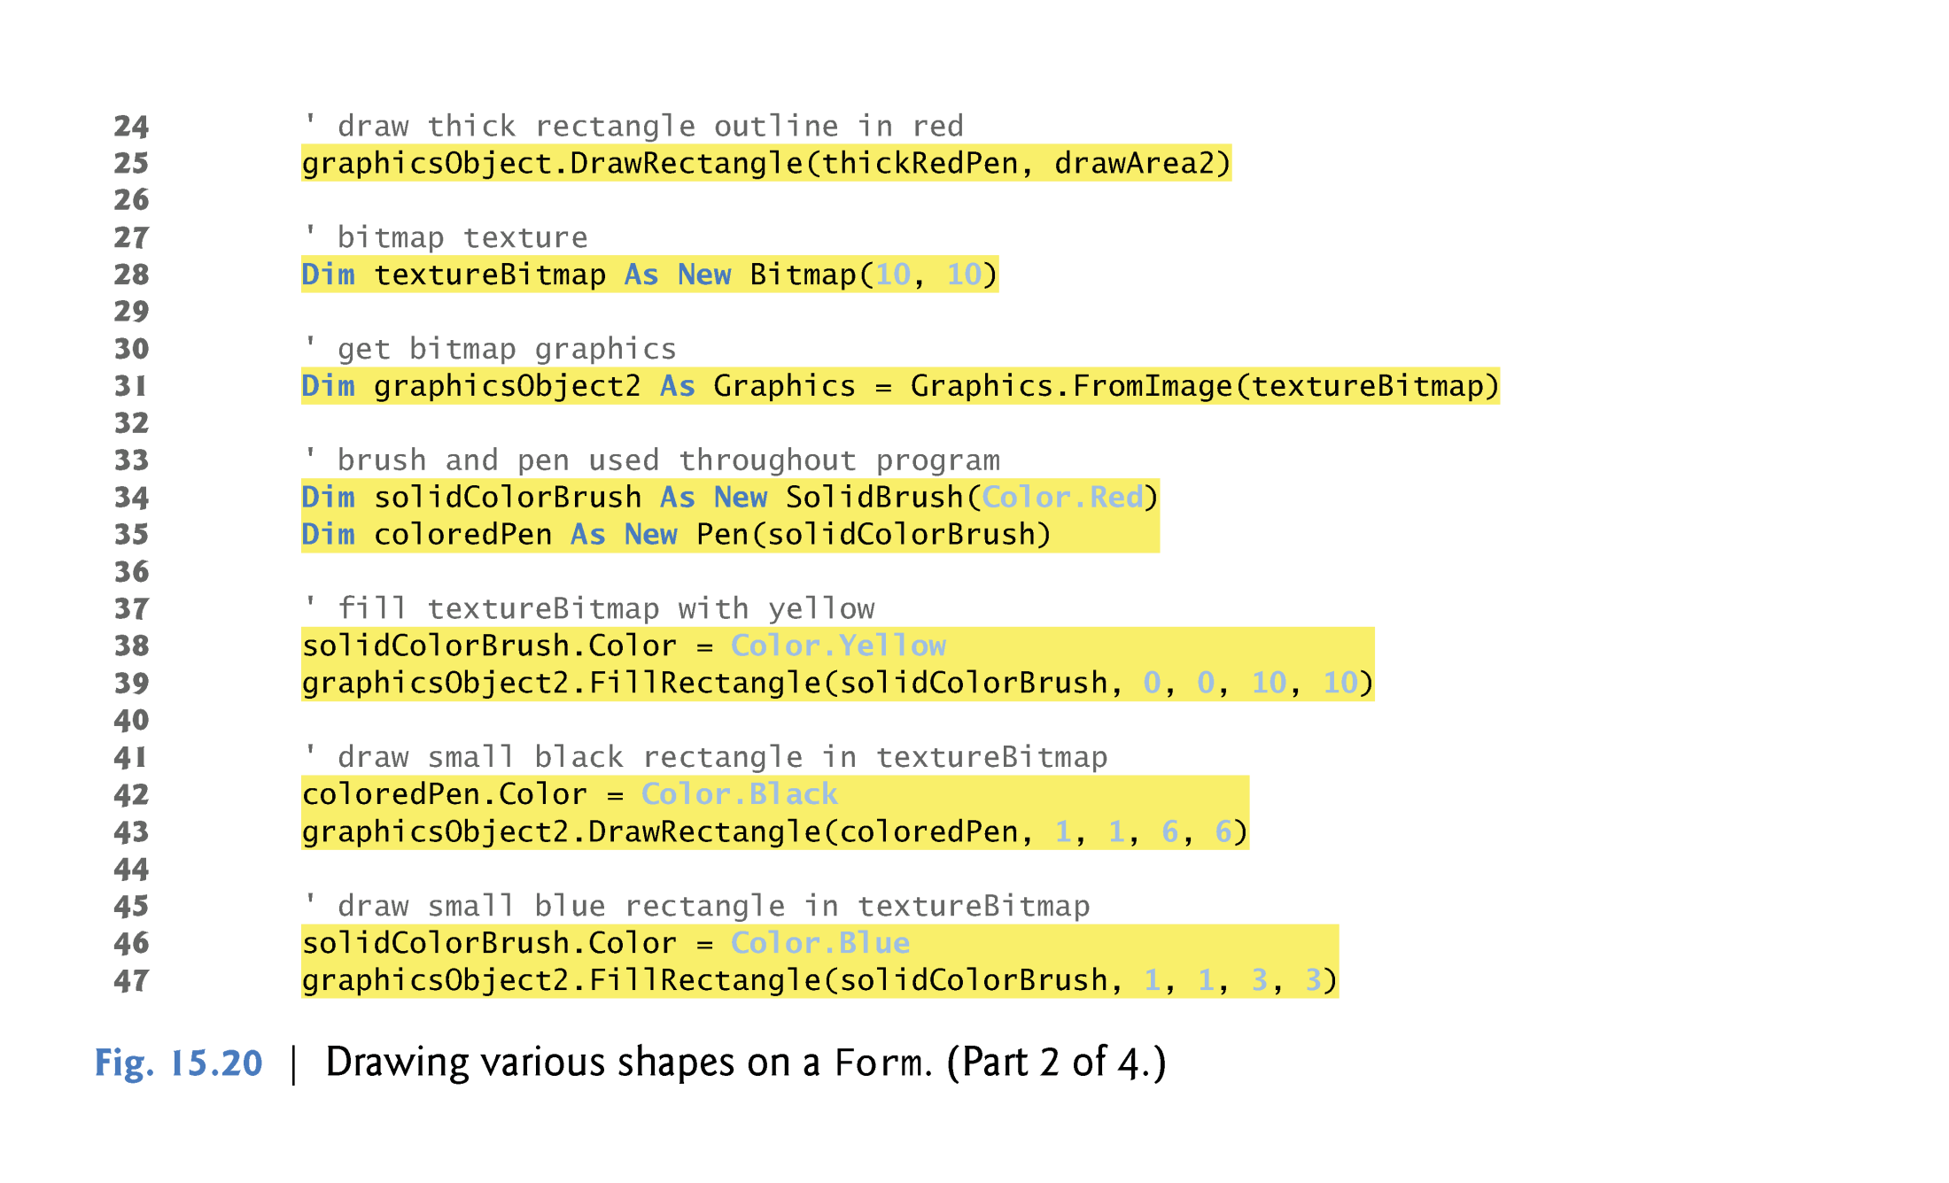

Slide 13
