Slide 1
Communication Systems
Lab#1
2nd semester 1436-1437

Slide 2
Outline
What is a communication system?
Communication system model.

Slide 3
Communication
Systems
Notes:
Communication is the transmission of information.

Slide 4
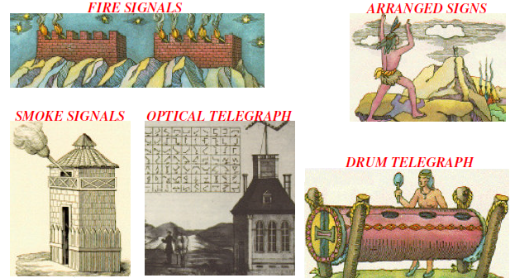
Long Distance Communication
Notes:
Communicating over long distances has been a challenge throughout history. Man has been seeking different ways of doing this since the beginning of time. The transmission of signals over a distance for the purpose of communication began thousands of years ago.
early methods of long-distance communication included runners to carry important messages, smoke signals, chains of searchlights, drums, carrier pigeons, the Pony Express and the telegraph.
Source Destination Signal

Slide 5
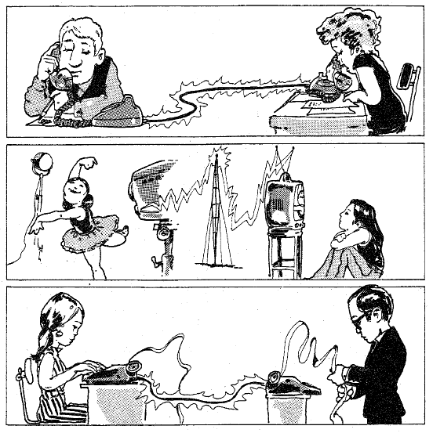
Electrical Communication Systems
Notes:
These methods of communication have been superseded by electrical communication systems, where the communication is by using electrical signal.

Slide 6
Communication System
Communication system is a combination of circuits and devices put together to accomplish a reliable transmission of information from one point to another.
Communication System
Source
Destination
Notes:
i.e. the purpose of a communication system is to carry information from one point to another.

Slide 7
What is the purpose of a communication system?
How to build a communication system?

Slide 8
Communication System
Source
Destination
Transmitter
Receiver
Channel
Source
Destination

Slide 9
Communications System Model
A typical communication system can be modeled as
Input
message
Input
signal
Transmitted
signal
Received
signal
Output
signal
Output
message
Source
Input
Transducer
Transmitter
Channel
Receiver
Output
Transducer
Destination
Sender/ Transmitter
Distortion
And
Noise
Receiver

Slide 11
Source
Produces an input message( voice, picture, computer data etc ).
There are many different types of sources and there are different forms for messages.
In general, input messages
Discrete: Finite set of outcomes. “Digital ”
Continuous: Infinite set of outcomes. “Analog”

Slide 12
Input Transducer
If the input message is nonelectrical ( e.g. voice), it must be converted by an input transducer to an electrical signal
A transducer: is a device that converts one form of energy into another.
In the communication system, it convert the output of a source into an electrical signal that is suitable for processing; e.g., a microphone and a camera.

Slide 13
Transmitter
The transmitter converts the electrical signal into a form that is suitable for transmission through the transmission medium or channel by a process called modulation.
Data form depends on the channel.

Slide 14
Channel
Channel: medium used to transfer signal from transmitter to receiver
Channel can be wired or wireless.
While the signal is travelling through the channel(the medium) it is always attenuated (and the level of attenuation increases with distance).
Also, the signal shape may be changed during the transmission i.e. become ‘distorted’.

Slide 15
Noise
The signal is not only distorted by a channel, but it is also contaminated along the path by undesirable signals lumped under the broad term noise
Noise are random and unpredictable signals from causes external ( such interference from signals transmitted on nearby channels) and internal ( such noise resulted from thermal motion of electrons in conductors).

Slide 16
Receiver
The function of the receiver is to recover the message signal contained in the signal received from the channel (received signal).
The received signal is a corrupted version of the transmitted signal.
So, the receiver reconstruct a recognizable form of the original message signal.
It reprocess the received signal by undoing the signal modifications ( demodulation) made at the transmitter and the channel.

Slide 17
Output Transducer
The receiver output is fed to the output transducer, which convert the electrical signals that are received into a form that is suitable for the final destination; e.g., speaker, monitor, etc.

Slide 18
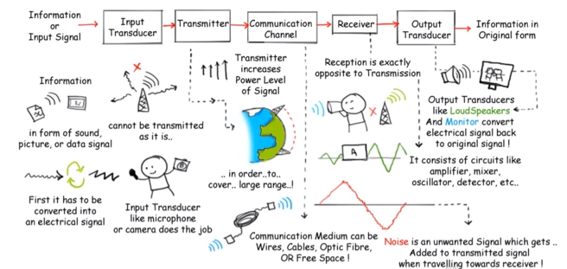

Slide 19
Review
What is a communication system?
Explain the functions of the three main parts of an electronic communication system.
Draw the communication system model
What is the purposes of modulation?

