Slide 1
Routers
2nd semester 1439-1440

Slide 2
Outline
What is a router
Router and OSI model
Physical Components of a Router
Router Functions

Slide 3
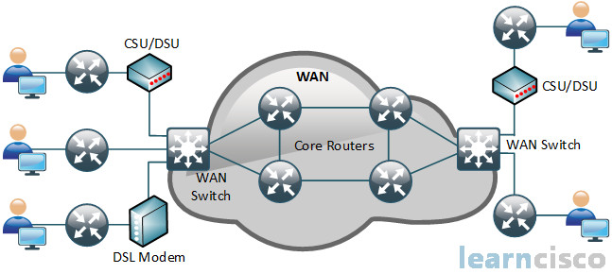
Introduction
Routers are one of the most vital components of any WAN.
Notes:
WANs are constructed of numerous different technologies, including routers, transmission facilities, and line drivers. It is the router’s capability to interconnect networks in a WAN that has made it indispensable.

Slide 4
The purpose of routers
Routers are intelligent network devices designed to interconnect multiple networks.
So, computers on different networks can communicate with each other.
Interconnected networks can be co-located or geographically dispersed.
Networks that are geographically dispersed are usually interconnected via a WAN.
Notes:
M*
different networks → network address , network types…

Slide 5
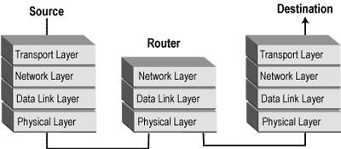
Router and OSI model
A router operates predominantly at the first three layers of the OSI reference model .
Layer 1, 2, and 3 standards and protocols
Notes:
Routers must use OSI Layer 1, 2, and 3 standards and protocols to perform one of the most basic functions of routers
Communication across the first two layers allows routers to communicate directly with LANs (data link layer constructs).
More importantly, routers can identify routes through networks based on Layer 3 addresses. This enables routers to internetwork multiple networks by using network layer addressing, regardless of how near or far they might be relative to each other.

Slide 6
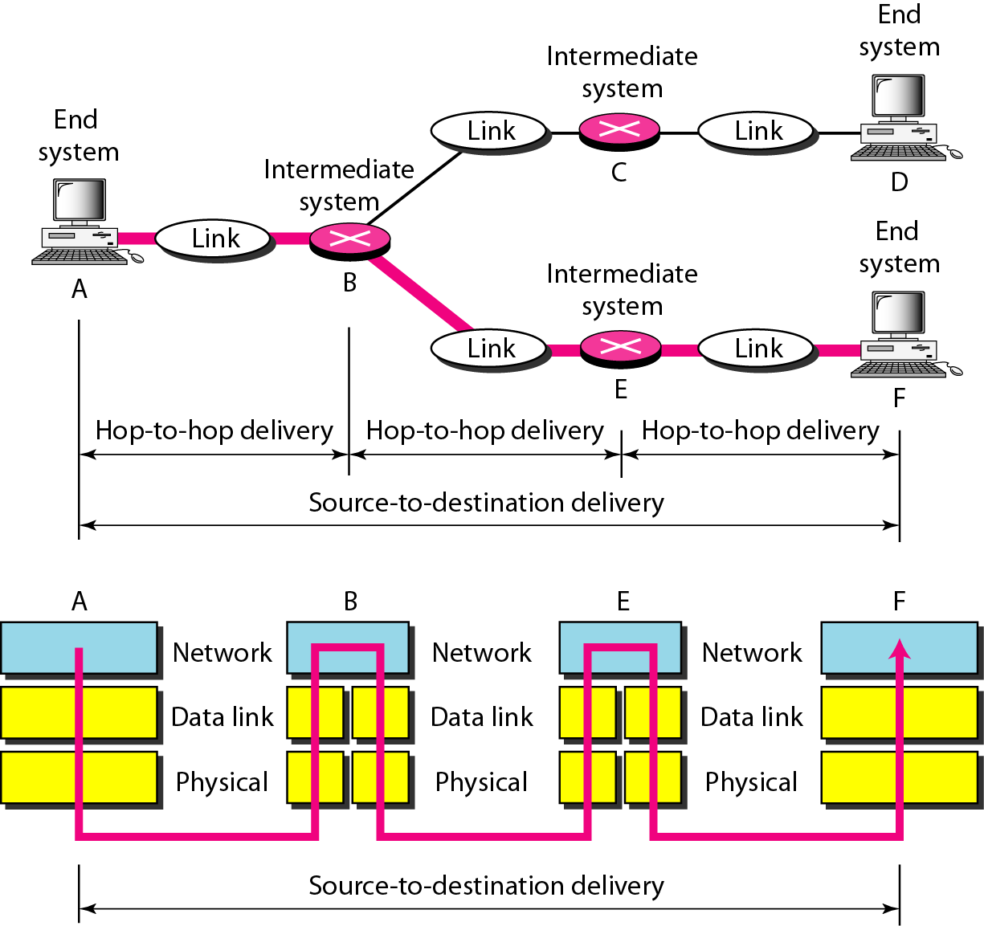
Router and OSI model

Slide 7
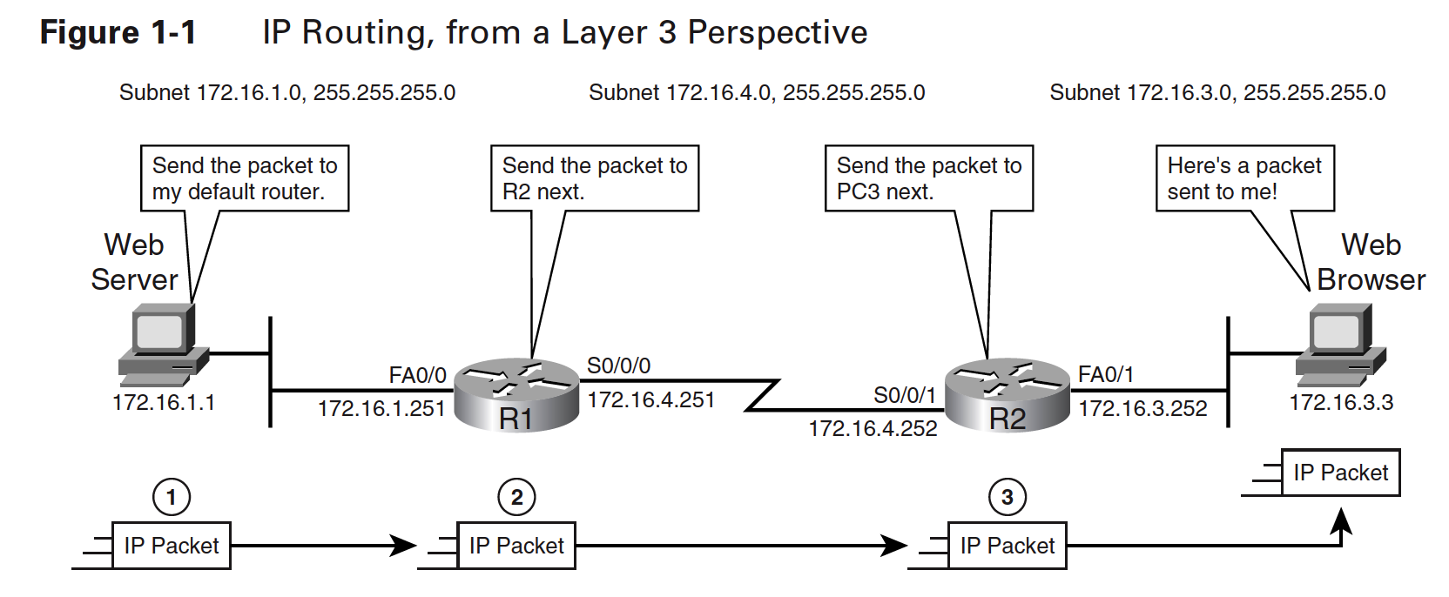
Router and OSI model
Notes:
From the perspective of the OSI network layer—Layer 3—hosts (computers) and routers work together to deliver packets from one host to another. To do so, the host that creates the packet sends the packet to a nearby router. That router might send the packet to a second router, with that second router forwarding the packet to a third router, and so on, until the packet is delivered
to a router that is connected to the same LAN as the destination computer. That last router then sends the packet to the final destination. Figure 1-1 shows just such an example, with the
web server on the left sending a packet back to the PC on the right.
This description focuses on the OSI Layer 3 (network layer) details of how hosts and routers forward packets in an IP network. However, both the hosts and the routers must also be aware of how to use Layer 1 and Layer 2 standards and protocols to send the packets over the various types of physical networks.

Slide 8
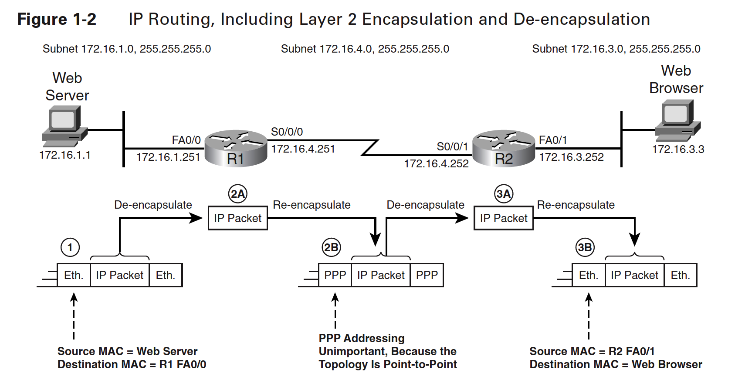
Router and OSI model
Notes:
For example, Figure 1-2 and the descriptions that follow it explain some of the Layer 2 details of the process. Specifically, the example shows the data-link headers and trailers, along with the encapsulation process.
Figure 1-2 focuses on how the hosts and routers need to encapsulate the packet before sending anything over the LAN and WAN links. Hosts and routers must use data-link protocols, such as Ethernet on the LAN and Point-to-Point Protocol (PPP) on WAN links, to forward the packets over the physical links. To use the data links, a router encapsulates the packet into a data-link
frame by putting the packet between a data-link header and trailer. The receiving router removes, or de-encapsulates, the packet.

Slide 9
Router
Understanding routers and routing requires examining a router from two different perspectives:
Together, these physical components and logical functions enable to build and use internetworks, including WANs
physical
logical

Slide 10
Physical Components of a Router
Routers are specialized computers containing the following required components to operate:
Ports and Interfaces
Central processing unit (CPU): Executes operating system instructions
Memory : temporarily and permanently store data to execute operating system instructions, such as system initialization and routing functions.
Notes:
Routers contain many parts, each of which has a specific function
Reference
http://www.ciscopress.com/articles/article.asp?p=2180208&seqNum=4

Slide 11
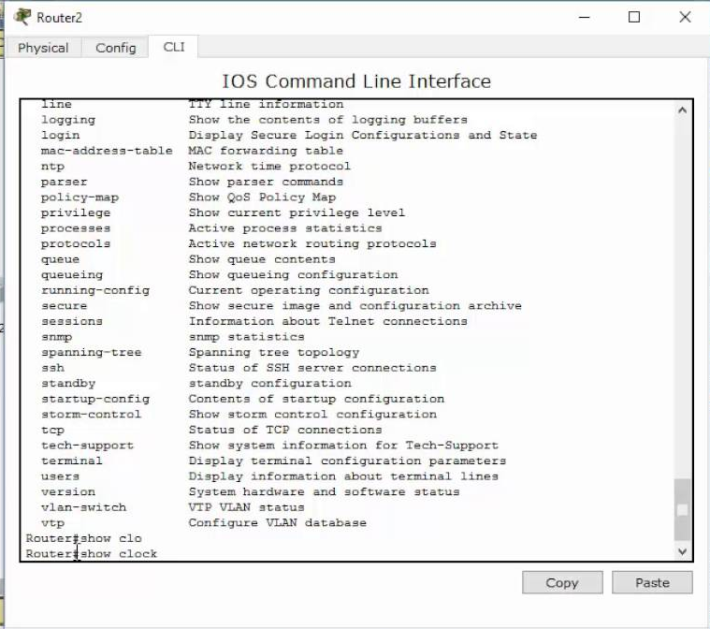
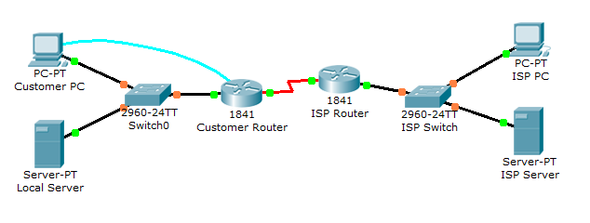
IOS
Configuration file

Slide 12
Router Interfaces and Ports
Routers have specialized ports and network interface cards to interconnect devices to other networks
When talking about routers, the term
interface → refers to physical connectors used for the purpose of forwarding packets.
port → to a physical connector used for managing and controlling a router.
Notes:
References
CHAPTER 1 WANs and Routers

Slide 13
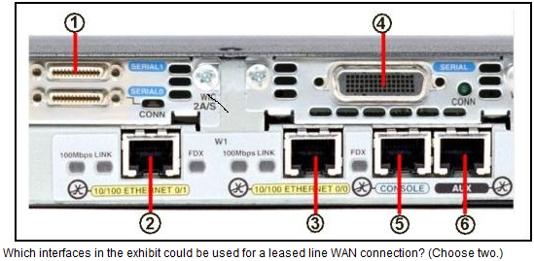
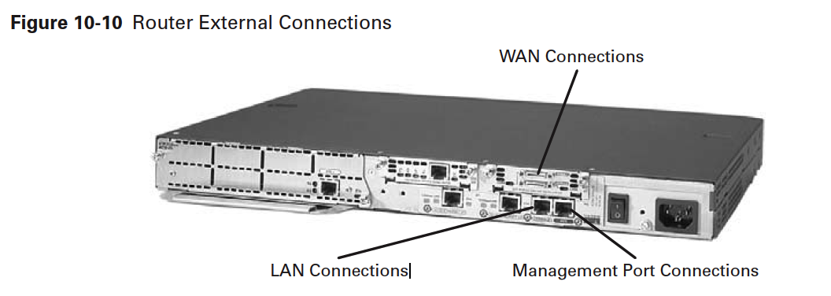
Notes:
LAN interfaces allow the router to connect to the LAN media, which is usually some form of Ethernet. However, it could be some other LAN technology such as Token Ring or ATM.
WAN connections provide connections through a service provider to a distant site or to the Internet. These connections can be serial connections or any number of other WAN interfaces. With some types of WAN interfaces, an external device such as a CSU is required to connect the router to the service provider’s local connection. With other types of WAN connections, the router might be directly connected to the service provider.
The function of management ports is different from that of the other connections. The LAN and WAN connections provide network connections through which frame packets are passed. The management port provides a text-based connection for the configuration and troubleshooting of the router. The common management interfaces are the console and auxilliary ports.

Slide 14
Router Interfaces
These interfaces consist of a socket or jack into which a cable can be easily connected.
Router interfaces : LAN interfaces and WAN interfaces.
LAN interfaces allow the router to connect to the LAN media ( usually Ethernet, Token Ring or ATM).
WAN connections provide connections through a service provider to a distant site or to the Internet (synchronous and asynchronous serial WICs, ISDN BRI WICs, DSL WICs, and Analog Modem WICs).
Notes:
Routers support a wide variety of different types of interfaces because routers need to be able to forward packets over many kinds of physical networks. For example, some routers may have serial interfaces, DSL interfaces, ISDN, cable TV, or other types of WAN interfaces

Slide 15
Router Ports
The management port provides a text-based connection for the configuration and troubleshooting of the router.
Most routers have two management ports:
the console port
the auxiliary port (aux port) . (Some routers do not have aux ports.)
Both ports are meant to allow a terminal, or more likely a PC with a terminal emulator , to log in to the router to issue commands on the router.
These commands may be used to
troubleshoot problems or
to configure the router to tell it how to act.
Notes:
The computer will run a terminal emulation program to provide a text-based session with the router. Through this session the network administrator can manage the device.

Slide 16
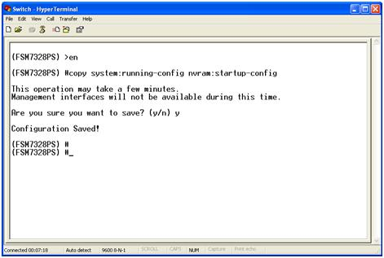
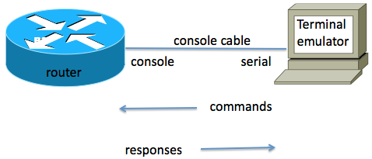
Router Ports
A terminal → a simple device with a display screen and a keyboard, but a terminal is not a PC.
A terminal emulator → software that acts like a terminal
Notes:
Terminals are simple devices that connect to a computer via a cable. The person using the terminal can type on the keyboard, and the terminal sends the text to the computer. The computer responds to what was typed—typically a
command to tell the computer to do something—by sending some text back to the terminal screen so the person knows the results of the command.
Terminal emulator software creates a window on the screen of a PC. When you use that window, any text you type on the keyboard (typically a command) is displayed in the window and sent to some other computer, such as a router. The other computer then executes the command and sends some text messages back to the terminal emulator.

Slide 17
Configuration Files
The network administrator must configure each interface via the router’s console.
Configuration includes:
defining the interface’s address,
the types of protocols that will be used through that interface.
the specific transmission technology
bandwidth available on the network connected to that interface,
The actual parameters that must be defined vary based on the type of network interface.
Notes:
As soon as a router interface is configured, it can be activated. The interface’s configuration identifies the type of transmission facility that it connects to, the interface’s IP address, and the address of the network that it connects to. Upon activation of a port, the router immediately begins monitoring all the packets that are being transmitted on the network attached to the newly activated port. This monitoring allows it to “learn” about network and host IP addresses that reside on the networks that can be reached via that port. These addresses are stored in tables called routing tables. Routing tables correlate the port number of each interface in the router with the network layer addresses that can be reached (either directly or indirectly) via that port.

Slide 18
IOS
Cisco IOS Software run configuration files that contain the instructions and parameters that control the flow of traffic in and out of the routers.
The configuration file specifies all the information the router needs to make these decisions.
Notes:
Just as computers need operating systems to run software applications, routers need Cisco IOS Software to run configuration files
Specifically, by using routing protocols to direct routed protocols and routing tables, routers make decisions regarding the best path for packets.

Slide 19
Router Memories

Slide 20
Router Memories
Routers store data using
Random Access Memory (RAM):
Provides temporary storage for various applications and processes, including:
the running IOS,
the running configuration file,
various tables (i.e., IP routing table, Ethernet ARP table),
and buffers for packet processing.
RAM is referred to as volatile because it loses its contents when power is turned off.

Slide 21
Router Memories
Read-Only Memory (ROM):
Provides permanent storage for
bootup instructions,
basic diagnostic software,
and a limited IOS in case the router cannot load the full featured IOS.
ROM is firmware and referred to as non-volatile because it does not lose its contents when power is turned off.

Slide 22
Router Memories
Non-Volatile Random Access Memory (NVRAM):
Provides permanent storage for the startup configuration file (startup-config).
NVRAM is non-volatile and does not lose its contents when power is turned off.
Flash:
Provides permanent storage for the IOS and other system-related files.
The IOS is copied from flash into RAM during the bootup process.
Flash is non-volatile and does not lose its contents when power is turned off.

Slide 23
Router Functions
Routers perform many functions, some of them:
The selection of best paths for incoming data packets
The switching of packets to the proper outgoing interface
Routers accomplish these functions by building routing tables and exchanging the network information contained within them with other routers.
finding other routers in the network,
learning about potential destination networks and hosts,
discovering and tracking potential routes
Notes:
The logical functions that a router performs are just as important as providing physical interconnectivity
for multiple networks. These functions make the physical interconnections usable.
For example, internetworked communications require that at least one physical path interconnect
the source and destination machines. However, having and using a physical path are two
very different things. Specifically, the source and destination machines must speak a common
language (a routed protocol). It also helps if the routers that lie between them also speak a
common language (a routing protocol) and agree on which specific physical path is the best
one to use.

Slide 24
To sum up
Therefore, some of the more salient functions that a router provides are
Physical interconnectivity
Logical interconnectivity
Route calculation and maintenance
Security

