Slide 1
4. Modelling Communications
HTTP://FAC.KSU.EDU.SA/AQUADRI

Slide 2
What are we gonna do today?
Coverage:
Why communication ?
How is it represented in UML
Diagrams that serve the purpose
Hands On and Lab Activity.

Slide 3
Lets Refresh!!
Communication Diagrams are used to illustrate the message flow between objects.
Applications use different sources of information.
The objects has a specific purposed to serve
The objects depend upon each other differently (context based)
Relationships between objects determines the importance of the participating objects.

Slide 4
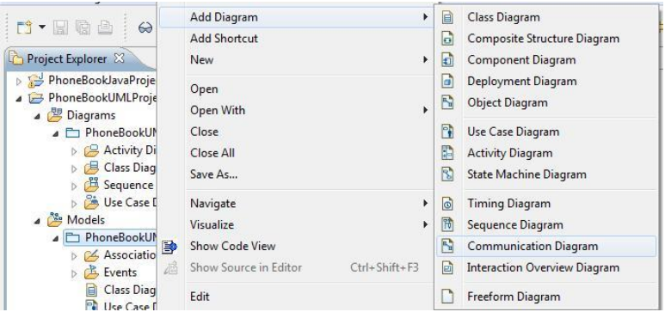
Communication Diagram – Hands on
Lets create Communication Diagram for the Sequence Diagram from Lab # 4.
Right click the Phone Book UML Model and select Add Diagram > Communication Diagram.
Give it a Name.

Slide 5
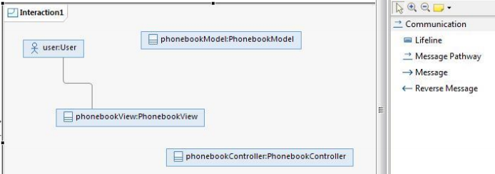
Contd.. 2
Drag the User. phoneBookView. phoneBookController and phoneBookModel from the Model in the project navigation pane.
Select Message Pathway in the Palette. As shown in the next figure. click the line under user: User and then the line under Select Message Pathway in the Palette. click the line under user: User and then the line under phoneBookView:PhoneBookView.

Slide 6
Contd..3
Hover over the newly added Message Pathway and click the Forward Message icon.
Select the operation PhoneBookView::getUserInput() from the drop down list. Erase the reverse message that goes from PhonebookView to User. which is automatically created.
Repeat the above steps to copy the operations added in the sequence diagram created in the previous section..

Slide 7
It should look like…
User:user
phoneBookController
1. getUserInput
2. userHasInput
3. addEntry
5. changeView
4. setState()
phoneBookView
phoneBookModel

Slide 8
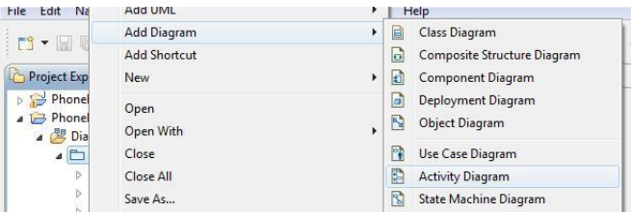
Activity Diagram
In this part. we will cover the activity diagram to illustrate the communication.
1. Right click the Phone Book UML Model and select Add Diagram > Activity Diagram.
2. Give it a name

Slide 9
3. Select Initial from the palette and click in the pane to add it. Add the name User runs application.
4. Add the following Actions:
System waits for input.
User enters name.
User enters phone.
User closes application.
User clicks save.
System saves entry.
User clicks search.
System shows search result.
User closes application.

Slide 10
Fork and Join - Refresher
Fork : When one activity can lead to more than one activity
Join: When more than one activity result in one single activity
Put all the elements together (actions and forks and joins)
*Don’t forget to add the End Activity AKA the Activity Final

Slide 11
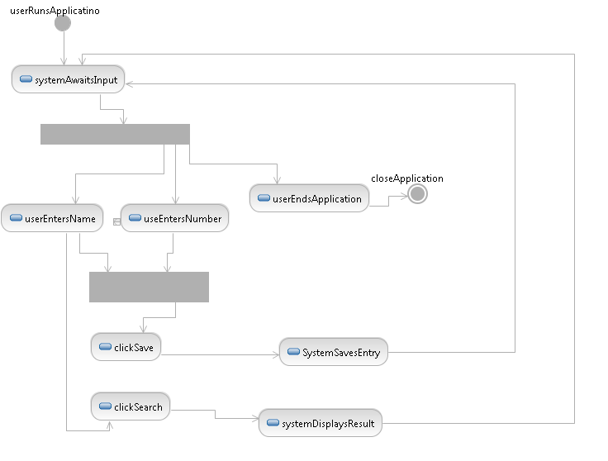
It should look like…
Arrange All

Slide 12
Lab Activity
Draw the Communication Diagram and the Activity Diagram for continuing the Tetra Airlines scenario where the users can search for flights or book flights using the Sequence Diagram from the previous session.

