Slide 1
Frame Relay

Slide 2
Outline
Why do we need Frame Relay?
Frame Relay Network
Frame Relay Network as a NBMA network
Virtual Circuits
DLCI
Mapping of DLCI
Frame Relay Frame

Slide 3
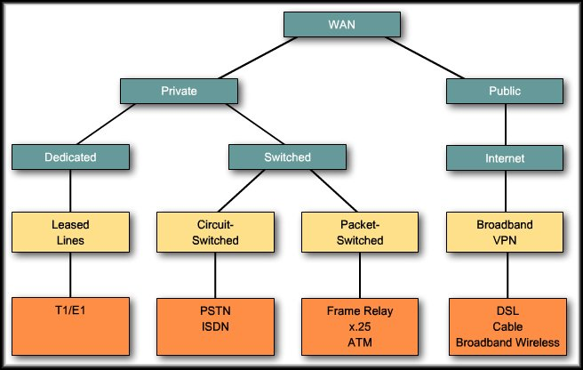
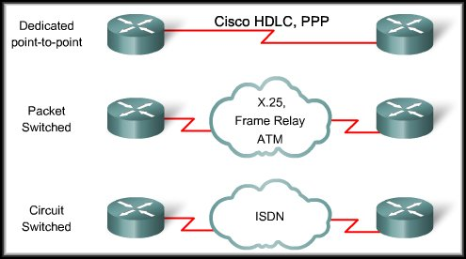

Slide 4
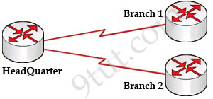
Why do we need Frame Relay?
Frame Relay is a more complex technology than point-to-point WAN links but also provides more features and benefits
Notes:
Let’s take a simple example. Suppose you are working in a big company and your company has just expanded to two new locations. The main site is connected to two branch offices, named Branch 1 & Branch 2 and your boss wants these two branches can communicate with the main site. The most simple solution is to connect them directly (called a leased line) as shown below
To connect to these two branches, the main site router, HeadQuarter, requires two serial interfaces which a router can provide. But what happens when the company expands to 10 branches, 50 branches? For each point-to-point line, HeadQuarter needs a separate physical serial interface (and maybe a separate CSU/DSU if it is not integrated into the WAN card). As you can imagine, it will need many routers with many interfaces and lots of rack space for the routers and CSU/DSUs. Maybe we should use another solution for this problem? Luckily, Frame Relay can do it!
By using Frame Relay we only need one serial interface at the HeadQuarter to connect to all branches. This is also true when we expand to 10 or 50 branches. Moreover, the cost is much lesser than using leased-lines.

Slide 5
Why do we need Frame Relay?
An alternative to dedicated, expensive, leased WAN lines is Frame Relay.
Frame Relay is a high-performance WAN protocol that operates at the physical and data link layers of the OSI reference model.
Frame Relay provides a cost-efficient solution for communications between multiple remote sites by using a single access circuit from each site to the provider.

Slide 6
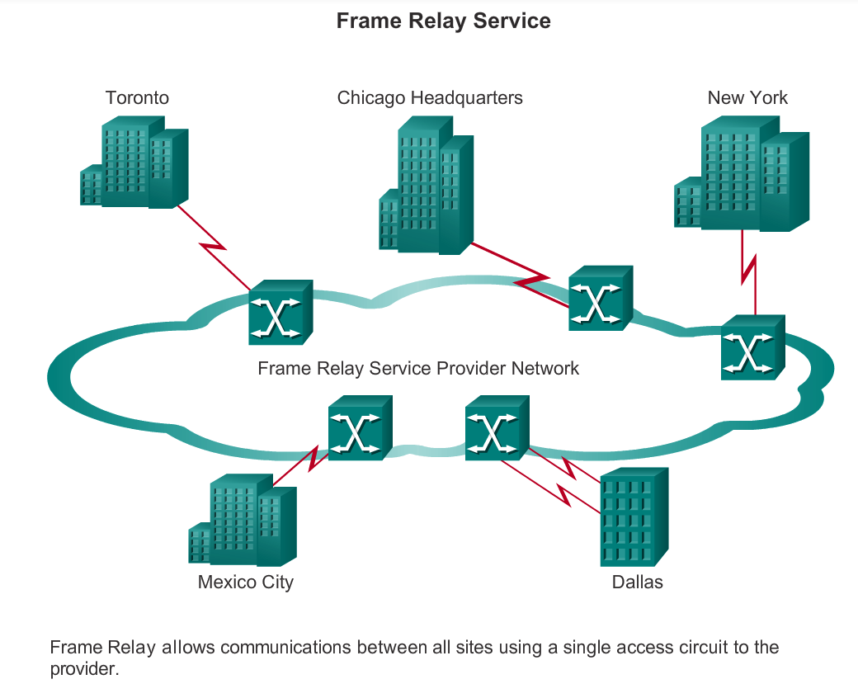
The capacity between any two sites can vary.
Notes:
Network providers implement Frame Relay to support voice and data traffic between LANs over a WAN. Each end user gets a private line, or leased line, to a Frame Relay node. The Frame Relay network handles the transmission over a frequently changing path transparent to all end users. As shown in the figure, Frame Relay provides a solution to allow the communications between multiple sites using a single access circuit to the provider.

Slide 7
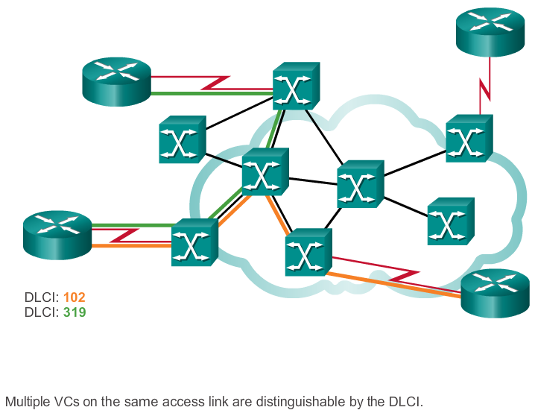
Frame Relay Network
access switches
access switches
access switches

Slide 8
Frame Relay Network
A Frame Relay network is made up of a large number of Frame Relay switches dispersed all over the coverage area of a Frame Relay service provider (e.g. region or country)
The switches are interconnected in a complex mesh topology.

Slide 9
Frame Relay Network
Frame Relay switches:
Terminate user circuits, in addition to connecting to other switches, and are called access switches.
Other Frame Relay switches do not terminate user circuits, connecting to other Frame Relay switches only, and make the backbone of the Frame Relay network.

Slide 10
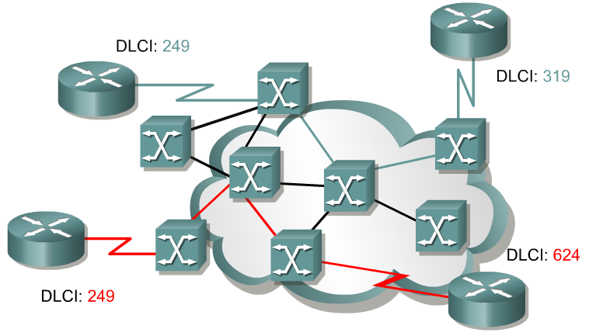
An SVC between the same two DTEs may change.
is temporary connections
is set up dynamically when needed
require call setup and termination for each connection.
A PVC between the same two DTEs will always be the same.
A predefined VC.
Is equated to a leased line in concept.

Slide 11
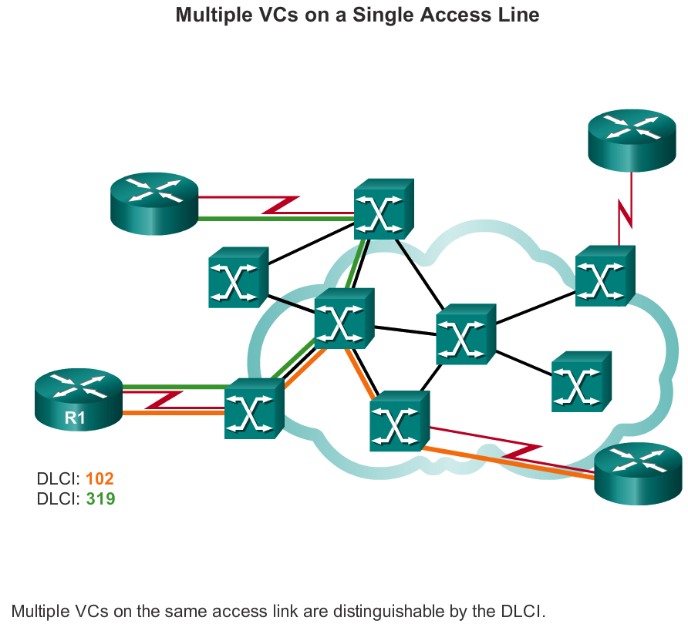
Multiple Virtual Circuits
The router or FRAD, connected to the Frame Relay network, may have multiple VCs connecting it to various endpoints.
Notes:
Frame Relay is statistically multiplexed, meaning that it transmits only one frame at a time, but that many logical connections can co-exist on a single physical line.

Slide 12
Multiple Virtual Circuits
Multiple VCs on a single physical line are distinguished by assigning each VC an identifier called data-link connection identifiers (DLCI) .
Notes:
Keep in mind that the DLCI has only local significance and may be different at each end of a VC.

Slide 13
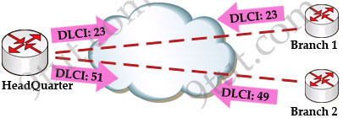
DLCI
VCs are identified by DLCIs.
Frame Relay DLCIs have local significance, that means that their values are unique per router, but not necessarily in the other routers.
DLCI values typically are assigned by the Frame Relay service provider.
Notes:
Frame Relay DLCIs have local significance, which means that the values themselves are not unique in the Frame Relay WAN.
A DLCI identifies a VC to the equipment at an endpoint. A DLCI has no significance beyond the single link.
Two devices connected by a VC may use a different DLCI value to refer to the same connection.

Slide 14
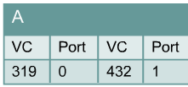
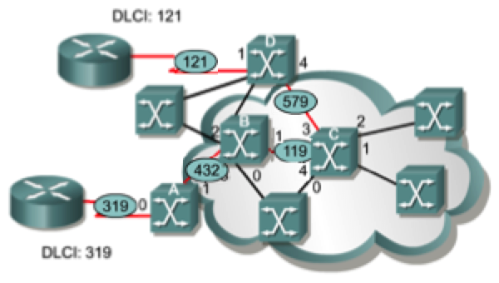
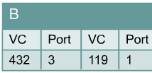
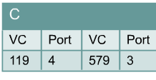
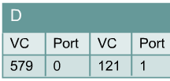
Frame Relay Switch
Frame Relay creates a VC by storing input-port to output-port mapping in the memory of each switch

Slide 15
Frame Relay Address Mapping

Slide 16
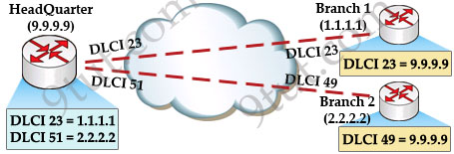
Frame Relay Address Mapping
Before DLCI can be used to route traffic, it must be associated with the IP address of its remote router

Slide 17
Frame Relay Address Mapping
The HeadQuarter will need to map Branch 1 IP address to DLCI 23 & map Branch 2 IP address to DLCI 51.
After that it can encapsulate data inside a Frame Relay frame with an appropriate DLCI number and send to the destination.

Slide 18
Mapping of DLCI
The mapping of DLCIs to Layer 3 addresses can be handled manually or dynamically.
Manually (static): the administrators can statically assign a DLCI to the remote IP address.
Dynamic: the router can send an Inverse ARP Request to the other end of the PVC for its Layer 3 address.
Notes:
We should use the “broadcast” keyword here because by default split-horizon will prevent routing updates from being sent back on the same interface it received. For example, if Branch 1 sends an update to HeadQuarter then HeadQuarter can’t send that update to Branch 2 because they are received and sent on the same interface. By using the “broadcast” keyword, we are telling the HeadQuarter to send a copy of any broadcast or multicast packet received on that interface to the virtual circuit specified by the DLCI value in the “frame-relay map” statement. In fact the copied packet will be sent via unicast (not broadcast) so sometimes it is called “pseudo-broadcast”.

Slide 19
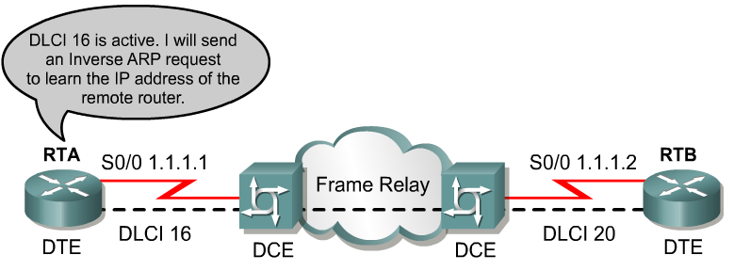
Inverse ARP
2
1
Once the router learns from the switch about available PVCs and their corresponding DLCIs, the router can send an Inverse ARP request to the other end of the PVC. (unless statically mapped )

Slide 20
Inverse ARP
For each supported and configured protocol on the interface, the router sends an Inverse ARP request for each DLCI. (unless statically mapped)
In effect, the Inverse ARP request asks the remote station for its Layer 3 address.
At the same time, it provides the remote system with the Layer 3 address of the local system.
The return information from the Inverse ARP is then used to build the Frame Relay map.

Slide 21
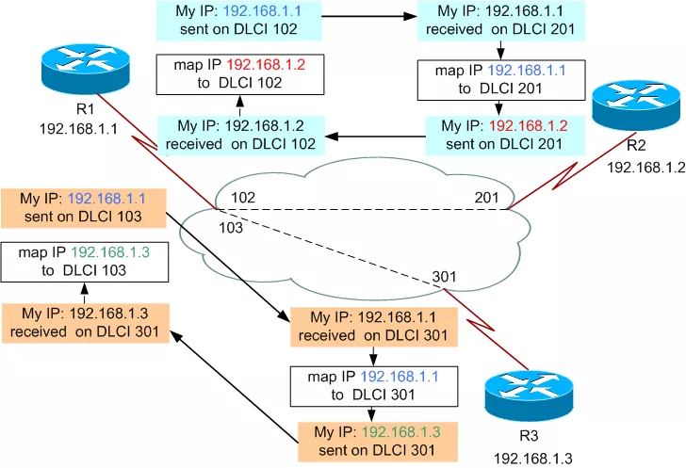
Now all the routers have a pair of DLCI & IP address of the router at the other end so data can be forwarded to the right destination.

Slide 22
Frame Relay Frame
Frame Relay is a data link protocol and the customer router encapsulates each Layer 3 packet inside a Frame Relay frame comprising a header and trailer before it is sent out the access link.
The header and trailer used is actually defined by the Link Access Procedure Frame Bearer Services (LAPF) specification
Notes:
The standard LAPF header is too simplistic and does not provide all the fields needed by Frame Relay routers. More specifically, there is no Protocol Type field in LAPF. Each data link layer needs such a field to define the type of Layer 3 packet carried by the data link frame. If Frame Relay uses only LAPF header, routers cannot support multiprotocol traffic because there is no way to identify the type of Layer 3 protocol.

Slide 23
Frame Relay Frame
The simple LAPF header was extended to compensate for the absence of a Protocol Type field:
Notes:
There are two Frame Relay encapsulation types: the Cisco encapsulation and the IETF Frame Relay encapsulation, which is in conformance with RFC 1490 and RFC 2427. The former is often used to connect two Cisco routers while the latter is used to connect a Cisco router to a non-Cisco router.

Slide 24
Frame Relay Frame
Header
DLCI ,
fields related to congestion management
Data – Contains encapsulated upper-layer data
Trailer
Frame Relay provides no error recovery mechanism. It only provides CRC error detection.
You should keep in mind that Frame Relay encapsulation should match on the routers at the two ends of a VC.
Notes:
If you fail to match the Frame Relay encapsulation (both sides cisco or both ietf) on the two routers, the connection does not come up. However, if you have Cisco routers at both ends of the connection (a likely scenario), and you don’t explicitly configure Frame Relay encapsulation, both routers default to cisco and the connection does get established. Frame Relay switches do not care about the Frame Relay encapsulation. In Cisco IOS Software configuration, the Cisco proprietarty encapsulation is called cisco while the other one is called ietf.

Slide 25
Frame Relay Configuration

Slide 26
Outline
Building the network and configuring the cloud
Basic Frame Relay Configuration Steps
Frame Relay Encapsulation
Configuring a Static Frame Relay Map

Slide 27
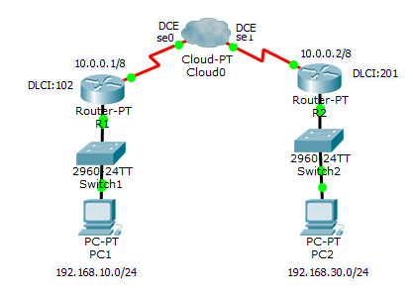
Building the Network

Slide 28
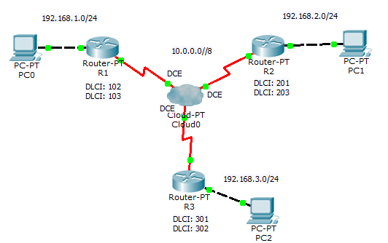
Evaluation

Slide 29
Evaluation

Slide 30
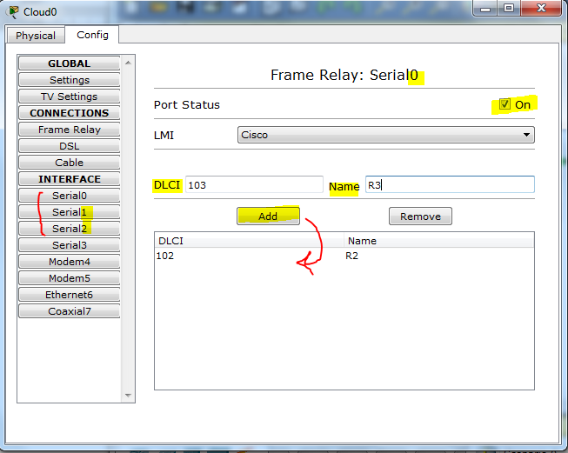
Configuring the cloud ( Frame Relay network)
Configure the DLCIs on the all the active serial interfaces of the cloud

Slide 31
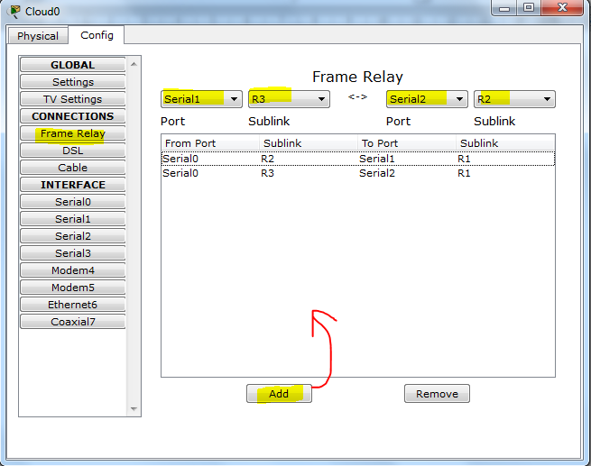
Configuring the cloud ( Frame Relay network)
Setup the VCs

Slide 32
Basic Frame Relay Configuration Steps
Notes:
4.2.1.1 Basic Frame Relay Configuration Commands

Slide 33
Frame Relay Encapsulation
Router(config-if)#encapsulation frame-relay {cisco | ietf}
cisco - Default.
Use this if connecting to another Cisco router.
Ietf -
Select this if connecting to a non-Cisco router.

Slide 34
R1(config)# interface serial 2/0
R1(config-if)# ip address 10.0.0.1 255.0.0.0
R1(config-if)# no shutdown
R1(config-if)# encapsulation frame-relay
R2(config)# interface serial 2/0
R2(config-if)# ip address 10.0.0.2 255.0.0.0
R2(config-if)# no shutdown
R2(config-if)# encapsulation frame-relay

Slide 35
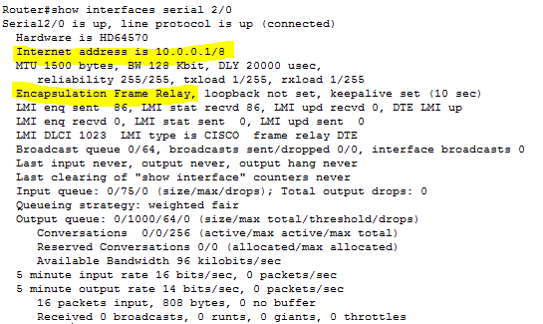
Verifies Frame Relay Configuration

Slide 36
Mapping of DLCI
The mapping of DLCIs to Layer 3 addresses can be handled manually or dynamically.
Manually (static): the administrators can statically assign a DLCI to the remote IP address.
Dynamic: the router can send an Inverse ARP Request to the other end of the PVC for its Layer 3 address.
Notes:
We should use the “broadcast” keyword here because by default split-horizon will prevent routing updates from being sent back on the same interface it received. For example, if Branch 1 sends an update to HeadQuarter then HeadQuarter can’t send that update to Branch 2 because they are received and sent on the same interface. By using the “broadcast” keyword, we are telling the HeadQuarter to send a copy of any broadcast or multicast packet received on that interface to the virtual circuit specified by the DLCI value in the “frame-relay map” statement. In fact the copied packet will be sent via unicast (not broadcast) so sometimes it is called “pseudo-broadcast”.

Slide 37
R1# show frame-relay map
Serial0 (up): ip 10.0.0.2 dlci 102, dynamic, broadcast, status defined, active
dynamic refers to the router learning the IP address via Inverse ARP

Slide 38
Configuring a Static Frame Relay Map
Notes:
4.2.1.2 Configuring a Static Frame Relay Map

Slide 39
Configuring a Static Frame Relay Map
Use the frame-relay map command to configure static address mapping.
Once a static map for a given DLCI is configured, Inverse ARP is disabled on that DLCI.
The broadcast keyword is commonly used with the frame-relay map command.
The broadcast keyword simplifies the configuration of OSPF for nonbroadcast networks that use Frame Relay.

Slide 40
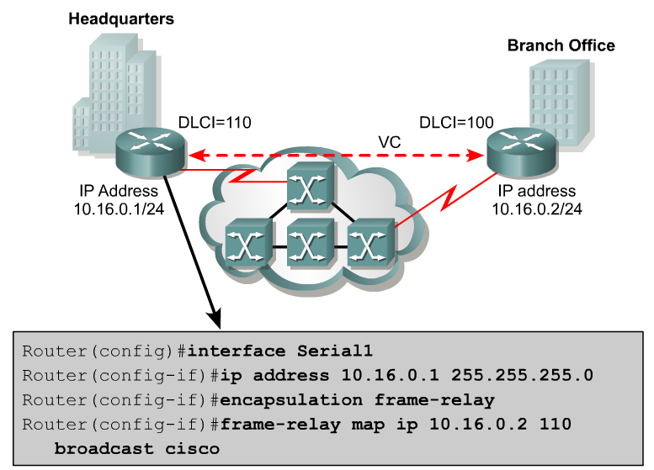
Remote IP Address
Local DLCI

Slide 41
Notes:
4.1.2.6 Frame Relay Address Mapping

Slide 42
Layer 3 Addressing with Frame Relay
Cisco's Frame Relay implementation defines three different options for assigning subnets and IP addresses on Frame Relay interfaces:
One subnet containing all Frame Relay DTEs
One subnet per VC
A hybrid of the first two options

Slide 43
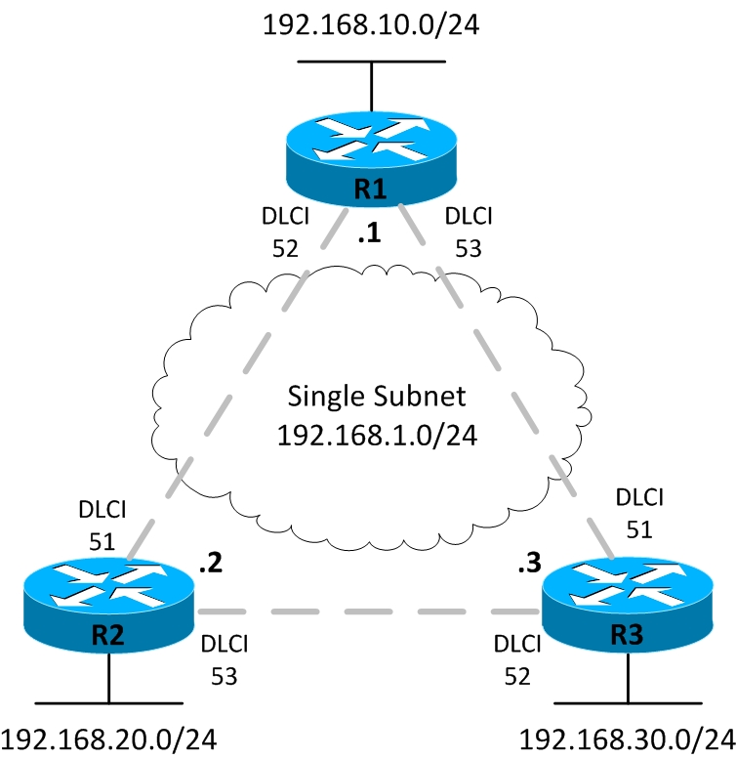
One Subnet Containing All Frame Relay DTEs
Is the using of a single subnet for the Frame Relay network.
The single-subnet option is typically used when a full mesh of VCs exists.
Notes:
https://www.youtube.com/watch?v=mjjWp5RjMX0
https://www.youtube.com/watch?v=mjjWp5RjMX0
https://www.youtube.com/watch?v=luEQzT__dAk
https://www.youtube.com/watch?v=JpUveApljiw

Slide 44
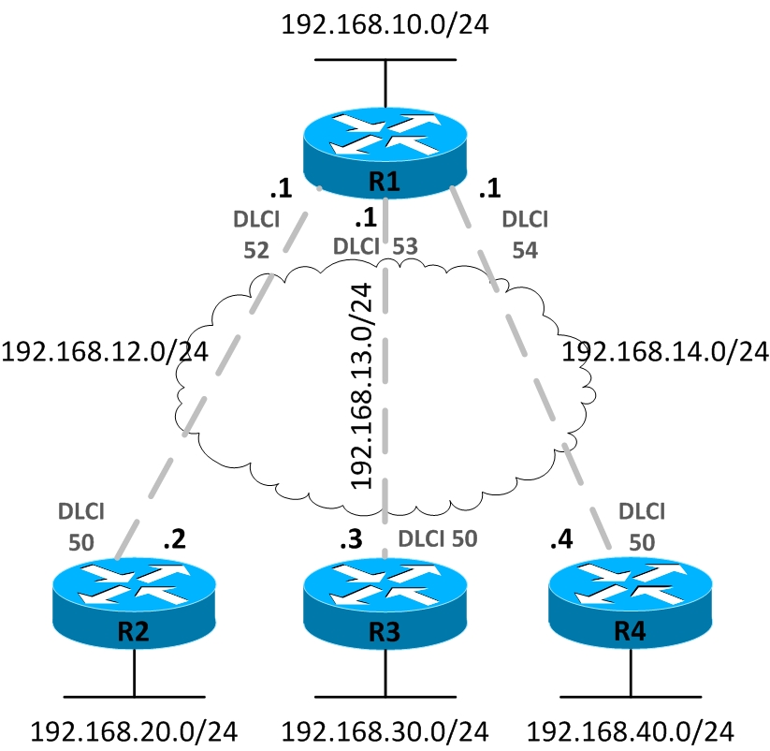
One Subnet Per VC

Slide 45
One Subnet Per VC
The single-subnet-per-VC works better with a partially meshed or star Frame Relay network.
The single-subnet-per-VC alternative matches the logic behind a set of point-to-point links.
Using multiple subnets instead of one larger subnet wastes some IP addresses, but it overcomes some issues with distance vector routing protocols.

Slide 46
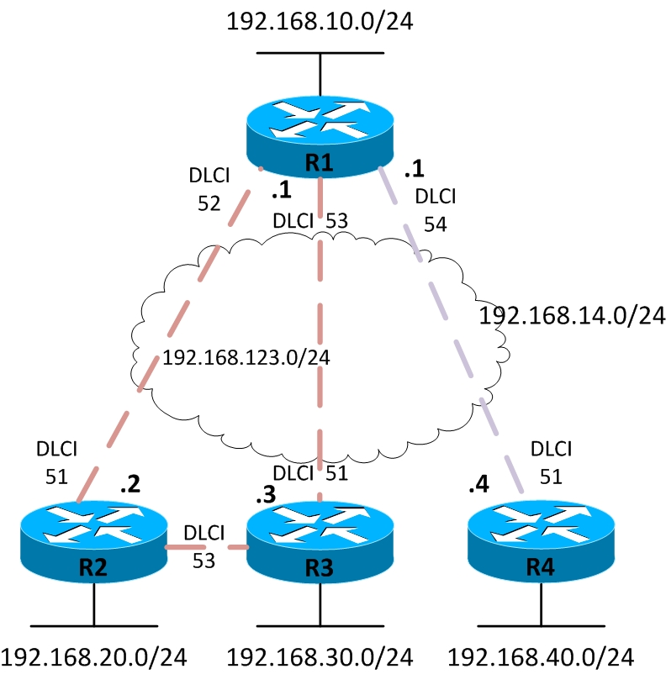
Hybrid Approach
Routers 1,2 , and 3 create a smaller full mesh between each other.
This allows Routers 1,2, and 3 to use one subnet.
Is treated as a separate subnet

Slide 47
Hybrid Approach
We are going to have both point-to-point and multipoint sub-interfaces.
Multipoint interfaces are logical Frame Relay sub-interfaces but they can terminate more than one PVCs just like physical serial interfaces.

Slide 48
Frame Relay Subinterfaces
Frame Relay can partition a physical interface into multiple virtual interfaces called subinterfaces.
A subinterface is simply a logical interface that is directly associated with a physical interface.
Therefore, a Frame Relay subinterface can be configured for each of the PVCs coming into a physical serial interface.

Slide 49
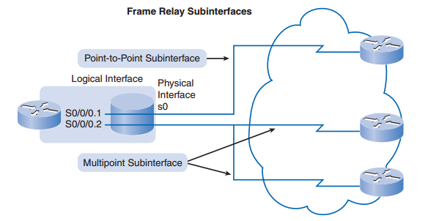
Frame Relay Subinterfaces
Frame Relay subinterfaces can be configured in either point-to-point or multipoint mode:

Slide 50
Point-to-Point Subinterface
A single point-to-point subinterface establishes one PVC connection to another physical interface or subinterface on a remote router.
In this case, each pair of the point-to-point routers is on its own subnet, and each point-to-point subinterface has a single DLCI.
In a point-to-point environment, each subinterface acts like a separate, conventional point-to-point interface.

Slide 51
Multipoint Subinterface
A single multipoint subinterface establishes multiple PVC connections to multiple physical interfaces or subinterfaces on remote routers.
All the participating interfaces are in the same subnet.

Slide 52
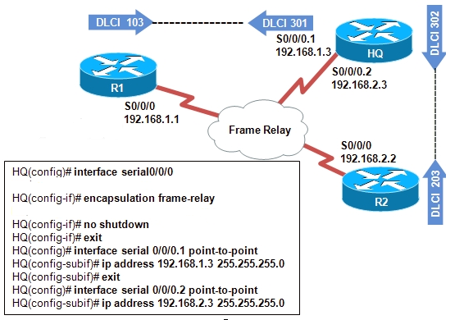
Assigning IP address to point-to-point subinterfacses

Slide 53
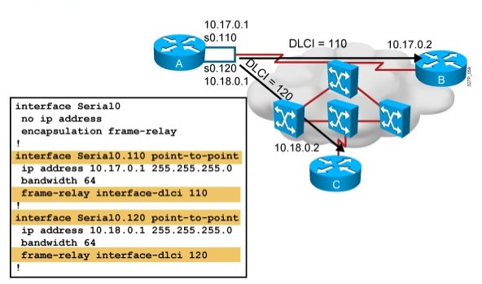
Mapping DLCI in point-to-point subinterfacses

Slide 54
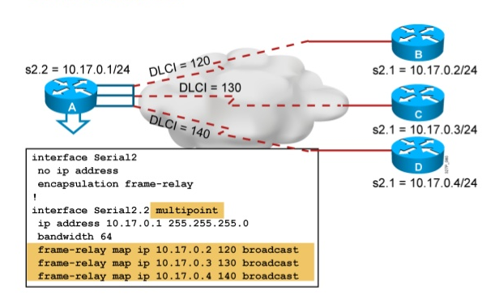
Multipoint subinterface

