Slide 1
Lab1
Basic laboratory equipment and procedures safety rules
CLS 381
Daheeya Alenazi

Slide 2
Assessments and syllabus

Slide 3
Outline
1- laboratory regulations
2- Emergency procedure.
3- Safety rules and first aid procedures.
4- Lab tools and signs.
5- Units of concentration.

Slide 4
laboratory regulations
1- Read each experiment thoroughly before entering the lab.
2- Discard solids into the waste crocks.
3- leave reagent bottles at the side shelves.
4- Read the labels .
5- Avoid using excessive amounts of reagents.

Slide 5
6- Never return unused chemicals to the stock bottle.
7- Don’t inset your own pipets or medicine droppers into the reagent bottles.
8- Don’t lay down the stopper of a bottle.
9- Don’t heat heavy glassware .
10- Always maintain a clean work area in the laboratory.
11- Wash glassware with water and a cleaner if needed.
12- When heating a liquid in a test tube point it away in case it pumps.

Slide 6
Emergency procedure
1- Notify the instructor or demonstrator immediately in case of accident.
2- learn the location and proper use of fire extinguisher, blanket, first-aid kit.
3- Spillage of corrosive chemicals must be reported.

Slide 7
Safety rules and first aid procedures
1- Wear safety glasses in the lab.
2- Don’t eat or drink in the lab.
3- Never attempt unauthorized experiments..
4- Never leave heated laboratory reactions unattended.
6- No practical jocks.
7- Never dip pipets or spatulas into reagent bottles and don’t return unused portion to the stock bottles.
8- Be familiar with emergency exit.
9- Be prepared to administer first aid .

Slide 8
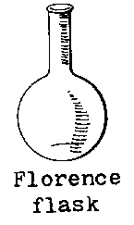
Lab tools
1- Florence flask:-
It is also known as a boiling flask. It is designed to be used for uniform heating and ease of swirling; it is produced in a number of different glass thicknesses to stand different types of use.

Slide 9
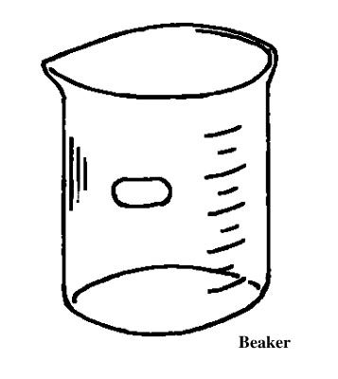
2- Beaker :
It is a simple container for stirring, mixing and heating liquids . They are generally cylindrical in shape, with a flat bottom.

Slide 10
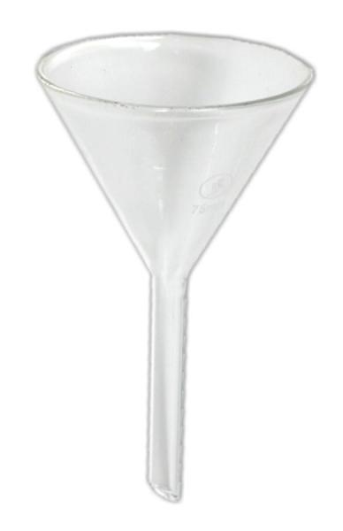
3- Funnel:
Different kinds of funnels that have been adapted for these specialized applications in laboratory. Main usage is transferring liquids to other containers through filtration.

Slide 11
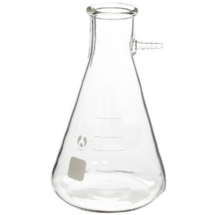
4- filter flask:
A filter flask is a flask fitted with a side arm for connecting to a vacuum source for fast filtering.

Slide 12
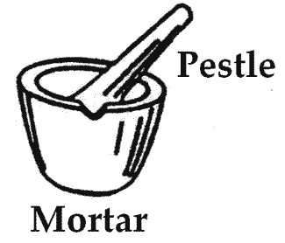
5- Mortar and pestle:
It is a tool used to grind and mix substances.

Slide 13
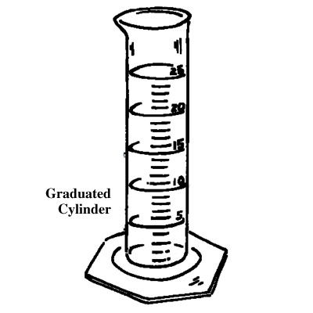
5- Graduated cylinder :
used to measure the volume of a liquid. Graduated cylinders are generally more accurate and precise than laboratory flasks and beakers.

Slide 14
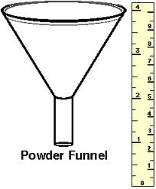
6- Powder funnel :
It has a small and wide neck for fast pouring of powders.

Slide 15
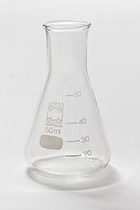
7- Erlenmeyer flask:
The Erlenmeyer is usually marked on the side (graduated) to indicate the approximate volume of contents, and has a spot of ground glass or enamel where it can be labeled with a pencil. It differs from the beaker in its tapered body and narrow neck.

Slide 16
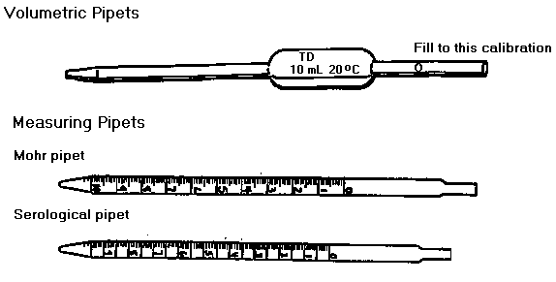
8- Mohr pipette :
Also known as a Graduated pipette, it is used to measure the volume of the liquid dispensed, although not as accurately as a volumetric pipette.

Slide 17
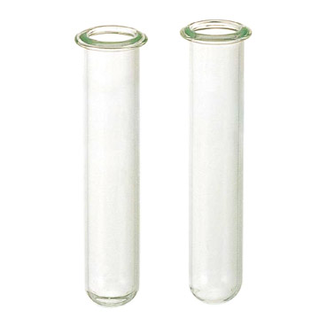
9- Test tubes:
Test tubes are widely used by chemist to hold, mix, or heat small quantities of solid or liquid chemicals, especially for qualitative experiments and assays.

Slide 18
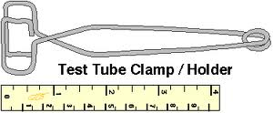
10- Test tube holder:
The test tube holder is used to hold test tubes. They are used by squeezing the handles to open the other end, and inserting the test tube. Test tube holders are typically used when heating the test tube is necessary, or for when caustic materials are being handled.

Slide 19
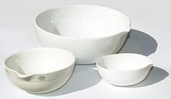
11- Evaporating dishes :
Are used to evaporate excess solvents, most commonly water - to produce a concentrated solution or a solid precipitate of the dissolved substance.

Slide 20
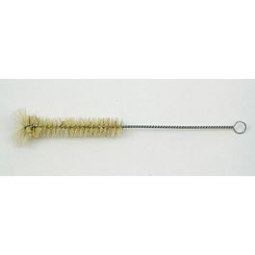
12- Test tube brush:
Designed to clean test tubes.

Slide 21
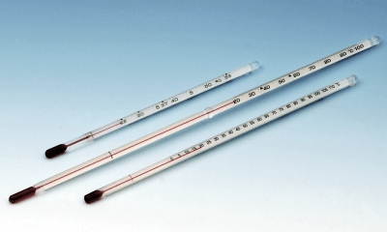
13- Thermometer:
It is a device that is used to measure temperature in different principles.

Slide 22
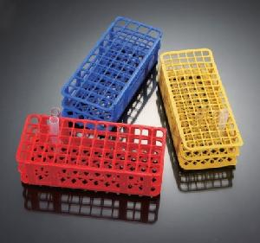
Test tube rack
14- Test tube rack:
it is used to hold/support test tubes containing chemicals waiting for further operations.

Slide 23
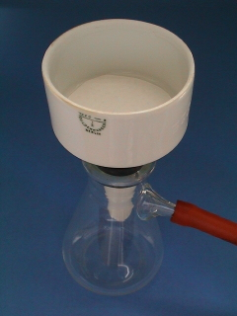
Buchner funnel
15-Buchner funnel:
It is used in filtrations .

Slide 24
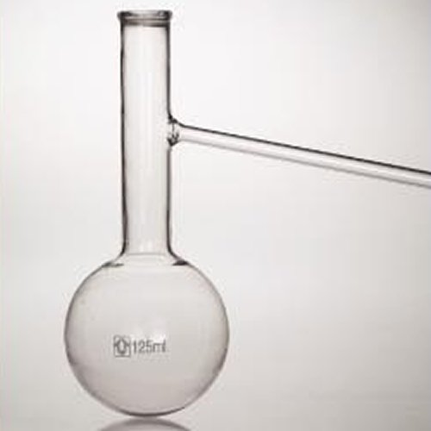
Distilling flask
16- A distilling flask:
Is used to separate mixtures of two liquids with different boiling points. Distillation occurs when the flask is heated and the components of the mixture change from liquid to gas, with the lowest boiling point liquids changing first and liquids with the highest boiling points changing last.

Slide 25
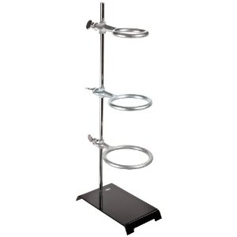
Ring stand, with rings
17- The ring stand :
Used to support laboratory apparatus.

Slide 26
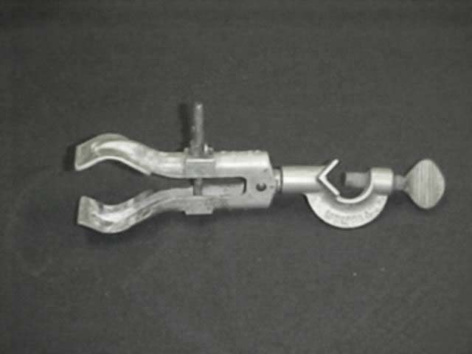
Burette clamp
18- A burette clamp:
is used to fasten glassware into place on a ring stand.
Other clamps are condenser and pinchcock clamps.

Slide 27
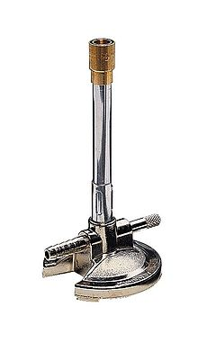
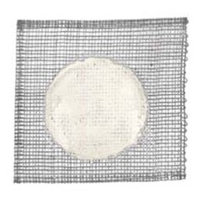
19- Bunsen burner:
is used for heating, sterilization.
20- wire gauze with asbestos center:
It can be used to support a container (such as a beaker or flask) during heating as it helps to spread the heat evenly over the container.

Slide 28
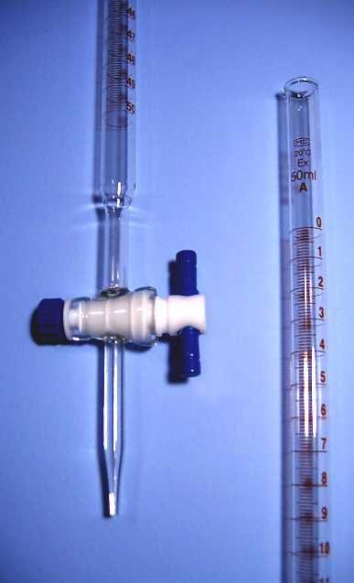
21- A burette:
is used to deliver solution in precisely-measured, variable volumes.

Slide 29
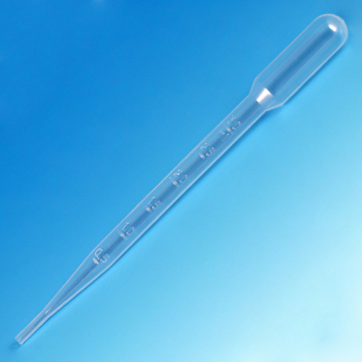
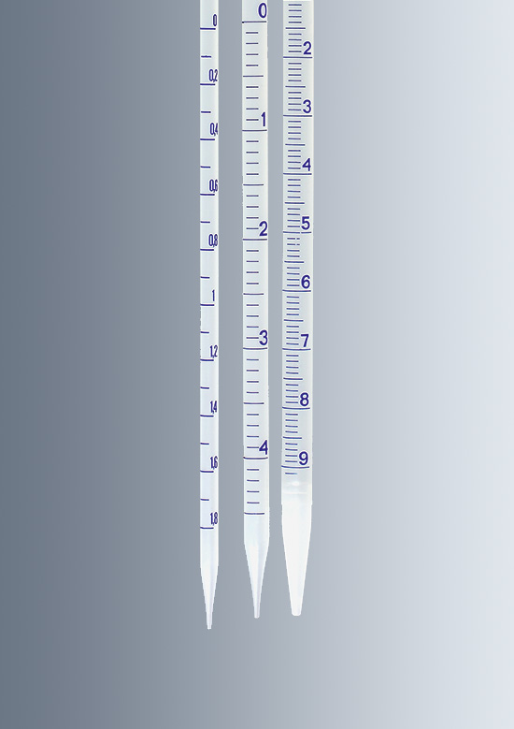
Pipettes
1- Transfer pipettes
2- Graduated pipettes

Slide 30
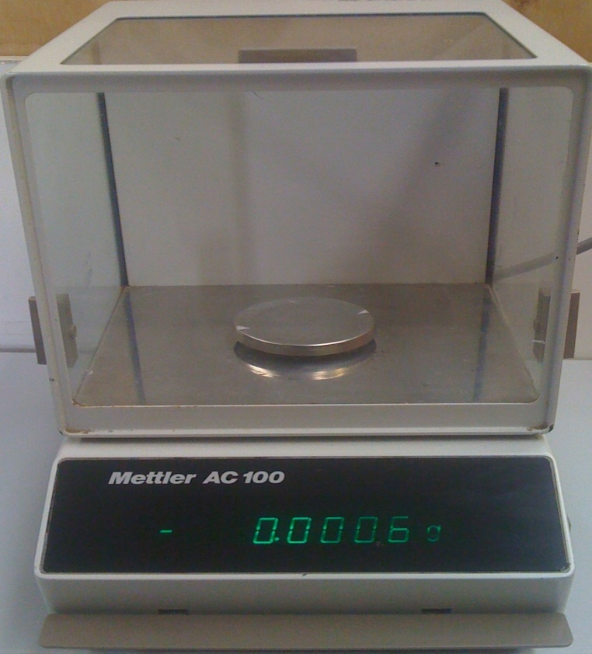
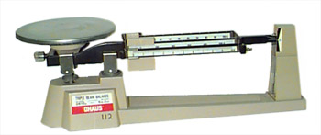
Analytical balances
`

Slide 31
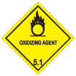
Laboratory Signs and Symbols
Biohazard
Radioactive
Toxic
Oxidizing

Slide 32
General danger
Explosive
Electrical hazard
Flammable

Slide 33
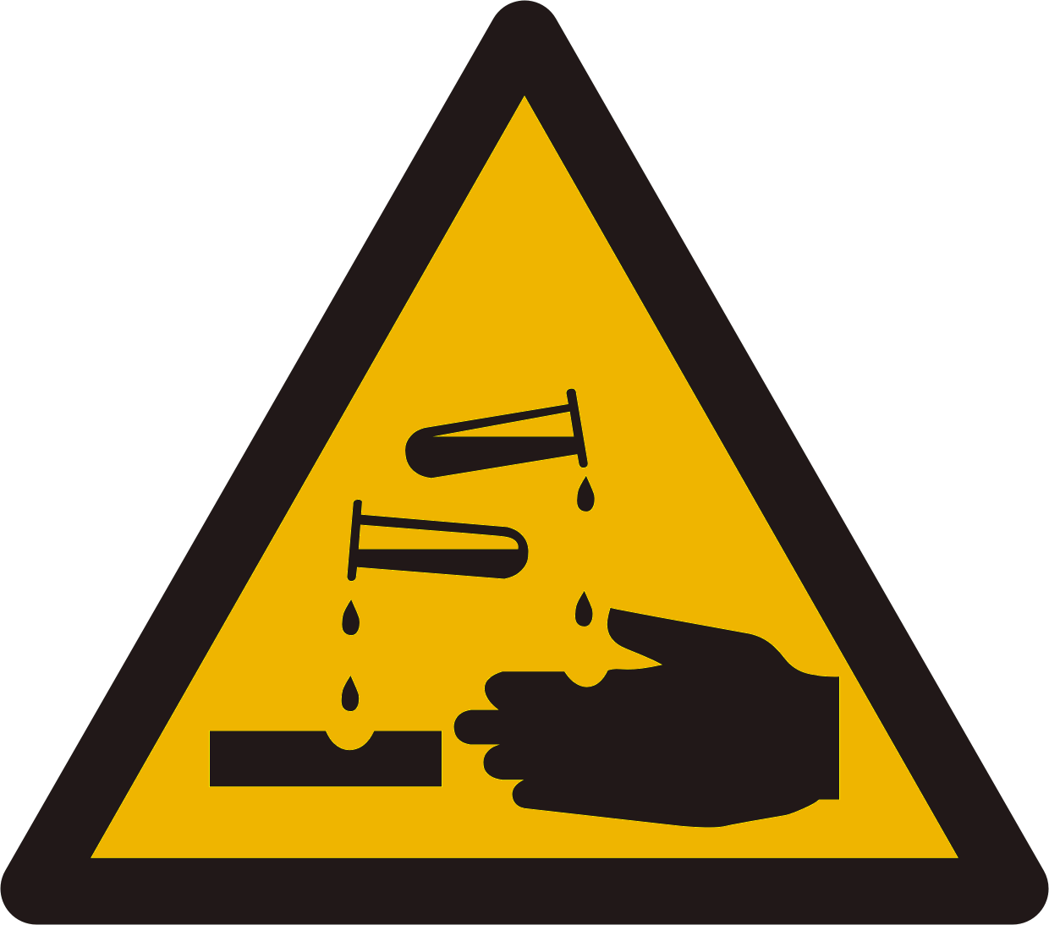
Corrosive
Harmful

Slide 34
Calculating Concentration
The concentration of a chemical solution refers to:
the amount of solute that is dissolved in a solvent.
-a solute can be solid-liquid and gas. (e.g., adding table salt to water).
-the solute could just as easily exist in another phase. For example, if we add a small amount of ethanol to water, then the ethanol is the solute, and the water is the solvent. If we add a smaller amount of water to a larger amount of ethanol, then the water could be the solute!

Slide 35
Units of Concentration
Concentration may be expressed several different ways:
1- percent composition by mass.
2- volume percent.
3- mole fraction.
4- molarity.
5- molality.
6- normality.

Slide 36
Percent Composition by Mass (%)
This is the mass of the solute divided by the mass of the solution (mass of solute plus mass of solvent), multiplied by 100.
Example: Determine the percent composition by mass of a 100 g salt solution which contains 20 g salt.
Solution:20 g NaCl / 100 g solution x 100 = 20% NaCl solution

Slide 37
Volume Percent (% v/v)
Volume percent or volume/volume percent most often is used when preparing solutions of liquids. Volume percent is defined as:
v/v % = [(volume of solute)/(volume of solution)] x 100%.
Example:
wine is about 12% v/v ethanol. This means there are 12 ml ethanol for every 100 ml of wine.
12%= vol of solute(?)/100
12/100=Vol of solute/100
0.12=Vol of solute/100 =12 ml

Slide 38
Mole Fraction (X)
This is the number of moles of a compound divided by the total number of moles of all chemical species in the solution. Keep in mind, the sum of all mole fractions in a solution always equals 1.
Example:What are the mole fractions of the components of the solution formed when 92 g glycerol is mixed with 90 g water? (molecular weight water = 18M; molecular weight of glycerol = 92M)
1-Number of moles=wt of substance/ molar mass(M)
2-Calculate?
3-Total number of moles? (Water+Glycerol)
4-X for water + X for glycerol = 1.

Slide 39
Answer:
1-Number of moles= Weight of substance/molar mass
-Number of moles Water =90 /18= 5 moles
-Number of moles glycerol =92/92 =1 mole
2-Total number of moles = 5+1=6 moles
3-X H2o = 5/6 = 0.833 , X glycerol= 1/6=0.166
4-Total of (X) = 0.833+0.166= 1

Slide 40
Molarity (M)
Molarity is probably the most used unit of concentration. It is the number of moles of solute per liter of solution (not necessarily the same as the volume of solvent!).
Example:What is the molarity of a solution made when water is added to 11 g CaCl2 to make 100 mL of solution?
Solution:
1-number of moles =11 g CaCl2 / (110 g CaCl2 / mol CaCl2) = 0.10 mol CaCl2
2- volume in liter= 100 mL / 1000 mL = 0.10 L molarity
3- Molarity = 0.10 mol / 0.10 L molarity = 1.0 M

Slide 41
Molality (m)
Molality is the number of moles of solute per kilogram of solvent. Because the density of water at 25°C is about 1 kilogram per liter, molality is approximately equal to molarity for dilute aqueous solutions at this temperature. This is a useful approximation but remember that it is only an approximation and doesn't apply when the solution is at a different temperature, isn't dilute, or uses a solvent other than water.

Slide 42
Example:What is the molality of a solution of 10 g NaOH in 500 g water?
Solution:
1-Number of mole NaOH=10 g NaOH / (40 g NaOH / 1 mol NaOH) = 0.25 mol
2-Mass of solvent in Kg= 500 g water /1000 g = 0.50 kg water
3-molality = 0.25 mol / 0.50 kg →molality = 0.50 m

Slide 43
Normality (N)
Normality is number of gram or mole equivalents of solute present in one liter of a solution.
Normality equals to the gram equivalent weight of a solute per liter of solution. A gram equivalent weight or equivalent is a measure of the reactive capacity of a given molecule. Normality is the only concentration unit that is reaction dependent.
Example:1 M sulfuric acid (H2SO4) is 2 N for acid-base reactions because each mole of sulfuric acid provides 2 moles of H+ ions. On the other hand, 1 M sulfuric acid is 1 N for sulfate precipitation, since 1 mole of sulfuric acid provides 1 mole of sulfate ions.

Slide 44
Dilutions
You dilute a solution whenever you add solvent to a solution. Adding solvent results in a solution of lower concentration. You can calculate the concentration of a solution following a dilution by applying this equation:
MiVi = MfVf
where M is molarity, V is volume in Liter, and the subscripts i and f refer to the initial and final values.
Example: How many milliliters(mL)of 5.5 M NaOH are needed to prepare 300 mL of 1.2 M NaOH?
Solution:
5.5 M x V1 = 1.2 M x 0.3 L
V1 = 1.2 M x 0.3 L / 5.5 M
V1 = 0.065 L →V1 = 65 mL

