Slide 1
3. MODEL DRIVEN APPLICATIONS
HTTP://FAC.KSU.EDU.SA/AQUADRI

Slide 2
WHAT IS UML
The Unified Modeling Language, or UML, was first released by the Object Management Group (OMG) in 1997.
Modeling language, independent of any programming language.
Provides various diagrams to elaborate the various aspects of application architecture.
Uses standard notations

Slide 3
Types of UML Diagrams
1. Activity diagram | 8. Object diagram
2. Class diagram | 9. Package diagram
3. Communication diagram | 10. Sequence diagram
4. Component diagram | 11. State machine diagram
5. Composite structure diagram | 12. Timing diagram
6. Deployment diagram | 13. Use case diagram
7. Interaction overview diagram

Slide 4
Coverage
Model the phone book application
Use case diagram using
MVC Driven Class diagram

Slide 5
Design the phone book
Start a blank UML Project in Rational Software Architect.
  Create the MyPhoneBookUMLProject
  Phone Book Model – Model Name

Slide 6
Use Case Diagram - RSA
Actors:
  User
Use cases:
  addEntry
  searchNumber
Relationship – Association
  Use case 1
  Use case 2

Slide 7
Adding Class Diagram – MVC Model
Class diagram are blueprints of a system
Capturing objects that make up a system
In line with the development model
Lists the relationship details (type & strength)
Functionalities of the objects
Services of the classes and the objects.

Slide 8
MVC Design
PhoneBookModel
Update Model
Query Model
Notify View
PhoneBookView
PhoneBookController
Notify Controller

Slide 9
MVC - Model
PhoneBookModel
  Manages the phone book entries and captures the state of the application.
  Whenever the state is changed, it notifies PhoneBookView,
  The PhoneBookView then refreshes the user interface based on the state of the Model.

Slide 10
MVC - Controller
PhoneBookController:
Controls the operation of the entire application.
Changes the model state of the application and updates the data model based on user input.

Slide 11
MVC - View
PhoneBookView:
  Manages the graphical or textual interface for the user based on the state of the application.
  Notifies PhoneBookController when an input is received.

Slide 12
Class Diagram using RSA
Add Class Diagram to the Phone Book Model
Rename the default name to “Class Diagram”
Create the following Classes with operations:
PhoneBookModel | PhoneBookView | PhoneBookController
addEntry | stateHasChanged | userHasInput
searchNumber | changeView | start
getSearchResult | getUserInput
getState

Slide 13
Associations and Relations in classes
Directed Association
Association
Aggregation
Composition

Slide 14
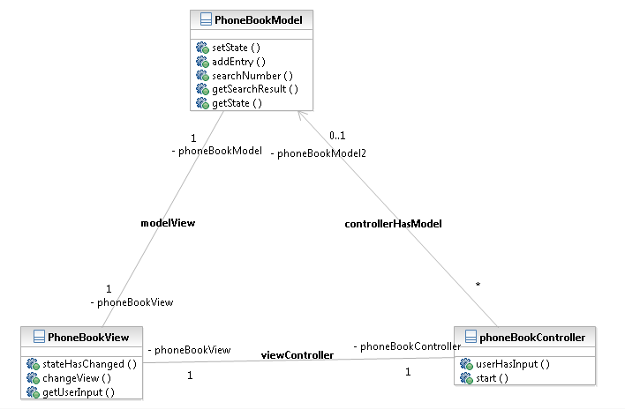
Solution

Slide 15
Lab Activity
Eduself, an online course tutoring academy needs a software for its users (tutors and learners)so that they can Search and Add course to the portal
You are assigned to do the following:
  Draw the use case diagram and class diagram for the same using MVC Model
  Draw the relationship between classes to demonstrate the same.

