Slide 1
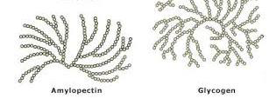
Qualitative analysis of carbohydrates II

Slide 2
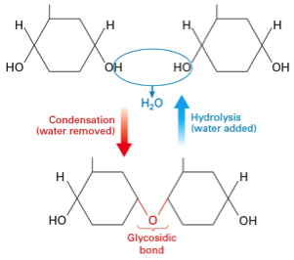
Complex sugars consist of more than one unit of monosaccharide, it could be:
-Disaccharides contain two monosaccharide units.
- Oligosaccharides contain 3-9 monosaccharide units.
- Polysaccharides can contain more than 9 monosaccharide units.
Complex carbohydrates can be broken down into smaller sugar units through a process known as hydrolysis.

Slide 3
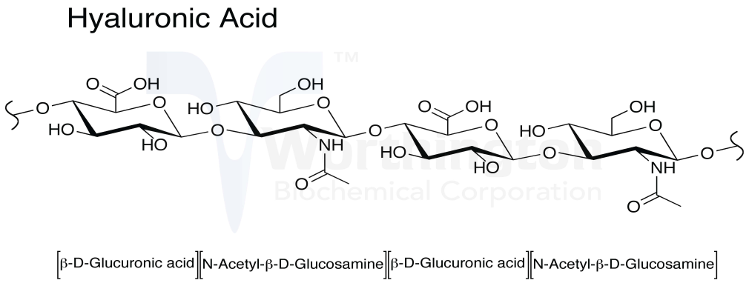
-Polysaccharides can either be :
1. homopolymeric (same repeating monosaccharide unit).
2.heteropolymeric (mixture of monosaccharaides).
-Plants and animals store glucose in the form of very large polysaccharide glucose homopolymers .
-The glucose homopolymer present in plants to store glucose is called starch, while the glucose homopolymer present in animal cells is called glycogen.
starch

Slide 4
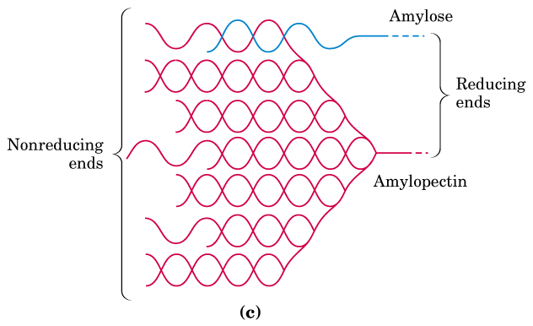
Starch consists of : amylose and amylopectin ..
-Amylose is a Linear helical polymer of glucose linked by α-1,4 glycosidic bonds (100 units).
-Amylopectin Branched polymer containing glucose linked by α-1,4 glycosidic bonds. Branch points has α-1,6 glycosidic bonds, (100,000 units).

Slide 5
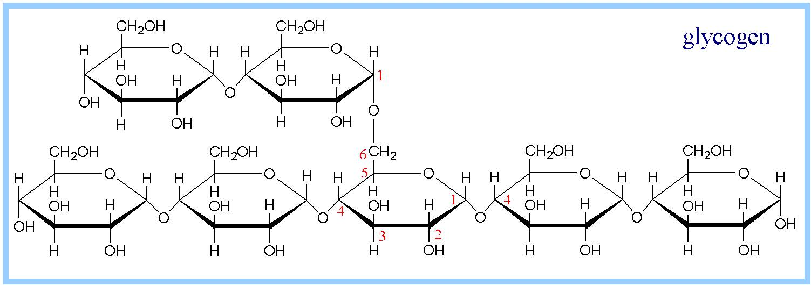
Glycogen
Is a branched polysaccharide of D-glucose which contains both α(1 4) and a(1 6) is similar in structure to amylopectin.
But glycogen has more (1 6) branches.

Slide 6
Practical Part

Slide 7
1-Sucrose hydrolysis Test:
Objective:
To identify the products of hydrolysis of di- and polysaccharides.
-This test is used to convert sucrose (non-reducing disaccharide) to glucose and fructose (reducing mono saccharides).
Principle:
-Sucrose is a non-reducing disaccharide so it does not reduce the Cu++ solution (Bendict's test) because the glycosidic bond is formed between the two hemiacetal bonds. So there is no free aldehydic or ketonic group to give positive reducing properties.
When glycosidic bond hydrolysed (in the presence of acid) sucrose will broken to glucose + fructose (which are reducing sugars) are then able to give positive reducing test.

Slide 8
No result with bendict
Positive result with bendect

Slide 9
Method:
1- Set up tow tubes add to each one 4ml of a sucrose solution ,Lable the tube : (Sucrose with HCL, Sucrose without HCl)
2- To only one tube add four drops of concentrated hydrochloric acid (HCl)
3-Heat both in boiling water bath for 15 minutes.
4- After 15 minutes of heating add 4 drops of concentrated NaOH to each tube (?)
5-From the tube containing HCl take 2ml in tow tube to do Benedict's test and Seliwanoff's test , lable the tube (Benedict +HCl) and (Seliwanoff‘+HCl)
Add 2 ml of Benedict's reagent and 2.5 ml of Seliwanoff's reagent WHAT do expect?
6-From the tube which contain only sucrose take 2 ml to do Benedict's test only (add 2 ml of Benedict's reagent) WHAT do expect?

Slide 10
Result
Sucrose without HCL | Sucrose with HCL
Benedict's test | Seliwanoff's test | Benedict's test

Slide 11
Sucrose+ HCl
(+) Seliwanoff's test
Sucrose+ HCl
(+) Benedict's test
Sucrose only
(-) Benedict's test

Slide 12
2-The Iodine/Potassium Test:
Objective:
To detect the presence of starch in a sample.
- This test used to distinguish between polysaccharides and mono or oligo saccharides.
Principle:
Starch forms deeply blue color complex with iodine. Starch contains α- amylose, a helical saccharide polymer and amylopectin. Iodine forms a large complex with α-amylose helix. This complex absorbs light and reflects the blue light only. Simple oligosaccharides and mono saccharides do not form this complex.
Note that other polysaccharides like glycogen may give other colors (red).

Slide 13
Method
-Two ml of a sample solution is placed in a test tube.
- Add 2drops of iodine solution and one ml of water. Shake it well
- A positive test is indicated by the formation of a blue complex.
- Take a half of the tube of starch and heat it in boiling water bath for 10 min compare between the tow tubes and write your observation.

Slide 14
Result
Comments | Observation | Tube
 |  | (Starch + Iodine) without heating
 |  | (Starch + Iodine) after heating
 |  | (Glucose+ Iodine)

Slide 15
Glucose + iodine
Starch + iodine
[before heating]
Starch + iodine
[after heating]
Notes:
Amylopectin (and glycogen) are unable to assume a stable helical conformation because of the branching.
•Amylopectin complexes with iodine to a much lesser extent than amylose, therefore, the amylopectin-iodin complex has a red voilet color that is much less intense than blue of the amylose-iodine complex.

Slide 16
3-Hydrolysis of Starch:
Objective:
To establish the effect of concentrated HCL on a glycosidic bond in starch.
Principle:
Although starch has free hemiacetal in the terminal glucose residue, it has no reducing properties, because the percentage between the free residues is very low in comparison to the whole molecule.
Heating starch solution in acid medium hydrolyses the glycosidic bonds giving many free glucose residues. These glucose molecules give reducing properties to the hydrolysis product.

Slide 17
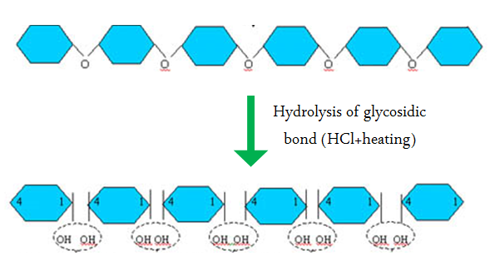
This experiment illustrates the conversion of starch (non-reducing sugar) to a reducing sugar by the action of hydrochloric acid at boiling point. The longer the starch is exposed to the acid the further hydrolysis proceeds.

Slide 18
Method
1-Two ml of starch in large tube
2- Add 1ml of Hydrochloric acid, heated in boiling water bath for 10 mints. then cold solution
3-Add 1ml of sodium hydroxide to become base
4-Divided in two tube (a,b)
5- In tube (a) add 1 ml of iodine solution and note the result. WHAT do expect?
6- In tube (b) add 1 ml of Benedict reagent, mix and heated for 3 mint and record result. WHAT do expect?

Slide 19
Result:
Starch with HCL
Iodine test | Benedict's test

Slide 20
Starch with HCL
[After heating]
[-] Iodine test
[+] Benedict's test

Slide 21
Questions:
How you can convert non-reducing sugar to reducing?
Why glucose does not give positive result with iodine test but not starch?
Explain why the blue color disappears upon heating?
Although starch has free hemiacetal bonds it is non reducing sugar, explain?

