Slide 1
7. State Diagram
HTTP://FAC.KSU.EDU.SA/AQUADRI

Slide 2
Coverage
Coverage:
State Diagram Demo
State Diagram Lab Exercise

Slide 3
Lets Refresh!!
AKA State Chart Diagram or State Machine Diagrams.
Concerned with the states of the objects (initial, transitional and final)
A ‘State’ represents a stage of of the object in behavior.
Helpful in capturing states of objects and useful in all forms of OOP.

Slide 4
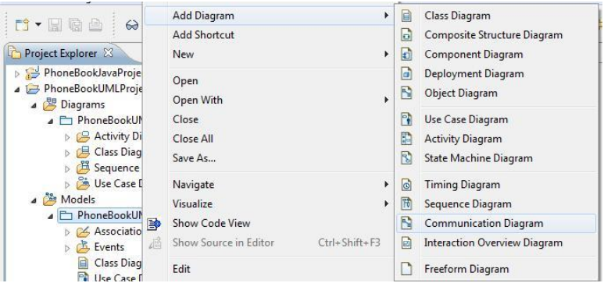
State Diagram – Hands on
Lets create State Diagram.
Create a New Blank Rose Package and Add Diagram > State Machine Diagram.
Give it a Name.

Slide 5
Description
A Trip Switch is used to ’Turn On’ or ‘Turn off’ the Air Conditioner.
When the switch is flipped up (Give, the AC is off), The motor starts working and the LED on the switch is blinking.
Once the AC is ON the LED on switch is ‘continuous on’.
When the switch is flipped down the the AC motor starts to SHUT down and the LED starts blinking.
Once the AC is Turned OFF completely the LED on Switch is ‘Continuous off’
While in the mid of turning off the AC, if the switch is flipped up again, the AC motors starts to turn ON the AC.

Slide 6
State Diagram

Slide 7
Lab Exercise
Drawing a state diagram for:
A button is used to initiate the opening and closing of the garage door.
When the button is pressed while the door is close, the door will be opening while the light is also turned on.
When the button is pressed while the door is open, the door will be closing while a flash light is turned on. Before start closing, the door has to check that the entrance is clear.
When closing the door, if the button is pressed while the door is closing, the motor is immediately thrown into the forward direction, causing the door to start opening again.

