Slide 1
8. Model Fusion
HTTP://FAC.KSU.EDU.SA/AQUADRI

Slide 2
Coverage
Coverage:
Use Rational Software Modeler to create a modeling project.
Create two models
Fuse two models together
Apply a design pattern to a model

Slide 3
Create UML modeling – Model 1
Open Rational Software Modeler.
From the Window menu, select Open Perspective > Other....
Select Modeling and click OK.
Make sure any other open projects are closed.
From the File menu, select New > Other....

Slide 4
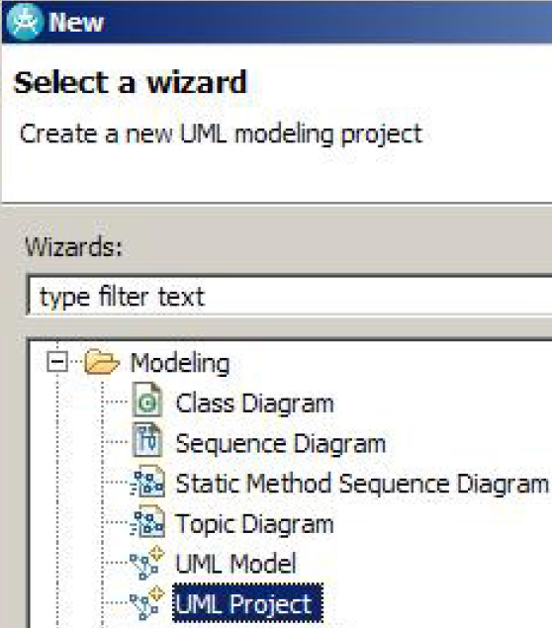
Contd…
Expand Modeling and select UML Project, as shown below.
Figure 1. New Project Wizard
Click Next.
In the UML Modeling Project window, name the project ‘Project1’
  Figure 2. Naming the project
  Click Next
In the Create a new UML model window, select the
Blank Model template.
In the File name: field, type Project1Model.
Select Freeform Diagram from the drop-down menu for
Default diagram type.
Click Finish.

Slide 5
Contd…
Close the Project1Model.emx editor that was automatically opened by creating a new project.
Close the Project1Model::Main editor that was automatically opened by creating a new project.
Create a UML Model in the project:
In the Project Explorer view, right-click MyModel
Select Add UML > Package
Type sample as the name and press Enter
Project1Model::sample::Main should now be open in the editor view. (If not, try closing and reopening the editor.)

Slide 6
In the Palette, on the right side of the editor, click to expand the Class components.
Click Class.
Click anywhere in the Project1Model::sample::Main editor.
Type YourClass for the class name, as shown below, and press Enter
Right-click YourClass and select Add UML > Attribute - ‘yourAttribute:String’
Right-click YourClass and select Add UML > Operation - ‘yourOperation()’
Press CTRL+S to save all changes.
Add 2 more classes ‘yourAssociatedClass1’ and ‘ youAssociatedClass2’ and connect ‘YourClass’ using ‘Directed Association’
Save the model – Ctrl+s

Slide 7
Add Another UML Project and Model
Project Name – Project 2
Model Name – Project2Model
Add UML Package
Add a class ‘YourAnotherClass’
Add Attribute ‘yourAnotherAttribute:Int’ and Operation ‘yourAnotherOperation()’
Save the model – Ctrl+S

Slide 8
Model Fusion
In Rational Software Modeler, you can fuse models in two ways:
  "Harvest" material from one UML model or code model, and "smart paste“ it into another UML model.
  Combine two logical models into a single logical model.

Slide 9
Model Fusion - contd
In the Project Explorer view, expand both projects you created earlier.
Click Project1Model, press and hold CTRL, and select Project2Model.
Right-click Project2Model and select Combine Models
In the Combine Models window, select Project1/Project1Model.emx.
Click OK.
* The Visual Combine will open
* The Pending changes: view lists all of the changes that can be made to the target model in order to combine it with the source.
* Check the model/class in project2model
Click OK

Slide 10
Apply Design Pattern (Observer) to UML
In the Project Explorer view, open the Project1Model::sample::Main editor.
From the main menu, select Window > Show View > Other
Expand the Modeling folder and select Pattern Explorer.
Click-and-drag the Pattern Explorer view to the right side of the screen
In the Pattern Explorer view, expand Design Patterns > Behavioral and select Observer
In the Pattern Explorer view, click-and-drag Observer onto a blank spot in your editor
  You can now see an abstraction of the Observer design pattern in UML notation.
  You need to bind classes to both a ConcreteSubject and a ConcreteObserver.
  In this example, the subject will be YourClass and the observers will be the two associated classes

Slide 11
Applying UML Pattern – Contd.
In the Project1Model::sample::Main editor, click-and-drag YourClass onto the ConcreteSubject section of the Observer pattern.
click-and-drag both YourAssociatedClass1 and YourAssociatedClass2 onto the ConcreteObserver section of the Observer pattern.
Right-click on a blank spot in the editor and select Select > All
Right-click YourClass and select Filters > Show Related Elements
In the Custom Query: list, select Show All Relationships [Default].
Change the Select in Model(s): drop-down to Project1Model
Click OK.
Right-click on a blank space in your editor and select Arrange All

