Slide 1
Digital Transmission Analog to Digital Conversion
2nd semester 1438-1439
NET 205: Data Transmission and Digital Communication

Slide 2
205NET CLO
1-Introduction to Communication Systems and Networks architecture OSI Reference Model.
2- Data Transmission Principles
3- Transmission medias
4- Data modulation and encoding

Slide 3
Outline
Pulse Code Modulation
Sampling
Quantizing
Encoding
PCM SNR and Bandwidth
Delta Modulation

Slide 4
ANALOG-TO-DIGITAL CONVERSION
A digital signal is superior to an analog signal because it
more robust to noise
can easily be recovered, corrected and amplified.
Pulse code modulation and delta modulation are two techniques that change an analog signal to digital data.
After the digital data are created (digitization), we can use one of the techniques described before to convert the digital data to a digital signal.
Notes:
For this reason, the tendency today is to change an analog signal to digital data.
Sometimes,
however, we have an analog signal such as one created by a microphone or camera.
We have seen in Chapter 3 that a digital signal is superior to an analog signal. The
tendency today is to change an analog signal to digital data. In this section we describe
two techniques, pulse code modulation and delta modulation. After the digital data are
created (digitization), we can use one of the techniques described in Section 4.1 to convert
the digital data to a digital signal.

Slide 5
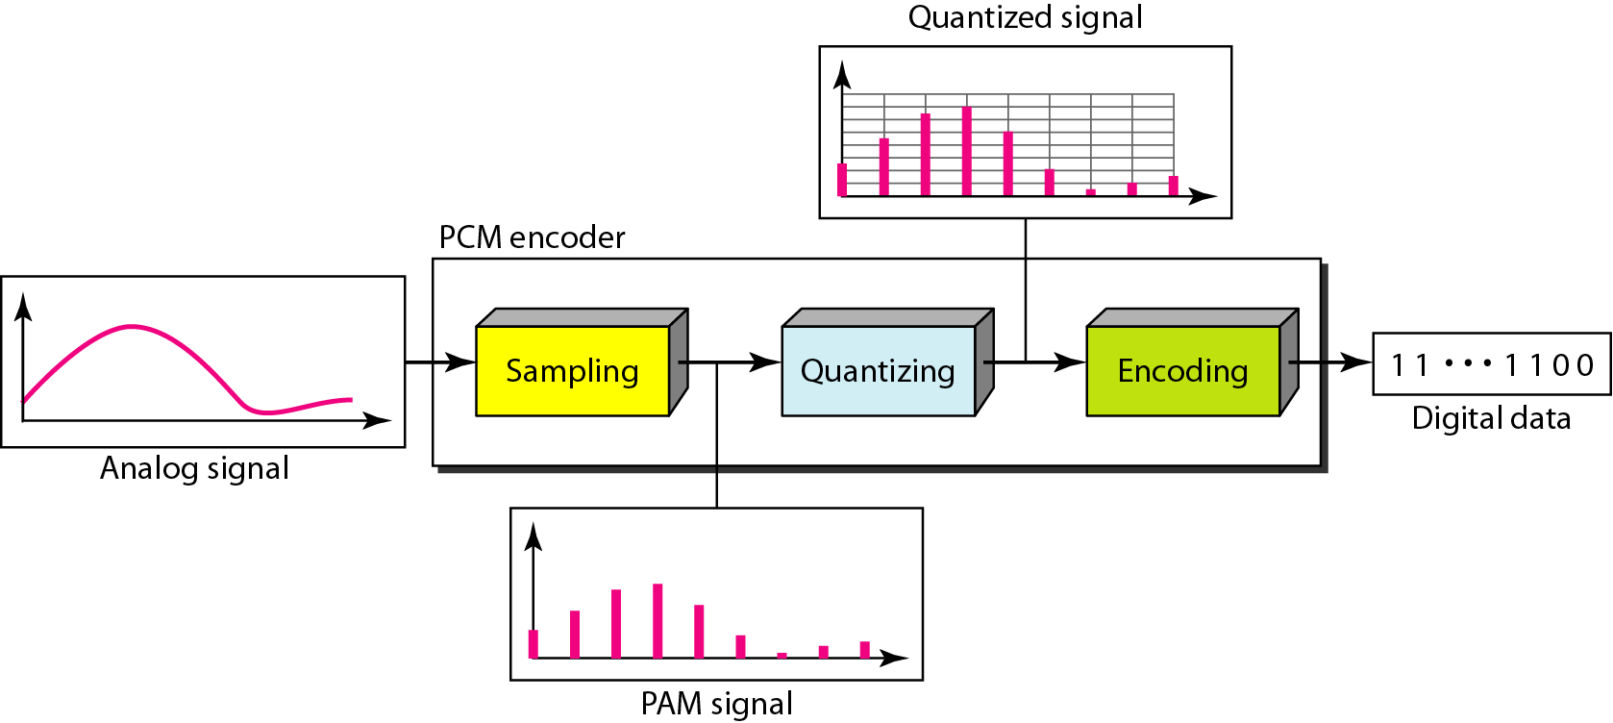
Pulse Code Modulation (PCM)
PCM consists of three steps to digitize an analog signal:
Sampling : The analog signal is sampled
Quantization: The sampled signal is quantized
Binary encoding: The quantized values are encoded as streams of bits.

Slide 6
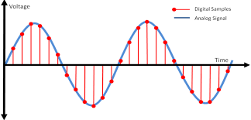
Sampling
Analog signal is sampled every T_{S} secs.
T_{s} is referred to as the sampling interval or period.
f_{s} = 1/T_{s} is called the sampling rate or sampling frequency.
This process is sometimes referred to as pulse amplitude modulation PAM and the outcome is a signal with analog (non integer) values

Slide 7
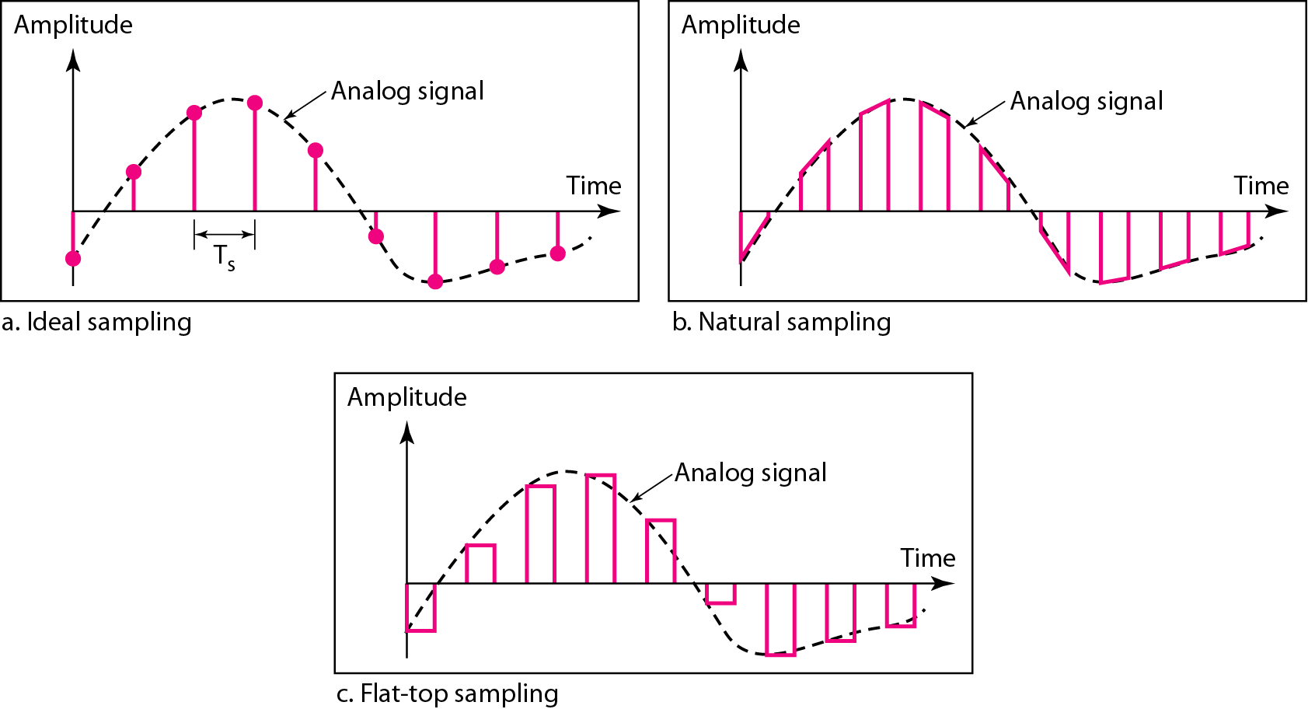
Sampling Methods
There are 3 sampling methods:
Ideal - an impulse at each sampling instant
Natural - a pulse of short width with varying amplitude
Flattop - sample and hold, like natural but with single amplitude value
Notes:
In ideal sampling, pulses from the analog signal are sampled. This is an ideal sampling
method and cannot be easily implemented. In natural sampling, a high-speed
switch is turned on for only the small period of time when the sampling occurs. The
result is a sequence of samples that retains the shape of the analog signal. The most
common sampling method, called sample and hold, however, creates flat-top samples
by using a circuit.

Slide 8
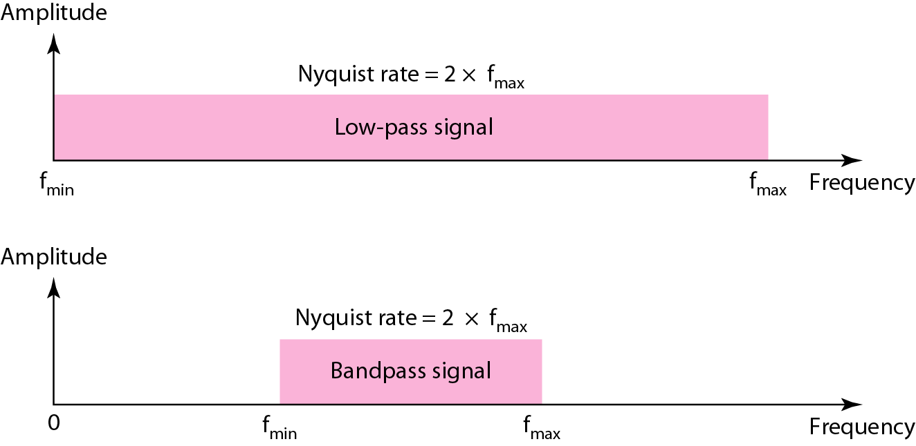
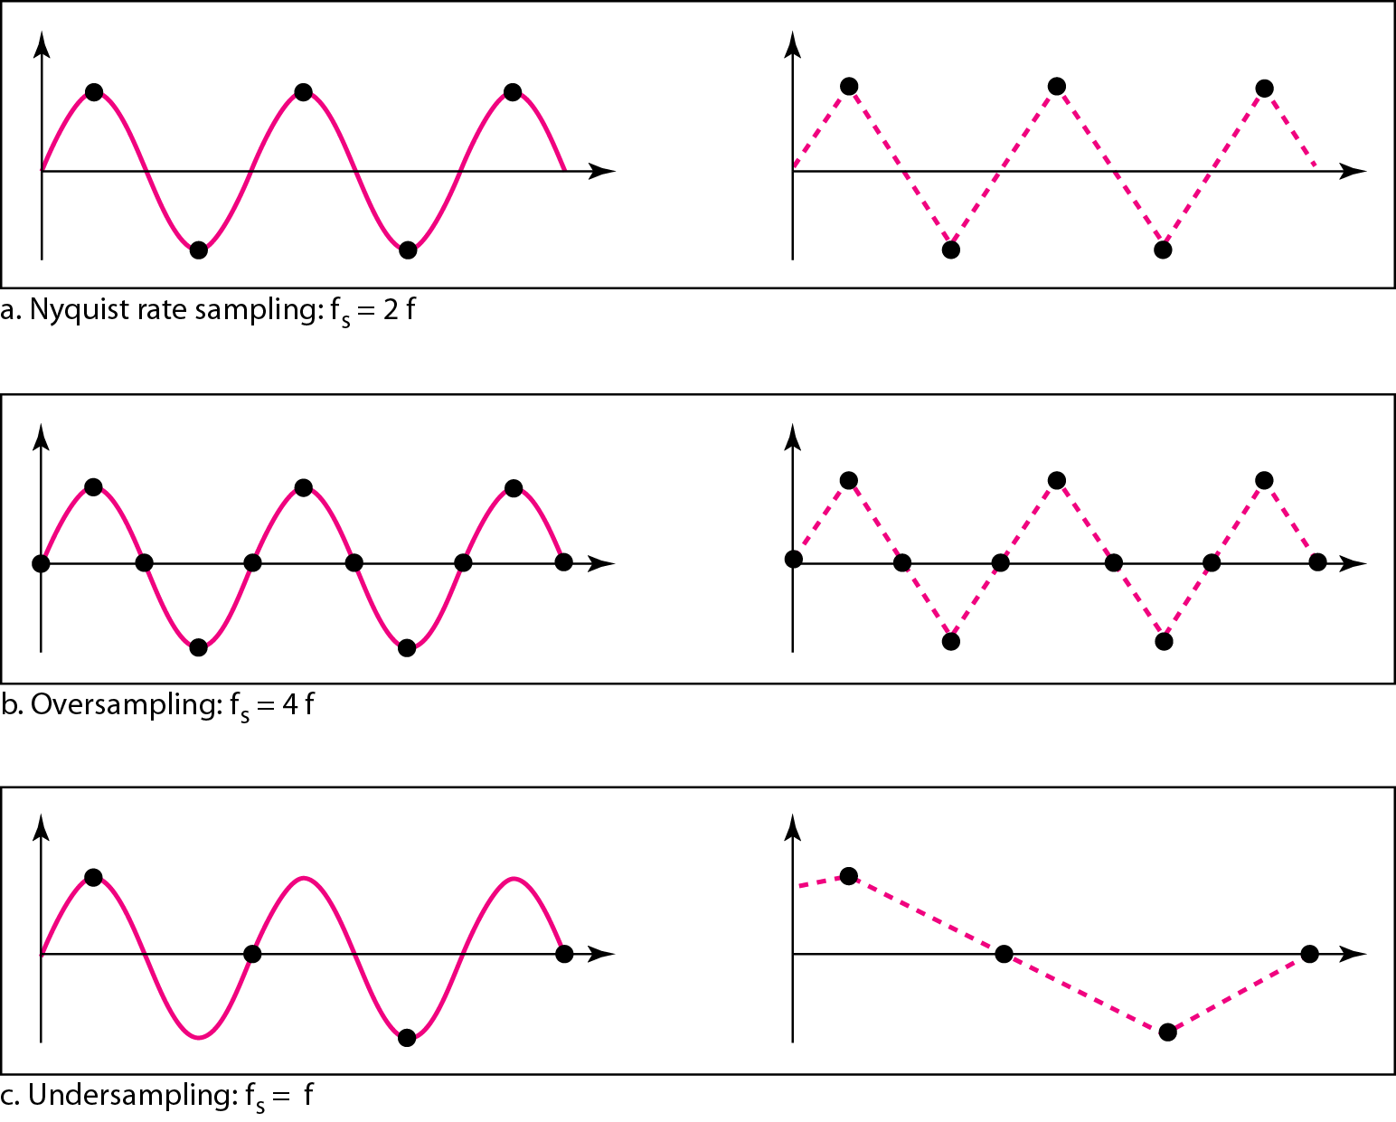
Nyquist Theorem
According to the Nyquist theorem, the sampling rate must be at least 2 times the highest frequency contained in the signal.
Notes:
One important consideration is the sampling rate or frequency. What are the restrictions on Ts? This question was elegantly answered by Nyquist. According
to the Nyquist theorem, to reproduce the original analog signal, one necessary condition is that the sampling rate be at least twice the highest frequency in the original signal.
We need to elaborate on the theorem at this point. First, we can sample a signal only if the signal is band-limited. In other words, a signal with an infinite bandwidth
cannot be sampled. Second, the sampling rate must be at least 2 times the highest frequency, not the bandwidth. If the analog signal is low-pass, the bandwidth and the highest frequency are the same value. If the analog signal is bandpass, the bandwidth value is lower than the value of the maximum frequency.
For an intuitive example of the Nyquist theorem, let us sample a simple sine wave at three sampling rates: f_{s} = 4f (2 times the Nyquist rate), f_{s} = 2f (Nyquist rate), and f_{s} = f (one-half the Nyquist rate). Figure 4.24 shows the sampling and the subsequent recovery of the signal.
It can be seen that sampling at the Nyquist rate can create a good approximation of the original sine wave (part a). Oversampling in part b can also create the same approximation, but it is redundant and unnecessary. Sampling below the Nyquist rate (part c) does not produce a signal that looks like the original sine wave

Slide 9
Example
A complex low-pass signal has a bandwidth of 200 kHz. What is the minimum sampling rate for this signal?
Solution
The bandwidth of a low-pass signal is between 0 and f, where f is the maximum frequency in the signal. Therefore, we can sample this signal at 2 times the highest frequency (200 kHz). The sampling rate is therefore 400,000 samples per second.

Slide 10
Example
A complex bandpass signal has a bandwidth of 200 kHz. What is the minimum sampling rate for this signal?
Solution
We cannot find the minimum sampling rate in this case because we do not know where the bandwidth starts or ends. We do not know the maximum frequency in the signal.

Slide 11
Filtering
Before we sample, we have to filter the signal to limit the maximum frequency of the signal as it affects the sampling rate.
Filtering should ensure that we do not distort the signal, i.e. remove high frequency components that affect the signal shape.

Slide 12
Quantization
Sampling results in a series of pulses of varying amplitude values ranging between two limits: a min and a max.
The amplitude values are infinite between the two limits.
We need to map the infinite amplitude values onto a finite set of known values.
This is achieved by doing Quantization process.

Slide 13
Quantization steps
The original analog signal has instantaneous amplitudes between V_{min} and V_{max}
We divide the range into L zones, each of height Δ (zone width) Δ = (V_{max} - V_{min} )/L
We assign quantized values of 0 to L – 1 (resulting in L values) to the midpoint of each zone.
We approximate the value of the sample amplitude to the quantized values

Slide 14
Example : Quantization Zones
Assume we have a voltage signal with amplitutes V_{min}=-20V and V_{max}=+20V.
We decide to have eight levels → L=8.
Zone width Δ = (20 - -20)/8 = 5
The 8 zones are: -20 to -15, -15 to -10, -10 to -5, -5 to 0, 0 to +5, +5 to +10, +10 to +15, +15 to +20
The midpoints are: -17.5, -12.5, -7.5, -2.5, 2.5, 7.5, 12.5, 17.5
Notes:
Quantization Levels In the previous example, we showed eight quantization levels.
The choice of L, the number of levels, depends on the range of the amplitudes of the
analog signal and how accurately we need to recover the signal. If the amplitude of a
signal fluctuates between two values only, we need only two levels; if the signal, like
voice, has many amplitude values, we need more quantization levels. In audio digitizing,
L is normally chosen to be 256; in video it is normally thousands. Choosing
lower values of L increases the quantization error if there is a lot of fluctuation in the
signal.

Slide 15
Example: Assigning Codes to Zones
5- Each zone is then assigned a binary code.
The number of bits required to encode the zones, or the number of bits per sample as it is commonly referred to, is obtained as follows:
n_{b} = log₂ L
Given our example, n_{b} = 3
The 8 zone (or level) codes are therefore: 000, 001, 010, 011, 100, 101, 110, and 111
Assigning codes to zones:
000 will refer to zone -20 to -15
001 to zone -15 to -10, etc.

Slide 16
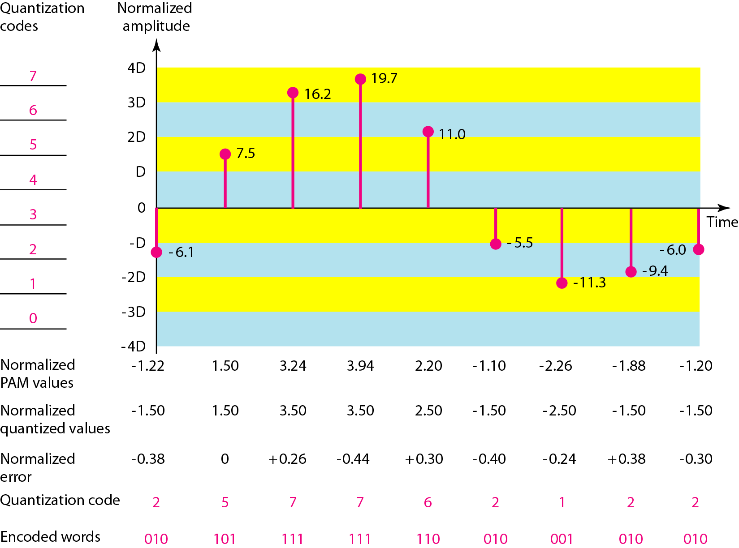

Slide 17
Quantization Error
When a signal is quantized, we introduce an error - the coded signal is an approximation of the actual amplitude value.
The difference between actual and midpoint value is referred to as the quantization error.
The more zones, the smaller Δ which results in smaller errors.

Slide 18
Encoding
After each sample is quantized and the number of bits per sample is decided, each sample can be changed to an n_{b}-bit code word.
The bit rate can be found from the formula
Bit rate = sampling rate × number of bits per sample=f_{s} × n_{b}
Notes:
Note that the number of bits for each sample is determined from the number of quantization levels. If the number of quantization
levels is L, the number of bits is nb =log2 L

Slide 19
Notes:
Quantization Error One important issue is the error created in the quantization process.
(Later, we will see how this affects high-speed modems.) Quantization is an
approximation process. The input values to the quantizer are the real values; the output
values are the approximated values. The output values are chosen to be the middle
value in the zone. If the input value is also at the middle of the zone, there is no quantization
error; otherwise, there is an error. In the previous example, the normalized
amplitude of the third sample is 3.24, but the normalized quantized value is 3.50. This
means that there is an error of +0.26. The value of the error for any sample is less than
.:112. In other words, we have -.:112 -::;; error -::;; .:112.

Slide 20
Example
We want to digitize the human voice. What is the bit rate, assuming 8 bits per sample?
Solution
The human voice normally contains frequencies from 0 to 4000 Hz. So the sampling rate and bit rate are calculated as follows:
Sampling rate = 4000 × 2 = 8000 samples/s
Bit rate = 8000 × 8 = 64,000 bps = 64 kbps

Slide 21
x(t)
10
Consider the analog Signal x(t).
2
t
X(nTs)
10
Ts
2
The signal is first sampled
n

Slide 22
10
8
6
dividing the range into 4 zones
2
4
2
n
3
2
1
0
assign quantized values of 0 to 3 to the midpoint of each zone.
n

Slide 23
3
2
1
0
n
approximating the value of the sample amplitude to the quantized values.
11
3
10
2
01
1
00
0
Each zone is assigned a binary code
n

Slide 24
11
3
10
2
01
1
00
0
01
11
11
11
01
00
00
n
The sequence bits if the samples 01111111010000
Use one of the line code scheme to get the digital signal

Slide 25
Quantization Error and SNR
The quantization error changes the signal-to-noise ratio (SNR) of the signal, which in turn reduces the upper limit capacity according to Shannon.
SNR_{dB} = 6.02 n_{b} + 1.76 dB

Slide 26
Example
What is the SNR_{dB} value if we quantize a signal using 8 levels?
We can use the formula to find the quantization. We have eight levels → 3 bits per sample, so
SNR_{dB} = 6.02(3) + 1.76 = 19.82 dB
Increasing the number of levels increases the SNR

Slide 27
PCM Bandwidth
If we digitize a low-pass analog signal with bandwidth B_{analog} , the new minimum bandwidth of the channel that can pass this digitized signal
B_{min} = n_{b} x B_{analog}
Example
We have a low-pass analog signal of 4 kHz. If we send the analog signal, we need a channel with a minimum bandwidth of 4 kHz. If we digitize the signal and send 8 bits per sample, we need a channel with a minimum bandwidth of 8 × 4 kHz = 32 kHz.

Slide 28
Delta Modulation (DM)
PCM is a very complex technique. Other techniques have been developed to reduce the complexity of PCM. The simplest is delta modulation.
PCM finds the value of the signal amplitude for each sample; DM finds the change from the previous sample.

Slide 29
Delta Modulation
In Delta Modulation, only one bit is transmitted per sample .That bit is:
1→ if the current sample > the previous sample
0 → if the current sample < the previous sample
Since so little information is transmitted, delta modulation requires higher sampling rates than PCM for equal quality of reproduction

Slide 30
Modulater
1- A staircase approximation of the message signal is derived
The analog signal is approximated with a staircase approximation signal (series of segments ).
Each segment of the approximated signal is compared to the message signal:
If the approximation fall below the signal at any sampling epoch → the segment is increased by ∆.
If the approximation lies above the signal at any sampling epoch → the segment is diminished by ∆.
So, the time and amplitude axes are quantized.

Slide 31
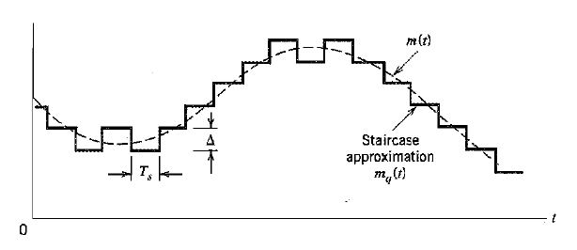

Slide 32
Modulator
2- encoding
This scheme sends only one bit each segment.
if the segment at time t_{n+1} is higher in amplitude value than the segment at time t_{n}, → then a bit “1” is used to indicate the positive value.
If the segment is lower in value → resulting in a negative value, a “0” is used.

Slide 33
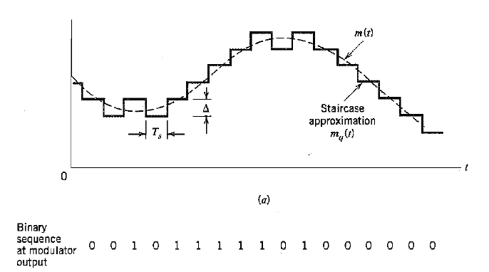
This scheme works well for small changes in signal values between samples.
If changes in amplitude are large, this will result in large errors.

Slide 34
Any Questions ?

