Slide 1
Bandwidth Utilization: Multiplexing
2nd semester 1438-1439
NET 205: Data Transmission and Digital Communication

Slide 2
205NET CLO
1-Introduction to Communication Systems and Networks architecture OSI Reference Model.
2- Data Transmission Principles
3- Transmission medias
4- Data modulation and encoding
5- Multiplexing

Slide 3
Outline
Multiplexing
Multiplexing Techniques
Frequency-Division Multiplexing
Wavelength-Division Multiplexing
Time-Division Multiplexing
Synchronous Time-Division Multiplexing
Statistical Time-Division Multiplexing

Slide 4
Multiplexing
Multiplexing is the set of techniques that allows the simultaneous transmission of multiple signals across a single data link
Notes:
Whenever the bandwidth of a medium linking two devices is greater than the bandwidth needs of the devices, the link can be shared
We can accommodate this increase by continuing to add individual links each time a new channel is needed; or we can install higher-bandwidth links and use each to carry multiple signals.
today's technology includes high-bandwidth media such as optical fiber and terrestrial and satellite microwaves. Each has a bandwidth far in excess
of that needed for the average transmission signal. If the bandwidth of a link is greater than the bandwidth needs of the devices connected to it, the bandwidth is wasted. An
efficient system maximizes the utilization of all resources; bandwidth is one of the most precious resources we have in data communications.
In a multiplexed system, n lines share the bandwidth of one link. Figure 6.1 shows the basic format of a multiplexed system. The lines on the left direct their transmission
streams to a multiplexer (MUX), which combines them into a single stream (many-to-one). At the receiving end, that stream is fed into a demultiplexer (DEMUX), which
separates the stream back into its component transmissions (one-to-many) and directs them to their corresponding lines. In the figure, the word link refers to the
physical path. The word channel refers to the portion of a link that carries a transmission between a given pair of lines. One link can have many (n) channels

Slide 5
Multiplexing Techniques
There are three basic multiplexing techniques:

Slide 6
Outline
Multiplexing
Multiplexing Techniques
Frequency-Division Multiplexing
Wavelength-Division Multiplexing
Time-Division Multiplexing
Synchronous Time-Division Multiplexing
Statistical Time-Division Multiplexing

Slide 7
Frequency-Division Multiplexing
Frequency-division multiplexing (FDM) is an analog technique that can be applied when the bandwidth of a link (in hertz) is greater than the combined bandwidths of the signals to be transmitted.
Notes:
We consider FDM to be an analog multiplexing technique; however, this does not mean that FDM cannot be used to combine sources sending digital signals. A digital
signal can be converted to an analog signal (with the techniques discussed in Chapter 5) before FDM is used to multiplex them.

Slide 8
Frequency-Division Multiplexing
In FDM:
Signals generated by each sending device modulate different carrier frequencies and then it combined into a single composite signal that can be transported by the link.
Carrier frequencies
must not interfere with the original data frequencies.
are separated by sufficient bandwidth to accommodate the modulated signal. These bandwidth ranges are the channels.
Channels can be separated by strips of unused bandwidth -guard bands - to prevent signals from overlapping.

Slide 9
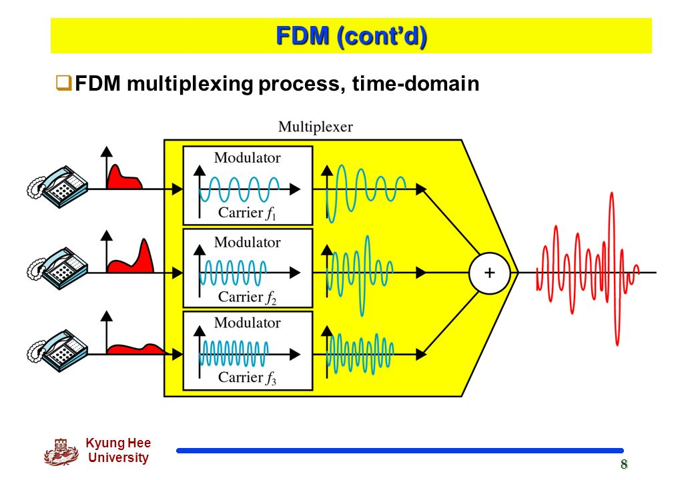
Multiplexing Process
Notes:
Figure 6.4 is a conceptual illustration of the multiplexing process. Each source generates a signal of a similar frequency range. Inside the multiplexer, these similar signals
modulates different carrier frequencies (f1,f2, and h). The resulting modulated signals are then combined into a single composite signal that is sent out over a media link that
has enough bandwidth to accommodate it.

Slide 10
Demultiplexing Process
Notes:
The demultiplexer uses a series of filters to decompose the multiplexed signal into its constituent component signals. The individual signals are then passed to a demodulator
that separates them from their carriers and passes them to the output lines. Figure 6.5 is a conceptual illustration of demultiplexing process.

Slide 11
Example
Assume that a voice channel occupies a bandwidth of 4 kHz. We need to combine three voice channels into a link with a bandwidth of 12 kHz, from 20 to 32 kHz. Show the configuration, using the frequency domain. Assume there are no guard bands.
We shift (modulate) each of the three voice channels to a different bandwidth, as shown in figure.
the first channel → we use the 20- to 24-kHz bandwidth
the second channel →we use the 24- to 28-kHz bandwidth,
the third channel →we use the 28- to 32-kHz bandwidth
Then we combine them as shown in figure.

Slide 12
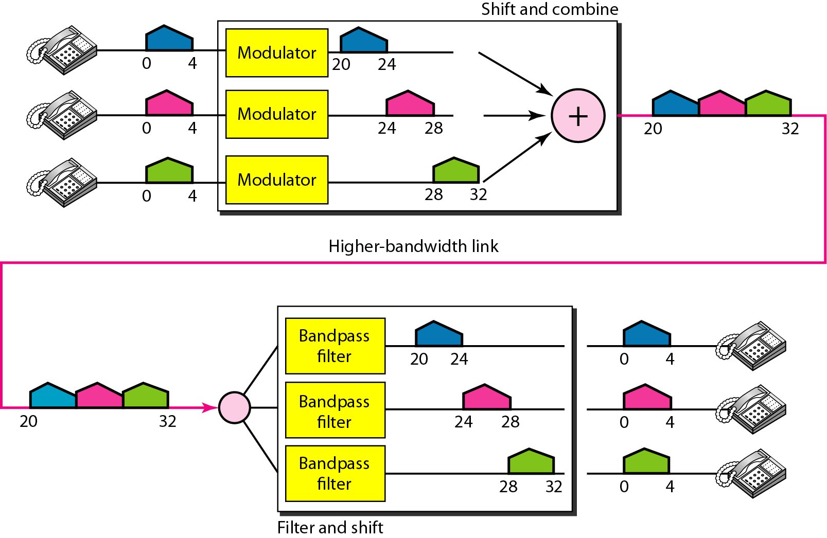

Slide 13
Example
Five channels, each with a 100-kHz bandwidth, are to be multiplexed together. What is the minimum bandwidth of the link if there is a need for a guard band of 10 kHz between the channels to prevent interference?
Solution
For five channels, we need at least four guard bands. This means that the required bandwidth is at least
5 × 100 + 4 × 10 = 540 kHz,

Slide 15
Applications of FDM
A very common application of FDM is AM and FM radio broadcasting.
A special band from 530 to 1700 kHz is assigned to AM radio. Each AM station needs 10kHz of bandwidth.
FM has a wider band of 88 to 108 MHz because each station needs a bandwidth of 200 kHz.
All radio stations need to share this band. Each station uses a different carrier frequency, which means it is shifting its signal and multiplexing.
A receiver receives all these signals, but filters (by tuning) only the one which is desired.
Notes:
A very common application of FDM is AM and FM radio broadcasting. Radio uses the
air as the transmission medium. A special band from 530 to 1700 kHz is assigned to AM
radio. All radio stations need to share this band. As discussed in Chapter 5, each AM station
needs 10kHz of bandwidth. Each station uses a different carrier frequency, which
means it is shifting its signal and multiplexing. The signal that goes to the air is a combination
of signals. A receiver receives all these signals, but filters (by tuning) only the one
which is desired. Without multiplexing, only one AM station could broadcast to the common
link, the air. However, we need to know that there is physical multiplexer or demultiplexer
here. As we will see in Chapter 12 multiplexing is done at the data link layer.
The situation is similar in FM broadcasting. However, FM has a wider band of 88
to 108 MHz because each station needs a bandwidth of 200 kHz.
Another common use of FDM is in television broadcasting. Each TV channel has
its own bandwidth of 6 MHz.

Slide 16
Outline
Multiplexing
Multiplexing Techniques
Frequency-Division Multiplexing
Wavelength-Division Multiplexing
Time-Division Multiplexing
Synchronous Time-Division Multiplexing
Statistical Time-Division Multiplexing

Slide 17
Wavelength-Division Multiplexing
Wavelength-division multiplexing (WDM) is designed to use the high-data-rate capability of fiber-optic cable by allowing us to combine several lines into one instead of using a fiber-optic cable for one single line.
WDM is conceptually the same as FDM
Notes:
Wavelength-division multiplexing (WDM) is designed to use the high-data-rate
capability of fiber-optic cable. The optical fiber data rate is higher than the data rate of
metallic transmission cable. Using a fiber-optic cable for one single line wastes the
available bandwidth. Multiplexing allows us to combine several lines into one.
WDM is conceptually the same as FDM, except that the multiplexing and demultiplexing
involve optical signals transmitted through fiber-optic channels. The idea is the
same: We are combining different signals of different frequencies. The difference is
that the frequencies are very high.
Figure 6.10 gives a conceptual view of a WDM multiplexer and demultiplexer.
Very narrow bands of light from different sources are combined to make a wider band
of light. At the receiver, the signals are separated by the demultiplexer.

Slide 18
Wavelength-Division Multiplexing
Although WDM technology is very complex, the basic idea is very simple.
A new method, called dense WDM (DWDM), can multiplex a very large number of channels by spacing channels very close to one another. It achieves even greater efficiency.
Notes:
Although WDM technology is very complex, the basic idea is very simple. We want to combine multiple light sources into one single light at the multiplexer and do
the reverse at the demultiplexer. The combining and splitting of light sources are easily handled by a prism. Recall from basic physics that a prism bends a beam of light based
on the angle of incidence and the frequency. Using this technique, a multiplexer can be made to combine several input beams of light, each containing a narrow band of frequencies,
into one output beam of a wider band of frequencies. A demultiplexer can also be made to reverse the process. Figure 6.11 shows the concept.

Slide 19
Outline
Multiplexing
Multiplexing Techniques
Frequency-Division Multiplexing
Wavelength-Division Multiplexing
Time-Division Multiplexing
Synchronous Time-Division Multiplexing
Statistical Time-Division Multiplexing

Slide 20
Time-Division Multiplexing
Time-division multiplexing (TDM) is a digital process that allows several connections to share the high bandwidth of a line Instead of sharing a portion of the bandwidth as in FDM, time is shared.
TDM can divided into two different schemes: synchronous and statistical
Notes:
Each connection occupies a portion of time in the link. Figure 6.12
gives a conceptual view of TDM. Note that the same link is used as in FDM; here, however,
the link is shown sectioned by time rather than by frequency. In the figure, portions
of signals 1,2,3, and 4 occupy the link sequentially. Note that in Figure 6.12 we are concerned with only multiplexing, not switching.
This means that all the data in a message from source 1 always go to one specific destination,
be it 1, 2, 3, or 4. The delivery is fixed and unvarying, unlike switching.
We also need to remember thatTDM is, in principle, a digital multiplexing technique.
Digital data from different sources are combined into one timeshared link. However, this
does not mean that the sources cannot produce analog data; analog data can be sampled,
changed to digital data, and then multiplexed by using TDM.

Slide 21
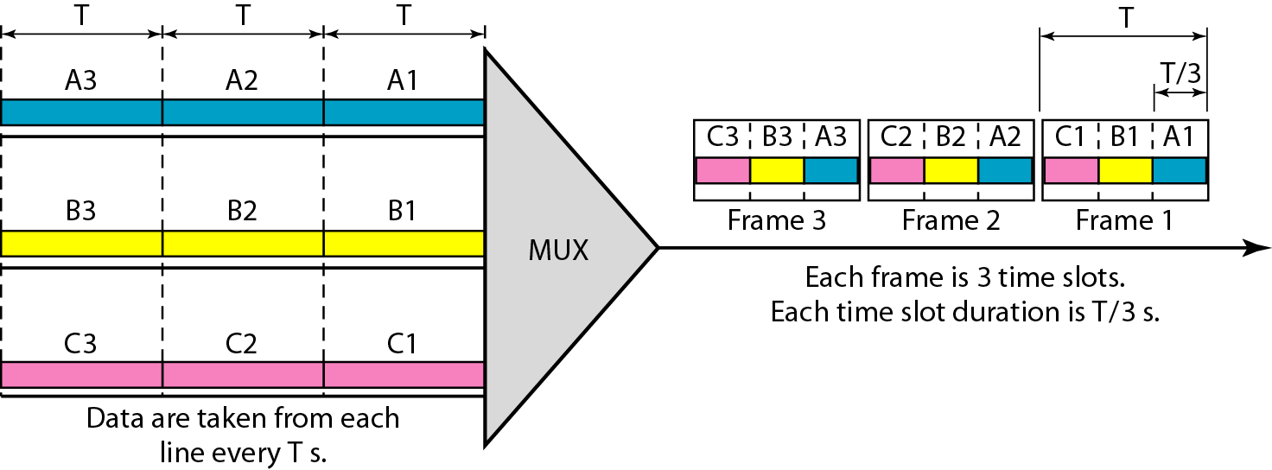
Synchronous Time-Division Multiplexing
In synchronous TDM, each input connection has an allotment in the output even if it is not sending data.

Slide 22
Time Slots and Frames
In synchronous TDM, the data flow of each input connection is divided into units.
A round of data units from each input connection is collected into a frame.
A frame consists of time slots, with one slot dedicated to each sending device.
In a system with n input lines, each frame has n slots, with each slot allocated to carrying data unit from a specific input line.
To guarantee the flow of data, the data rate of the output link must be n times the data rate of a connection.
If the duration of the input unit is T, the duration of each slot is T/n and the duration of each frame is T .
Notes:
In other words, a unit in the output connection has a shorter duration; it travels faster.
In synchronous TDM, the data rate of the link is n times faster, and the unit duration is n times shorter.

Slide 23
Example
In Figure 6.13, the data rate for each input connection is 1 kbps. If 1 bit at a time is multiplexed (a unit is 1 bit), what is the duration of (a) each input slot, (b) each output slot, and (c) each frame?
Solution
We can answer the questions as follows:
a. The data rate of each input connection is 1 kbps. This means that the bit duration is 1/1000 s or 1 ms. The duration of the input time slot is 1 ms (same as bit duration).

Slide 24
Example
b. The duration of each output time slot is one-third of the input time slot. This means that the duration of the output time slot is 1/3 ms.
c. Each frame carries three output time slots. So the duration of a frame is 3 × 1/3 ms, or 1 ms. The duration of a frame is the same as the duration of an input unit.

Slide 25
Example

Slide 27
Outline
Multiplexing
Multiplexing Techniques
Frequency-Division Multiplexing
Wavelength-Division Multiplexing
Time-Division Multiplexing
Synchronous Time-Division Multiplexing
Statistical Time-Division Multiplexing

Slide 28
Statistical Time-Division Multiplexing
In statistical time-division multiplexing, slots are dynamically allocated (when an input line has data to send, it is given a slot in the output frame.)
This improve bandwidth efficiency.
the number of slots in each frame < the number of input lines.
Notes:
As we saw in the previous section, in synchronous TDM, each input has a reserved slot
in the output frame. This can be inefficient if some input lines have no data to send. In
statistical time-division multiplexing, slots are dynamically allocated to improve bandwidth
efficiency. Only when an input line has a slot's worth of data to send is it given a
slot in the output frame. In statistical multiplexing, the number of slots in each frame is
less than the number of input lines. The multiplexer checks each input line in roundrobin
fashion; it allocates a slot for an input line if the line has data to send; otherwise,
it skips the line and checks the next line.

Slide 29
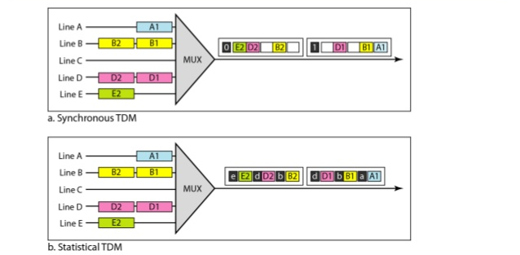
TDM Slot Comparison
Notes:
Figure 6.26 shows a synchronous and a statistical TDM example. In the former,
some slots are empty because the corresponding line does not have data to send. In
the latter, however, no slot is left empty as long as there are data to be sent by any
input line.

Slide 30
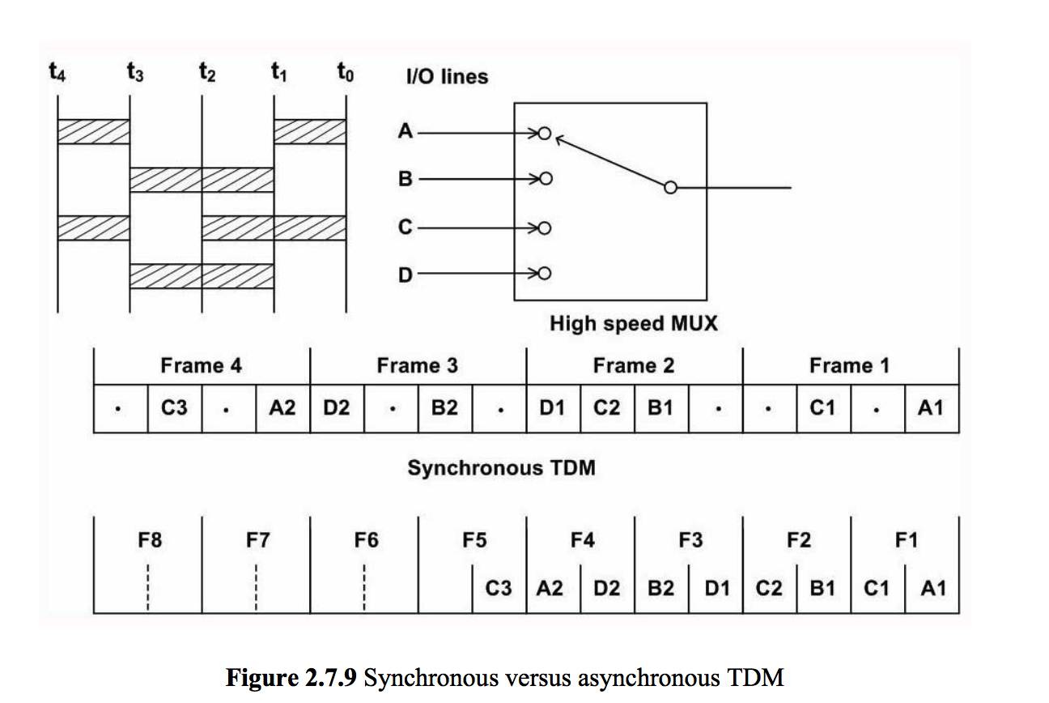

Slide 31
TDM Slot Comparison
Addressing
An output slot:
in synchronous TDM → totally occupied by data
in statistical TDM→ carry data + the address of the destination.
In synchronous TDM, there is no need for addressing because of preassigned relationships between the inputs and outputs .
In statistical multiplexing, there is no fixed relationship because there are no preassigned or reserved slots. So we need to include the address of the receiver inside each slot to show where it is to be delivered
Notes:
Figure 6.26 also shows a major difference between slots in synchronous TDM and
statistical TDM. An output slot in synchronous TDM is totally occupied by data; in
statistical TDM, a slot needs to carry data as well as the address of the destination.
In synchronous TDM, there is no need for addressing; synchronization and preassigned
relationships between the inputs and outputs serve as an address. We know, for example,
that input 1 always goes to input 2. If the multiplexer and the demultiplexer are
synchronized, this is guaranteed. In statistical multiplexing, there is no fixed relationship
between the inputs and outputs because there are no preassigned or reserved
slots. We need to include the address of the receiver inside each slot to show where it
is to be delivered. The addressing in its simplest form can be n bits to define N different
output lines with n =10g2 N. For example, for eight different output lines, we need a
3-bit address.

Slide 32
TDM Slot Comparison
Slot Size
Since in statistical TDM a slot carries both data and an address, the ratio of the data size to address size must be reasonable to make transmission efficient.
In statistical TDM, a block of data is usually many bytes while the address is just a few bytes.
No Synchronization Bit
The frames in statistical TDM need not be synchronized, so we do not need synchronization bits.
Notes:
Since a slot carries both data and an address in statistical TDM, the ratio of the data size
to address size must be reasonable to make transmission efficient. For example, it
would be inefficient to send 1 bit per slot as data when the address is 3 bits. This would
mean an overhead of 300 percent. In statistical TDM, a block of data is usually many
bytes while the address is just a few bytes.
There is another difference between synchronous and statistical TDM, but this time it is
at the frame level. The frames in statistical TDM need not be synchronized, so we do not
need synchronization bits.

Slide 33
Any Questions ?

