Slide 1
Data Transmission And Digital Communication
Lecture 1– 2019/1440
By: Elham Sunbu

Slide 2
OUTLINE
Matlab introduction
Why Matlab
Matlab Software install and interface

Slide 3
Layered Tasks
We use the concept of layers in our daily life. As an example, let us consider two friends who communicate through postal mail. The process of sending a letter to a friend would be complex if there were no services available from the post office.

Slide 4
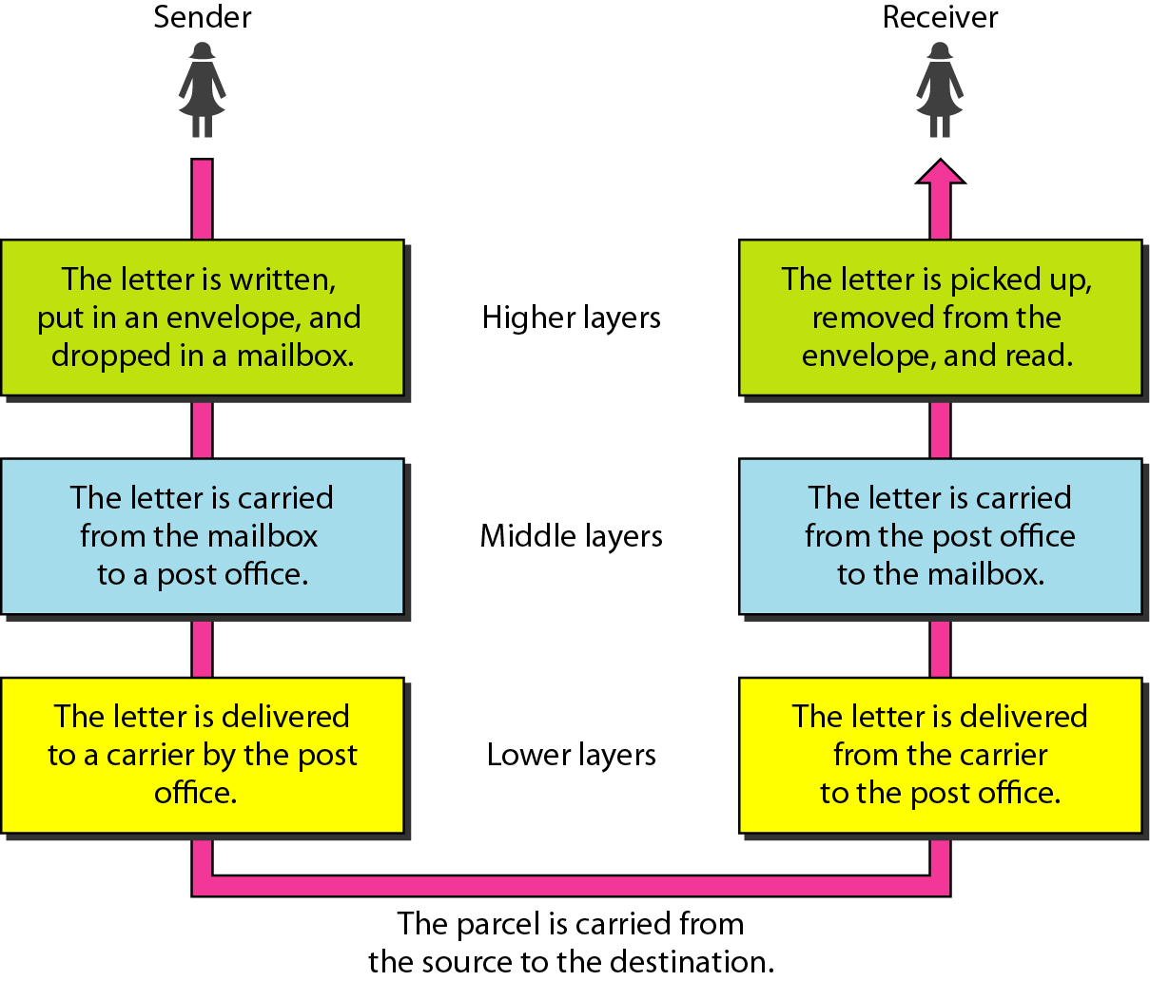
Figure: Tasks involved in sending a letter

Slide 5
Note:
THE OSI MODEL
Established in 1947, the International Standards Organization (ISO) is a multinational body dedicated to worldwide agreement on international standards. An ISO standard that covers all aspects of network communications is the Open Systems Interconnection (OSI) model. It was first introduced in the late 1970s.
ISO is the organization.
OSI is the model.

Slide 6
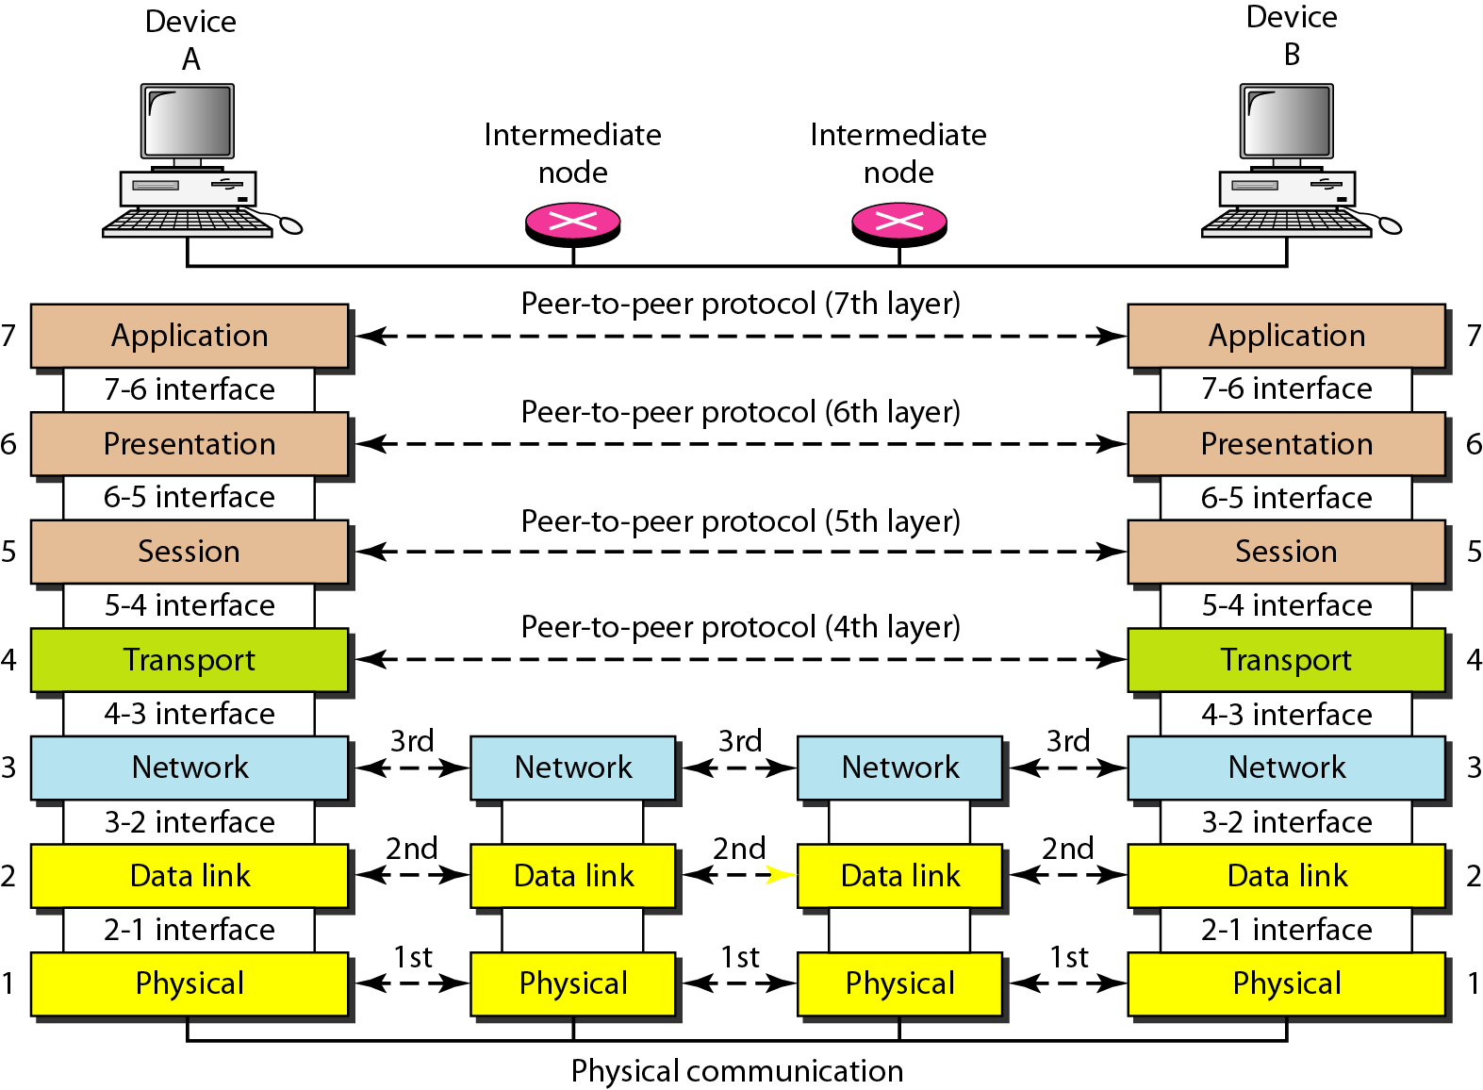
Figure: The interaction between layers in the OSI model

Slide 7
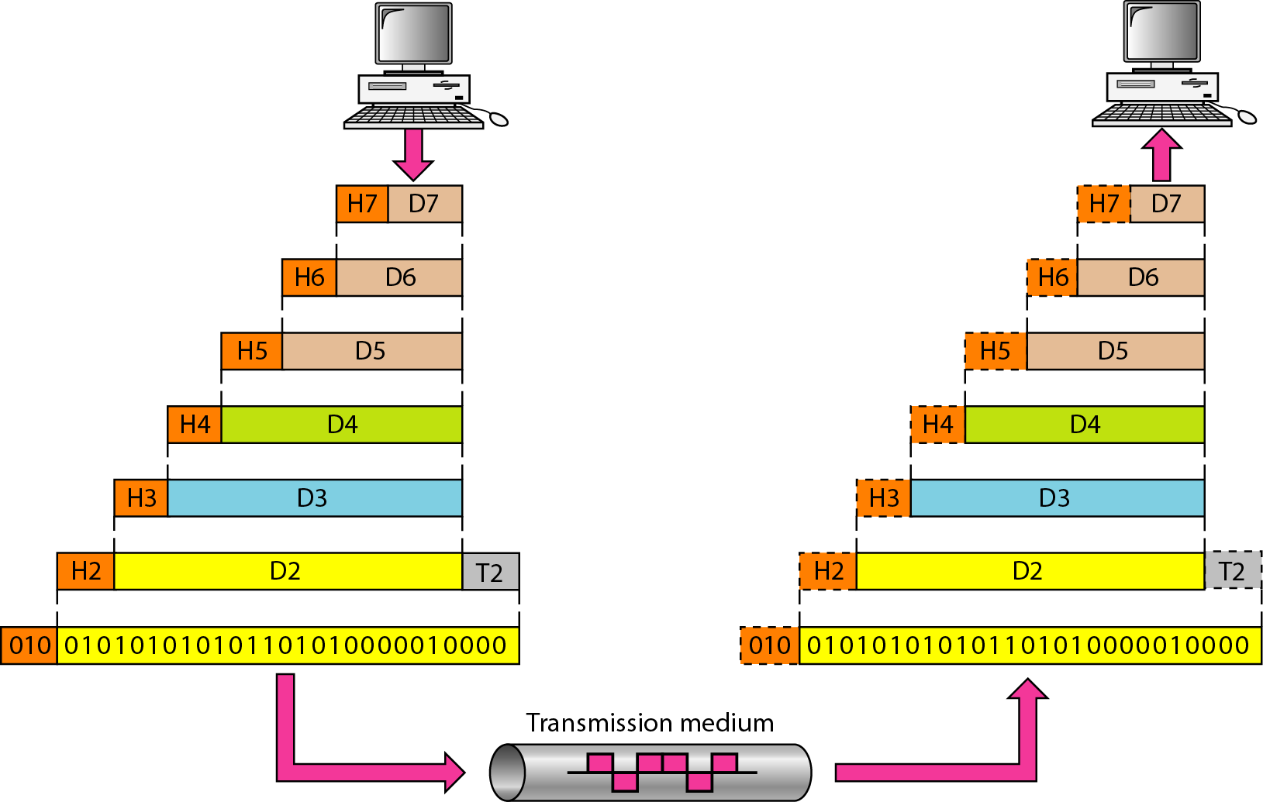
Figure: An exchange using the OSI model

Slide 8
LAYERS IN THE OSI MODEL
In this section, we briefly describe the functions of each layer in the OSI model.
Physical Layer
Data Link Layer
Network Layer
Transport Layer
Session Layer
Presentation Layer
Application Layer

Slide 9
Physical Datalink Network Transport Session Presentation Application
7-LAYER MODEL OF OSI
Application Layer
  set of utilities used by application programs
Presentation Layer
  formats data for presentation to the user
  provides data interfaces, data compression and translation between different data formats
Session Layer
  initiates, maintains and terminates each logical session between sender and receiver

Slide 10
Physical Datalink Network Transport Session Presentation Application
7-LAYER MODEL OF OSI
Transport Layer
  deals with end-to-end issues such as segmenting the message for network transport, and maintaining the logical connections between sender and receiver
Network Layer
  responsible for making routing decisions
Data Link Layer
  deals with message delineation, error control and network medium access control
Physical Layer
  defines how individual bits are formatted to be transmitted through the network

Slide 11
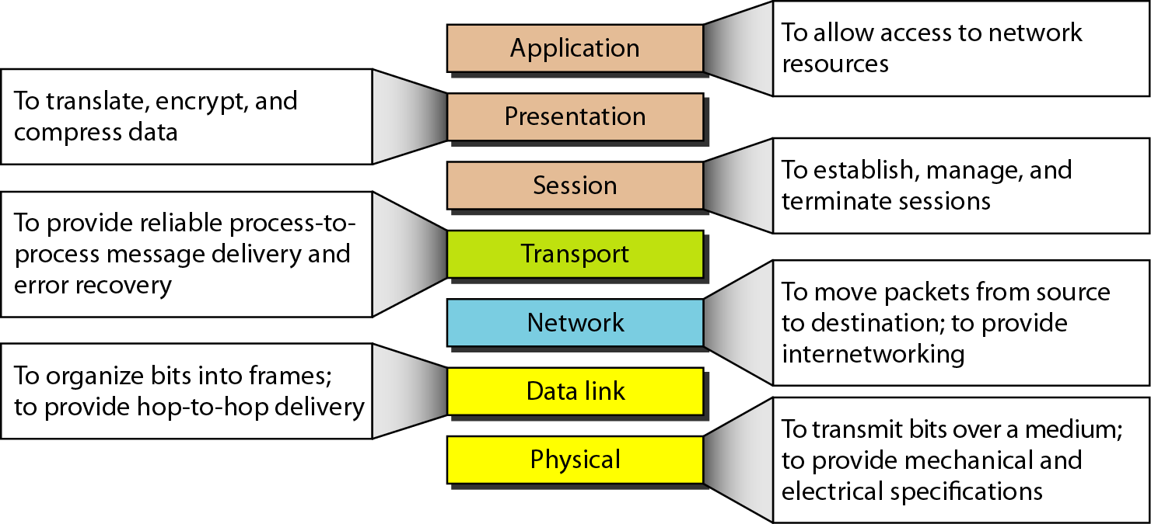
Figure: Summary of layers

Slide 12
Physical Datalink Network Transport Application
INTERNET’S 5-LAYER MODEL
Application Layer
  used by application program
Transport Layer
  responsible for establishing end-to-end connections, translates domain names into numeric addresses and segments messages
Network Layer - same as in OSI model
Data Link Layer - same as in OSI model
Physical Layer - same as in OSI model
1 -
12

Slide 13
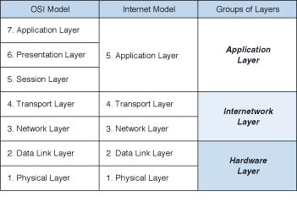
COMPARISON OF NETWORK MODELS
1 -
13

Slide 14
MESSAGE TRANSMISSION USING LAYERS
sender receiver
Applications A
pplications
A receiving layer wraps incoming message with an envelope
Adds layer related addressing
A receiving layer removes the layer related envelope and
information
forwards the
message up
1 -
14

Slide 15
DATA VERSUS SIGNAL
Data | Signals
Convey meaning within a computer (stored in files). | Electric or electromagnetic encoding of data.
Need to be converted into a signal before transfer. | Networks and communication systems transmit signals.
can be analog ( information can be audio or video) or digital (binary)
 | Issues related to the transmission of signals: Impairments (also transmission flaws) Capacity of the media

Slide 16
A COMMUNICATIONS MODEL
Source
  generates data to be transmitted
Transmitter
  Converts data into transmittable signals
Transmission System
  Carries data
Receiver
  Converts received signal into data
Destination
  Takes incoming data

Slide 17
COMMUNICATIONS TASKS
Transmission system utilization | Addressing
Interfacing | Routing
Signal generation | Recovery
Synchronization | Message formatting
Exchange management | Security
Error detection and correction | Network management
Flow control

Slide 18
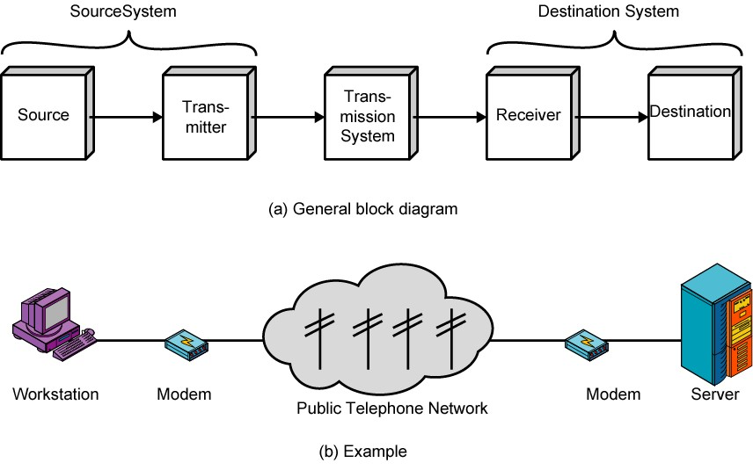
SIMPLIFIED COMMUNICATIONS MODEL - DIAGRAM

Slide 19
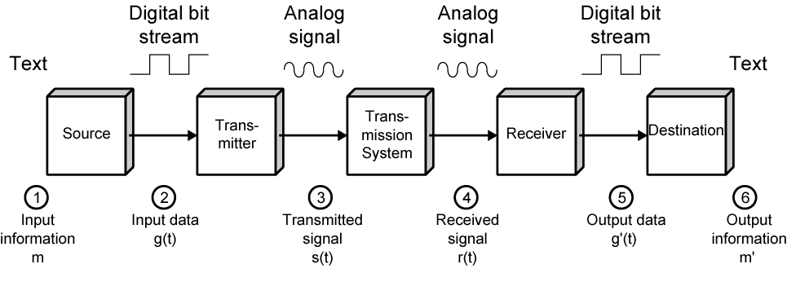
SIMPLIFIED DATA COMMUNICATIONS MODEL

Slide 20
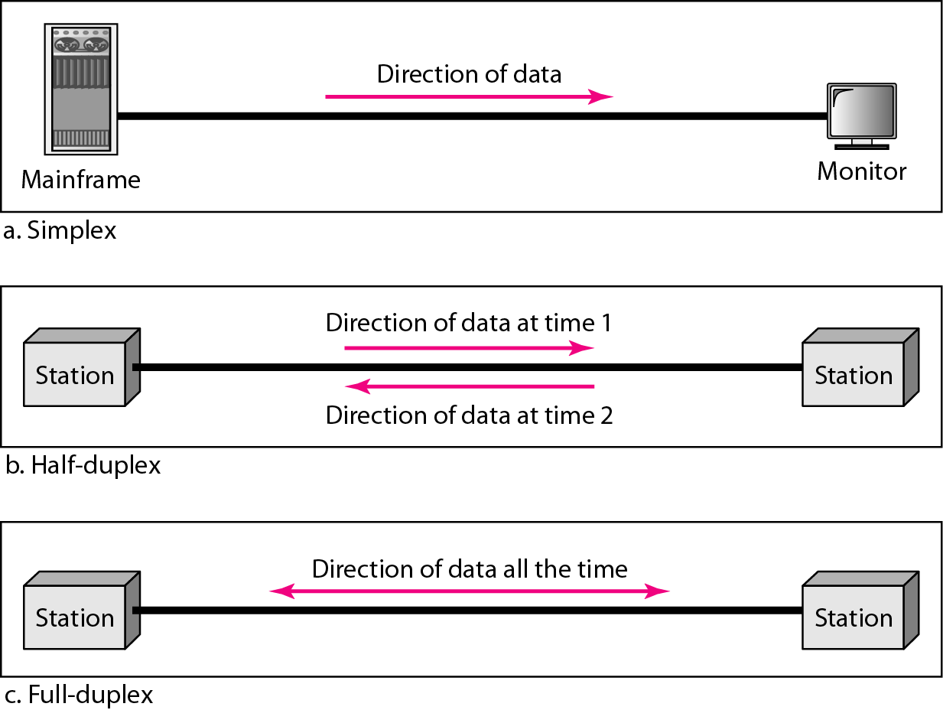
Figure: Data flow (simplex, half-duplex, and full-duplex)

Slide 21
Analog vs. Digital
Analog signals
  Value varies continuously
x(t)
t
Digital signals
  Value limited to a finite set
x(t)
t
Binary signals
  Has at most 2 values
  Used to represent bit values
  Bit time T needed to send 1 bit
  Data rate R=1/T bits per second
x(t)
1
1
1
0 0 0
0
T
_{t}

Slide 22
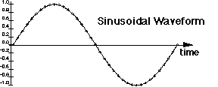
Frequency, Spectrum and Bandwidth
Time domain (examining the signal over time):
  Continuous signal - signal with no breaks or discontinuities
  Discrete signal - signal with a finite number of values
  Amplitude - the instantaneous value of a signal (Volt)
  Frequency - inverse of the period in cycles per second, Hertz
  Phase - measure of relative position in time within a single period (degree or radian)

Slide 23


Frequency, Spectrum and Bandwidth
Audio signal
Digital signal
Frequency Domain (signal viewed as a function of frequency):
  any signal is made up of components at various frequencies, each sinusoid
Spectrum- the range of frequencies in a signal
Absolute bandwidth - is the width of the spectrum (fn - f1) where, fn is largest frequency in signal and f1 is the smallest

Slide 24
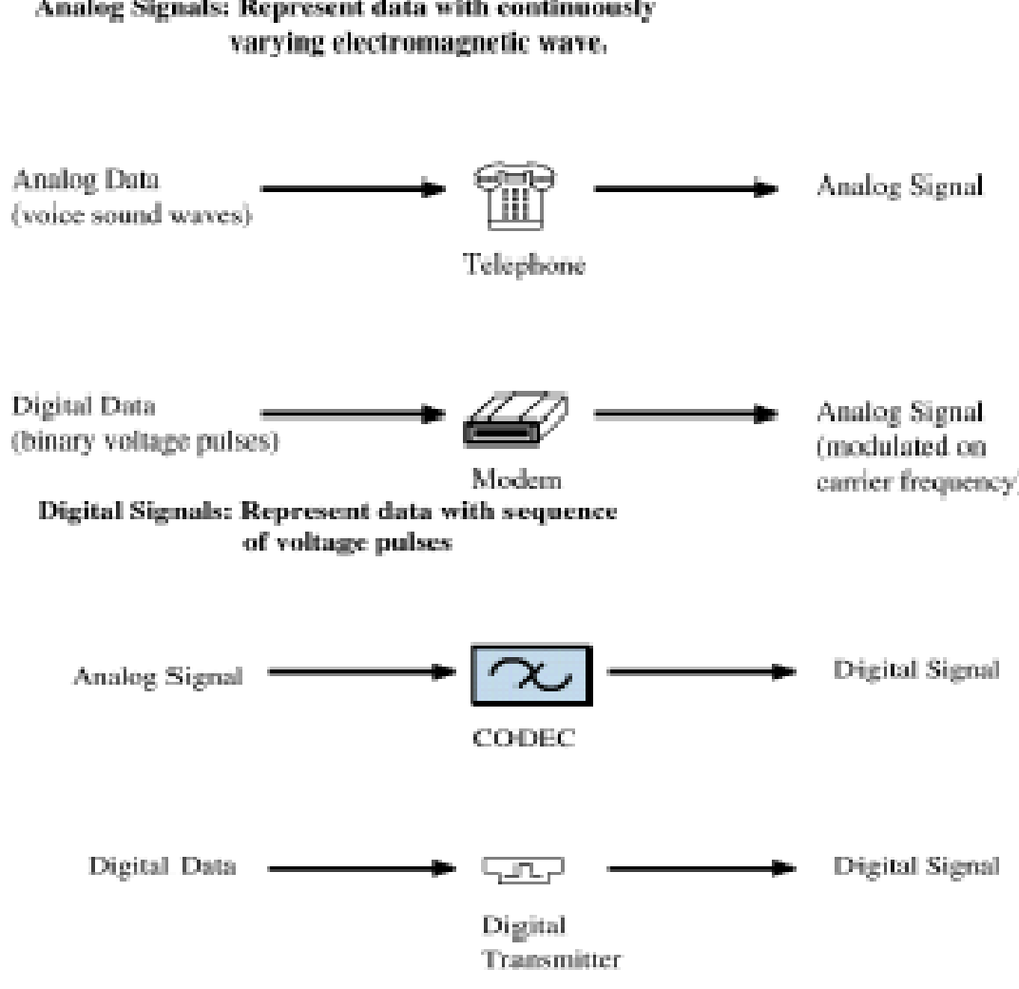
Modulation and Encoding schemes
Modulation:
Encoding:

Slide 25
Conversion
Encoding | Modulation
Digital data to digital signal : less complex and less expensive equipment than analog modulation equipment. | Digital data to analog signal : Some transmission media can propagate analog signals only. Example: fiber , wire.
Analog data to digital signal : To use the modern digital transmission and switching equipment. Transmit baseband signal over wire transmission (Microwave) => Low frequency baseband means few kilometer antenna !!! shift baseband signals of several voice channel (FDM).

Slide 26
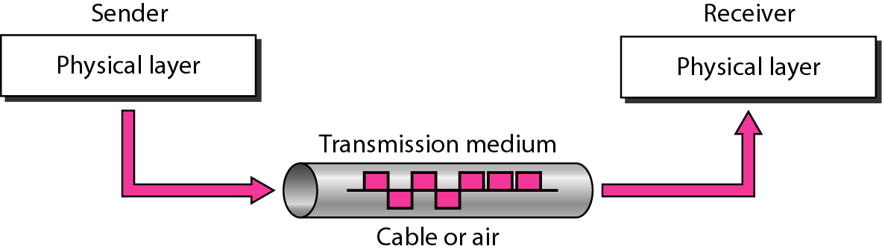
Figure: Transmission medium and physical layer

Slide 27
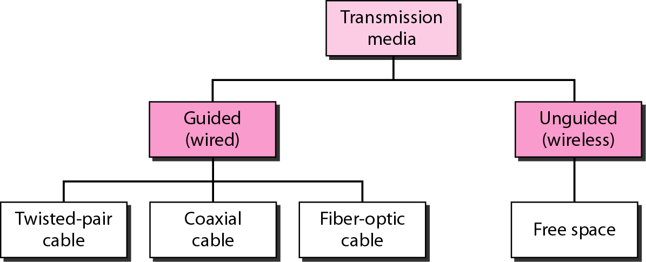
Figure: Classes of transmission media

Slide 28
GUIDED MEDIA
Guided media, which are those that provide a conduit from one device to another, include twisted-pair cable, coaxial cable, and fiber-optic cable.
Topics discussed in this section:
  Twisted-Pair Cable
  Coaxial Cable
  Fiber-Optic Cable

Slide 29
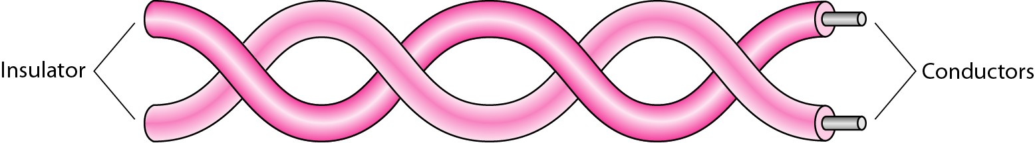
Figure: Twisted-pair cable

Slide 30
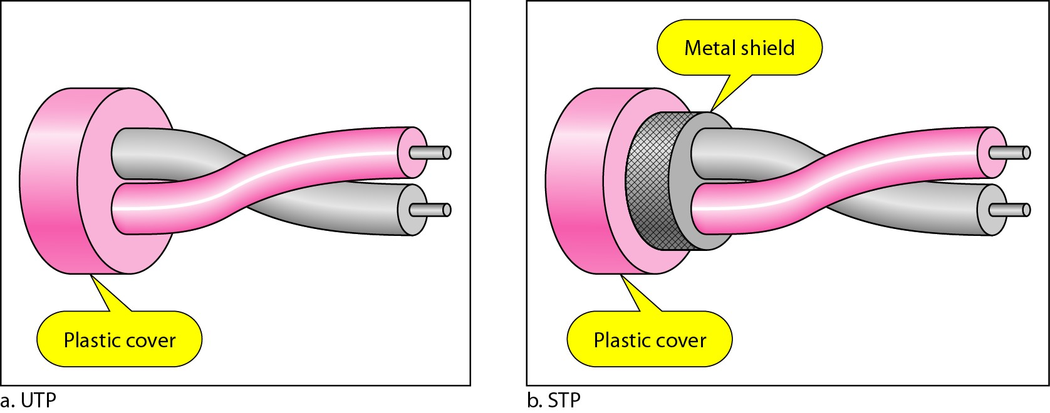
Figure :UTP and STP cables

Slide 31
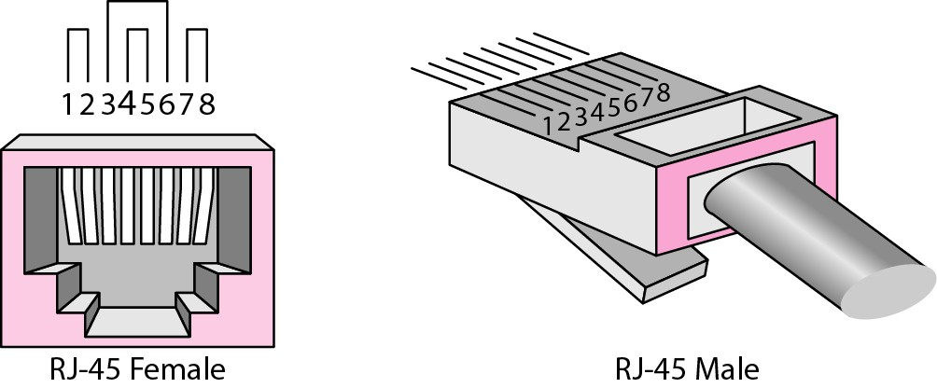
Figure :UTP connector

Slide 32
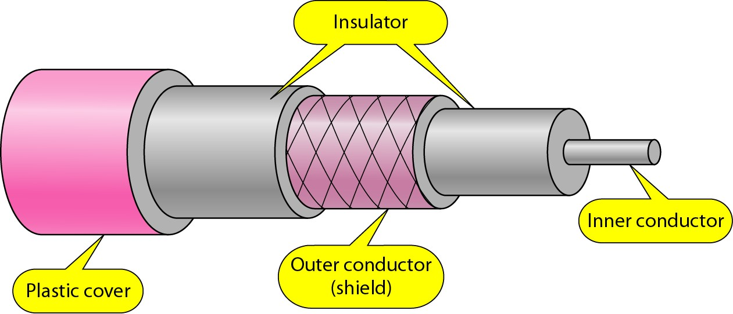
Figure : Coaxial cable

Slide 33
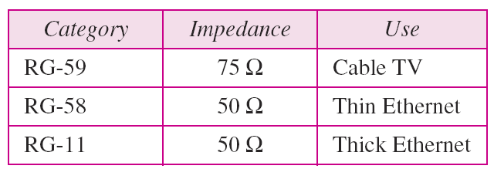
Categories of coaxial cables

Slide 34
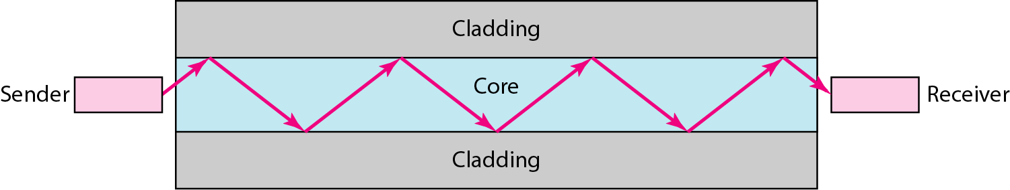
Figure: Optical fiber

Slide 35
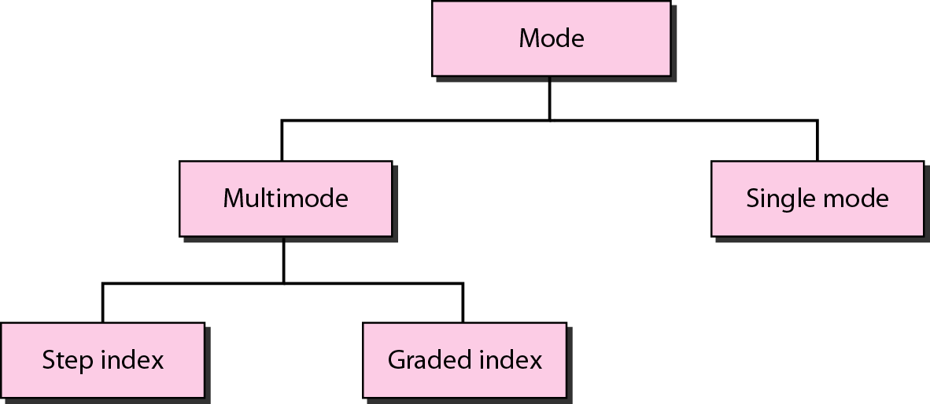
Figure Propagation modes

Slide 36
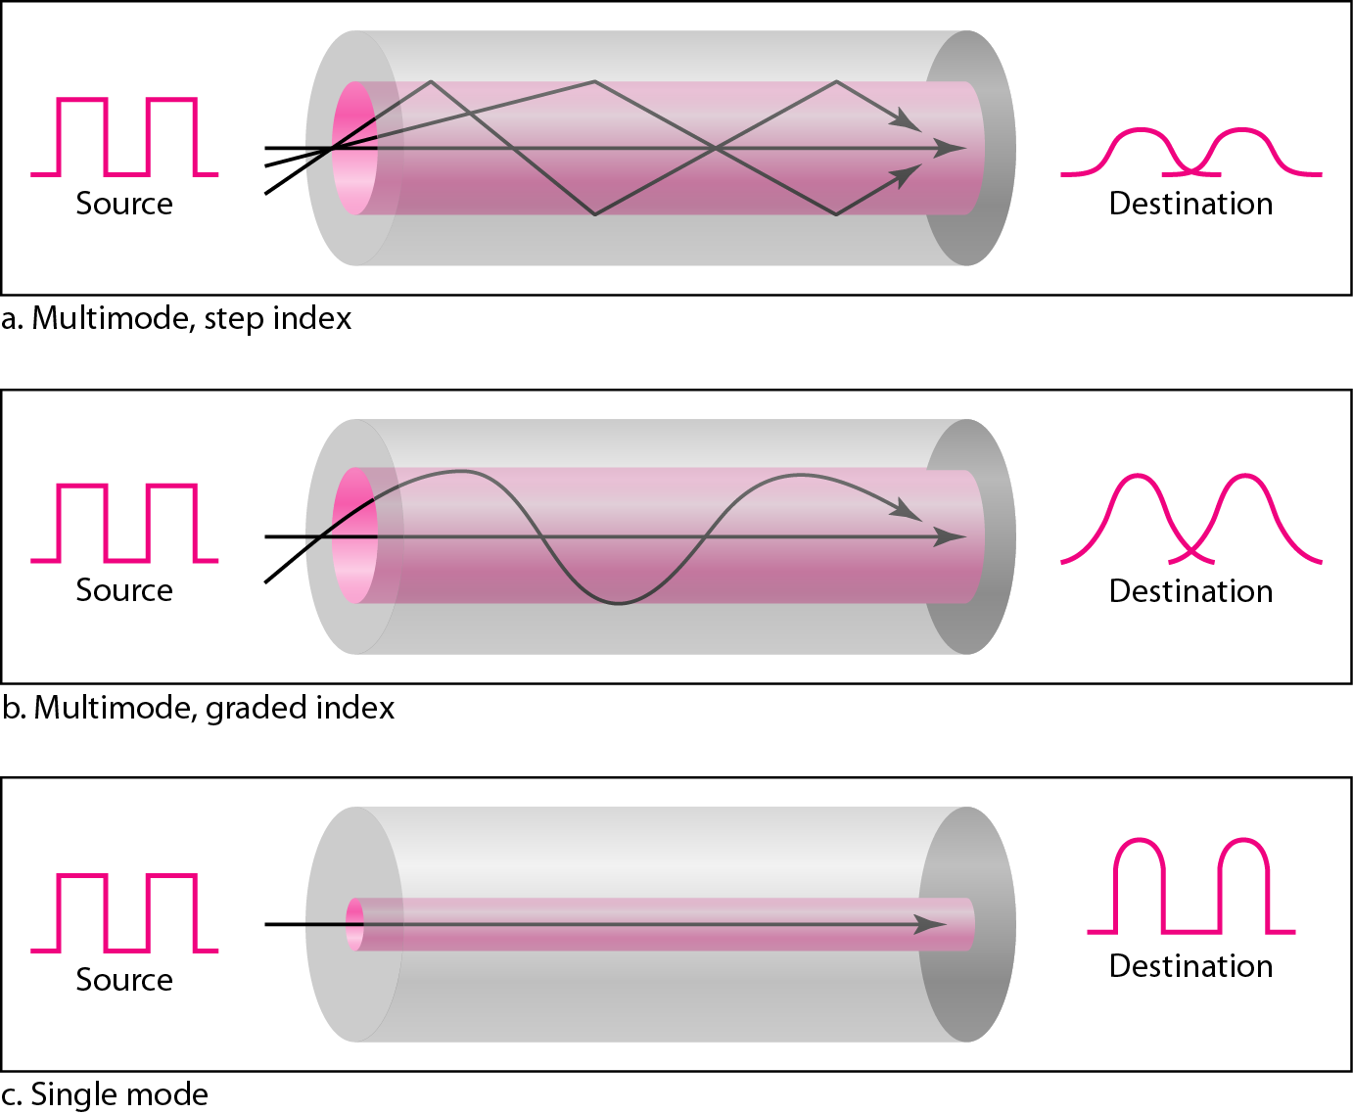
Figure : Modes

Slide 37
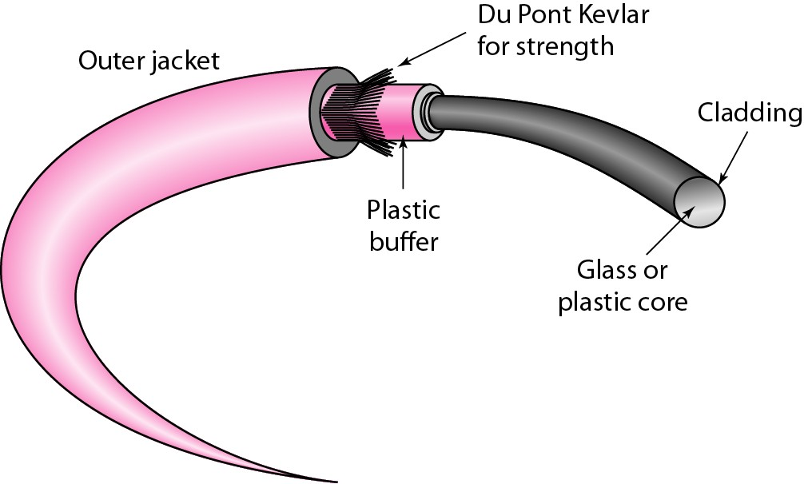
Figure: Fiber construction

Slide 38
UNGUIDED MEDIA: WIRELESS
Unguided media transport electromagnetic waves without using a physical conductor.
This type of communication is often referred to as wireless communication.

Slide 39
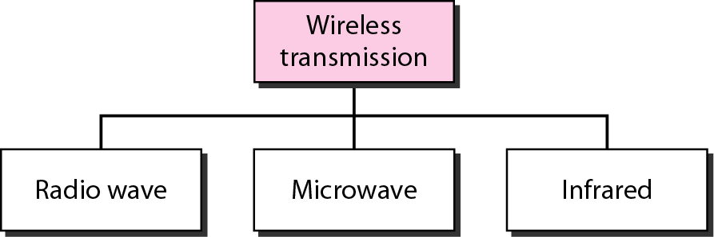
Figure :Wireless transmission waves

Slide 40
Thank You

