Slide 1
Lecture 5
Frequency Shift Keying (FSK)
1st semester 1440 - 2018

Slide 2
Outline
FSK (Frequency Shift Keying)
FSK Modulator.
ASK and FSK

Slide 3
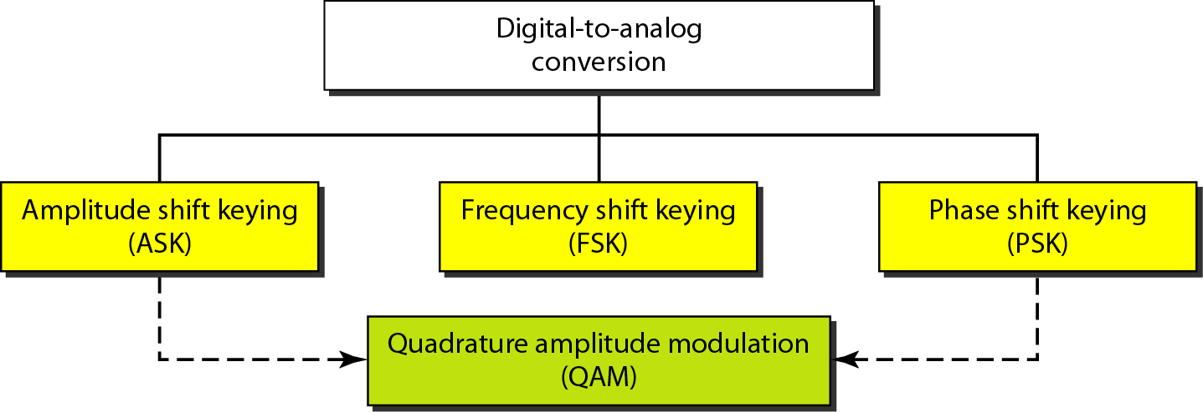
Types of Digital-to-Analog Conversion

Slide 4
FSK (Frequency Shift Keying)
The frequency of the carrier signal is varied to represent binary 1 or 0.
Both peak amplitude and phase remain constant while the frequency changes.
The frequency of the signal during each bit duration is constant, and its value depends on the bit (0 or 1).

Slide 5
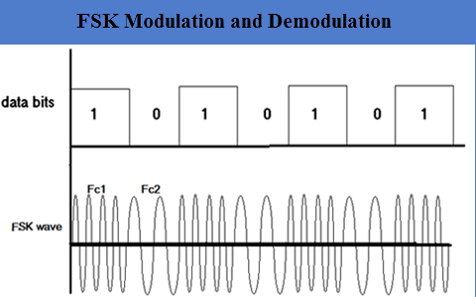
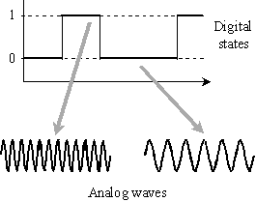
FSK Modulator
- One way to think about binary FSK (or BFSK) is to consider two carrier frequencies
Switch between two oscillators accordingly

Slide 6
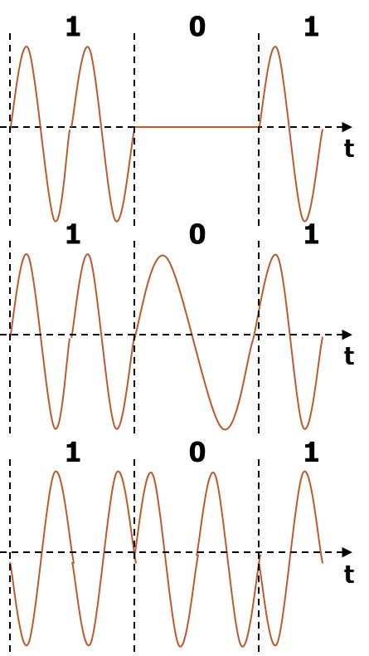
ASK and FSK
Amplitude Shift Keying (ASK) | Frequency Shift Keying (FSK)
Very simple. | Needs larger bandwidth.
Low bandwidth requirements. | More error resilience than AM.
Very susceptible to interference

Slide 7
Any Question?

