Slide 1
Lecture 7:
Noise to ASK, FSK and PSK
1st semester 1440 - 2018

Slide 2
Outline
- Several types of noise.
- Additive white Gaussian noise (AWGN).
- Signal to noise ratio (SNR).

Slide 3
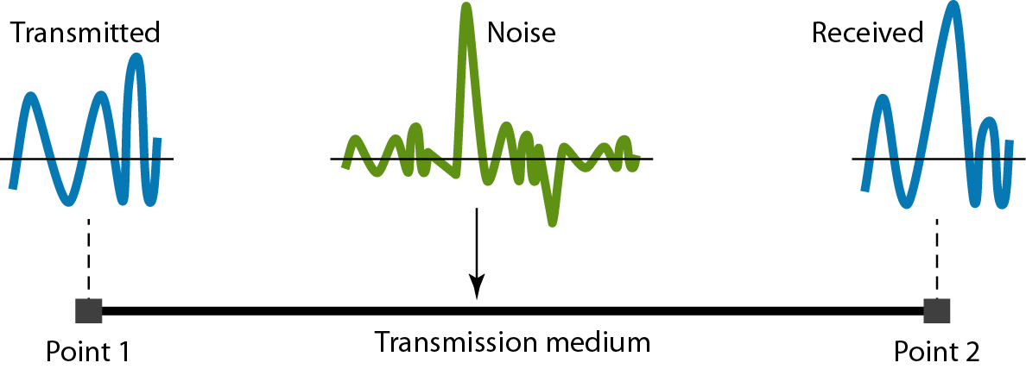
Noise
As signal is transmitted through a channel, undesired signal in the form of noise gets mixed up with the signal, along with the distortion introduced by the transmission media.
Noise is any unwanted energy tending to interfere with the signal to be transmitted.

Slide 4
Noise
The noise either be:
External Noise:
This is noise originating from outside the communication system.
Internal Noise: This is noise originating from within the communication system.

Slide 5
Some Examples of Noise
Thermal Noise: This noise is due to the random and rapid movement of electrons in any resistive component. Electrons “bump” with each other.
Impulse noise:
is irregular pulses or noise spikes of short duration

Slide 6
Some Examples of Noise
Cross talk is a result of bunching several conductors together in a single cable. Signal carrying wires generate electromagnetic radiation, which is induced on other conductors because of close proximity of the conductors.

Slide 7
Signal-to-Noise Ratio
In the study of noise, it is not important to know the absolute value of noise.
Even if the power of the noise is very small, it may have a significant effect if the power of the signal is also small.
What is important is a comparison between noise and the signal.
The signal-to-noise ratio (SNR) is the ratio of signal power to noise power.

Slide 8
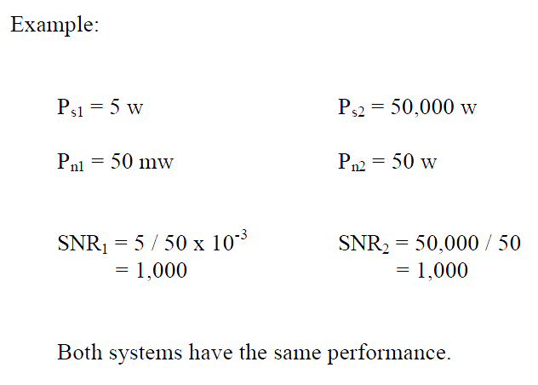
Signal-to-Noise Ratio
SNR = P_{s} / P_{n}

Slide 9
Signal-to-Noise Ratio
Ideally, SNR = ∞ (when P_{n} = 0). In practice, SNR should be high as possible.
A high SNR ratio means a good-quality signal.
A low SNR ratio means a low-quality signal.
The SNR is normally expressed in decibels, that is:
SNR = 10 log₁₀ (P_{s} / P_{n}) dB

Slide 10
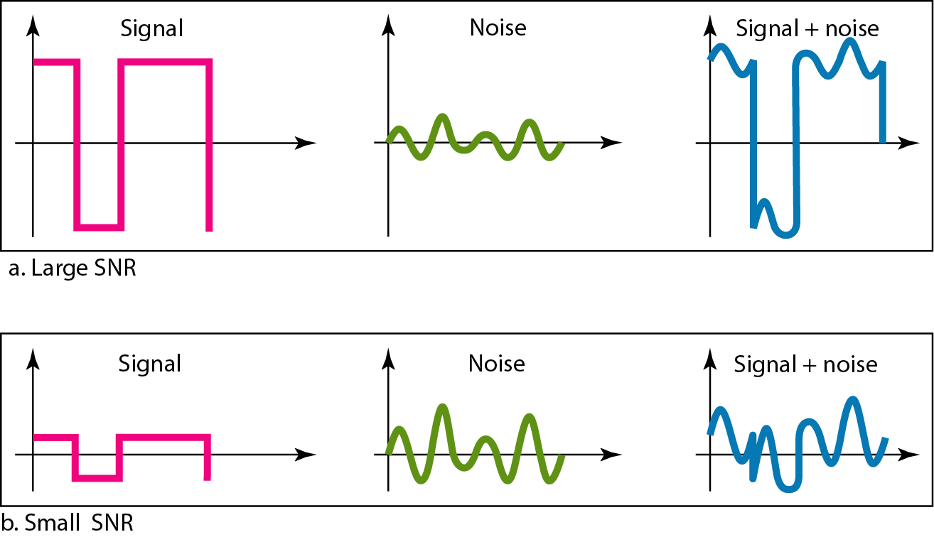
Figure 3.30 Two cases of SNR: a high SNR and a low SNR

Slide 11
Example
The power of a signal is 10 mW and the power of the noise is 1 μW; what are the values of SNR and SNR_{dB}
SNR = 10 × 10⁻³ / 10⁻⁶ = 10,000
SNR_{dB} = 10 log₁₀ (10 × 10⁻³ / 10⁻⁶)
= 10 log₁₀ (10,000) = 40 dB

Slide 12
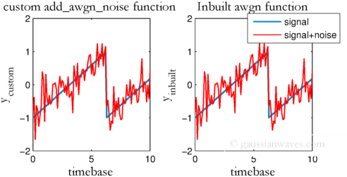
Additive White Gaussian Noise (AWGN)
- Additive white Gaussian noise (AWGN):
Is a basic noise model used in Information theory to mimic the effect of many random processes that occur in nature.

Slide 13
Any Question?

