Slide 1
Manufacturing Engineering Technology in SI Units, 6th Edition
Chapter 27:
Advanced Machining Processes
Copyright © 2010 Pearson Education South Asia Pte Ltd
Notes:
Presentation slide for courses, classes, lectures et al.

Slide 2
Chapter Outline
Copyright © 2010 Pearson Education South Asia Pte Ltd
Introduction
Chemical Machining
Electrochemical Machining
Electrical-discharge Machining
Laser-beam Machining
Electron-beam Machining
Water-jet Machining
Ultrasonic machining

Slide 3
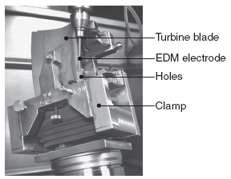
Introduction
Why Advanced (non-conventional) machining processes are required
Machining processes involve material removal by mechanical means ⇒ chip formation, abrasion, or microchipping
Situations where mechanical methods are not satisfactory, economical or possible:
Very high strength and hardness
Material is too brittle
Workpiece is too flexible
Workpiece is too thin
Shape of the part is complex
Surface finish and dimensional
tolerance requirements
Temperature rise during processing

Slide 4

Introduction

Slide 5
Chemical Machining
  Chemical machining(CHM) is developed based on the observation that chemicals attack metals and etch them by using chemical solutions.
CHM is the removal of metal by chemical attack by a corrosive liquid.
The area affected by the chemical reagent is controlled by masking or by partial immersion
The areas of the workpiece which are not to be machined are masked.
The workpiece is either immersed in or exposed to a spray of chemical reagent.
CHM was basically developed for aerospace industry to maintain strength of part at reduced weight.
Notes:
Wikipedia: Etching is traditionally the process of using strong acid … to cut into the unprotected parts of a metal surface to create a design in intaglio (incised) in the metal (نمش بالأسيد)

Slide 6
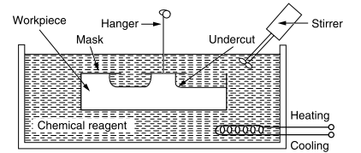
Principle of Chemical Machining
Strong acid or alkaline solution is used to dissolve materials selectively.
An etchant resistant mask, made typically of rubber or plastic is used to protect those regions of the component from which no material is to be removed.
Schematic of chemical machining process

Slide 7
Steps in chemical machining
The four steps in chemical machining are as follows:
Cleaning. The first step is a cleaning operation to ensure that material will be removed uniformly from the surfaces to be etched.
Masking. A protective coating called a maskant is applied to certain portions of the part surface. This maskant is made of a material that is chemically resistant to the etchant (the term resist is used for this masking material). It is therefore applied to those portions of the work surface that are not to be etched.
Etching. This is the material removal step. The part is immersed in an etchant that chemically attacks those portions of the part surface that are not masked. The usual method of attack is to convert the work material (e.g. a metal) into a salt that dissolves in the etchant and is thereby removed from the surface. When the desired amount of material has been removed, the part is withdrawn from the etchant and washed to stop the process.
Demasking. The maskant is removed from the part
Notes:
Groover

Slide 8
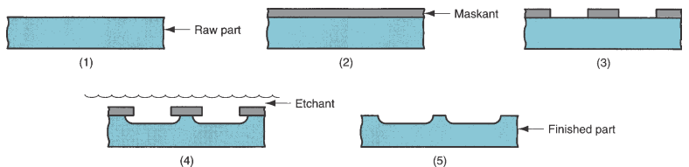
Steps in chemical machining
Notes:
Groover

Slide 9
Steps in chemical machining
The Cleaning and Demasking are common steps in all kinds of CHM processes.
However, significant variations are involved in Masking and Etching steps.

Slide 10
Chemical Machining
Chemical Milling
Copyright © 2010 Pearson Education South Asia Pte Ltd

Slide 11
Types of masks used in CHM
Masking can be accomplished by the following methods
Cut and peel masks.
Photo resist masks.
Screen resist masks.

Slide 12
1. Cut and peel masks
The maskant is applied over the entire part by dipping, painting, or spraying (resulting thickness of the maskant is 0.025 to 0.125 mm)
After the maskant has hardened, it is cut using a scribing knife and peeled away in the areas of the work surface that are to be etched.
The maskant cutting operation is performed by hand, usually guiding the knife with a template.
The cut and peel method is generally used for
  large workpieces,
  low production quantities,
  and where accuracy is not a critical factor.
This method cannot hold tolerances tighter than 0.125 mm except with extreme care.
Notes:
Groover

Slide 13
2. Photographic resist masks
https://www.youtube.com/watch?v=NDp3OPI6dgo
As the name suggests, the photographic resist method (called the photoresist method for short) uses photographic techniques to perform the masking step.
The masking materials contain photosensitive chemicals. They are applied to the work surface and exposed to light through a negative image of the desired areas to be etched.
These areas of the maskant can then be removed from the surface using photographic developing techniques.
This procedure leaves the desired surfaces of the part protected by the maskant and the remaining areas unprotected, vulnerable to chemical etching.
Photoresist masking techniques are normally applied where small parts are produced in high quantities, and close tolerances are required.
Tolerances closer than ±0.0125 mm can be held.
Notes:
Groover

Slide 14
3. Screen resist masks
The screen resist method applies the maskant by means of screening methods.
In these methods, the maskant is painted onto the workpart surface through a silk or stainless steel mesh.
Embedded in the mesh is a stencil that protects those areas to be etched from being painted.
The maskant is thus painted onto the work areas that are not to be etched through the screen.
The screen resist method is generally used in applications that are between the other two masking methods in terms of accuracy, part size, and production quantities.
Tolerances of ±0.075 mm can be achieved with this masking method.
Notes:
Stencil: m-w.com: an impervious material (such as a sheet of paper, thin wax, or woven fabric) perforated with lettering or a design through which a substance (such as ink, paint, or metallic powder) is forced onto a surface to be printed (روسم)

Slide 15
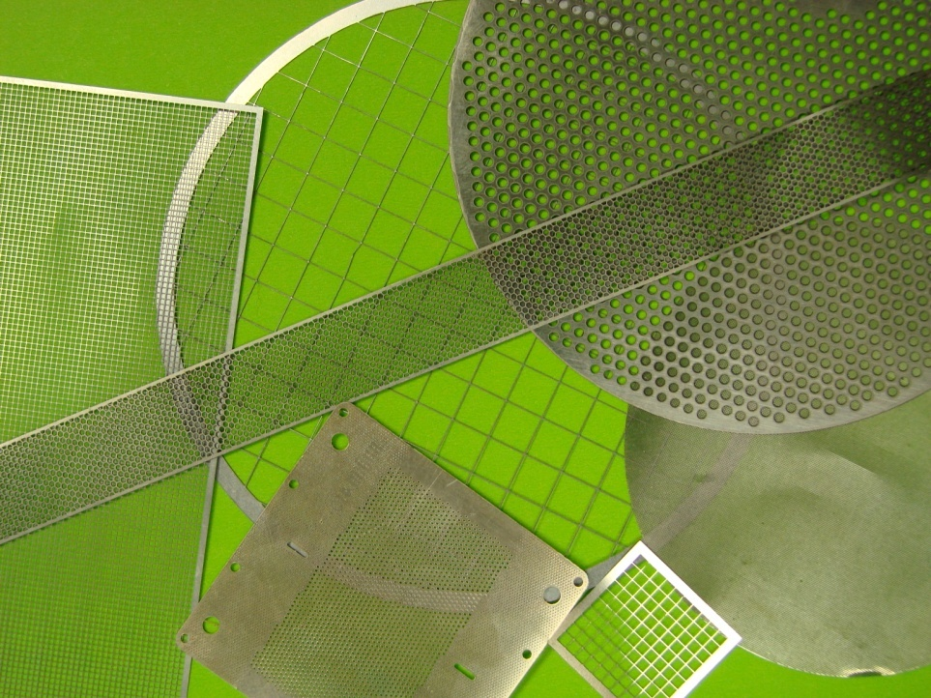
Samples Screens
Mesh/screens
Notes:
www.shimifrez.com

Slide 16

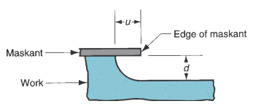
Undercut
Along with the penetration into the work, etching also occurs sideways under the maskant; this effect is referred to as the undercut.
Undercuts may be developed because etchant attacks both in horizontal and vertical direction.
It must be accounted for in the design of the mask for the resulting cut to have the specified dimensions. For a given work material, the undercut is directly related to the depth of cut. The constant of proportionality for the material is called the etch factor, defined as
where $Fe$ = etch factor; $d$ = depth of cut; and $u$ = undercut
Notes:
Groover

Slide 17
Design considerations for Chemical machining
Designs involving sharp corners, deep & narrow cavities, or porous workpiece should be avoided due to undercuts.
Dimensional variations can occur, this can be minimized by proper controlling of the environment.

Slide 18
Chemical machining processes types
Chemical milling
Chemical blanking
Chemical engraving
Photochemical machining

Slide 19
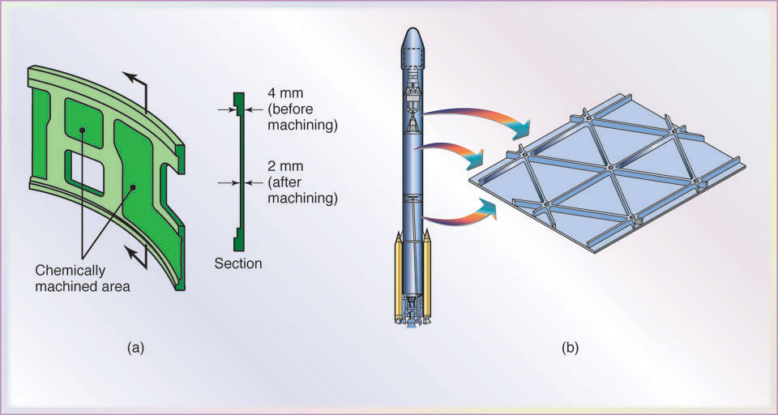
Chemical milling
Chemical milling is still used largely in the aircraft industry, to remove material from aircraft wing and fuselage panels for weight reduction.
It is applicable to large parts where substantial amounts of metal are removed during the process.
The cut and peel maskant method is employed. A template is generally used that takes into account the undercut that will result during etching.
Chemical milling produces a surface finish that varies with different work materials.
As depth increases, finish becomes worse
Notes:
Fuselage: هيكل الطائرة

Slide 20
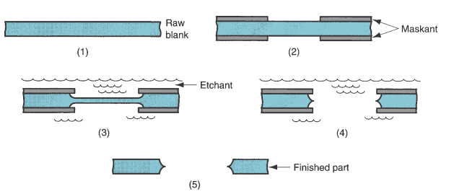
Chemical blanking
Chemical blanking is used to etch entirely through a metal part. Applied for thickness down to 0.025 mm thick and/or for intricate cutting patterns.
Conventional punch-and-die methods do not work because the stamping forces damage the sheet metal, or the tooling cost would be prohibitive, or both.
Also, hardened materials can be processed by chemical blanking where mechanical methods would surely fracture the work.
In chemical blanking, holes and slots that penetrate entirely through the material are produced, usually in thin sheet materials.
Very cheap and efficient.

Slide 21
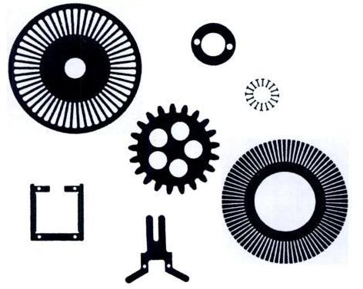
Parts profiled by chemical blanking process
Chemical blanking

Slide 22
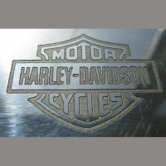
Chemical Engraving
Chemical Engraving is the practice of carving a design on to a hard, usually flat surface, by cutting grooves into it.
The result may be a decorated object in itself, as when silver, gold, steel are engraved, or may provide a printing plate, of copper or another metal, for printing images on paper as prints or illustrations; these images.
Notes:
http://4grain.cz/data/images/stranky/normal/14.jpg

Slide 23
Photo Chemical Machining
Photochemical machining (PCM) is chemical machining in which the photoresist method of masking is used.
Photochemical machining (PCM) is also known as photochemical milling or photo etching.
The term can, therefore, be applied correctly to chemical blanking and chemical engraving when these methods use the photographic resist method.
It involves fabricating sheet metal components using photo resist masks and etchants to corrosively machine away selected areas.
PCM can be used on virtually any commercially available metal or alloy, of any hardness. Metals include aluminium, brass, copper, inconel, nickel, silver, steel, stainless steel, zinc and titanium.

Slide 24
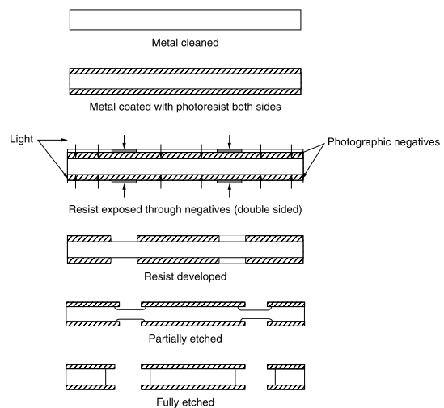
Photo Chemical Machining

Slide 25
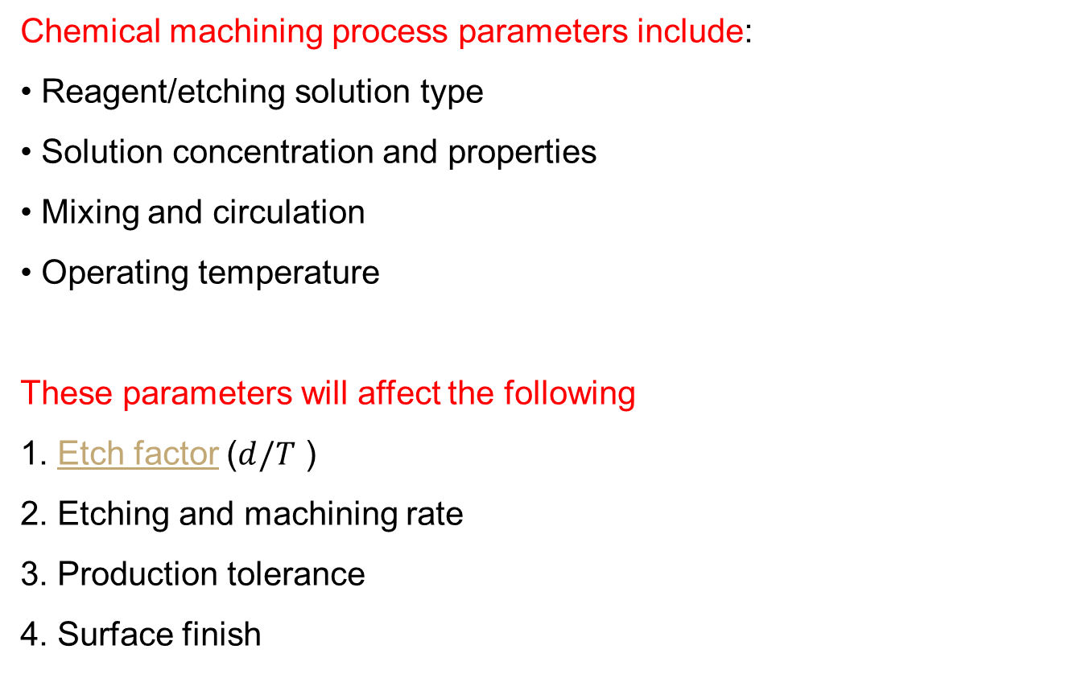
Process parameters
Chemical machining process parameters include:
Reagent/etching solution type
Solution concentration and properties
Mixing and circulation
Operating temperature
These parameters will affect the following
1. Etch factor ($d/T$ )
2. Etching and machining rate
3. Production tolerance
4. Surface finish

Slide 26
Advantages and disadvantages of Chemical machining
Advantages
Removing speed of material is independent of hardness and toughness
Surfaces with a complicated shape with high accuracy and quality
No heat and mechanically (stress) affected zone,
Large areas – more economical than milling
Eliminates cost of hard tooling
Stress and burr-free components
Complex components can be easily machined
Easy weight reduction

Slide 27
Advantages and disadvantages of Chemical machining
Advantages (contd.)
Low capital cost of equipment
Easy and quick design changes
Requirement of less skilled worker
Using decorative part production

Slide 28
Advantages and disadvantages of Chemical machining
Disadvantages:
The main limitations of this process are:
1. Difficult to get sharp corner
2. Difficult to chemically machine thick material
3. Scribing accuracy is very limited, causes less dimensional accuracy
4. Etchants are very dangerous for workers
5. Etchant disposals are very expensive
6. Environmental laws have important effects when chemical machining is used
Notes:
Scribing: خدش

Slide 29
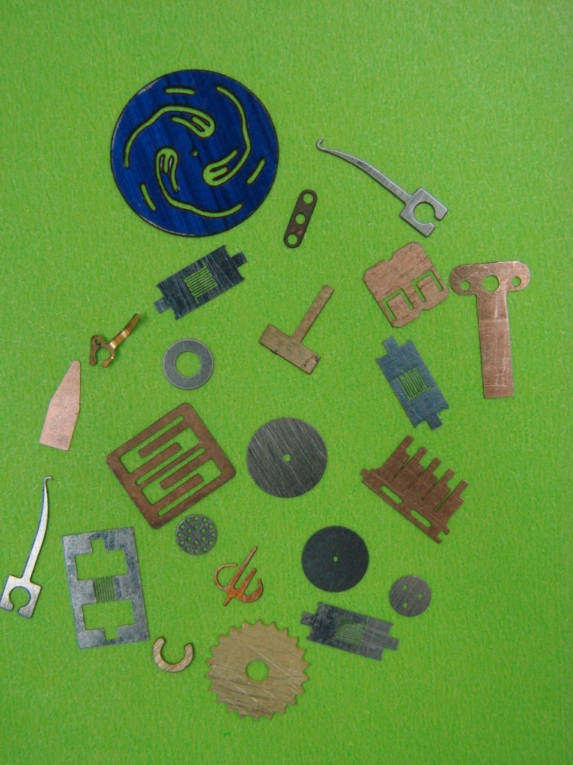
Applications
Computer & Telecommunications
Electronics/micro-electronics
Medical & Instrumentation
Micro Fluidics
Ornaments & Jewelries
Elimination of the recast layer from parts machined by EDM

Slide 30
Applications
(a) Missile skin-panel section contoured by chemical milling to improve the stiffness-to-weight ratio of the part. (b) Weight reduction of space-launch vehicles by the chemical milling of aluminum-alloy plates. These panels are chemically milled after the plates first have been formed into shape by a process such as roll forming. The design of the chemically machined rib patterns can be modified readily at minimal cost.
Notes:
Manufacturing, Engineering & Technology, Fifth Edition, by Serope Kalpakjian and Steven R. Schmid. ISBN 0-13-148965-8. © 2006 Pearson Education, Inc., Upper Saddle River, NJ. All rights reserved.

Slide 31
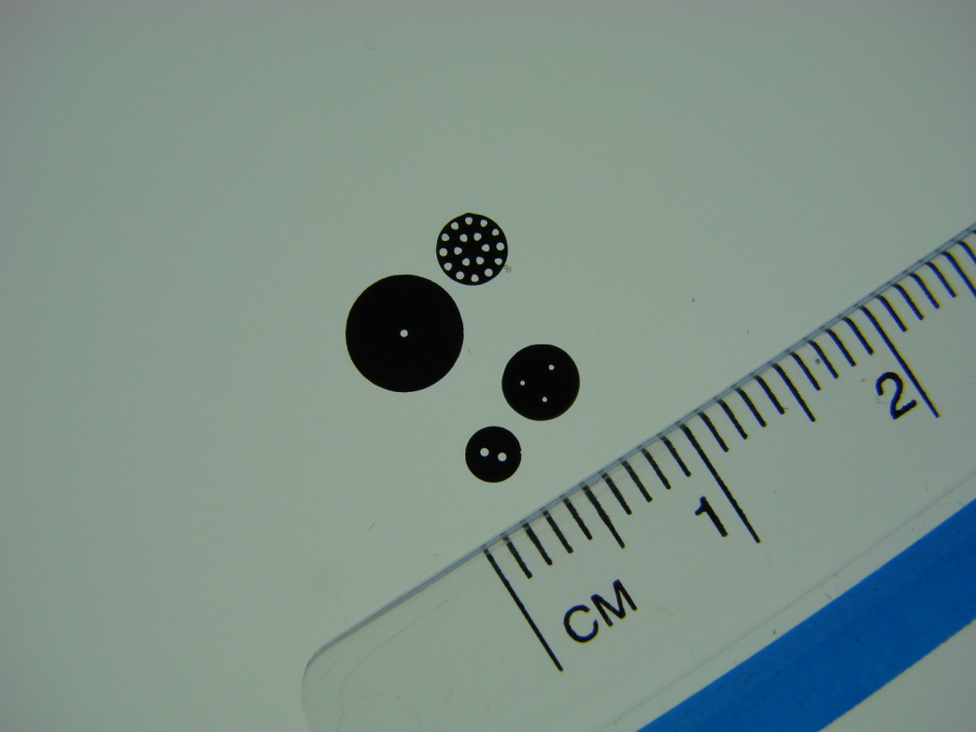
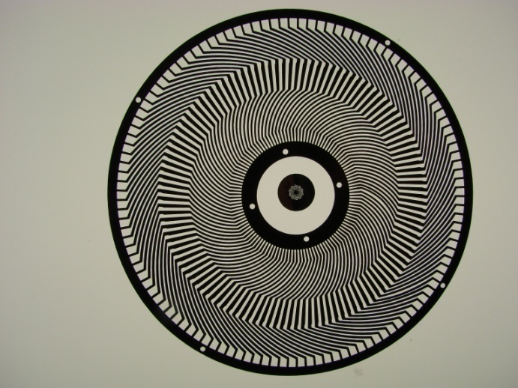
Photo Etching is an alternative to
Applications
Laser cut
Wire EDM
Stamping / punching
Pin holes
Flat Shield

Slide 32
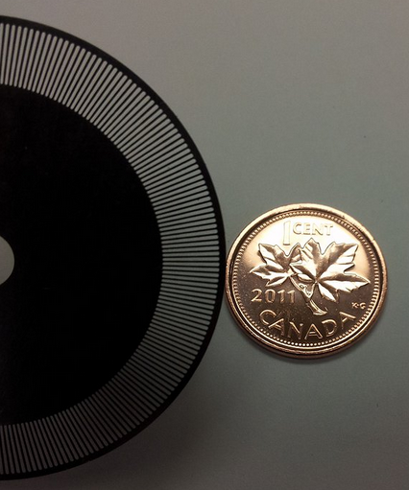
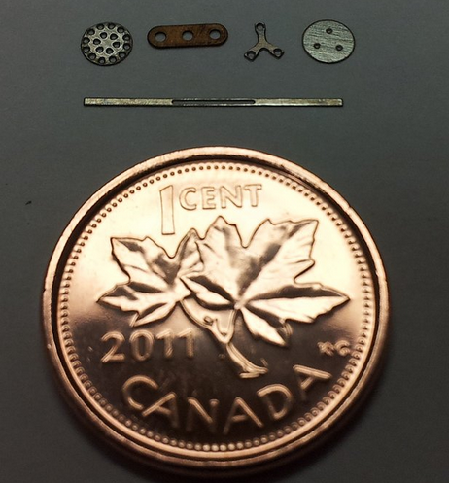
Applications
Encoder disc
Micro holes and slots
Notes:
http://www.shimifrez.com/#!Encoder-Disc/zoom/cfno/i09ex

Slide 33

Electrochemical Machining
The reverse of electroplating
An electrolyte acts as current carrier and the high rate of electrolyte movement in the tool washes metal ions away from the workpiece (anode) before they have a chance to plate onto the tool (cathode)
The material-removal rate (MRR) in electrochemical machining is
I = current in amperes
C = material constant
Copyright © 2010 Pearson Education South Asia Pte Ltd
Notes:
Electroplating: طلاء بالكهرباء

Slide 34
Electrochemical Machining
Process Capabilities
Used to machine complex cavities and shapes in high-strength materials
Aerospace industry for the mass production of turbine blades, jet-engine parts and nozzles
Modification of ECM, shaped-tube electrolytic machining (STEM), is used for drilling small-diameter deep holes
ECM process leaves a burr-free, bright surface and can be used as a deburring process
Available as numerically controlled machining centers with high production rates, high flexibility, and close dimensional tolerances
Copyright © 2010 Pearson Education South Asia Pte Ltd
Notes:
deburring process: smooth the rough edges or ridges of an object, typically one made of metal

Slide 35
Electrochemical Machining
Process Capabilities

Slide 36
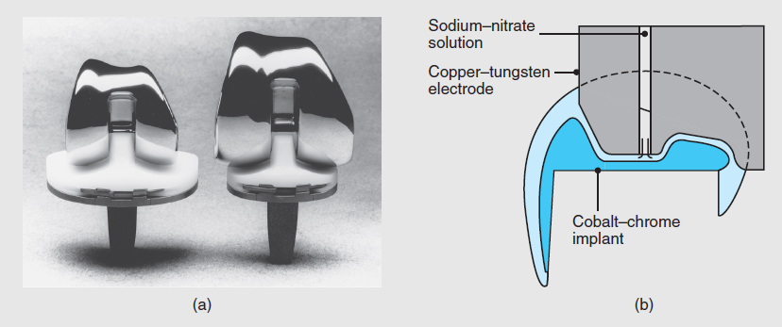
Electrochemical Machining
CASE STUDY 27.1
Electrochemical Machining of a Biomedical Implant
2 total knee-replacement systems, showing metal implants (top pieces) with an ultrahigh-molecular-weight polyethylene insert (bottom pieces)
Cross section of the ECM process as applied to the metal implant
Copyright © 2010 Pearson Education South Asia Pte Ltd

Slide 37
Electrical-discharge (EDM) Machining
Process is based on the erosion of metals by spark discharges
When two current-conducting wires are allowed to touch each other, an arc is produced
At the point of contact between the two wires, a small portion of the metal is eroded away ⇒ leaves a small crater
Copyright © 2010 Pearson Education South Asia Pte Ltd

Slide 38
Electrical-discharge Machining
Electric discharge processes remove metal by a series of discrete electrical discharges (sparks) that cause localized temperatures high enough to melt or vaporize the metal in the immediate vicinity of the discharge.
The two main processes in this category are
    (1) electric discharge machining die sinking (ram type)
    (2) wire electric discharge machining.
These processes can be used only on electrically conducting work materials.
Electric discharge machining (EDM) is one of the most widely used nontraditional processes.

Slide 39
Electrical-discharge Machining
Principle of Operation
EDM system consists of an electrode and the workpiece, connected to a DC power supply and placed in a dielectric fluid
When the potential difference between the electrode and the workpiece is high, the dielectric breaks down and a transient spark discharges through the fluid, removing a small amount of metal
Can be used on any material that is an electrical conductor
The material-removal rate can be estimated from
I = current in amperes
T_{w} = melting point
Copyright © 2010 Pearson Education South Asia Pte Ltd
Notes:
dielectric: عازل كهربائي
Note how like in ECM, EDM MRR is a function of current and material property

Slide 40
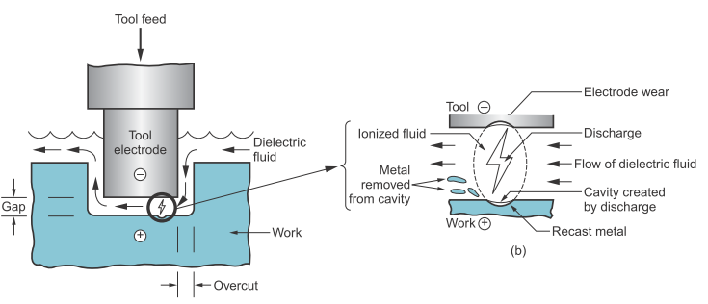
Electrical-discharge Machining
Principle of Operation
The sparks occur across a small gap between tool and work surface.
The fluid creates a path for each discharge as the fluid becomes ionized in the gap.
The discharges are generated by a pulsating direct current (DC) power supply connected to the work and the tool.
The spark temperatures generated can range from 8,000 to 12,000 °C.

Slide 41
Electrical-discharge Machining setup
Electrical-discharge Machining systems have four sub-systems:
A DC power supply to provide the electrical discharges, with control circuits for voltage, current, duration, frequency, and polarity
A dielectric system to introduce fluid into the voltage area/discharge zone and flush away work and electrode debris; this fluid is usually a hydrocarbon or silicone based oil
A consumable electrode, usually of copper or graphite
A servo motor system to control the feed rate of the electrode and maintain a gap of typically 0.01 to 0.5 mm between the electrode and the workpiece.
Notes:
http://manufacturing.stanford.edu/processes/EDM.pdf

Slide 42
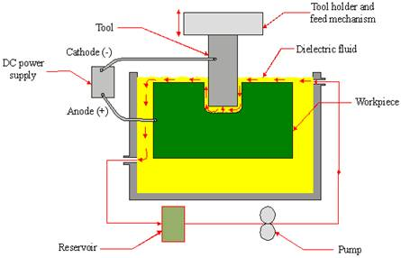
A typical Die Sinking EDM Setup
Feed direction
The shape of the finished work surface is produced by a negative shaped electrode tool.
Notes:
http://www.turnxon.com/articles/articles_2.html (Very good introduction of Non-conventional machining in this link)

Slide 43
Electrical-discharge Machining
Overcut
As the electrode tool penetrates into the work, overcutting occurs.
Overcut in EDM is the distance by which the machined cavity in the workpiece exceeds than the size of the tool on each side of the tool because the electrical discharges occur at the sides of the tool as well as its frontal area.
Overcut is a function of current and frequency and can be equal to several hundredths of a millimeter.

Slide 44
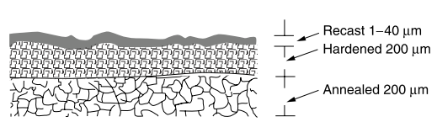
Electrical-discharge Machining
Heat-affected zone (Surface integrity issue)
With the temperature of the discharges reaching 8,000 to 12,000 °C, metallurgical changes occur in the surface layer of the workpiece.

Slide 45
Electrical-discharge Machining
Dielectric Fluids
The functions of the dielectric fluid are to:
Act as an insulator until the potential is sufficiently high
Provide a cooling medium
Act as a flushing medium and carry away the debris in the gap
Electrodes
Electrodes are made of graphite, brass, copper or copper–tungsten alloys
Copyright © 2010 Pearson Education South Asia Pte Ltd

Slide 46
Electrical-discharge Machining
Electrodes
Can be made (shaped) by forming, casting, powder metallurgy, or CNC machining techniques
Wear ratio* is defined as the ratio of the volume of workpiece material removed to the volume of tool wear
Tool wear is related to the melting points of the materials involved
The lower the melting point of the electrode, the higher is the wear rate
Tool wear can be minimized by reversing the polarity and using copper tools
Copyright © 2010 Pearson Education South Asia Pte Ltd
Notes:
Note how similar this is to the grinding ratio

Slide 47
Electrical-discharge Machining
Process Capabilities
Stepped cavities with sharp corners can be produced by controlling the relative movements of the workpiece in relation to the electrode
High rates of material removal produce rough surface finish with poor surface integrity and low fatigue properties

Slide 48
Electrical-discharge Machining
Design Considerations for EDM
General design guidelines:
Parts should be designed so that the required electrodes can be shaped properly and economically
Deep slots and narrow openings should be avoided
The surface finish specified should not be too fine.
Bulk of material removal should be done by conventional processes
Copyright © 2010 Pearson Education South Asia Pte Ltd

Slide 49
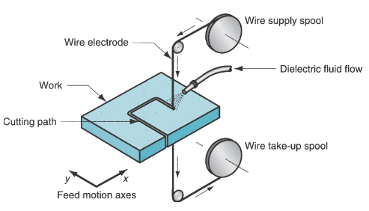
Electrical-discharge Machining:
Wire EDM
Electric discharge wire cutting (EDWC), commonly called wire EDM, is a special form of electric discharge machining that uses a small diameter wire (0.076 to 0.30 mm ) as the electrode to cut a narrow kerf in the work.
The cutting action in wire EDM is achieved by thermal energy from electric discharges between the electrode wire and the workpiece.
The workpiece is fed past the wire to achieve the desired cutting path.
Notes:
Kerf: خدش أو شقّ

Slide 50
Electrical-discharge Machining
Advantages:
The main advantages of EDM are:
By this process, materials of any hardness can be machined
One of the main advantages of this process is that thin and fragile components can be machined without distortion
Complex internal shapes can be machined
No burrs are left in machined surface

Slide 51
Electrical-discharge Machining
Disadvantages:
The main limitations of this process are:
This process can only be employed in electrically conductive materials
Material removal rate is low compared to conventional machining processes
Unwanted erosion and overcut of material can occur
Rough surface finish when at high rates of material removal
Lead time is needed to produce specific, consumable electrode shapes

Slide 52
Electrical-discharge Machining
Disadvantages:
The chance of flash fire in the dielectric fluid if the level falls too low.
Smoke can be irritating to the eyes and lungs and but can be controlled with exhaust and smoke-eating devices

Slide 53
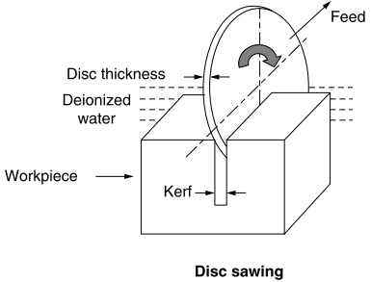
Electrical-discharge Machining
Applications
Drilling of holes: narrow, stepped, tapered, angled.
Sawing: The process cuts any electrically conductive material at a rate that is twice that of the conventional abrasive sawing method.
Notes:
http://www.photonics.com/Article.aspx?AID=50060

Slide 54
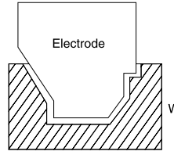
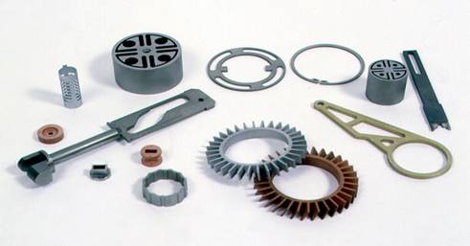
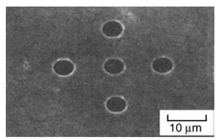
Electrical-discharge Machining
Applications
Machining of dies and molds
Micro-machining
Notes:
http://www.turnxon.com/articles/articles_2.html

Slide 55
Laser-beam Machining
The source of energy is a laser which focuses optical energy on the surface of the workpiece
The highly focused, high-density energy source melts and evaporates portions of the workpiece in a controlled manner

Slide 56
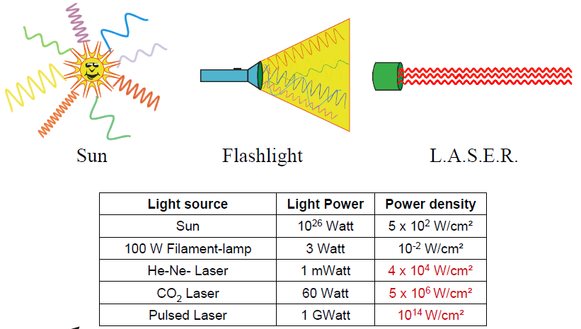
Laser-beam Machining
The term laser stands for light amplification by stimulated emission of radiation.
A laser light beam has several properties that distinguish it from other forms of light.
  It is monochromatic (the light has a single wavelength)
  Highly collimated (the light rays in the beam are almost perfectly parallel)
  Highly coherent (all waves in line)
These properties allow the light generated by a laser to be focused using conventional optical lenses, onto a very small spot with resulting high power densities.
Notes:
Collimated: مسدّد

Slide 57
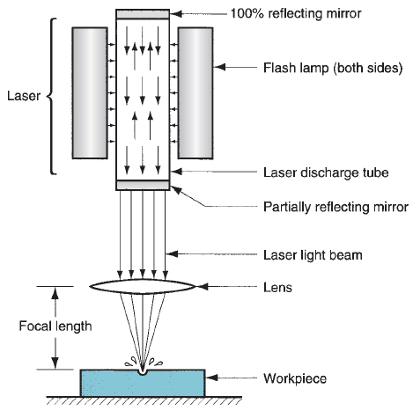
Laser-beam Machining
A laser is an optical transducer that converts electrical energy into a highly coherent light beam.
A laser machine consists of the laser, some mirrors or a fiber for beam guidance, focusing optics and a positioning system
The laser beam is focused onto the workpiece and can be moved relatively to it.
The laser machining process is controlled by switching the laser on and off, changing the laser pulse energy and other laser parameters, and by positioning either the work-piece or the laser focus.
www.youtube.com/watch?v=s3gYgMJkKM

Slide 58
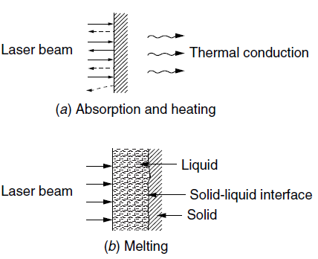
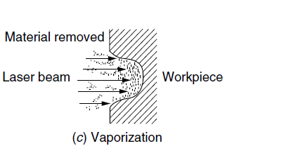
Laser-beam Machining
Material removal mechanism
The unreflected laser light is absorbed, thus heating the surface of the specimen.
On sufficient heat the workpiece starts to melt and evaporate
Depending on the power density and time of beam interaction, the mechanism progresses from one of heat absorption and conduction to one of melting and then vaporization

Slide 59
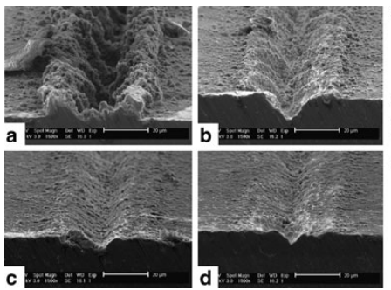
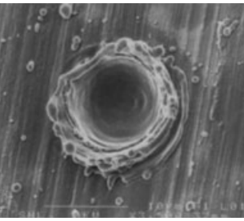
Laser-beam Machining
A close up of one of the 10µm pits showing remnants of material resolidiﬁed on the rim and ejected into the surrounding region
Cross-sectional SEM images (scale bars are 20µm) of the laser-machined (56 J/cm²)
surfaces shows decreasing size and slope of groove walls with increasing translation distance: (a) 2µm, (b) 4µm, (c) 6µm, and (d) 8µm
https://www.princeton.edu/~spikelab/papers/book02.pdf
Notes:
https://www.princeton.edu/~spikelab/papers/book02.pdf
SEM: Scanning Electron Microscope

Slide 60
Laser-beam Machining
The cutting depth is expressed as
t = depth
C = constant for the process
P = power input
v = cutting speed
d = laser-spot diameter
Copyright © 2010 Pearson Education South Asia Pte Ltd

Slide 61
Laser-beam Machining
Process Capabilities
It is used for drilling, trepanning, and cutting metals, nonmetallic materials, ceramics, and composite materials
Laser-beam machining is being used increasingly in the electronics and automotive industries
Also used for welding, small-scale and localized heat treating of metals and ceramics, and marking of parts
Copyright © 2010 Pearson Education South Asia Pte Ltd

Slide 62
Laser-beam Machining
Design Considerations for LBM
General design guidelines:
Sharp corners should be avoided
Deep cuts will produce tapered walls
Reflectivity of the workpiece surface
Adverse effects on the properties of the machined materials
Copyright © 2010 Pearson Education South Asia Pte Ltd

Slide 63
Laser-beam Machining
Advantages:
Non-contact, no cutting forces are developed
Tool wear and breakage are not encountered
Very small holes with a large aspect ratio can be produced
Selective material removal can be achieved
Machining is extremely rapid and the setup times are economical
No solvent chemical
Fully automated
The operating cost is low

Slide 64
Laser-beam Machining
Disadvantages:
Recast layers on top of machined surfaces
Heat affected zones
Poor machining with reflective surfaces
Not for mass metal removal
Tapers are normally encountered in the direct drilling of holes
Tolerances are lose
Expensive equipment
Environmental hazard

Slide 65
Laser-beam Machining
Lasers are widely used in many industrial applications including:
  Ablation or cutting of plastics, glasses, ceramics, semiconductors and metals and composite materials
  Heat treatment
  Welding
  Texturing of sheet metals to prevent adhering
  Material deposition – cladding
  Micromachining
  3D printing especially for metals
  Surgery
  Photo-polymerization (e.g. 3D printing and masking for chemical machining)
Notes:
Cladding:\ تكسية التغليف

Slide 66
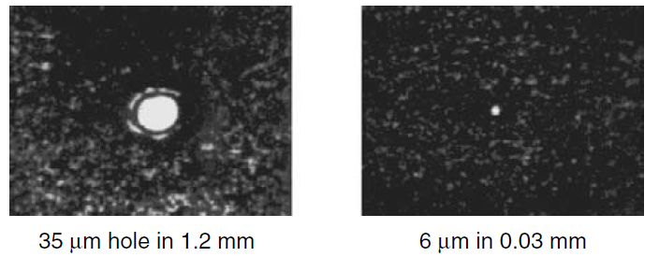
Applications
Fine drilling of holes in steel

Slide 67
Electron-beam Machining
Electron beam machining (EBM) is a thermal material removal process that utilizes a focused beam of high-velocity electrons to perform high-speed drilling and cutting.
Material-heating action is achieved when high-velocity electrons strike the workpiece
Upon impact, the kinetic energy of the electrons is converted into the heat necessary for the rapid melting and vaporization of any material.

Slide 68
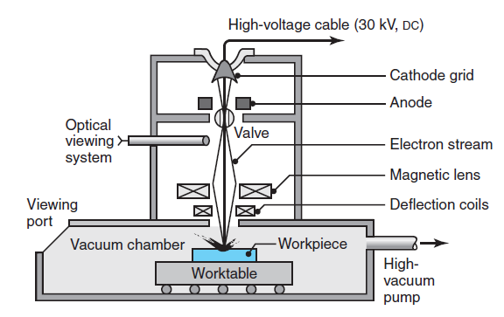
Electron-beam Machining
Notes:
Unlike LBM, EBM produces a vacuum, so the workpiece size is limited to the size of the vacuum chamber

Slide 69
Electron-beam Machining
Generally used for very accurate cutting of a wide variety of metals
Surface finish is better and kerf width is narrower than in other thermal cutting processes e.g. better than Laser machining.
Copyright © 2010 Pearson Education South Asia Pte Ltd

Slide 70
Electron-beam Machining
Design Considerations for EBM
Guidelines for EBM:
Individual parts or batches should closely match the size of the vacuum chamber for a high production rate per cycle
Manufacture in small batches
Copyright © 2010 Pearson Education South Asia Pte Ltd

Slide 71
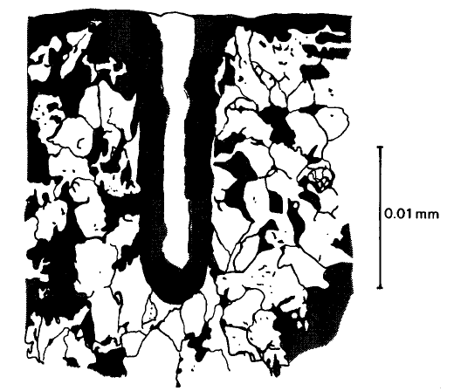
Electron-beam Machining
Advantages:
Large depth-to-width (100:1) ratio of material penetrated by the beam with applications of very fine hole drilling can be achieved (particularly in micro-machining)

Slide 72
Electron-beam Machining
Advantages (contd.):
There is no mechanical contact between tool and workpiece; hence no tool wear and cutting forces
10⁴ to 10⁵ holes per second can be produced in thin sheets (µs pulses needed); e.g. 620 holes per square millimeter for filter application at a rate of one hole every 10 μs
No limitation is imposed by workpiece hardness, ductility, and surface reflectivity

Slide 73
Electron-beam Machining
Disadvantages:
Environmental hazard: the interaction of the electron beam with the workpiece produces hazardous x-rays
EBM is best suited for small parts only due to the restriction of vacuum
Rate of material removal is low
Cost of equipment is high
Need for auxiliary backing material

Slide 74
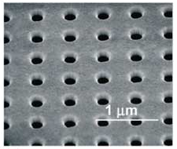
Electron-beam Machining
Applications: EBM is widely used in many industrial applications including:
  Drilling of holes in pressure differential devices used in nuclear reactors, air craft engines
  Machining of wire drawing dies having small cross sectional area
  Welding
  Slotting of sheets
  3D printing of metals
A scanning electron micrograph shows a typical array of holes drilled via electron beam in a gold film
http://www.photonics.com/Article.aspx?AID=50060
Notes:
http://www.photonics.com/Article.aspx?AID=50060

Slide 75
Electron-beam Machining:
Plasma machining
A plasma is defined as a superheated, electrically ionized gas
A plasma is generated by subjecting a flow of the gas to the electron bombardment of an electric arc.
Plasma beam machining (PBM) or plasma arc cutting (PAC) uses a plasma stream operating at temperatures in the range 10,000 to 14,000 ºC to cut metal by melting
Plasma cutting is a process that is used to cut ferrous (stainless steel, cast iron, etc.) and non-ferrous metal (aluminum, copper, tool steel, die steel, lead, nickel, tin, titanium and zinc, and alloys such as brass, etc.)
Can be used to machine non-conductive materials as well

Slide 76
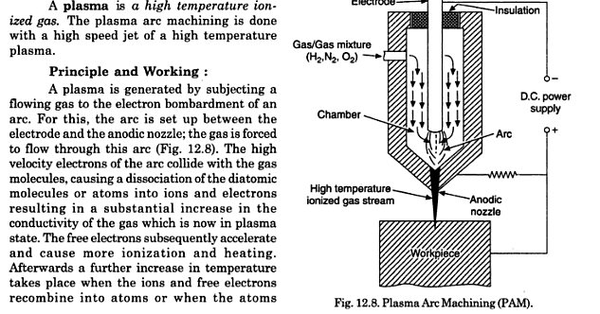
Electron-beam Machining:
Plasma machining
In plasma machining a continuous arc is generated between a hot tungsten cathode and the copper anode.
The gas is forced to flow through this arc.
The Torch serves as the holder for the consumable nozzle and electrode, and provides cooling (either gas or water assisted) to these parts. The nozzle and electrode constrict and maintain the plasma jet.
The plasma arc process is started by initiating a low current pilot arc between the electrode and the constricting nozzle or anode. This ionizes the plasma gas flowing through the nozzle. The ionized gas and the high temperature of the plasma gas provides a low resistance path to start an arc between the electrode and the workpiece.
Notes:
The tip of the plasma arc torch is constricted or reduced in cross sectional area. This constriction of arc considerably increases its temperature (up to 10000 deg Celsius) since it carries the same amount of current.
http://www.mechanicalengineeringblog.com/tag/plasma-arc-welding-electrode/
http://www.sppusa.com/reference/white_paper/wp_pc.html

Slide 77
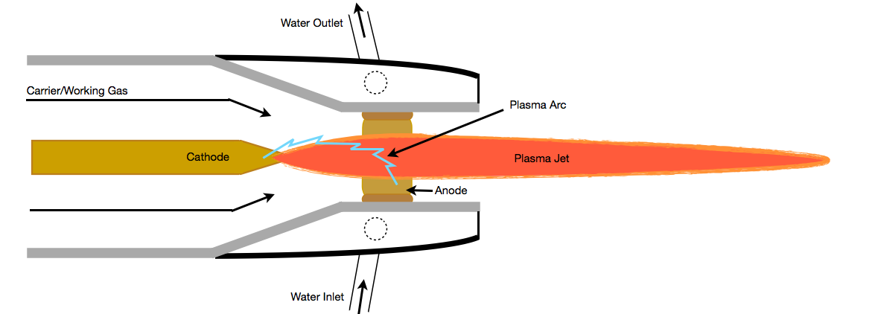
Electron-beam Machining:
Plasma machining
After the gas flow stabilizes, the circuit between the electrode and anode is activated.
The high voltage breaks down between the electrode and nozzle inside the torch in such a way that the gas must pass through this arc before exiting the nozzle.
Energy transferred from the arc to the gas causes the gas to become ionized, therefore electrically conductive.
This electrically conductive gas creates a current path between the electrode and the nozzle, and a resulting plasma arc is formed.
Notes:
http://www.axisplasma.com/what_is_plasma_cutting.html

Slide 78
Electron-beam Machining:
Plasma machining
The temperature of the plasma arc melts the metal, pierces through the workpiece.
The high velocity gas flow removes the molten material from the bottom of the cut kerf.
At this time, torch motion is initiated and the cutting process begins.
Notes:
http://www.axisplasma.com/what_is_plasma_cutting.html

Slide 79
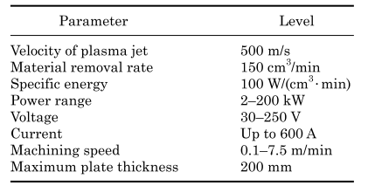
Electron-beam Machining:
Plasma machining
Process capability
Notes:
https://www.princeton.edu/~spikelab/papers/book02.pdf‎

Slide 80
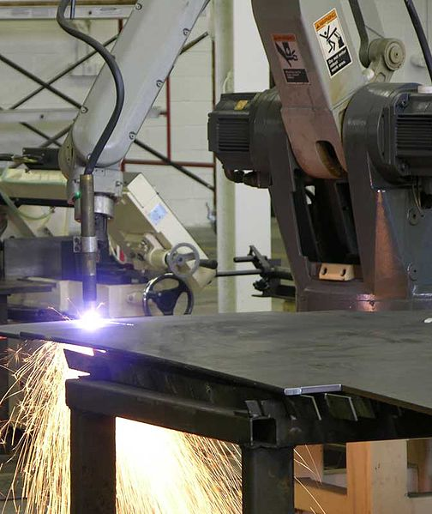
Electron-beam Machining:
Plasma machining
Advantages:
Very high material removal rates up to 150 cm³/min
Can be used to cut any material (usually metals)
Requires no complicated chemical analysis required as in case of oxyacetylene welding
Needs less energy to operate i.e. low power consumption
No vacuum chamber required
Torch can be mounted on robotic arms

Slide 81
Electron-beam Machining:
Plasma machining
Disadvantages:
Severe heat affected zones
Thick recrystallized (recast layer) top machined surface and microstructure changes
Toxic fumes are produced
Need to frequently replace the nozzle surrounding the electrode
More chances of electrical hazards are associated with this process (especially in hand operated plasma)
Unpleasant, disturbing and damaging noise

Slide 82
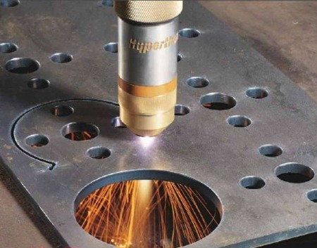
Electron-beam Machining:
Plasma machining
It can cut all electrically conductive metals like S.S, C.S, Copper, Aluminum, Inconel, Titanium, etc. and also non-conductive materials as well e.g. Ceramics.
Cut bulk metal, painted or rusted plates.
Turning and milling of hard to machine materials
A large number of parts can also be produced from one large sheet thus eliminating shearing operations.
Welding
https://www.youtube.com/watch?v=CILxSlricyc
https://www.youtube.com/watch?v=DYTkHZWIyqQ
Notes:
http://www.photonics.com/Article.aspx?AID=50060

Slide 83
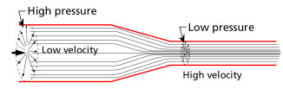
Water-jet Machining
Waterjets are created by converting high pressure water into high velocity jet.
Usually done by passing high pressure water through a narrow cross-section called orifice (Venturi effect)
Abrasive waterjets (AWJ) are created by adding abrasives into the high velocity waterjet.
Abrasive particles are accelerated to high velocities (300 m/s – 600 m/s) by momentum transfer from the waterjet.
To optimize the momentum transfer efficiency between water and abrasive (grit) particles a suitable length of nozzle is applied (e.g. 75mm)
Notes:
Reference of the bottom figure: http://lurnq.com/lesson/How-does-an-Airplane-Fly/

Slide 84
Water-jet Machining
Cutting head consists of Orifice, abrasive inlet, mixing chamber and a nozzle (focussing tube).
Abrasive particles are delivered from the abrasive metering system into the cutting head at the abrasive inlet port.
Particle are mixed with the waterjet in the mixing chamber
Particles are accelerated and a coherency is achieved while the abrasive, water droplets and air flow down the length of the nozzle.
Thus a three phase mixture is formed usually termed as AWJ.

Slide 85
Water-jet Machining
High pressure
water in
Abrasive
in
Nozzle
assembly
Abrasive Waterjet
Workpiece

Slide 86
Water-jet Machining
Notes:
a) WJM process; b) computer-controlled WJM machine; c) parts produced by WJM process

Slide 87
Water-jet Machining
Advantages
AWJ machining is a highly environment friendly process as compared with conventional chip removal processes (milling, turning) which also make use of cutting fluids (toxics)
AWJ enables the machining of difficult-to-cut materials (e.g. Ti/Ni alloys, ceramics)
AWJ machining involves very low specific cutting forces at acceptable material removal rates. No deflection of the workpiece
AWJ processing results in overall low cutting temperatures typically less than 60⁰C; therefore can be used for machining heat sensitive material e.g. Ni/Ti shape memory alloys
The AWJ machining uses a “universal cutting tool”, no tool wear

Slide 88
Water-jet Machining
Disadvantages
Abrasive embedment in the target surface is one of the most prominent drawbacks of the AWJ machining process; the embedded abrasive particles and associated cracks result in reducing the strength of the target surface and can act as crack propagation points during the loading of the target
It is very difficult to control the geometry (e.g. kerf taper) of the part being machined and the process heavily relies on human intervention and skill
The quality of the surface finish is low as compared to the conventional machining processes; e.g. the development of striation marks on the cut face
Notes:
Striation: خدش؛ علامة رفيعة

Slide 89
Water-jet Machining
Applications
Ti/Ni alloys for aerospace applications (e.g. casings)
Biologic (bones) compatible materials (NiTi) for medical applications (e.g. implants)
Engineered ceramics (SiC, Al₂O₃) for parts with chemical inertness and/or high wear resistance.
Ultra-hard materials (e.g. diamond) for tooling fabrication
Engineering composites for aerospace, automotive applications
Turning and dressing of grinding wheels
Coating removal in aerospace and nuclear industries
Machining of large and/or complex shape parts by mounting the cutting head on a robotic arm

Slide 90
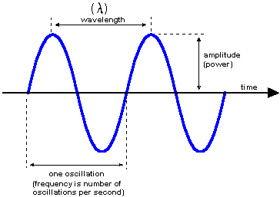
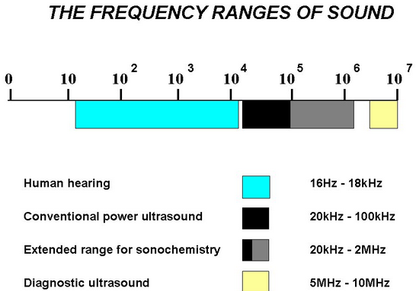
Ultrasonic Machining
Ultrasonic machining (USM) is the removal of hard and brittle materials using an axially oscillating/vibrating tool at ultrasonic frequencies [18–25 kilo-hertz (kHz)]

Slide 91
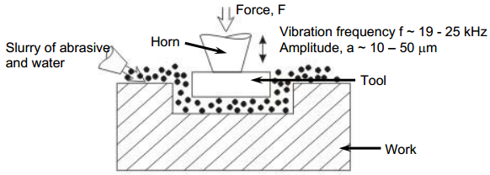
Ultrasonic Machining
During the axial tool oscillation, the abrasive slurry of typically B₄C or SiC is continuously fed into the machining zone between a soft tool (brass or steel) and the workpiece.
The abrasive particles are, therefore, hammered into the workpiece surface and cause chipping/extraction of fine particles from it. Furthermore, abrasive particles also performs abrasion along with the hammering action.
The oscillating tool, at amplitudes ranging from 10 to 40µm, imposes a static pressure on the abrasive grains and feeds down as the material is removed to form the required tool shape
USM is characterized by the absence of any harmful effect on the metallic structure of the workpiece material.

Slide 92
Ultrasonic Machining
Tools
Tool tips must have high wear resistance and fatigue strength.
For machining glass and tungsten carbide, copper and chromium silver steel tools are recommended. Silver and chromium nickel steel are used for machining sintered carbides.
Since impact is the basic phenomenon responsible for machining in USM, therefore, the tool material employed is always more soft/tough as compared to the workpiece material being cut.

Slide 93
Ultrasonic Machining
Abrasive slurry
Abrasive slurry is usually composed of 50 percent (by volume) fine abrasive grains (100–800 grit number) of boron carbide (B4C), aluminum oxide (Al2O3 ), or silicon carbide (SiC) in 50 percent water. The abrasive slurry is circulated between the oscillating tool and workpiece.
Under the effect of the ultrasonic vibration, the abrasive particles are hammered into the workpiece surface causing mechanical chipping of minute particles.

Slide 94
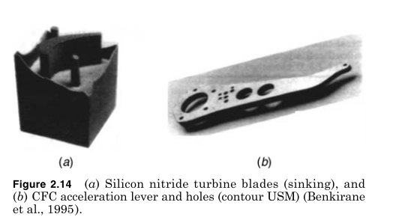
Ultrasonic Machining
Limitations
Low MRR
High tool wear
Low depth of hole

Slide 95
Rotary Ultrasonic machining (RUM)
Process principle and working
RUM is a mechanical material removal process used to machine hard or brittle materials by combining the ultrasonic impacts (hammering, extraction, abrasion) and the grinding action of the diamond abrasives bonded on the tool.
The key difference between USM and RUM is that in RUM the tool also rotates and the tool has metal bonded diamond abrasive particles.

Slide 96
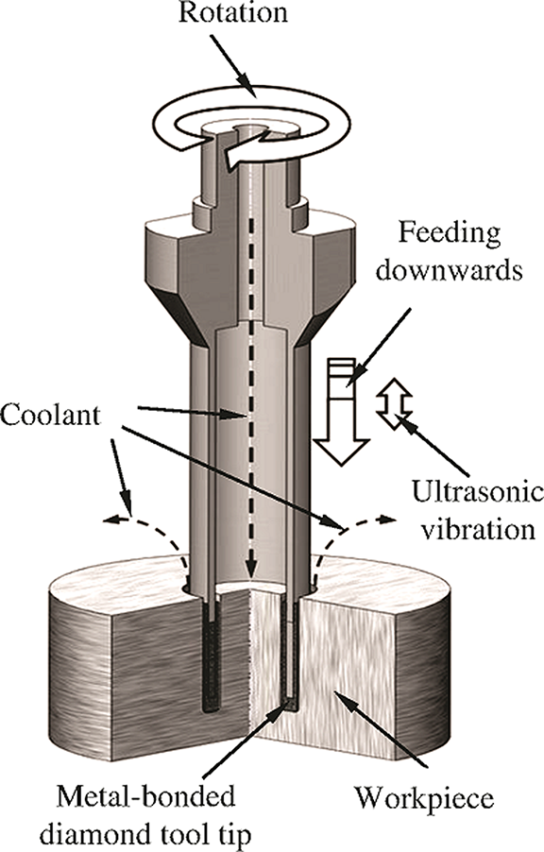
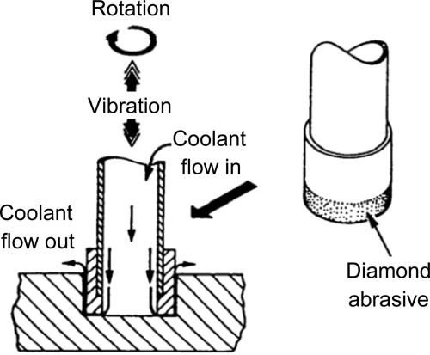
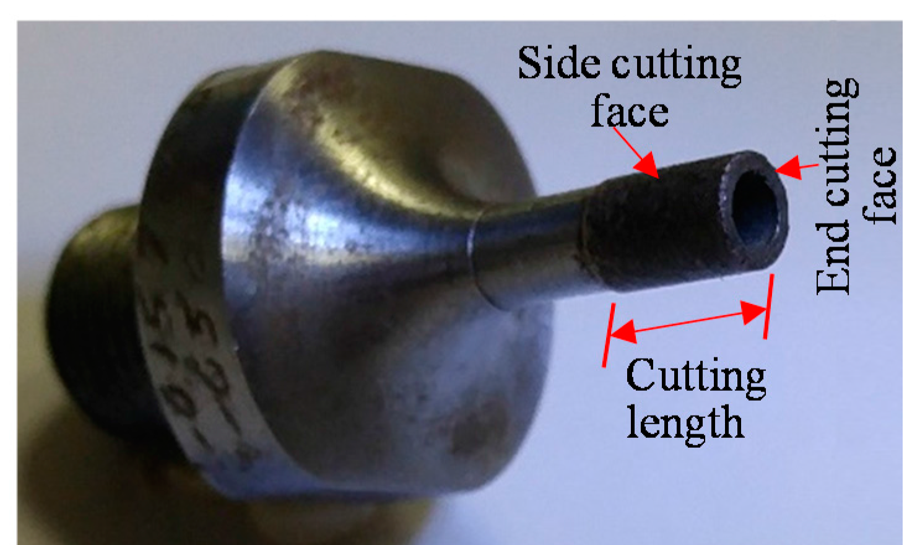
Rotary Ultrasonic machining (RUM)
Notes:
http://manufacturingscience.asmedigitalcollection.asme.org/data/journals/jmsefk/926545/manu_134_6_064501_f002.png
http://manufacturingscience.asmedigitalcollection.asme.org/data/journals/jmsefk/28479/041012_1_1.jpeg

Slide 97
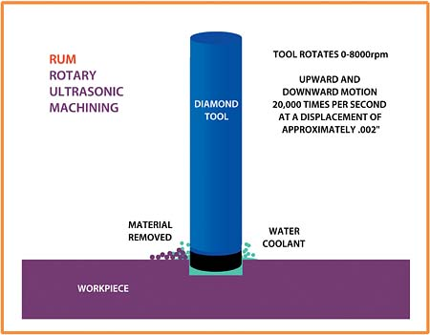
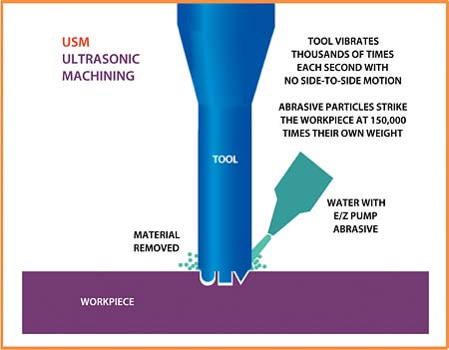
Rotary Ultrasonic machining (RUM)
Notes:
https://www.ceramicindustry.com/articles/83906-machining-ceramics-with-rotary-ultrasonic-machining

Slide 98
Rotary Ultrasonic machining (RUM)
RUM VS USM
High depths of cuts and aspect-ratios can be achieved in RUM as compared to USM
Lower tool wear rate in RUM as compared to USM
Very high dimensional accuracy in RUM as compared to USM

