Slide 1
Lecture 2 Transmission Basics

Slide 2
Data vs Signal
Data – information formatted in human/machine readable form
examples: voice, music, image, file
Signal – electric or electromagnetic representation of data
transmission media work by conducting energy along a physical path; data must be turned into energy in the form of electro-magnetic signals to be transmitted

Slide 3
Transmission Basics
Transmission – communication of data through propagation and processing of signals
Transmit means to issue signals to the network medium
Transmission refers to either the process of transmitting or the progress of signals after they have been transmitted

Slide 4
Terminology (1)
Data transmission occurs between transmitter and receiver over some transmission medium.
Signal: electromagnetic waves
Can propagate along the transmission medium
Transmission Medium
Guided medium: the signals are guided along a physical path
e.g., twisted pair, coaxial cable, optical fiber
Unguided medium: wireless
e.g., air, water, vacuum

Slide 5
Terminology (2)
Direct link
Refer to the transmission path between the transmitter and receiver in which signals propagate directly with no intermediate devices, other than amplifiers or repeaters used to increase signal strength.
Note that it can apply to both guided and unguided media
A transmission medium is point-to-point if:
Direct link
Only 2 devices share the medium
A transmission medium is multipoint if:
More than two devices share the same medium
Point-to-point
Multipoint

Slide 6
Analog and Digital Signals

Slide 7
Transmission Basics
Analog and Digital Signaling
On a data network, information can be transmitted via one of two signaling methods: analog or digital
Both types of signals are generated by electrical current, the pressure of which is measured in volts

Slide 8
Transmission Basics (continued)
An analog signal, like other waveforms, is characterized by four fundamental properties:
Amplitude
Frequency
Wave length
Phase

Slide 9
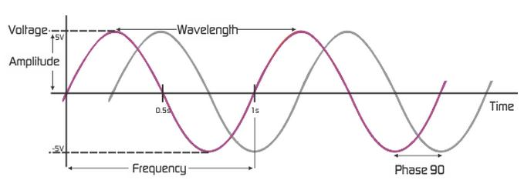
Analog Signals
Amplitude:
Analog wave’s strength
Amplitude of a signal refers to the height of the signal.
Frequency:
frequency refers to number cycles per second.
Measure in hertz (Hz)
Wavelength:
Distance between corresponding wave cycle points
Inversely proportional to frequency
Expressed in meters or feet

Slide 10
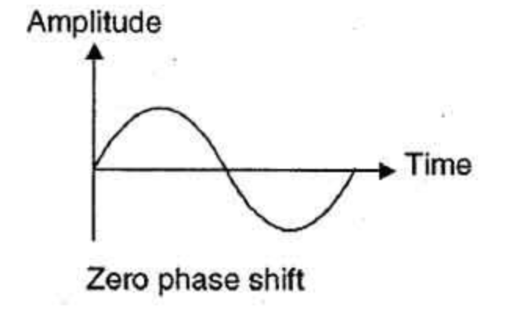
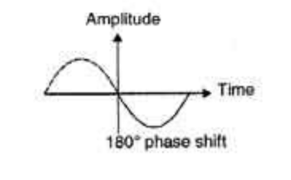
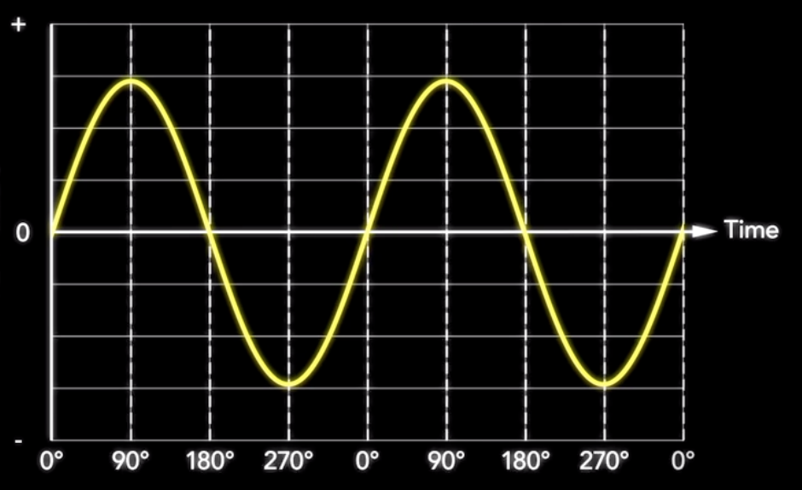
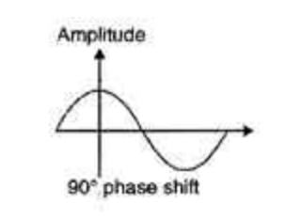
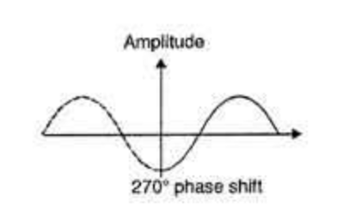
Analog Signals
Phase
Phase describes the position of the waveform relative to time zero.
Phase is measured in degrees
phase shift of 90º = shift of ¼ cycle
phase shift of 180º = shift of ½ cycle
Phase shift of 270 – shift of ¾ cycle

Slide 11
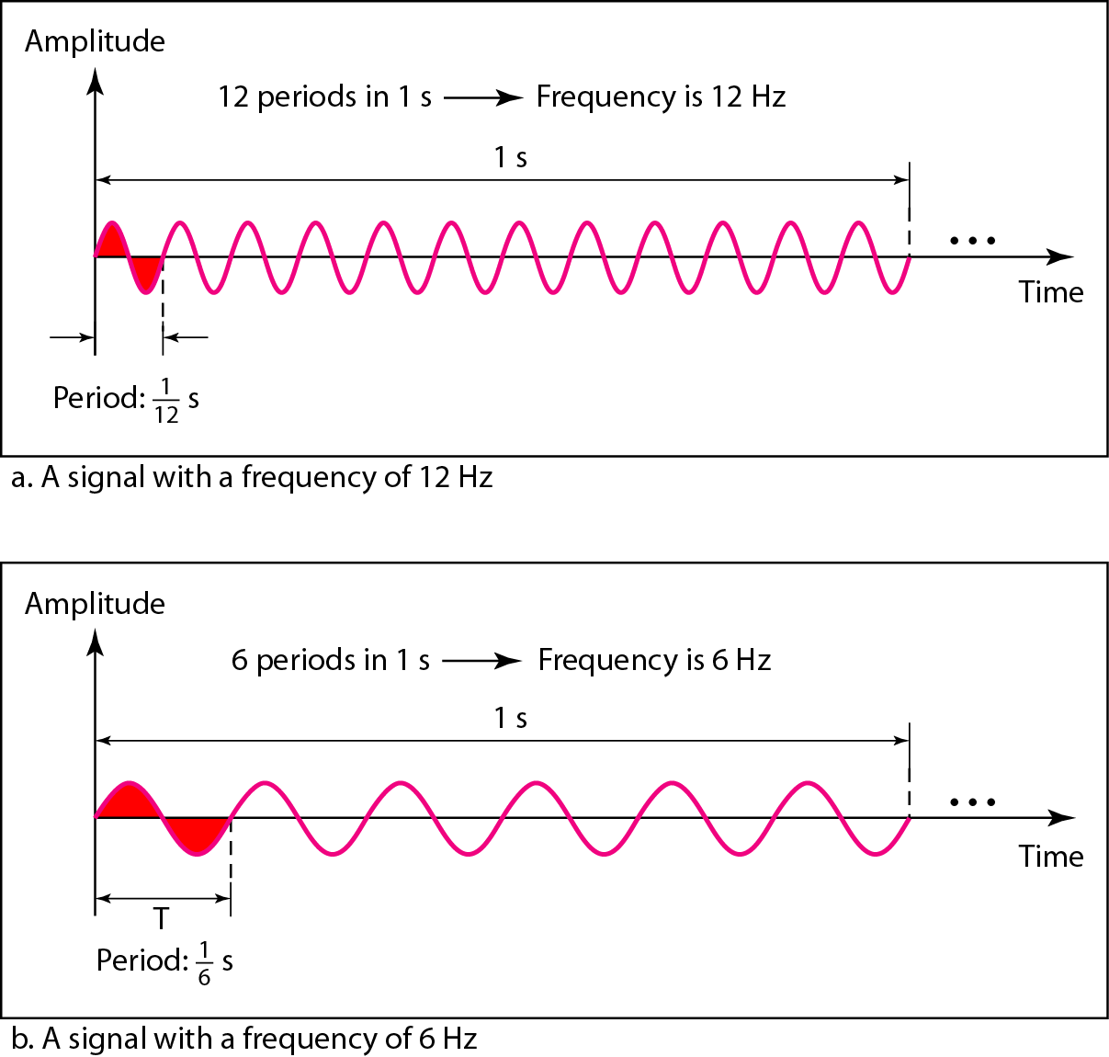
Two signals with the same amplitude and phase, but different frequencies

Slide 12
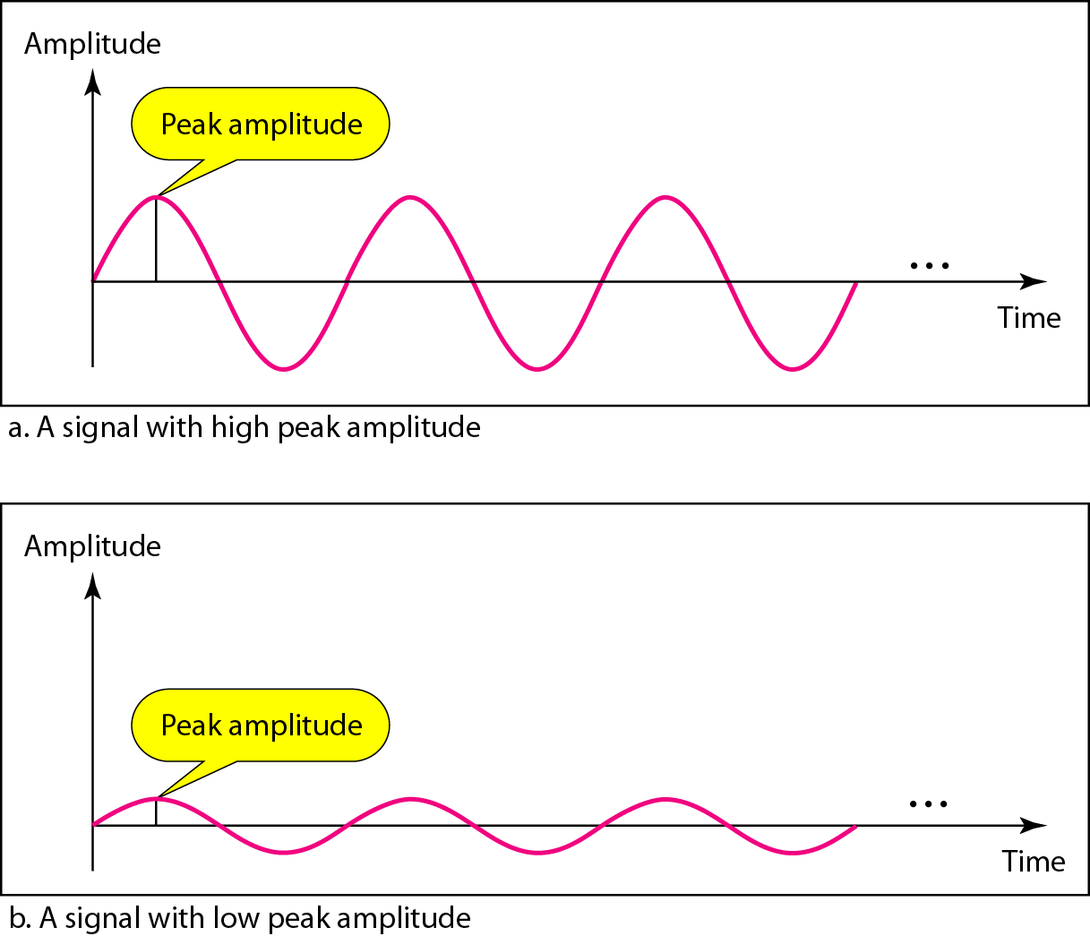
Two signals with the same phase and frequency, but different amplitudes

Slide 13
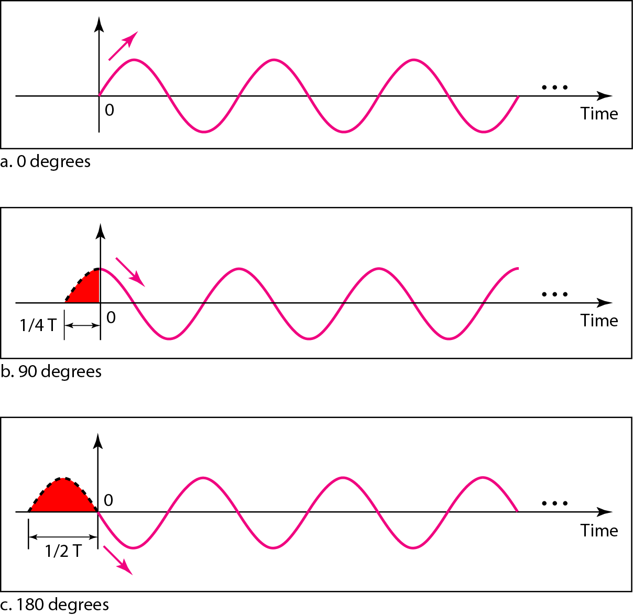
Three sine waves with the same amplitude and frequency, but different phases

Slide 14
Analog Signals
Analog signal benefit over digital
More variable
Convey greater subtleties with less energy
Drawback of analog signals
Varied and imprecise voltage
Vulnerable to transmission flaws

Slide 15
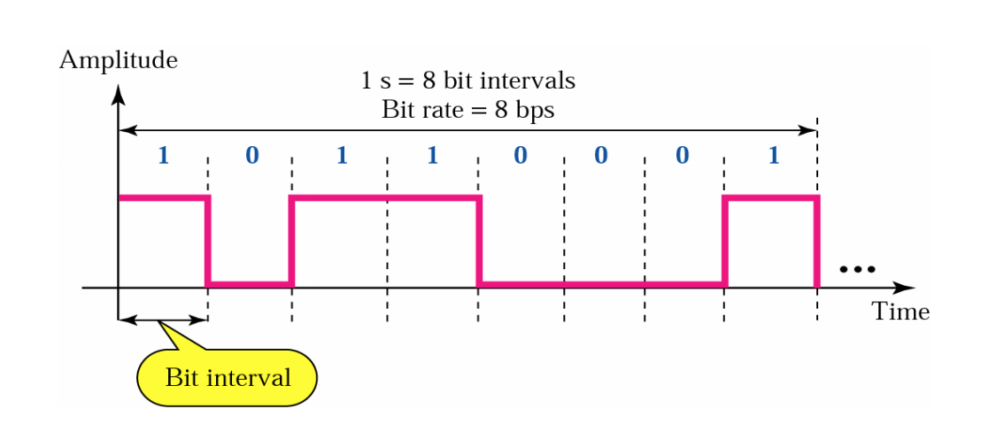
Digital Signals
Digital signals
Pulses of voltages
Positive voltage represents a 1
Zero voltage represents a 0
Digital signals composed of pulses
bit interval – time required to send a single bit, unit: [sec]
bit rate – number of bit intervals per second – unit: [bps]

Slide 16
Bandwidth and Bitrate
Bandwidth - The amount of data that can be transmitted in a fixed amount of time.
For digital devices, the bandwidth is usually expressed in bits per second (bps) or bytes per second.
For analog devices, the bandwidth is expressed in cycles per second, or Hertz (Hz).
Bitrate - is the number of transmitted bits per time unit (usually seconds) expressed in bits per second (bps) or bytes per second. Bit rate is part of bandwidth.

Slide 17
Data and Signals
Usually use digital signals for digital data and analog signals for analog data
Can use analog signal to carry digital data
Modem
Can use digital signal to carry analog data
Compact Disc audio

Slide 18
Analog Signals Carrying Analog and Digital Data

Slide 19
Digital Signals Carrying Analog and Digital Data

Slide 20
Analog Transmission
Analog signal transmitted without regard to content
May be analog or digital data
Attenuated over distance
Use amplifiers to boost signal
Also amplifies noise

Slide 21
Digital Transmission
Concerned with content
Integrity endangered by noise, attenuation etc.
Repeaters used
Repeater receives signal
Extracts bit pattern
Retransmits
Attenuation is overcome
Noise is not amplified

Slide 22
Advantages of Digital Transmission
Digital technology
Low cost technology
Data integrity
Longer distances over lower quality lines
Capacity utilization
High bandwidth links economical
High degree of multiplexing easier with digital techniques
Security & Privacy
Encryption
Integration
Can treat analog and digital data similarly

Slide 23
Transmission Impairment

Slide 24
Transmission Impairments
With any communications system, the signal that is received may differ from the signal that is transmitted, due to various transmission impairments.
Consequences:
For analog signals: degradation of signal quality
For digital signals: bit errors
The most significant impairments include
Attenuation
Distortion
Noise

Slide 25
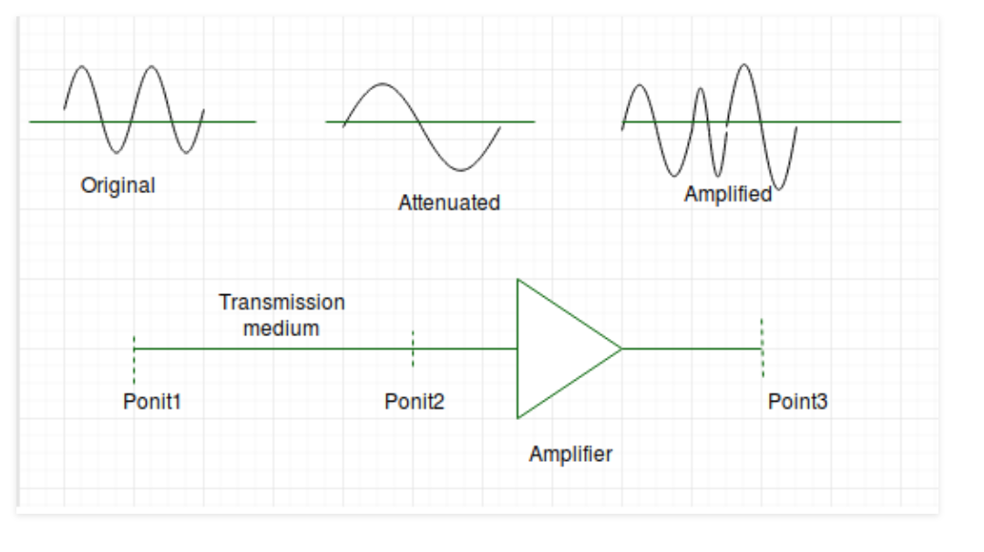
Attenuation
It means loss of energy.
The strength of signal decreases with increasing distance which causes loss of energy in overcoming resistance of medium.
Amplifiers are used to amplify the attenuated signal which gives the original signal back.

Slide 26
Attenuation
Attenuation is measured with decibel (dB) .
Decibel: A measure of the relative strength of two signal points.
Decibel can be positive + is signal is amplified, or negative if signal is attenuated.

Slide 27
decibel
dB = 10 Log10 ( P2/P1)
P2: the power of a signal at the end point (Watt)
P1: the power of a signal at the start point (Watt).
Example1:
Imagine a signal travels through a transmission medium and its power is reduced to half. Calculate the decibel.
Reduced to half means P2 = ½ P1
dB = 10 Log10 (P2/P1) = 10 Log 10 (0.5 p1/p1)
dB = 10 Log 10 (0.5) = 10 (-0.3) = - 3 dB

Slide 28
Distortion
It means change in the shape of signal.

Slide 29
Noise
For any data transmission event, the received signal will consist of the transmitted signal, modified by the various distortions imposed by the transmission system, plus additional unwanted signals that are inserted somewhere between transmission and reception.
The undesired signals are referred to as noise, which is the major limiting factor in communications system performance.
Four categories of noise:
Thermal noise
Intermodulation noise
Crosstalk
Impulse noise

Slide 30
Noise
Thermal noise (or white noise)
Due to thermal agitation of electrons
It is present in all electronic devices and transmission media, and is a function of temperature.
Cannot be eliminated, and therefore places an upper bound on communications system performance.
Intermodulation noise
When signals at different frequencies share the same transmission medium, the result may be intermodulation noise.
Signals at a frequency that is the sum or difference of original frequencies or multiples of those frequencies will be produced.

Slide 31
Noise
Crosstalk
It is an unwanted coupling between signal paths. It can occur by electrical coupling between nearby twisted pairs.
Typically, crosstalk is of the same order of magnitude as, or less than, thermal noise.
Impulse noise
Impulse noise is non-continuous, consisting of irregular pulses or noise spikes of short duration and of relatively high amplitude.
It is generated from a variety of cause, e.g., external electromagnetic disturbances such as lightning.
It is generally only a minor annoyance for analog data.
But it is the primary source of error in digital data communication.

Slide 32
Modulation

Slide 33
Modulation
Modulation
Modulation is the process of encoding information from a message source in a way that is suitable for transmission.
Modulation technique is used to change the signal characteristics.
Why do we modulate
larger distance transfer
accurate data transfer
low-noise data reception

Slide 34
Modulation

Slide 35
Analog Modulation
Analog modulation: a continuously varying sine wave is used as a carrier wave that modulates the message signal or data signal.

Slide 36
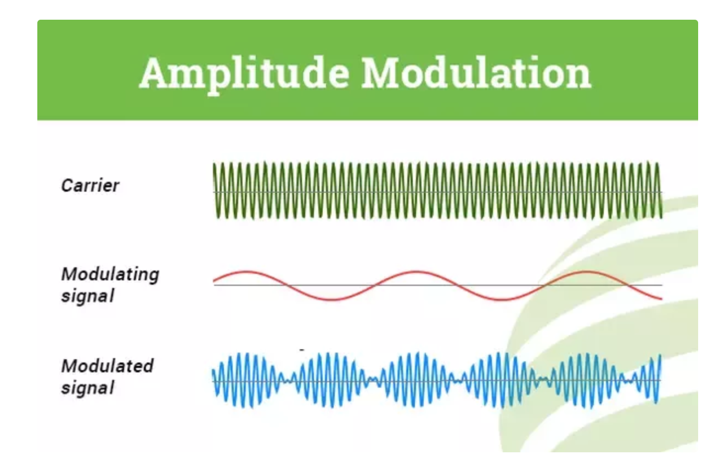
Amplitude Modulation
Amplitude modulation or AM: the height of the signal carrier is varied to represent the data being added to the signal.
The other factors like phase and frequency remain constant.

Slide 37
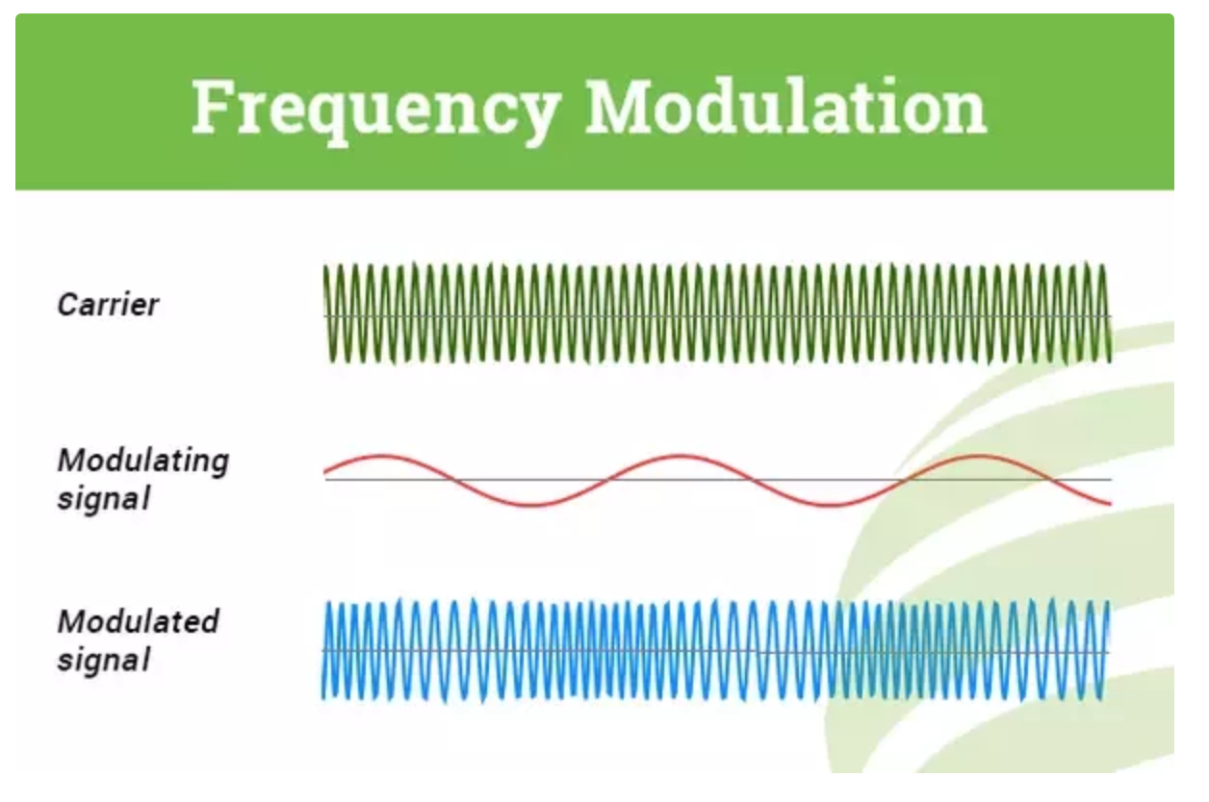
Frequency Modulation
Frequency modulation (FM), in which the frequency of the carrier waveform is varied to reflect the frequency of the data.
The other factors like phase and amplitude remain constant.

Slide 38
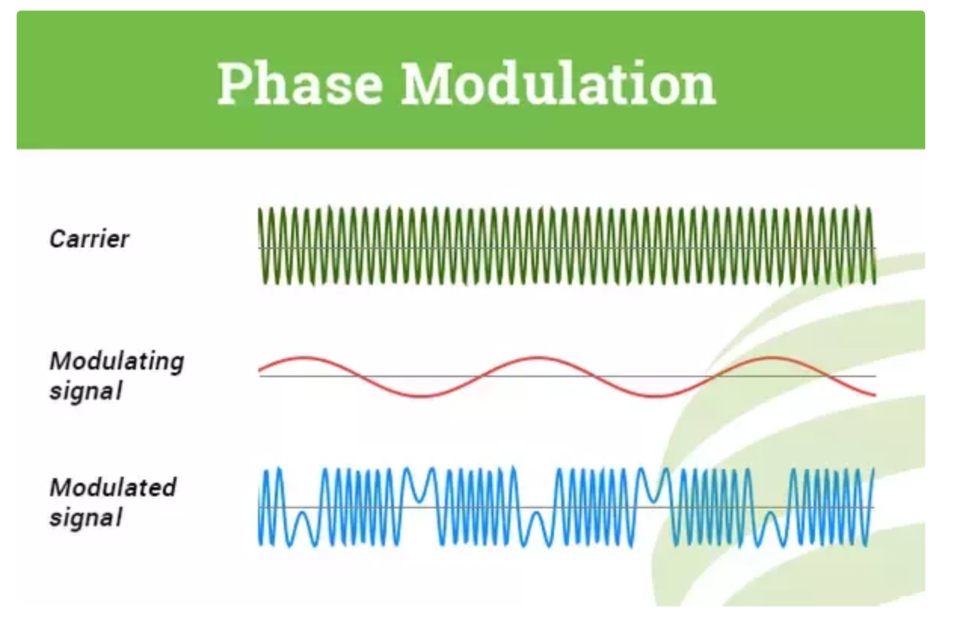
Phase Modulation
Phase modulation (PM), in which the frequency of the carrier waveform is varied to reflect changes in the frequency of the data.
it affects the frequency. So, for this reason, this modulation is also comes under the frequency modulation.

Slide 39
Analog Modulation
Analog modulation (AM, FM and PM) is more sensitive to noise. If noise enters into a system, it persists and gets carried till the end receiver. Therefore, this drawback can be overcome by the digital modulation technique.

Slide 40
Digital modulation
Digital modulation modifies an analog carrier signal with another discrete signal.
For a better quality and efficient communication, digital modulation technique is employed.
The main advantages of the digital modulation over analog modulation:
permissible power,
available bandwidth and
high noise immunity.
In digital modulation, a message signal is converted from analog to digital message, and then modulated by using a carrier wave.

Slide 41
Digital Modulation
In an Amplitude shift keying ASK, the amplitude of the carrier wave changes based on the message signal or on the base-band signal, which is in digital format.
It is sensitive to noise and used for low-band requirements.
In Frequency Shift Keying FSK, the frequency of the carrier wave is varied for each symbol in the digital data.
It needs larger bandwidths.
The Phase Shift Keying PSK changes the phase of the carrier for each symbol.
It is less sensitive to noise.

Slide 42
Transmission Types

Slide 43
Transmission Types
Simplex transmission
Signals are transmitted in only one direction
e.g. Television
Half duplex
Signals can be transmitted in either direction, but only one way at a time.
e.g. police radio
Full duplex
Both stations may transmit simultaneously.
e.g. telephone

Slide 44
Transmission Basics (continued)
Multiplexing
Allows multiple signals to travel simultaneously over one medium
In order to carry multiple signals, the medium’s channel is logically separated into multiple smaller channels, or sub channels
A device that can combine many signals on a channel, a multiplexer (mux), is required at the sending end of the channel
At the receiving end, a demultiplexer (demux) separates the combined signals and regenerates them in their original form

Slide 45
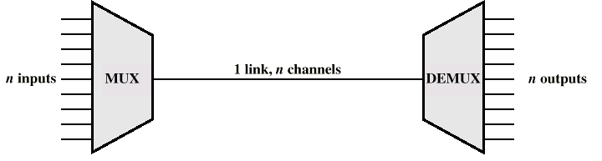
Multiplexing

Slide 46
Categories of multiplexing

Slide 47
Frequency Division Multiplexing
FDM
Useful bandwidth of medium exceeds required bandwidth of channel
Each signal is modulated to a different carrier frequency
Carrier frequencies separated so signals do not overlap (guard bands)
e.g. broadcast radio
Channel allocated even if no data

Slide 48
Frequency-division multiplexing (FDM)

Slide 49
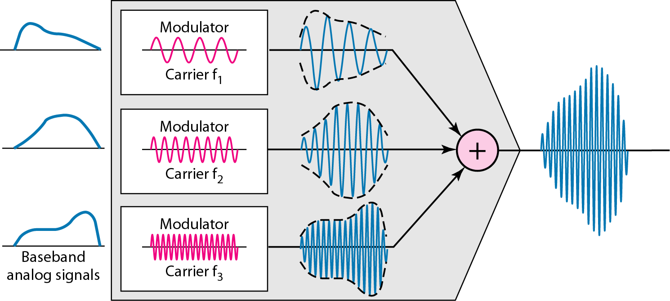
FDM process

Slide 50
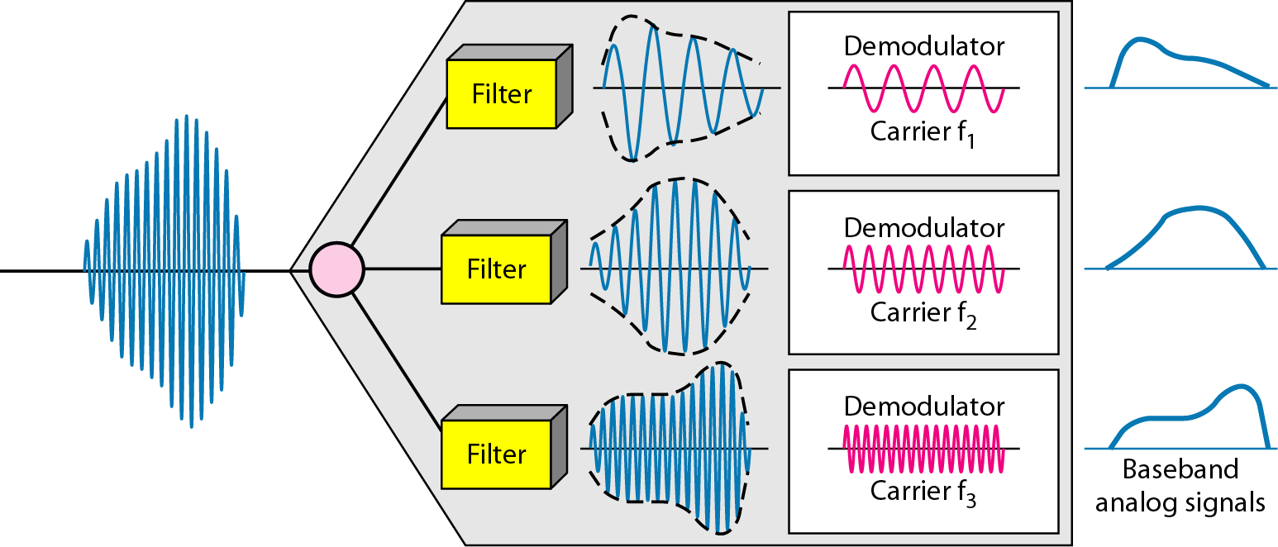
FDM demultiplexing example

Slide 51
Time Division Multiplexing (TDM)
Two ways of implementing TDM are:
Synchronous TDM
Asynchronous TDM

Slide 52
Synchronous TDM
Synchronous TDM works by the muliplexor giving exactly the same amount of time to each device connected to it.
This time slice is allocated even if a device has nothing to transmit.
This is wasteful in that there will be many times when allocated time slots are not being used.
Therefore, the use of Synchronous TDM does not guarantee maximum line usage and efficiency.

Slide 53
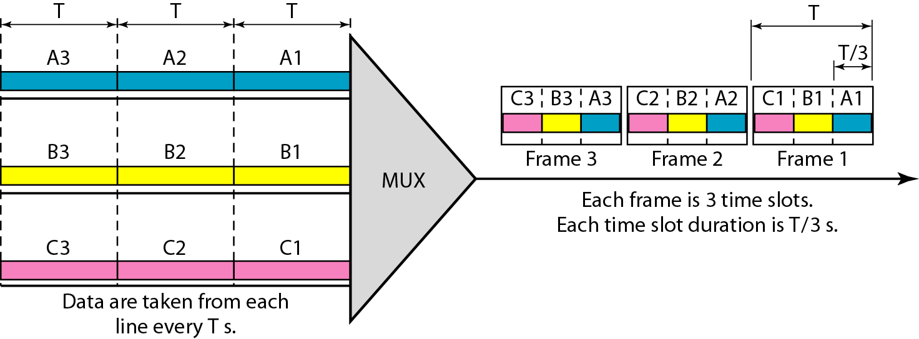
Synchronous time-division multiplexing

Slide 54
Asynchronous TDM
Asynchronous TDM is a more flexible method of TDM. With Asynchronous TDM the length of time allocated is not fixed for each device but time is given to devices that have data to transmit.
This version of TDM works by tagging each frame with an identification number to note which device it belongs to.
This may require more processing by the multiplexor and take longer, however, the time saved by efficient and effective bandwidth utilization makes it worthwhile.

