Slide 2
System Software
System software consists of the programs that control or maintain the operations of the computer and its devices
Operating systems
Utility Programs
Page 398

Slide 3
Operating Systems
An operating system (OS) is a set of programs containing instructions that work together to coordinate all the activities among computer hardware resources
Start and shut down a computer
Provide a user interface
Manage programs
Manage memory
Coordinate tasks
Configure devices
Establish an Internet connection
Monitor performance
Provide utilities
Automatically update
Control a network
Administer security
Pages 398 - 399

Slide 4
Operating Systems
Pages 398 – 399
Figure 8-1

Slide 5
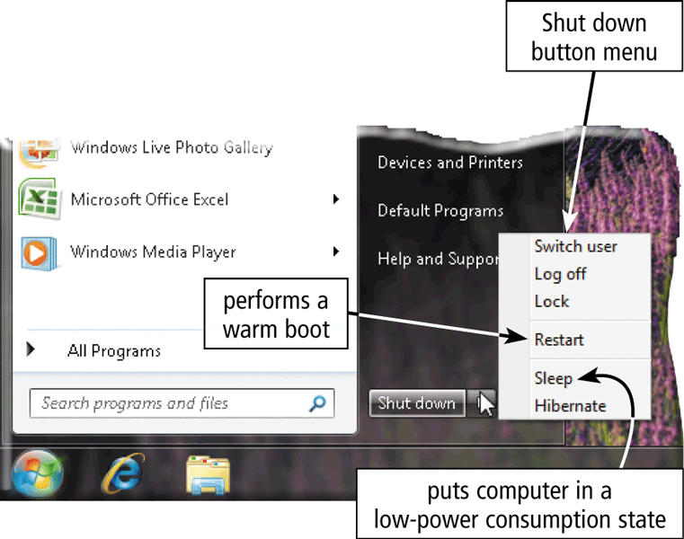
Operating System Functions
The process of starting or restarting a computer is called booting
Cold boot
Turning on a computer that has been powered off completely
Warm boot
Using the operating system to restart a computer
Page 400
Figure 8-2

Slide 6
Operating System Functions
Page 401
Figure 8-3

Slide 7
Operating System Functions
A boot drive is the drive from which your computer starts
You can boot from a boot disk
A recovery disk contains a few system files that will start the computer
Page 402

Slide 8
Operating System Functions
An operating system includes various shut down options
Sleep mode saves any open documents and programs to RAM, turns off all unneeded functions, and then places the computer in a low-power state
Hibernate saves any open documents and programs to a hard disk before removing power from the computer
Page 402

Slide 9
Operating System Functions
A user interface controls how you enter data and instructions and how information is displayed on the screen
With a graphical user interface (GUI), you interact with menus and visual images
Pages 402 – 403
Figure 8-4

Slide 10
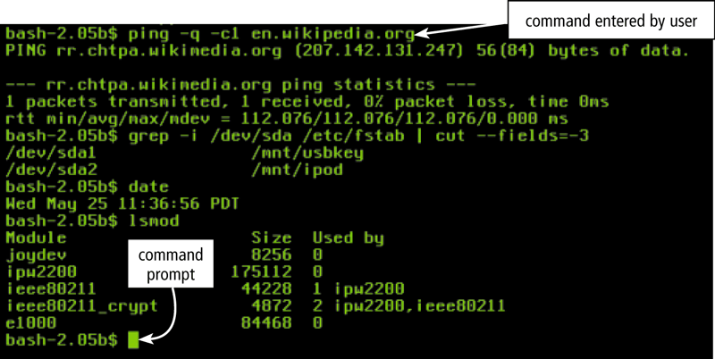
Operating System Functions
With a command-line interface, a user uses the keyboard to enter data and instructions
Page 403
Figure 8-5

Slide 11
Operating System Functions
Page 404
Figure 8-6

Slide 12
Operating System Functions
A driver is a small program that tells the operating system how to communicate with a specific device
Plug and Play automatically configures new devices as you install them
Page 408

Slide 13
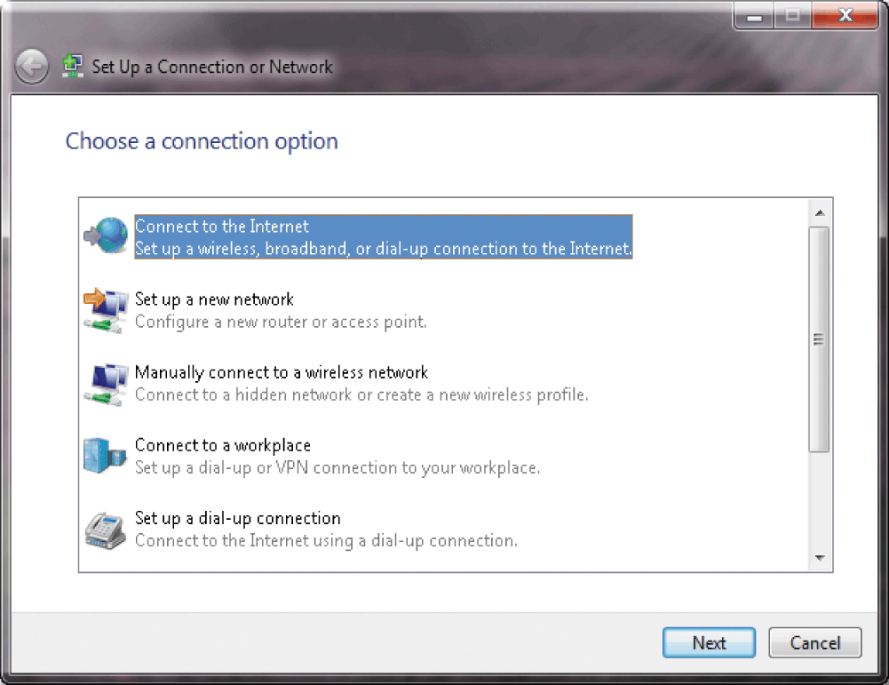
Operating System Functions
Operating systems typically provide a means to establish Internet connections
Page 408
Figure 8-10

Slide 14
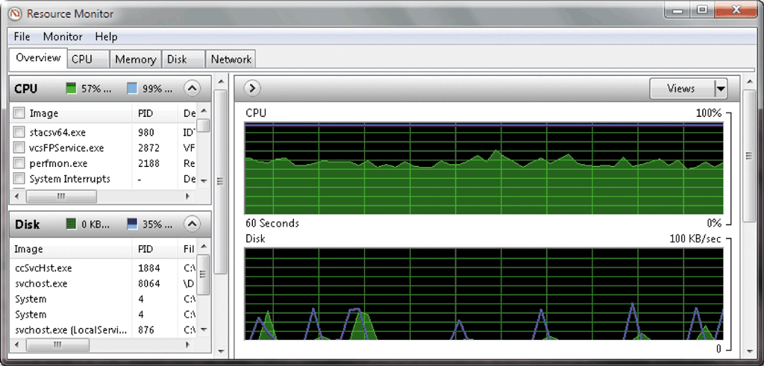
Operating System Functions
A performance monitor is a program that assesses and reports information about various computer resources and devices
Pages 408 – 409
Figure 8-11

Slide 15
Operating System Functions
Operating systems often provide users with the capability of:
Managing files
Searching for files
Viewing images
Securing a computer
Uninstalling programs
Cleaning up disks
Defragmenting disks
Diagnosing problems
Backing up files and disks
Setting up screen savers
Page 409

Slide 16
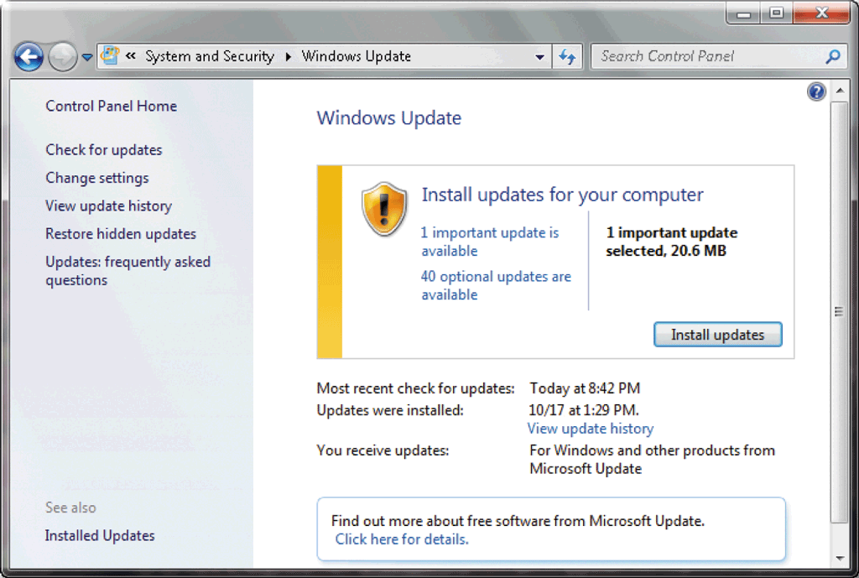
Operating System Functions
Automatic update automatically provides updates to the program
Page 409
Figure 8-12

Slide 17
Operating System Functions
Each user has a user account
A user name, or user ID, identifies a specific user
A password is a private combination of characters associated with the user name
Page 410
Figure 8-13

Slide 18
Types of Operating Systems
Page 412
Figure 8-14

Slide 19
Stand-Alone Operating Systems
A stand-alone operating system is a complete operating system that works on a desktop computer, notebook computer, or mobile computing device
Windows 7
Mac OS X
UNIX
Linux
Page 412

Slide 20
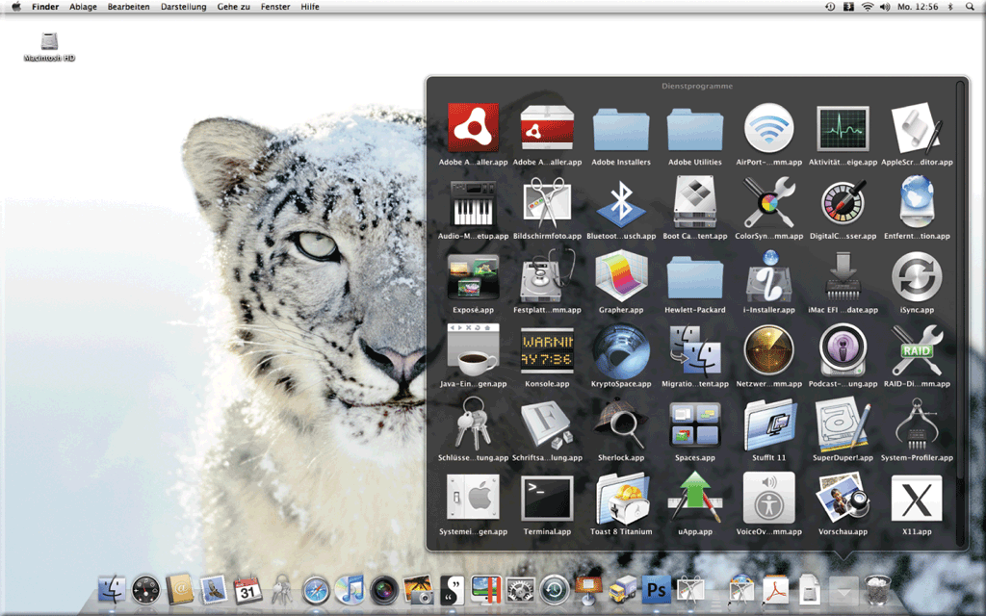
Stand-Alone Operating Systems
The Macintosh operating system has set the standard for operating system ease of use
Latest version is Mac OS X
Page 415
Figure 8-19

Slide 21
Stand-Alone Operating Systems
UNIX is a multitasking operating system developed in the early 1970s
Linux is an open-source, popular, multitasking UNIX-type operating system
Pages 416 – 417
Figures 8-20 – 8-21

Slide 22
Server Operating Systems
Windows Server 2008
UNIX
Linux
Solaris
NetWare
Pages 417 - 418

Slide 23
Embedded Operating Systems
An embedded operating system resides on a ROM chip on a mobile device or consumer electronic device
Windows Embedded CE
Windows Phone 7
Palm OS
iPhone OS
BlackBerry
Embedded Linux
Symbian OS
Google Android
Pages 418 - 420

Slide 24
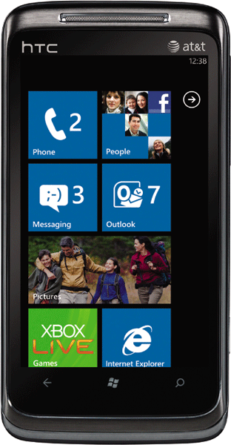
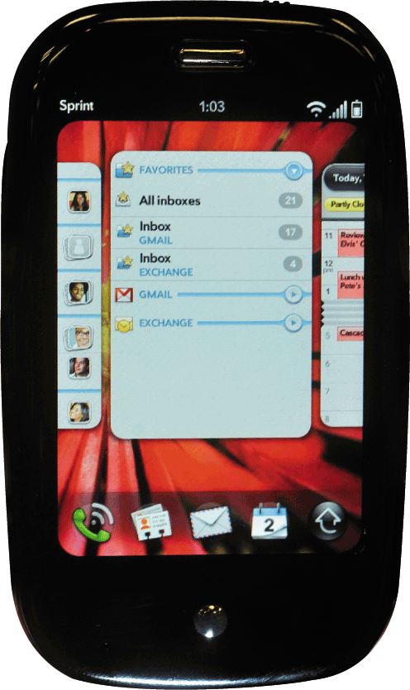
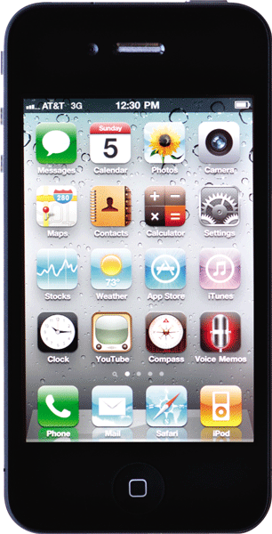
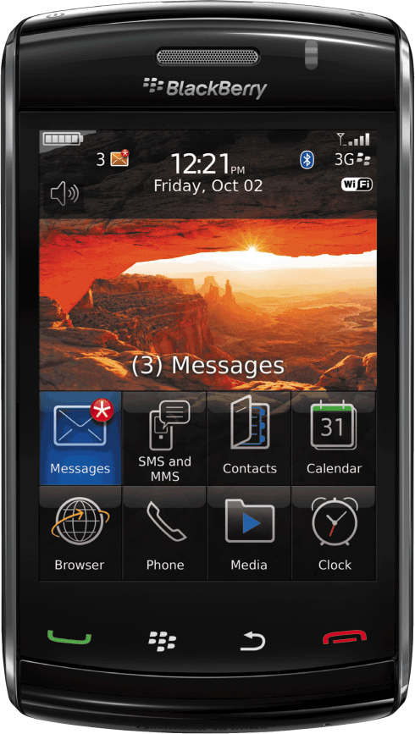
Embedded Operating Systems
Pages 419 – 420
Figures 8-22 – 8-26

Slide 25
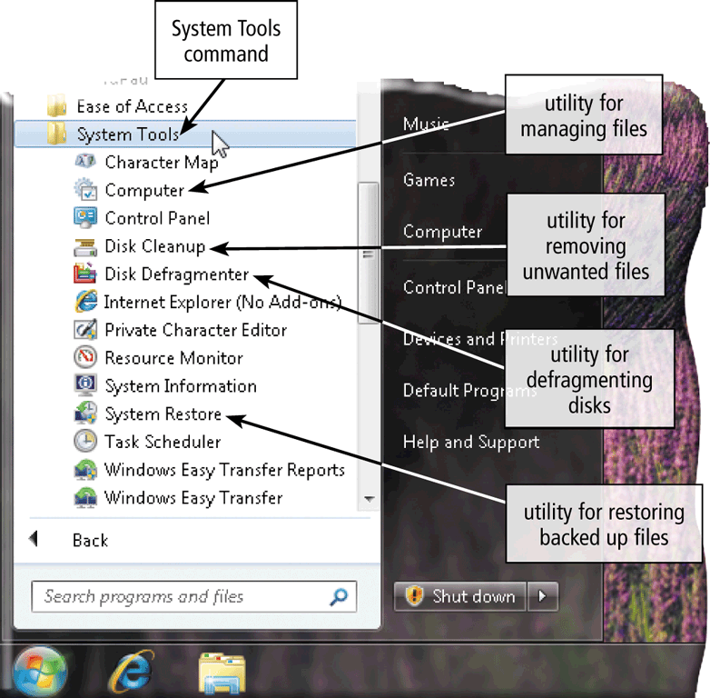
Utility Programs
A utility program is a type of system software that allows a user to perform maintenance-type tasks
Page 421
Figure 8-27

Slide 26
Utility Programs
A file manager is a utility that performs functions related to file management
Displaying a list of files
Organizing files in folders
Copying, renaming, deleting, moving, and sorting files and folders
Creating shortcuts
Page 422
Figure 8-28

Slide 27
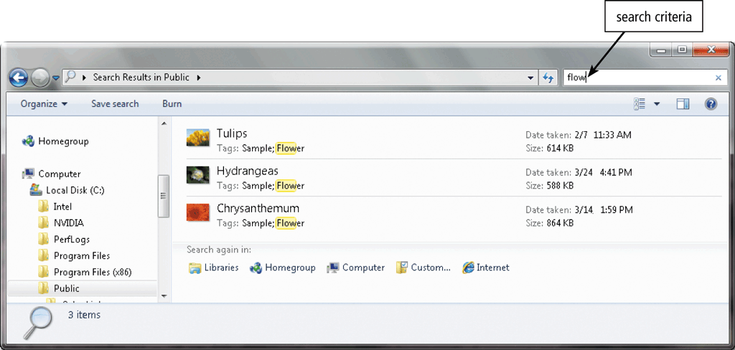
Utility Programs
A search utility is a program that attempts to locate a file on your computer based on criteria you specify
Page 422
Figure 8-29

Slide 28
Utility Programs
An image viewer allows users to display, copy, and print the contents of a graphics file
Page 423
Figure 8-30

Slide 29
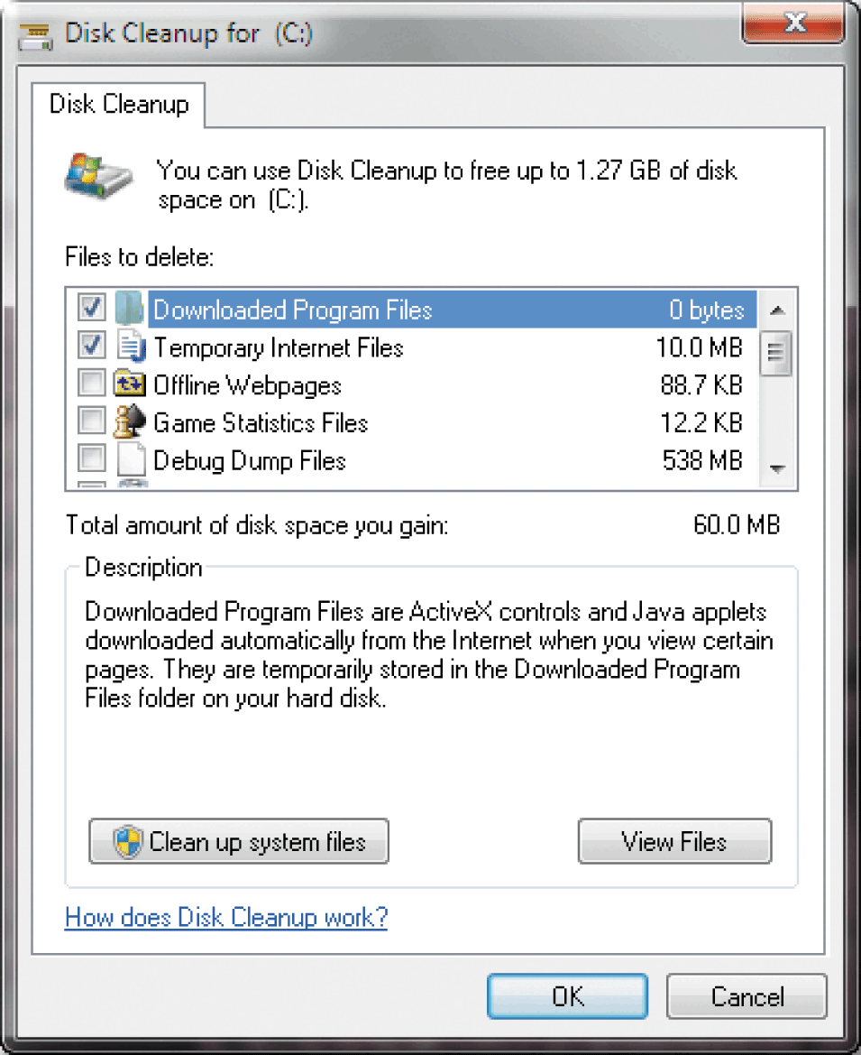
Utility Programs
A disk cleanup utility searches for and removes unnecessary files
Downloaded program files
Temporary Internet files
Deleted files
Unused program files
Page 423
Figure 8-31

Slide 30
Utility Programs
A disk defragmenter reorganizes the files and unused space on a computer’s hard disk so that the operating system accesses data more quickly and programs run faster
Defragmenting
Pages 423 – 424
Figure 8-32

Slide 31
Utility Programs
A backup utility allows users to copy files to another storage medium
A restore utility reverses the process and returns backed up files to their original form
Page 424
Figure 8-33

Slide 32
Utility Programs
A virus describes a potentially damaging computer program that affects a computer negatively
A worm copies itself repeatedly in memory or over a network
A Trojan horse hides within or looks like a legitimate program
An antivirus program protects a computer against viruses
Pages 425 - 426

Slide 33
Utility Programs
Spyware is a program placed on a computer without the user’s knowledge that secretly collects information about the user
Adware displays an online advertisement in a banner or pop-up window
A spyware remover detects and deletes spyware and other similar programs
An adware remover is a program that detects and deletes adware
Page 426

Slide 34
Utility Programs
A file compression utility shrinks the size of a file(s)
Compressing files frees up room on the storage media
Compressed files sometimes are called zipped files
Can be uncompressed
Page 427

Slide 35
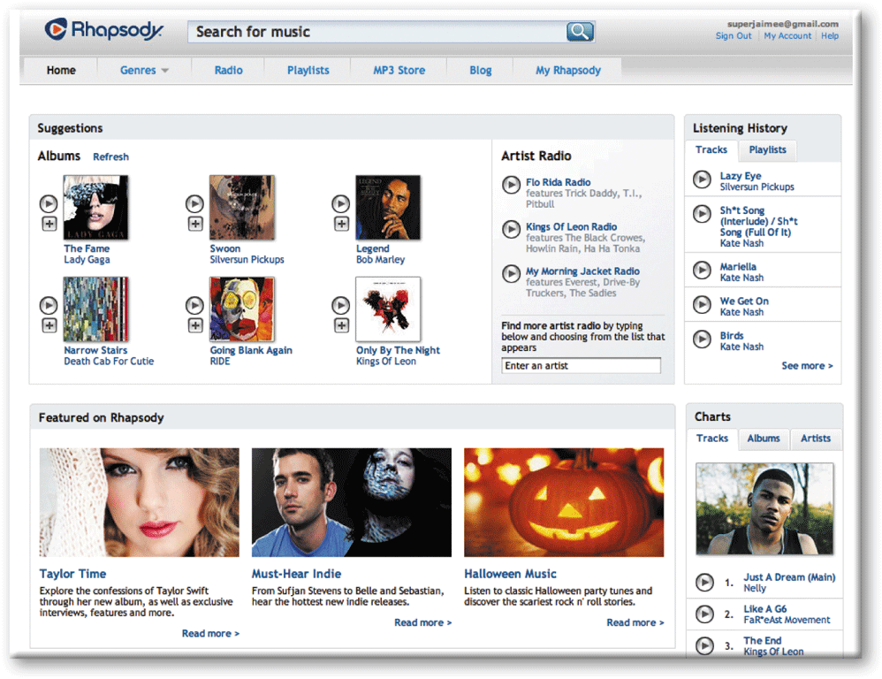
Utility Programs
A media player allows you to view images and animation, listen to audio, and watch video files on your computer
Page 427
Figure 8-38

Slide 36
Utility Programs
Disc burning software writes text, graphics, audio, and video files on a recordable or rewritable optical disc
Page 428
Figure 8-39

