Slide 1
Edited By :Asma AlOsaimi
Modified by: Nawal AlShehri

Slide 2
Objectives
storage devices vs. storage media
Storage characteristics
magnetic storage
Optical storage
Flash memory storage
Cloud storage
Other storage devices

Slide 3
Storage
Storage holds data, instructions, and information for future use
The physical material that actually holds data is called a storage medium. The surface of a floppy disk is a storage medium.
The hardware that writes data to or reads data from a storage medium is called a storage device. A floppy disk drive is a storage device.
The storage technologies are magnetic , optical , flash memory stoarge and cloud stoarge .

Slide 4
Storage
Reading is the process of transferring items from a storage medium into memory
Writing is the process of transferring items from memory to a storage medium
Page 354

Slide 5
Storage
Pages 352 – 353
Figure 7-1

Slide 6
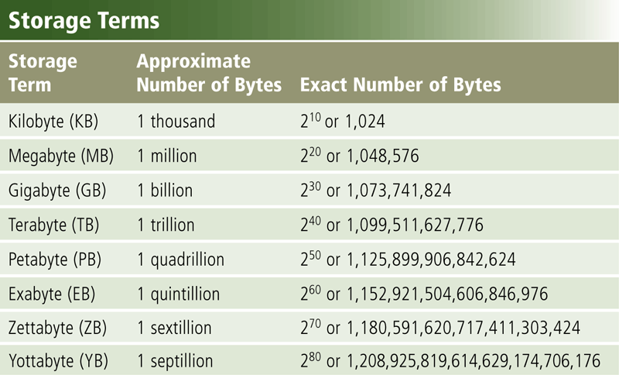
Storage
Capacity is the number of bytes a storage medium can hold
Page 354
Figure 7-2

Slide 7
Storage
Access time measures:
The amount of time it takes a storage device to locate an item on a storage medium
The time required to deliver an item from memory to the processor
Page 355
Figure 7-4

Slide 8
Magnetic storage
How Magnetic Storage Works
Formatting
Disk Areas
Types:
Hard Disk
Diskette
Zip disks.

Slide 9
How Magnetic Storage Works
A magnetic disk's medium contains iron particles, which can be polarized—given a magnetic charge—in one of two directions.
Each particle's direction represents a 1 (on) or 0 (off), representing each bit of data that the CPU can recognize.
A disk drive uses read/write heads containing electromagnets to create magnetic charges on the medium.

Slide 10
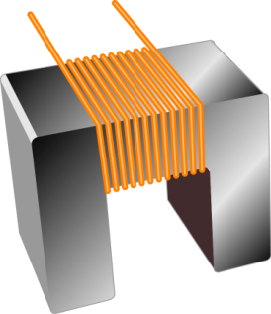
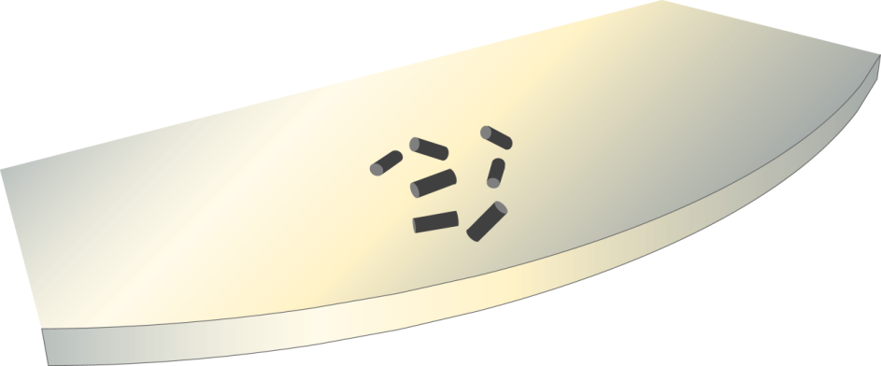
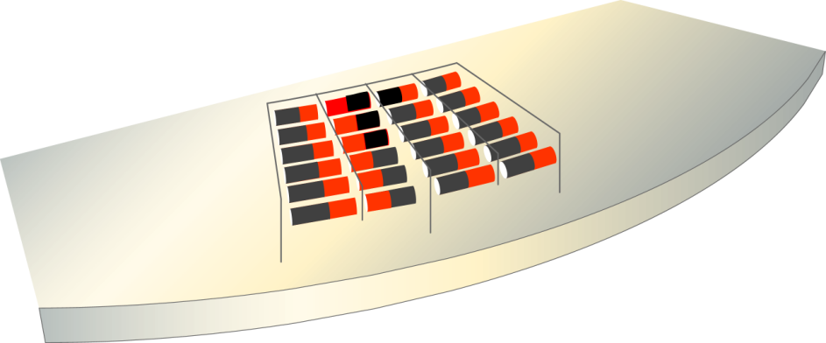
Write head
Medium
Random particles
(no data stored)
Current flow
(write operation)
Organized particles
(represent data)

Slide 11
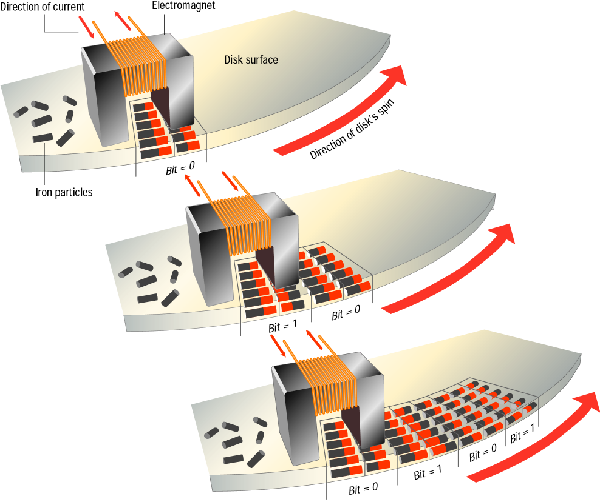
http://www.youtube.com/watch?v=f3BNHhfTsvk
As the medium
rotates, the head
writes the data.

Slide 12
Formatting
Before a magnetic disk can be used, it must be formatted—a process that maps the disk's surface and determines how data will be stored.
During formatting, the drive creates circular tracks around the disk's surface, then divides each track into sectors.
The OS organizes sectors into groups, called clusters, then tracks each file's location according to the clusters it occupies.

Slide 13
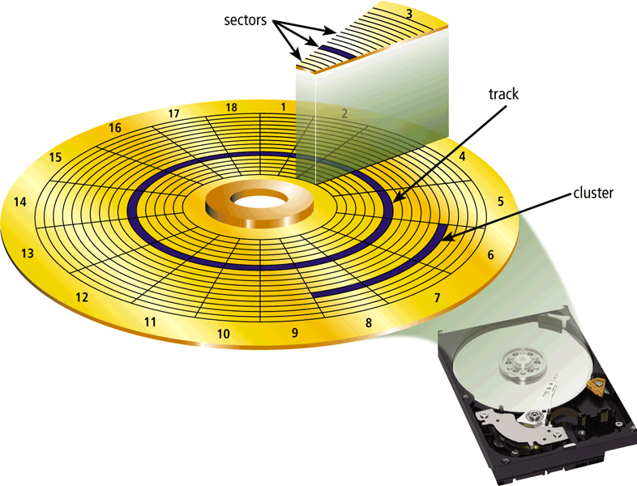
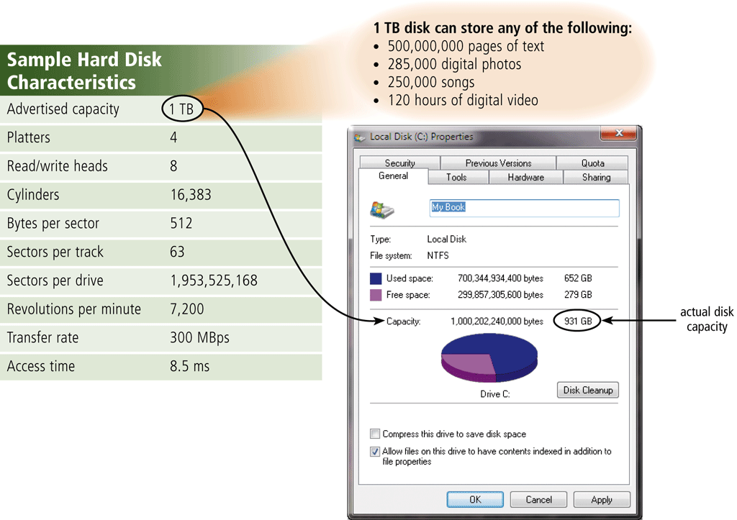
Formatted Disk
http://www.youtube.com/watch?v=kdmLvl1n82U

Slide 14
Disk Areas
When a disk is formatted, the OS creates four
areas on its surface:
Boot sector – stores the master boot record, a small program that runs when you first start (boot) the computer
File allocation table (FAT) – a log that records each file's location and each sector's status
Root folder – enables the user to store data on the disk in a logical way
Data area – the portion of the disk that actually holds data

Slide 15
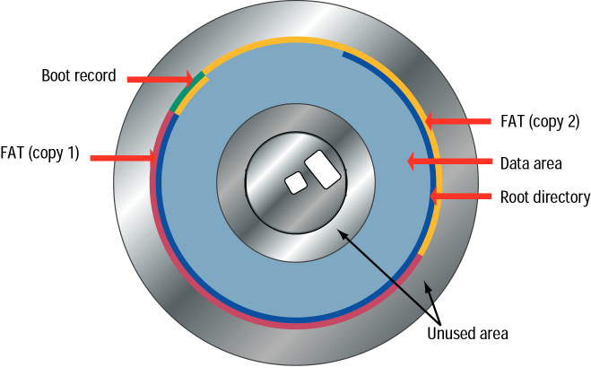

Slide 16
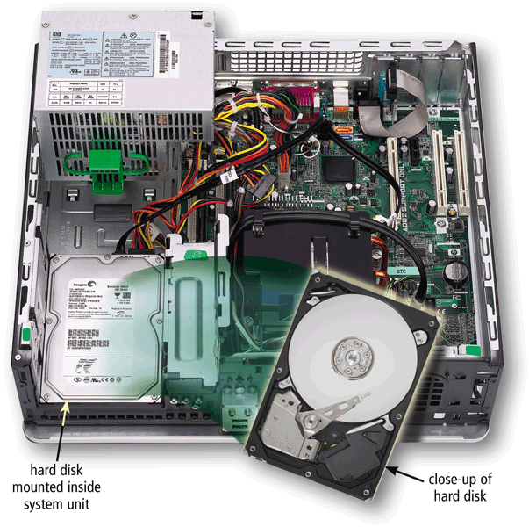
Magnetic Storage Devices -Hard Disks
A hard disk contains one or more inflexible, circular platters that use magnetic particles to store data, instructions, and information
Page 355
Figure 7-5

Slide 17
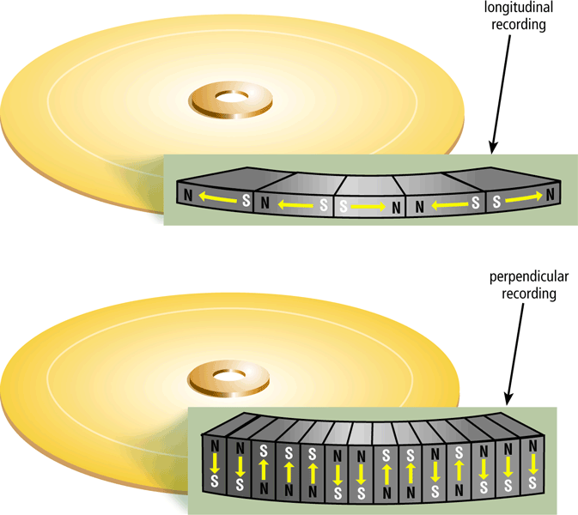
Magnetic Storage Devices -Hard Disks
Hard disks can store data using longitudinal recording or perpendicular recording
Hard disks use multiple platters. Each platter has two read/write heads, one for each side.
Page 356
Figure 7-6

Slide 18
Characteristics of a Hard Disks
The capacity of a hard disk is determined from the number of platters it contains.
Platter is made of aluminum, glass, or ceramic.
On desktop computer, platters most often have size of approximately 3.5 inches in diameter.
While the computer is running, the platters rotate at a high rate of speed.
The platters typically continue to spin until power is removed from the computer.
On many computers, the hard disk stops spinning after a specified time to save power.
Backup is a duplicate of a file, program, or disk that you can use in case the original is lost, damaged, or destroyed.
http://www.youtube.com/watch?v=9eMWG3fwiEU

Slide 19
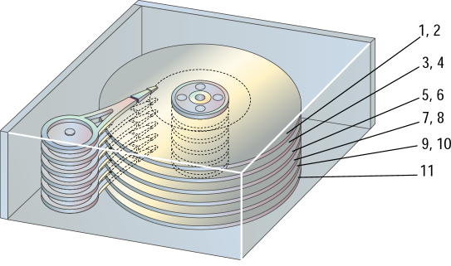
Read/write heads

Slide 20
How a Hard Disk works
Page 358
Figure 7-9

Slide 21
Hard Disks – reading & writing
The hard disk arms move the read/write head, which reads items and writes items in the drive
Location often is referred to by its cylinder
Page 358
Figure 7-10

Slide 22
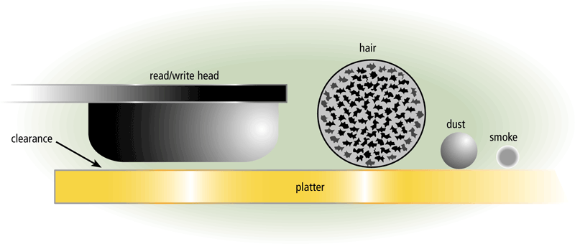
Hard Disks - head crash
A head crash occurs when a read/write head touches the surface of a platter
Always keep a backup of your hard disk
Pages 358 – 359
Figure 7-11

Slide 23
Hard Disks – other categories
An external hard disk is a separate free-standing hard disk that connects to your computer with a cable or wirelessly
A removable hard disk is a hard disk that you insert and remove from a drive
Internal and external hard disks are available in miniature sizes (miniature hard disks)
They are found in devices such as audio players, digital cameras, smart phones, and PDAs.
Pages 360 – 361
Figures 7-14 – 7-15

Slide 24
Magnetic Storage Devices - Diskettes
Diskette drives, also known as floppy disk drives, read and write to diskettes (called floppy disks or floppies).
Diskettes are used to transfer files between computers, as a means for distributing software, and as a backup medium.
Diskettes come in two sizes: 5.25-inch and 3.5-inch.
Diskettes are available in different capacities, but the most common store 1.44 MB.

Slide 25
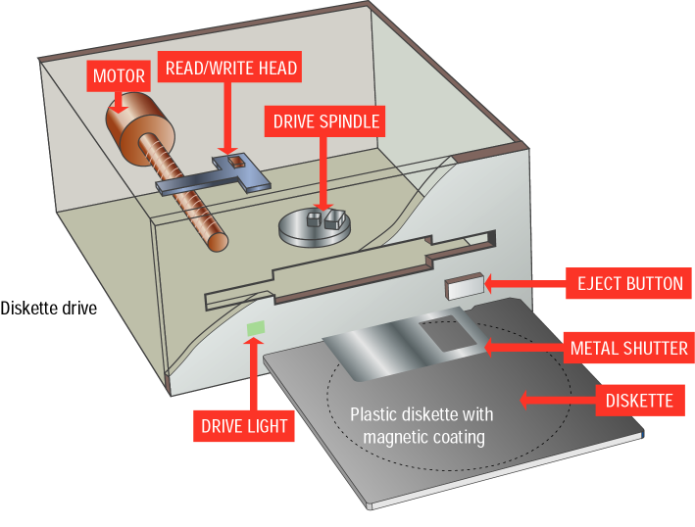
3.5 inch
floppy
and drive

Slide 26
Magnetic stoarge devices – Zip disk
Is a type of portable magnetic media that can store from 100 MB to 750 MB of data.
Zip Drive
Is a high capacity disk drive developed by Iomega Corporation that reads from and writes on a Zip disk.

Slide 27
Thee primary types of optical storage :
CD
BD-ROM
DVD

Slide 28
Optical Discs
An optical disc consists of a flat, round, portable disc made of metal, plastic, and lacquer that is written and read by a laser
Typically store software, data, digital photos, movies, and audio
Read only vs. rewritable
http://www.youtube.com/watch?v=9UpXZePFQ0M
Page 370
Figure 7-25

Slide 29
Optical Discs
Page 370
Figure 7-26

Slide 30
Optical Discs
Optical discs commonly store items in a single track that spirals from the center of the disc to the edge
Track is divided into evenly sized sectors
Page 371
Figure 7-27

Slide 31
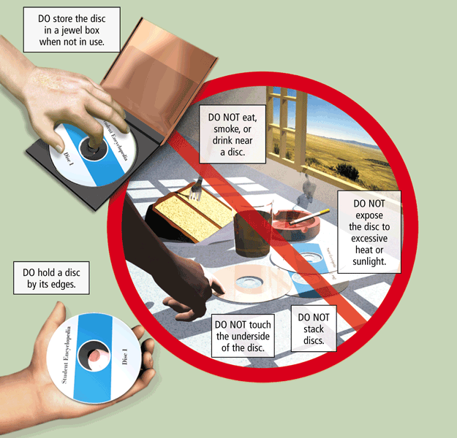
Optical Discs
Care of optical discs
Page 371
Figure 7-28

Slide 32
Optical Discs
A CD-ROM can be read from but not written to
Read from a CD-ROM drive or CD-ROM player
A CD-R is a multisession optical disc on which users can write, but not erase
A CD-RW is an erasable multisession disc
Must have a CD-RW drive
Pages 372 – 373
Figure 7-29

Slide 33
Optical Discs
A DVD-ROM is a high-capacity optical disc on which users can read but not write or erase
Requires a DVD-ROM drive
A Blu-ray Disc-ROM (BD-ROM) has a storage capacity of 100 GB
DVD-RW, DVD+RW, and DVD+RAM are high-capacity rewritable DVD formats
Pages 375 – 376
Figure 7-29

Slide 34
Flash Memory Storage
Memory cards
USB flash drives
ExpressCard module.

Slide 35
Flash Memory Storage
Flash memory chips are a type of solid state media and contain no moving parts
Solid state drives (SSDs) have several advantages over magnetic hard disks:
Faster access time
Faster transfer rates
Generate less heat and consume less power
Last longer
Pages 362 - 363

Slide 36
Flash Memory Storage
Page 363
Figure 7-17

Slide 37
Flash Memory Storage
A memory card is a removable flash memory device that you insert and remove from a slot in a computer, mobile device, or card reader/writer
CompactFlash (CF)
Secure Digital (SD)
Secure Digital High Capacity (SDHC)
microSD
microSDHC
xD Picture Card
Memory Stick
Memory Stick Micro (M2)
Page 364

Slide 38
Flash Memory Storage
Pages 364 – 365
Figures 7-18 – 7-19

Slide 39
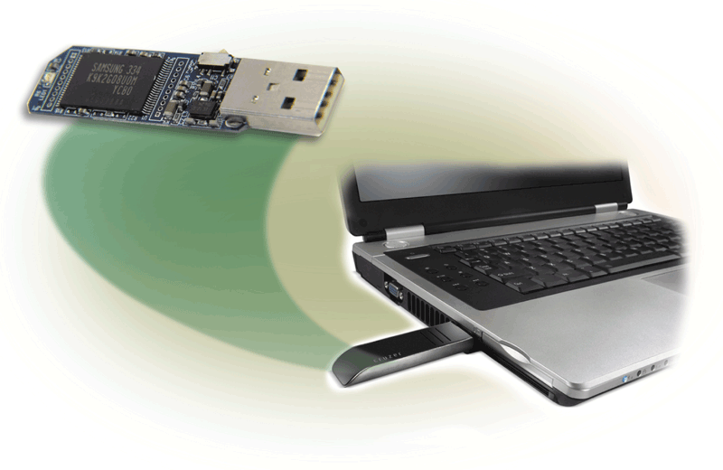
Flash Memory Storage- USB flash drives
USB flash drives plug into a USB port on a computer or mobile device
Sometimes called a pen drive
Become the mobile user’s primary storage device.
Current USB flash drive have storage capacities up to 64 GB.
Page 367
Figure 7-21

Slide 40
Flash Memory Storage- ExpressCard
An ExpressCard module is a removable device that fits in an ExpressCard slot
Developed by the PCMCIA
Commonly used in notebook computers
Page 367
Figure 7-22

Slide 41
Cloud Storage
Cloud storage is an Internet service that provides storage to computer users
Page 368
Figure 7-23

Slide 42
Cloud Storage
Page 368
Figure 7-24

Slide 43
Other Types of Storage
Tape
Magnetic stripe cards
Microfilm and microfiche
Smart cards
Page 376

Slide 44
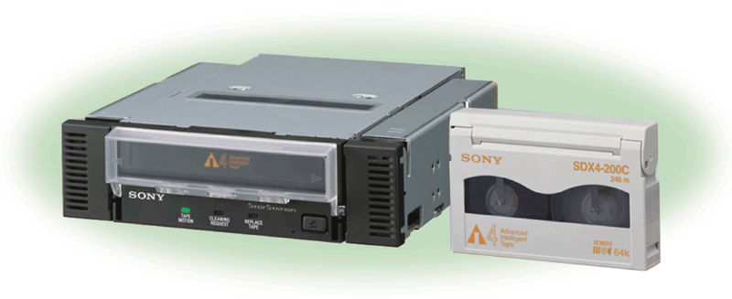
Tape
Tape is a magnetically coated ribbon of plastic capable of storing large amounts of data and information
A tape drive reads and writes data and information on a tape
Tape storage requires sequential access, which refers to reading or writing data one after the other.
You must forward or rewind the tape to a specific point to access a specific piece of data.
Page 376
Figure 7-35

Slide 45
Other Types of Storage
A magnetic stripe card contains a magnetic stripe that stores information
A smart card stores data on a thin microprocessor embedded in the card
Page 377
Figure 7-36

Slide 46
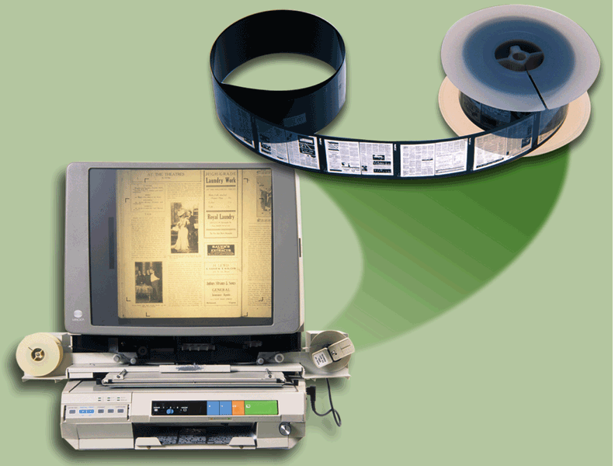
Other Types of Storage
Microfilm and microfiche store microscopic images of documents on a roll or sheet film
Page 378
Figure 7-37

Slide 47
Other Types of Storage
Page 378
Figure 7-38

