Slide 1
GE105
Introduction to Engineering Design College of Engineering
King Saud University
Lecture 2.
An Overview of Engineering Design
Summer 2017

Slide 2
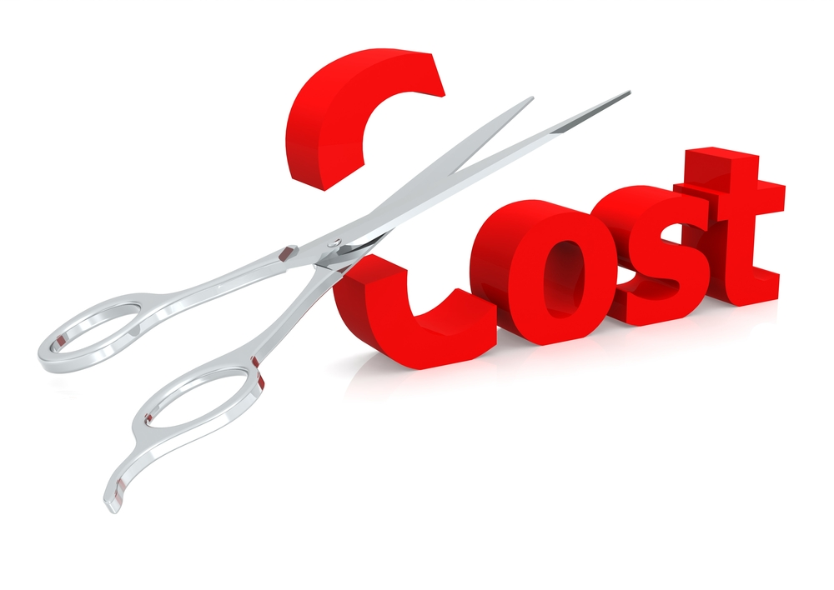
Importance of Engineering Design
70% of a product’s total cost (design, manufacturing and installation) is determined by its design
Studies have shown that 50 to 80% of the life cycle costs of products (maintenance, energy, etc.) are influenced by engineering design
Costs Include:
Material costs
Facilities
Tooling
Labor
Other support costs

Slide 3
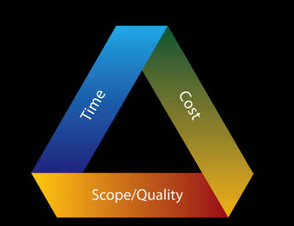
What is Engineering Design?
Engineering design is the process of devising a system, component or process to meet desired needs.
In this process, basic sciences and engineering are applied to optimally convert resources to meet a stated objective.
Among the fundamental blocks of this process are: objectives, criteria, synthesis, analysis, construction, testing, and evaluation.
In addition to these blocks It is essential to consider realistic constraints such as economic factors, safety, reliability, aesthetics, ethics and social factors.

Slide 4
An ABET Requirement
(Accreditation Board for Engineering and Technology)
Every Engineering Department* must include a major engineering design experience that builds upon the fundamental concepts of: mathematics, basic sciences, humanities, social sciences, engineering topics, and communication skills
The scope of the design experience within a program should match the requirements of practice within that discipline
All design work should not be done in isolation by individual students; team efforts are encouraged where appropriate
Notes:
* More specifically, every academic program

Slide 5
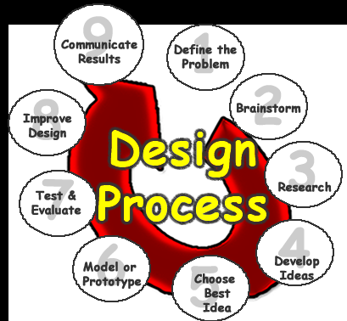
The Design Process Steps
Define the Problem
Brainstorm for creative ideas
Search and research
Develop Ideas
Analyze alternative solutions and choose the best one
Model or prototype
Test and Evaluate
Improve if needed
Communicate results

Slide 6
Problem Statement
This is the single most important step in the design process
Only when you can specify the problem can you hope to achieve your goal
Loss of efforts and efficiency occurs when trying to solve unclear problems
If this step is done incorrectly or incompletely it results in a failure of the design
It is important to define the true problem one is solving, not just the symptoms of the problem or the perceived problem
Objectives
Objectives are a function of needs
Objectives should be SMART
Specific
Measurable
Achievable
Realistic
Time-bounded

Slide 7
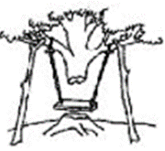
Problem Statement: “The current box is easily damaged during transportation” Objective “Design a stronger box for our new product” Another Objective “Design an improved box*”
Step 1: Problem Statement
Importance of Accurate Objective and Statement **
Problem Definition
Design
Installation
Customer
Need
Notes:
e.g. shape or material, etc.
i.e. there are different perspectives to a certain problem (and all must be taken into consideration)

Slide 8
Step 2: Brainstorming
Think “outside the box”
Generate creative ideas
Explore other members’ ideas
Avoid criticism/judgment
(do not criticize during brainstorming! Criticism will be applied at a later stage)

Slide 9
Step 3: Search and Research
Search: for finding a product or checking the price of an item
Research*: finding the answers to more complicated questions or looking at multiple aspects of an issue
Possible resources: Publications, Internet, Market, Patent listings, Sales catalogs, Experts
Notes:
* Research: usually involves the latest features involving a certain product, design, etc.

Slide 10
Step 4: List and Evaluate Alternative Solutions
One possible solution!!
Be critical
Edison: ”It is easy to obtain 100 patents if you also have 5000 unsuccessful inventions*”
Notes:
* See as an example how much effort went into creating the famous “Angry Birds” game http://www.ibtimes.co.uk/rovio-overnight-angry-brids-success-51-failed-522587

Slide 11
Step 5: Choose the Best Solution
 | Weight | Rate for Design 1 | Rate for Design 2 | Rate for Design 3
1. Cost
2. Production difficulty
3. Size, weight, strength
4. Appearance
5. Convenience
6. Safety
7. Legal issues
8. Reliability/ durability
9. Customer appeal
TOTAL points | 100 | points=rate*weight

Slide 12
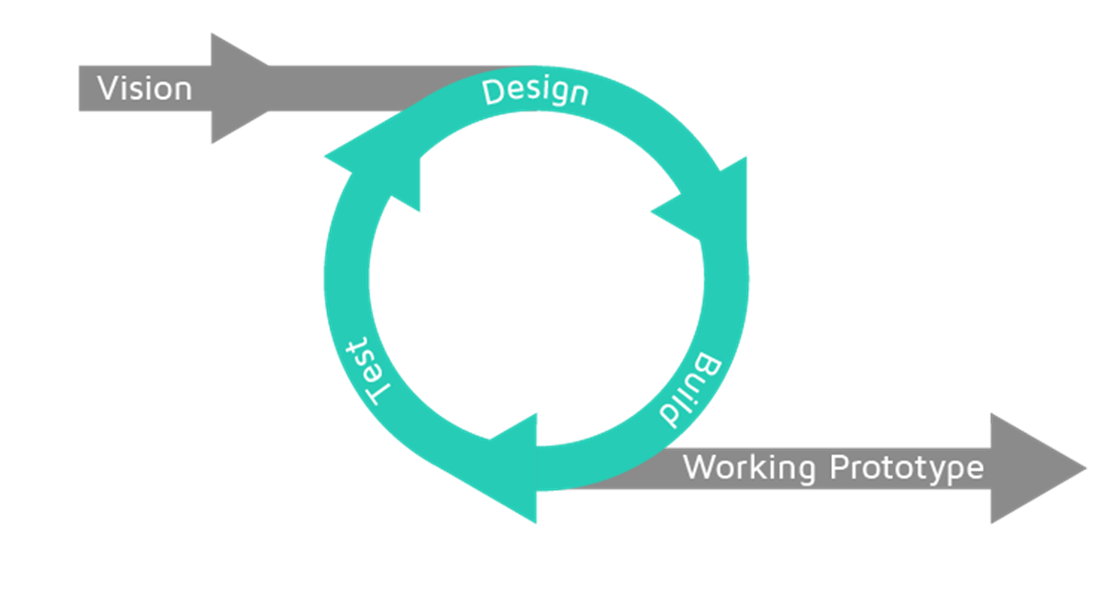
Step 6: Construction, Analysis and Testing
An Iterative process
Step 7: Final Evaluation
Develop the best design

Slide 13
Step 8: Communication
Communicate and report on all the final details of the design through:
Engineering Notebook (logbook)
Written reports
Technical presentation
Training material, catalogue, manuals*
Notes:
* All additional material

