Slide 1
Chapter 11
Simple Linear Regression
and Correlation

Slide 2
Introduction:
A reasonable form of a relationship between the response (dependent) Y and the independent variable, $x$is the linear relationship
where $β_{0}$ is the intercept and $β_{1}$ is the slope. The relationship is illustrated in the following figure.

Slide 3
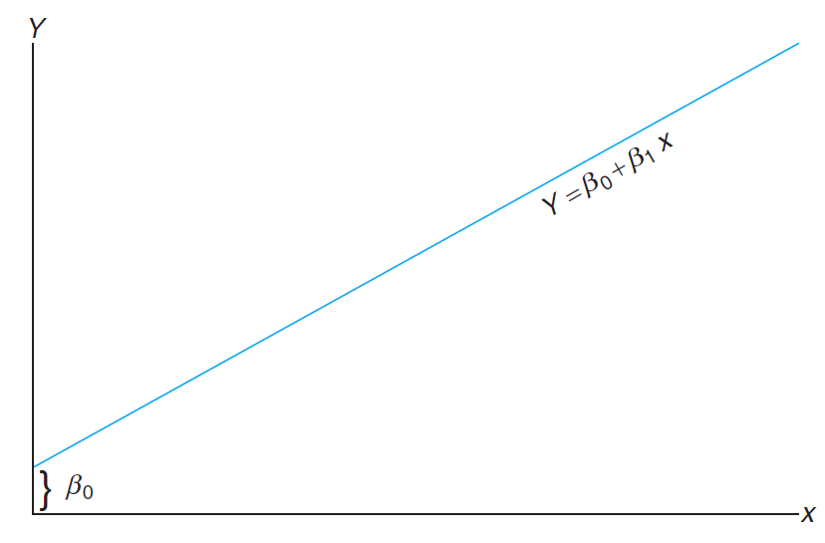

Slide 4
Regression Analysis:
The concept of regression analysis deals with finding the best relationship between Y and X.
Regression analysis measures the strength of the relationship, and allows for prediction of the response values Y for given values of the regressor X (x.)

Slide 5
In many applications, there will be more than one independent variable that helps to explain Y.
For example: in the case where the response is the price of a house, one would expect the age of the house to contribute to the explanation of the price, so in this case the multiple regression structure might be written
$$Y = β_{0} +β_{1}x_{1}+β_{2}x_{2},$$
where Y is price, $x_{1}$ is square footage, and $x_{2}$ is age in years.

Slide 6
The Simple Linear Regression Model
In the above, $β_{0}$ and $β_{1}$ are unknown intercept and slope parameters, respectively, and $ε$is a random variable that is assumed to be distributed with
$E(ε)$ = 0 and $Var(ε)$ = $σ^{2}$.

Slide 7
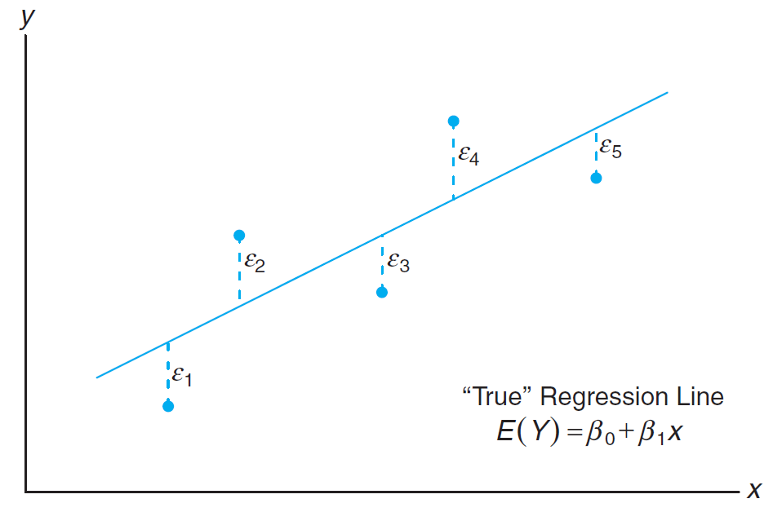
Note: We must keep in mind that in practice $β_{0}$ and $β_{1}$are not known and must be estimated from data. We can only draw an estimated line. The following figure shows the nature of hypothetical $(x, y)$data scattered around a true regression line for a case in which only $n = 5$observations are available.

Slide 8
The Fitted Regression Line
The Method of Least Squares

Slide 9
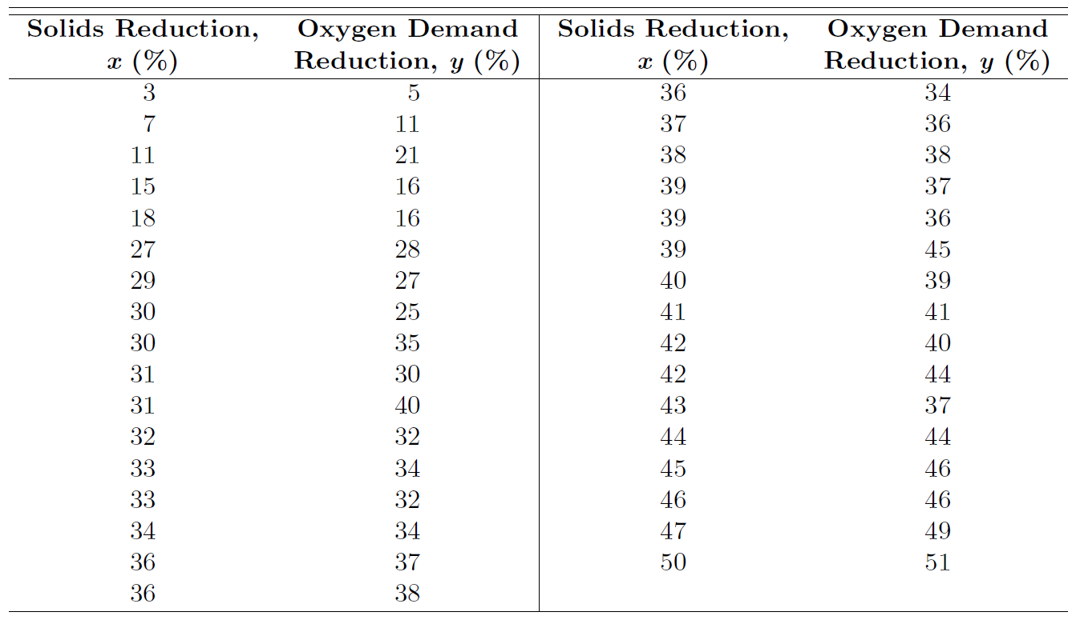
Example: Estimate the regression line for the pollution data of the following table
And then, predict the value of y when x=30

Slide 10
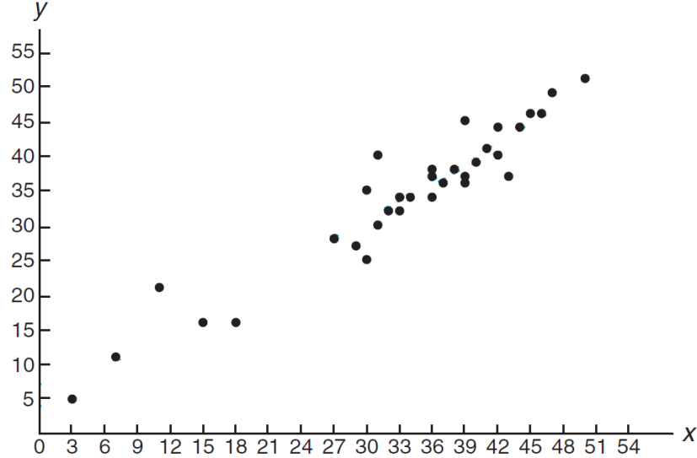
The scatter diagram for these data
It can be seen from this scatter diagram that the points closely follow a straight line, indicating that the assumption of linearity between the two variables appears to be reasonable.

Slide 11
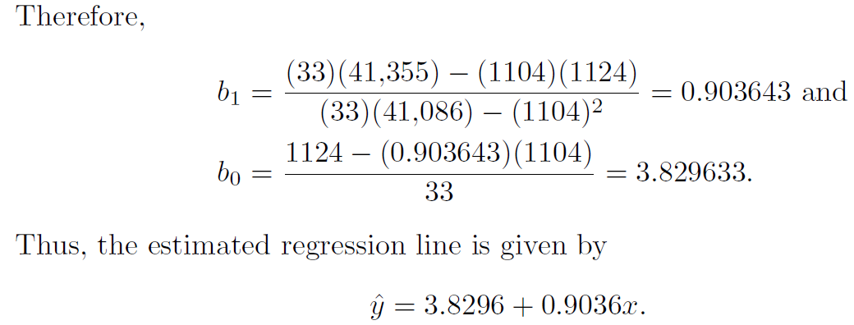
Solution:
Prove that
That is for x = 30, the fitted value of Y is:
$$\hat{Y}= b_{o} + b_{1}x=3.8296+0.9036 \left(30\right)=30.9376$$

Slide 12
Analysis-of-Variance Approach
Often the problem of analyzing the quality of the estimated regression line is handled by an analysis-of-variance (ANOVA) approach. The analysis of variance is a powerful resource that is used for many applications.
Suppose that we have n experimental data points in the usual form $\left(x_{i},y_{i}\right)$ and that the regression line is estimated. In our estimation, we established the identity
$$S_{yy}=b_{1}S_{xy}+SSE$$
where $S_{yy}$ is called the total corrected sum of squares of y and SSE is called the sum of squares of the errors about the regression line.

Slide 13
An alternative and perhaps more informative formulation is
$$\sum_{i=1}^{n}{{\left(y_{i}−\overline{y}\right)}^{2}=\sum_{i=1}^{n}{{\left({\hat{y}}_{i}−\overline{y}\right)}^{2}}+}\sum_{i=1}^{n}{{\left(y_{i}−{\hat{y}}_{i}\right)}^{2}}$$
Then, we can obtain that
SST=SSR+SSE
where SSR is called the regression sum of squares.
Suppose that we are interested in testing the hypothesis
$$H_{0}:β_{1}=0 versus H_{1}:β_{1}≠0$$
where the null hypothesis, $H_{0}$, says that the model is $μ_{Y|x}=β_{0}$.
To test the hypotheses above, we compute
$$F=\frac{MSR}{MSE}$$
where $MSR=\frac{SSR}{1}$ and $MSE=\frac{SSE}{n−2}$ .

Slide 14
Reject $H_{0}$ at the level of significance when $F>F_{α}\left(1, n−2\right)$.
where $F_{α}\left(1, n−2\right)$ is the critical value (tabulated value) of the F- distribution with degrees of freedoms $ν_{1}=1$ and $ν_{2}=n−2$. (It is obtained from the F- table).
ANOVA Table:
Source of Variation (SV) | Sum of Squares (SS) | Degrees of Freedom (df) | Mean Square (MS) | F
Regression | SSR | 1 | $$MSR=\frac{SSR}{1}$$ | $$\frac{MSR}{MSE}$$
Error | SSE | $$n−2$$ | $$MSE=\frac{SSE}{n−2}$$
Total | SST | $$n−1$$

Slide 15
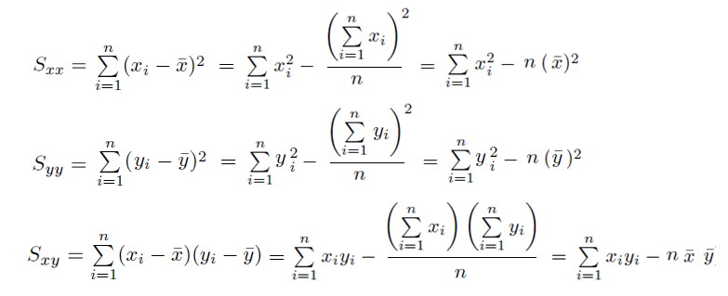
Computational Formulas:

Slide 16
Note:
$$b_{1}=\frac{S_{xy}}{S_{xx}}$$
or
or

Slide 17
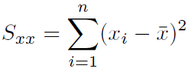
The regression sum of squares SSR$=\sum_{i=1}^{n}{{\left({\hat{y}}_{i}−\overline{y}\right)}^{2}}$
or SSR = SST – SSE
or

Slide 18
Example:
Using data in Example 11.1, the ANOVA table for testing $β_{1}$= 0 is:
Source of Variation SV | Sum of Squares SS | Degrees of Freedom df | Mean Squares MS = SS/df | F (F- ratio = MSR/MSE)
Regression | 3390.6 | 1 | 3390.6 | 325.08
Error | 323.3 | 31 | 10.4
Total | 3713.9 | 32
For testing:
We can use the F-ratio: F= 325.08
For α=0.05, the tabulated value $F_{α}\left(1, n−2\right)$=$F_{0.05}\left(1, 31\right)$≈4.17
Since the F-ratio = 325.08 >$F_{α}\left(1, n−2\right)$, we reject $H_{0}$.

Slide 19
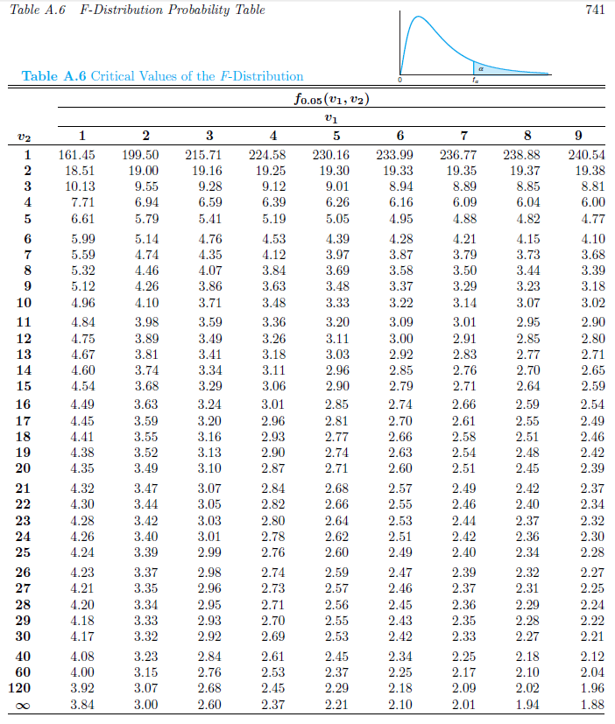

Slide 20
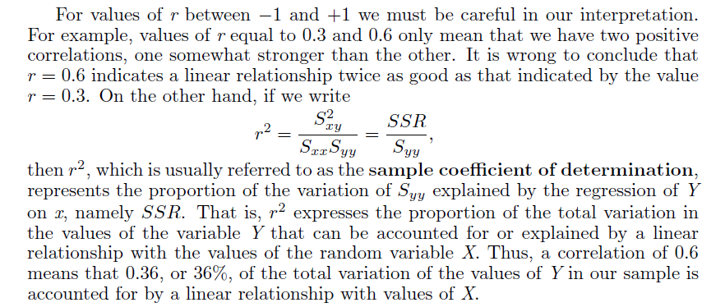
CORRELATION:

Slide 21
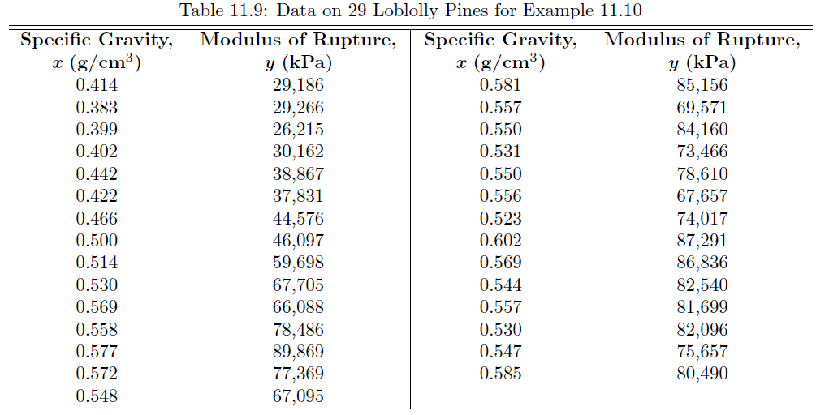
Example: loblolly pine

