Slide 1
GE105
Introduction to Engineering Design College of Engineering
King Saud University
Lecture 12.
Engineering Ethics
Summer 2017

Slide 2
Before we Start
Ethics are more important than laws. Wynton Marsalis
Ethics is knowing the difference between what you have a right to do and what is right to do. Potter Stewart
“Education without values, as useful as it is, seems rather to make man a more clever devil.” C.S. Lewis
“Educating the mind without educating the heart is no education at all.” Aristotle

Slide 3
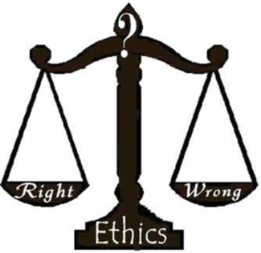
Ethics
A set of moral values and principles which form the standards of the code of conduct* of individuals, organizations and professions.
It is the principles of good and bad behavior governing what is right and wrong conduct.
Notes:
Code of conduct: قواعد السلوك
Ethics: أخلاقيات

Slide 4
Engineering Ethics
Engineering is based on “Preventative Ethics” which is based on two dimensions:
Think ahead and anticipate possible consequences of professional actions
Think effectively about consequences and decide what is the ‘ethically’ correct manner to handle the situation
Notes:
* i.e. think about the correct thing to do now, and the future consequences

Slide 5
Standards of Proper Conduct
1. Professional Ethics: the set of standards adopted by professionals to govern their particular profession, known as the ‘code of ethics’ for that profession*
2. Personal Values (Ethics): the set of one’s own ethical commitments, usually developed in early home, religious, or social training
3. Common Morality: the set of moral ideals shared by most members of a culture or society**
Notes:
* e.g. the code of ethics regarding accepting gifts at work
** e.g. issues that are considered moral/immoral and differ from one society to another

Slide 6
Concepts of Engineering Ethics
Ethical considerations are an integral part of making engineering decisions.
The professional obligations of engineers go beyond fulfilling a contract with a client or customer.
Codes of ethics can provide guidance in the decision-making process
Ethical obligations do not stop at any country’s border; they are global
6
Notes:
6

Slide 7
Engineering Codes of Ethics
Accreditation Board for Engineering and Technology (ABET)
National Society of Professional Engineers (NSPE)
Institute of Electrical and Electronic Engineers (IEEE)
American Society of Mechanical Engineers (ASME)
American Society of Civil Engineers (ASCE)
Notes:
In IE: IIE (Institute of Industrial Engineers)

Slide 8
Extract of NSPE Code
General rules: Engineers, in the fulfillment of their professional duties, shall:
Hold paramount (vital) the safety, health and welfare of the public in the performance of their professional duties
Perform services only in areas of their competence
Issue public statements only in an objective and truthful manner
Act in professional matters for each employer or client as faithful agents or trustees
Avoid deceptive acts* in the solicitation of professional employment
Notes:
* Can you give an example of this? e.g. Auctioning for companies, favoring relatives in business

Slide 9
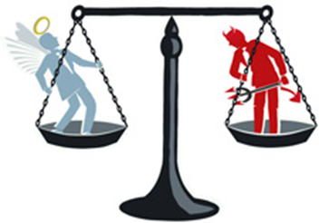
Extract of IEEE Code
Safety, health and welfare of the public, and to disclose (reveal) promptly factors that might endanger the public or the environment;
To avoid real or perceived conflicts of interest, and to disclose them to affected parties;
To be honest and realistic in stating claims or estimates based on available data;
To reject bribery (corruption) in all its forms;
To treat fairly all persons regardless of such factors as race, religion, gender, disability, age, or national origin
Notes:
conflicts of interest: تضارب المصالح (can you give an example)? How do you disclose conflict of interest?

Slide 10
Personal Ethics (everyday examples)
Software piracy
Copying of homework or tests
“Borrowing” office supplies from employer
Copying of Videos or CD’s
Plagiarism
Expense account padding (adding unnecessary material or expenses for the purpose of increasing the cost claim)*
Personal use of the copy machine at work
10
Notes:
* e.g. “miscellaneous” expenses
10

Slide 11
Ethical Issues are Seldom Black and White*
Conflicting Demands
Ethical standards are usually relative and personal, there is seldom an absolute standard
Loyalty to company and colleagues
Concern for public welfare
Personal gain, ambition
Notes:
* Can you give an example? (very important slide)

Slide 12
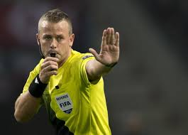
Whistle-Blowing
The term whistle-blower comes from the whistle a referee uses to indicate an illegal or foul play*.
Whistleblower is a person who exposes misconduct or illegal activity occurring in an organization such as fraud, health and safety violations, and corruption.
Whistleblowers may make their allegations internally (within the accused organization) or externally (to regulators, law enforcement agencies, to the media or to groups concerned with the issues)
Notes:
* Or whistle of policemen in the past; can you give a famous example of whistle-blowing (الوشاية) ? see: https://mic.com/articles/49867/5-famous-whistleblowers-who-shaped-history#.XUvDo4OAx

Slide 13
Whistle-Blowing (contn’d)
It is morally permissible for engineers to engage in external whistle-blowing if:
The harm that will be done to the public is serious and considerable
Getting no satisfaction from their immediate superiors, even after going to the board of directors
Need a documented evidence that would convince a reasonable, impartial observer
There must be strong evidence that making the information public will in fact prevent the threatened harm*
Notes:
* i.e. not to just look like a hero, or to gain money/fame, which –ironically- would be in itself unethical

Slide 14
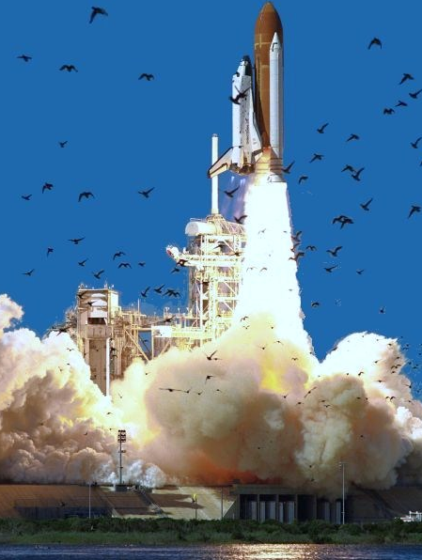
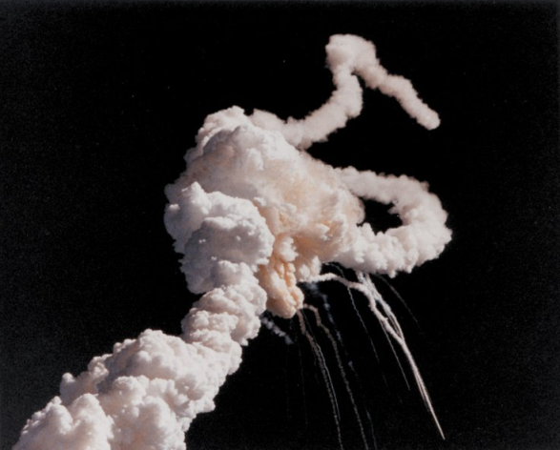
Case Studies in Engineering Ethics
Case 1: The “challenger” disaster (1986)
Designed a system that required a gasketed connection and did not have sufficient data to predict performance across a spectrum of conditions; pressure from management to end the job lead to:
Poor Engineering Judgment
Entire crew lost
Space program set back years
Lost public confidence
Notes:
Videos regarding “Engineering Ethics in the Real World”: https://www.youtube.com/watch?v=QbtY_Wl-hYI&list=PLA61bxD8Jg-1qNd6xBY6A4_mD-fOOMwAI
Gasket: soft flat sheet or ring of rubber حشية

Slide 15
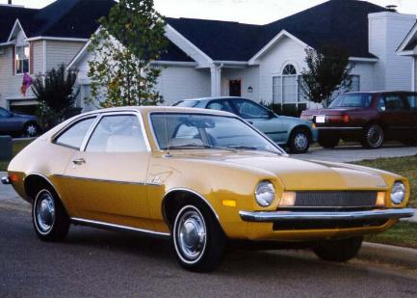
Case 2: The “Ford Pinto” Gas Tank (1972)
Under management pressure, engineers designed an automobile component* that later proved to fail under certain conditions and could be replaced for only $11 under a recall
At $11 per vehicle to recall, the total cost would be $137 million
Corporate decision based on a “Benefit/Cost analysis”
Fearing the loss, Ford did not recall for repair
Notes:
rubber bladder/liner (which would cost ~$5 to being with); read more about story here: http://auto.howstuffworks.com/1971-1980-ford-pinto12.htm
Videos: https://youtu.be/vVq0qCpcCoA and https://youtu.be/lgOxWPGsJNY

Slide 16
Case 2 (contn’d)
Over 500 documented deaths related to rear-end collisions in the Pintos
Hundreds of serious injuries and thousands of burned vehicles
Lawsuits and personal injury cases totaled over $450 million
Company nearly folded after the lawsuits and low sales due to lack of trust in Ford products

Slide 17
Case 3: The “Hyatt Regency ” (Kansas City 1981)
Engineers were asked to sign on a set of shop drawings that had come from a reliable vendor with whom they had a very good working relationship
Support system was changed in the shop drawings by the steel fabricator
Engineer failed to review the shop drawings and therefore did not discover the change
The change doubled the load on the supports
32 ton walkways collapsed
114 deaths, 200 injuries
Engineers prosecuted
Design
Construction
Notes:
* Who would you consider legally responsible? Ethically responsible? Can you mention a case similar to this happening recently, from your experience?

Slide 18
Ask yourself (when Making Decisions)
Is it safe?
Is it legal?
Is it just, balanced, and fair?
How will it make me feel about myself*?
If something terrible happened, could I defend my actions?
Does this choice lead to the greatest good for the greatest number?
Is it the right thing to do?
Notes:
* What do we have to support this in Islam?

Slide 19
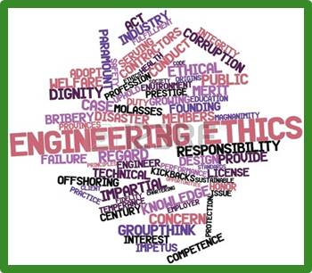
Final Thoughts
Read carefully the code of ethics of your profession*, better yet, memorize it!
Never disclose information given to you in confidence, unless it violates ethical codes
Assume responsibilities** of your mistakes
Never accept gifts that compromise your ability to perform with freedom
Start applying (no plagiarism, no software pirating, no abuse of office resources,…)
“Indeed the most honorable of you in the sight of God is the most righteous." Chapter 49, Verse 13
Notes:
* NSPE ethics code is uploaded to course website; read it carefully!
** Do you agree “the higher up you go, the easier it is to throw blame on people underneath you”? Surah Hujurat

