Slide 1
503 STAT Probability and Mathematical statistics Text Book: Probability and Statistics for Engineers and Scientists. By: R.E.Walpole and R.H.Myers

Slide 2
Schedule of Assessment Tasks for Students During the Semester
Assessment | Examination | Week due | Proportion of Final Assessment
1 | Mid-term exam (1) | 5th - 6th | 25
2 | Mid-term exam (2) | 9th - 10th | 25
3 | Assignment | 12th - 13th | 10
4 | Final exam | After 15th Week | 40

Slide 3
Chapter 1: Introduction to Statistics and Data Analysis
Definition: Statistics
Statistics is a collection of methods for planning experiments, obtaining data, and then organizing, summarizing, presenting, analyzing, interpreting and drawing conclusions based on that data.

Slide 4
Types of Statistics
1- Descriptive Statistics
Descriptive Statistics are used to summarize or describe the important characteristics of a known set of data.
For example: Let us consider everyone in this room. Each one of us is a source of data. A characteristic of this data may be degree program, age, height, sex, marital status.

Slide 5
Types of Statistics
2- Inferential Statistics
Inferential Statistics goes beyond the description. It involves the use of sample data to make inferences about a larger set of data from which the sample was chosen.
For example: If we consider this class as a sample of KSU students and calculated the average age of the class. We could then infer that the average age of all KSU students is the same as our sample.

Slide 6
Population and Sample
Definition:
A population is the complete collection of elements (scores, people, measurements) to be studied.
A sample is a subcollection of elements drawn from the population.

Slide 7
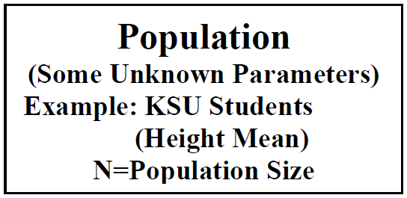
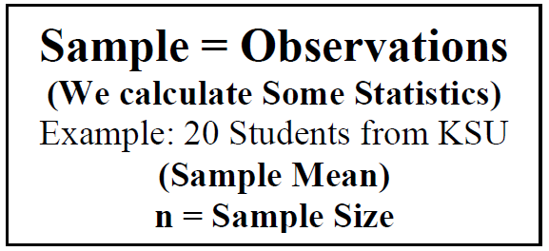
Population and Sample

Slide 8
Notes:

Slide 9
Why do we study and analyze subcollections (samples) of a population

Slide 10
Definition (Parameter)
It is a numerical characteristics of a population that summarize the data for the entire population.
Definition (Statistic)
It is a numerical characteristics of a sample.

Slide 11
Definition (Variables)
A variable is a characteristic, feature or factor that varies from one individual to another in a population.

Slide 12
Classification of Variables
Quantitative Variables
Discrete variables
(The number of cars in a parking lot – The number of patients in a hospital )
Continuous variables
(height - weight - time it takes to get to school)
Qualitative Variables

Slide 13
Measures of Location (Central Tendency)
The data (observations) often tend to be concentrated around the center of the data.
Some measures of location are: the mean, mode, and median.
These measures are considered as representatives (or typical values) of the data. They are designed to give some quantitative measures of where the center of the data is in the sample.

Slide 14
The Sample mean of the observations
(unit)

Slide 15
Example:
Suppose that the following sample represents the ages (in year) of a sample of 3 men:
$$x_{1}=30, x_{2}=35, x_{3}=27$$
Then, the sample mean is:
$\overline{x}=\frac{30+35+27}{3}=30.67$(years)

Slide 16
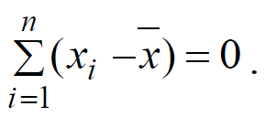
Note:
Prove that?

Slide 17
Median
(unit)

Slide 18
Example: suppose the data set is the following: 1.7, 2.2, 3.9, 3.11, and 14.7. The sample mean and median are, respectively,

Slide 19
Note:
The mean is influenced by the extreme observations, whereas the median places emphasis on the true “center” of the data set.
See previous Example

Slide 20
Example: suppose we have the following two data sets: data 1: 59,60,60,61 data 2: 50,60,60,70 Calculate the Mean and the Median? What do you see?

Slide 21
Measures of Variability (Dispersion or Variation)
The variation or dispersion in a set of data refers to how spread out the observations are from each other.
The variation is small when the observations are close together. There is no variation if the observations are the same.
Some measures of dispersion are range, variance, and standard deviation
These measures are designed to give some quantitative measures of the variability in the data.

Slide 22
Range:
It is the simplest measure of variation and defined as
(unit)

Slide 23
Example:
What is the range of the following data set
42,55,47,41,57,50

Slide 24
Solution:

Slide 25
The Sample Variance $\left(S^{2}\right)$

Slide 26
The Standard Deviation (S)
The standard deviation is another measure of variation. It is the square root of the variance

Slide 27
Example:
Compute the sample variance and standard deviation of the following observations (ages in year): 10, 21, 33, 53, 54.

Slide 28
Solution:

Slide 29
The sample standard deviation is

Slide 30
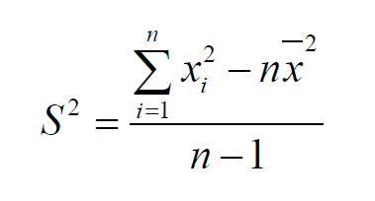
Another Formula for Calculating S²:

Slide 31
Note:
To calculate S² we need:
$n$= sample size
$\sum{x_{i}=}$The sum of the values
$\sum{{x^{2}}_{i}}$=The sum of the squared values

Slide 32
For the above example:

Slide 33
Exercises
Numbers 1.7 and 1.8 on page 17
Number 1.21 on page 31

Slide 34
GRAPHICAL REPRESENTATIONS
(1) Bar Charts: In a bar chart, the frequency of each class is represented by a bar. The height of the bar corresponds to the frequency of the class. The width of the bar doesn’t matter.

Slide 35
Example: Draw the bar chart for the following data
Blood group | Frequency
O | 16
A | 18
B | 4
AB | 2
Total | 40

Slide 36
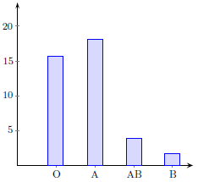
Answer:

Slide 37
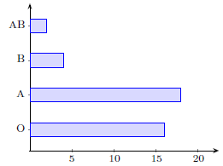
Other presentation

Slide 38
(2) Histogram: is similar to bar chart but they both have a basic difference that is in histograms, classes of the variable are adjacent to each other and the rectangular bars must touch each other. Histograms are generally used to represent quantitative data.

Slide 39
Example : Consider the following data
Continuous Classes | Frequency
0-10 | 1
10-20 | 3
20-30 | 6
30-40 | 4
40-50 | 2
Total | 16

Slide 40
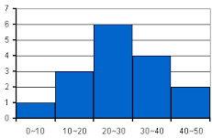
Answer:
Frequency
classes

Slide 41
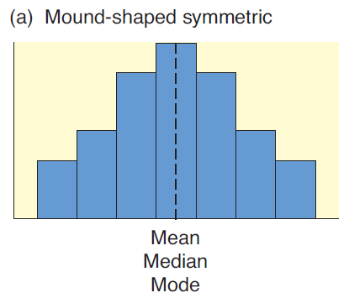
Distribution Types and Averages

Slide 42
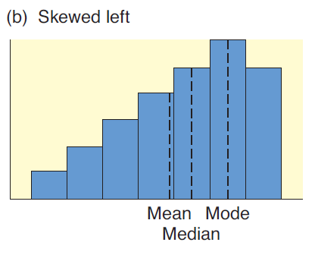

Slide 43
