Slide 1
PHYS 663 Advanced Particles Physics
Recommended Book:
Particle Physics
3rd Edition
B.R. Martin and G. Shaw
Syllabus:
Quark model of hadrons, solutions, bag models. Gluon exchange, mass formulae, quark masses, heavy quarks. Quark-parton model, deep inelastic electron-nucleon scattering, scaling, corrections to scaling behaviour, jets. Chiral symmetry, chiral symmetry breaking, quark masses.

Slide 2
The Quark Model of Hadrons
Outline
Building Block of the Universe
Classification of Matters
Hadrons, Baryons, Mesons & Leptons
The Quark Model
Constitution of Hadrons & Original Quark Model
Addition to the Original Quark Model
General Properties of Quarks & Hadron’s
Generation of Matters
Quantum Numbers & Flavors
Particle Interactions & Hadron’s Life Time
Hadron’s Discoveries
Strange Meson & Baryon
2

Slide 3
What is all the matter in the Universe made of?
and
What holds it together?
All matter is comprised of Leptons and Quarks
2. Force carrier particles hold all matter together.
(There are 4 fundamental forces – Strong, Weak, Electromagnetic, Gravity).
Force Carriers are: Gluon, W± & Z, Gamma, Graviton

Slide 5
Hadrons
Consist of particles that interact through the strong force.
Hadrons are set apart from leptons because they are composed of other, smaller particles
Separated into two categories
Baryons & Mesons
These are distinguished by their internal structure

Slide 6
Baryons
Baryons are composed of three quarks
All but two baryons are very unstable, they are:
The proton and neutron!!
Most baryons are excited states of protons and neutrons

Slide 7
Protons & Neutrons
Protons are made of three quarks, two up quarks and a down quark
This is written as uud
Neutrons are also made up of three quarks, one up quark and two down quarks
This is written as udd

Slide 8
Mesons
Composed of a quark and anti-quark
All are very unstable
They are not part of everyday matter
Have a mass between that of the electron and the proton
All decay into electrons, positrons, neutrinos and photons etc.

Slide 9
Numbers of Particles
At the present, physicists believe the “building blocks” of matter are complete
Six quarks with their antiparticles
Six leptons with their antiparticles
9

Slide 10
What are Leptons and Quarks?
They are sub-atomic particles.
They are fundamental particles incapable of being subdivided into smaller particles.
There are 6 Leptons and 6 Quarks.
The nucleus is a combination of quarks which manifest themselves as protons and neutrons.
Each elementary particle has a corresponding antiparticle.

Slide 11
Baryons, Mesons, & Leptons
These three types of particles were originally categorized by their masses
Baryons from the Greek for heavy
Mesons from the Greek for intermediate
Leptons from the Greek for light
Now they are classified by internal structure
Leptons are elementary particles
Mesons are made of a quark and anti-quark
Baryons consist of three quarks

Slide 12
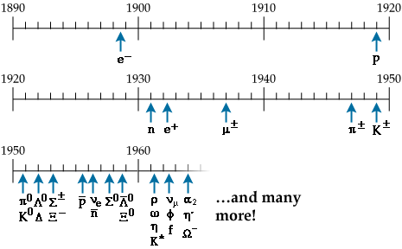
The Quark Model
By the early 60’s there was a large zoo of particle found in bubble chamber experiments

Slide 13
Sorting them out
We could classify them by various quantum numbers
Mass
Spin
Parity
C parity
Isospin
Strangeness

Slide 14
First steps
It was realized that even these new particles fit certain patterns:
pions: π⁺(140 MeV) π⁻(140 MeV) πº(135 MeV)
kaons: k⁺(496 MeV) k⁻(496 MeV) kº(498 MeV)
⇒ How come:
M_{n} > M_{p} and M_{k}o > M_{k}+ but M_{π}+ > M_{π}o
Lots of models concocted to try to explain why these particles exist:
⇒ Model of Fermi and Yang (late 1940’s-early 50’s):
pion is composed of nucleons and anti-nucleons (used SU(2) symmetry)
note this model was proposed
before discovery of anti-proton !

Slide 15
First steps
With the discovery of new unstable particles (Λ, k) a new quantum number was invented: ⇒ strangeness
Gell-Mann, Nakano, Nishijima realized that electric charge (Q) of all particles could be related to isospin (3rd component), Baryon number (B) and Strangeness (S):
Q = I₃ +(S + B)/2= I₃ +Y/2
hypercharge (Y) = (S+B)
Interesting patterns started to emerge when I₃ was plotted vs. Y
Y
I₃

Slide 16
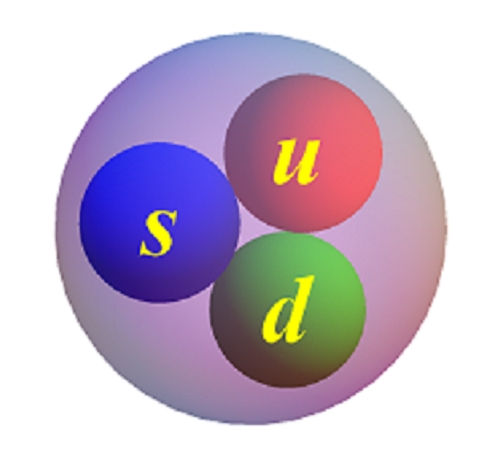
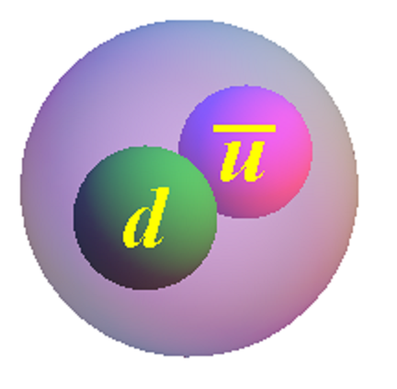
Constitution of Hadrons & Original Quark Model
1964 The model was proposed independently by Gell-Mann and Zweig
Three fundamental building blocks 1960’s (p,n,λ) ⇒ 1970’s (u,d,s)
mesons are bound states of a of quark and anti-quark:
Can make up "wave functions" by combing quarks:
baryons are bound state of 3 quarks:
proton = (uud), neutron = (udd), Λ= (uds)
anti-baryons are bound states of 3 anti-quarks:
Λ= (uds)

Slide 17
Early 1960’s Quarks
Successes of 1960’s Quark Model:
Classify all known (in the early 1960’s) particles in terms of 3 building blocks
predict new particles (e.g. Ω⁻)
explain why certain particles don’t exist
explain mass splitting between meson and baryons
explain/predict magnetic moments of mesons and baryons
explain/predict scattering cross sections (e.g. σ_{πp}/σ_{pp} = 2/3)
Failures of the 1960's model:
No evidence for free quarks (fixed up by QCD)
Pauli principle violated (fixed up by color)
What holds quarks together in a proton ? (gluons! )
How many different types of quarks exist ? (6?)
17

Slide 18
Additions to the Original Quark Model – Charm
Another quark was needed to account for some discrepancies between predictions of the model and experimental results
Charm would be conserved in strong and electromagnetic interactions, but not in weak interactions
In 1974, a new meson, the J/Ψ was discovered that was shown to be a charm quark and charm antiquark pair
18

Slide 19
More Additions – Top and Bottom
Discovery led to the need for a more elaborate quark model
This need led to the proposal of two new quarks
t – top (or truth)
b – bottom (or beauty)
Added quantum numbers of topness and bottomness
Verification
b quark was found in a Υ meson in 1977
t quark was found in 1995 at Fermilab
19

Slide 20
Quarks & their Properties
Each quark has an anti-particle
Quarks have a physical property called color, it could be blue, green or red
Each color also has an anti-color
They are not really different colors, it is a property, like charge
Quarks cannot exist individually because the color force increases as they are pulled apart.

Slide 21
Quark Properties
These quark objects are:
point like
spin 1/2 fermions
parity = +1 (-1 for anti-quarks)
two quarks are in isospin doublet (u and d), s is an
iso-singlet (=0)
Obey Q = I₃ +1/2(S+B) = I₃ +Y/2
Group Structure is SU(3)
For every quark there is an anti-quark
The anti-quark has opposite charge, baryon number and strangeness
Have mass, electric charge, etc.

Slide 22
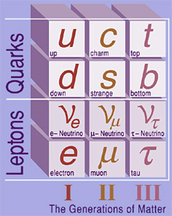
Generations of Matter
Mass increases from 1 generation to the next
Going down in each generation, the charges are:
+2/3, -1/3, 0, -1
These are all in multiples of the elementary charge

Slide 23
Number of particles
The additive quark quantum numbers are given below:
Quantum # u d s c b t
electric charge 2/3 -1/3 -1/3 2/3 -1/3 2/3
I₃ 1/2 -1/2 0 0 0 0
Strangeness 0 0 -1 0 0 0
Charm 0 0 0 1 0 0
bottom 0 0 0 0 -1 0
top 0 0 0 0 0 1
Baryon number 1/3 1/3 1/3 1/3 1/3 1/3
Lepton number 0 0 0 0 0 0

Slide 24
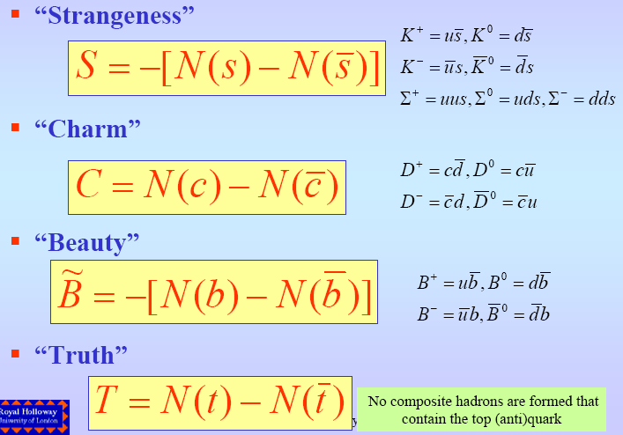
Quantum Numbers and flavours

Slide 25
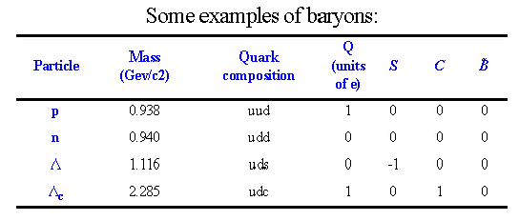
Strangeness is defined so that S=-1 for s-quark and S =1 for the
anti s-quark. Further, C=1 for c-quark, B=-1 for b-quark and T=1 for
t-quark
Since t-quark is a very short living one, there are no hadrons
containg top, i,e, T=0 for all
Quark numbers for up and down quarks have no name, but just like
any other flavour, they are conserved in strong and em interactions
Baryons are assigned own quantum number B:
B=1 for baryons, B=-1 for antibaryons, B=0 for mesons
In strong interactions the flavour quantum number is conserved
Quarks can change flavours in weak interactions (ΔS =±1, ΔC =±1)

Slide 26
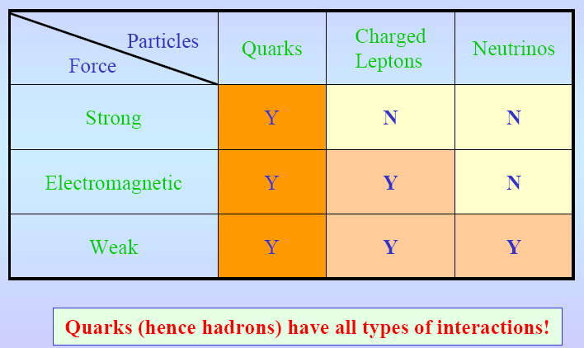
Particles and Interactions

Slide 27
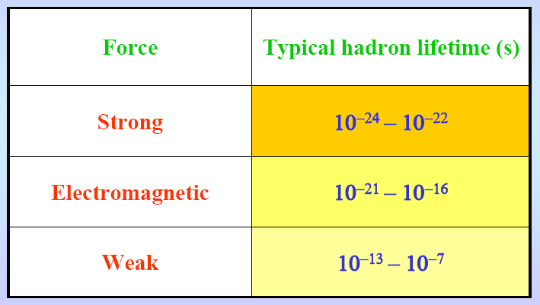
Hadrons and lifetime
The typical Lifetime ranges corresponding to each interaction
is shown here:

Slide 28
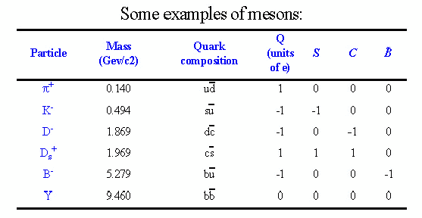
Majority of hadrons are unstable and tend to decay by the strong
interaction to the state with the lowest possible mass (τ ~ 10⁻²³ s)
Hadrons with the lowest possible mass for each quark number
(S, C, etc.) may live much more before decaying weekly
(τ ~ 10⁻⁷⁻ 10⁻¹³ s) or electromagnetically (mesons, τ~10⁻¹⁶⁻ 10⁻²¹ s)
Such hadrons are called stable particles

Slide 29
Hadron discoveries
First known hadrons were proton and neutron
The lightest most mesons are pions π. There are charged
pions π+, π-, with mass of 0.140 GeV/c², and neutral ones π⁰,
with mass of 0.135 GeV/c²
This paritcles are produced copiously in many hadronic reactions
that conservs both charge & baryon numbers:
An example is proton-proton collission:

Slide 30
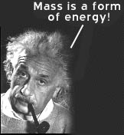
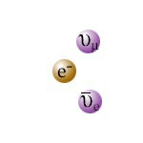
How does a particle decay?
Due to unstable Nucleus
Here the end products are totally new particles
Missing Mass:
Total mass of the new particles < the original nucleus. This missing mass gives KE to the new particles

Slide 31
Pion discovery

Slide 32
Pion discovery
Charged pions decay mainly to the muon-neutrino pair
(BR ~99.99%) having lifetimes of 2.6x10⁻⁸ s.
In quark terms:
Neutral pions decay mostly by the electro- magnetic
interaction, having shorter lifetime of 0.8x10⁻¹⁶ s
At the beginning discovered pions were believed to be
responsible for the nuclear forces
However, later on this idea fails.

Slide 33
Strange mesons and baryons
Were called so because, being produced in strong interactions,
had quite long lifetimes and decayed weakly rather than
strongly
The most light particles containing s-quark
mesons K⁺, K⁻ and : Kaons,
lifetime of K⁺ = 1.2x10⁻⁸ s
Principal decay modes of strange hadrons:

Slide 34
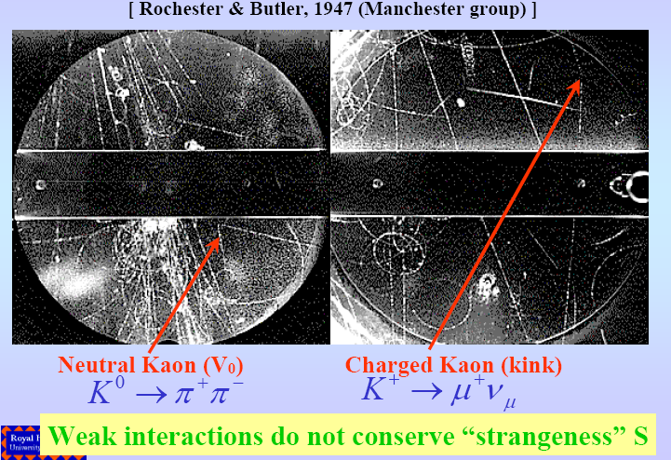
Strange particles: kaon discovery

