Slide 1
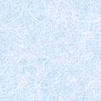
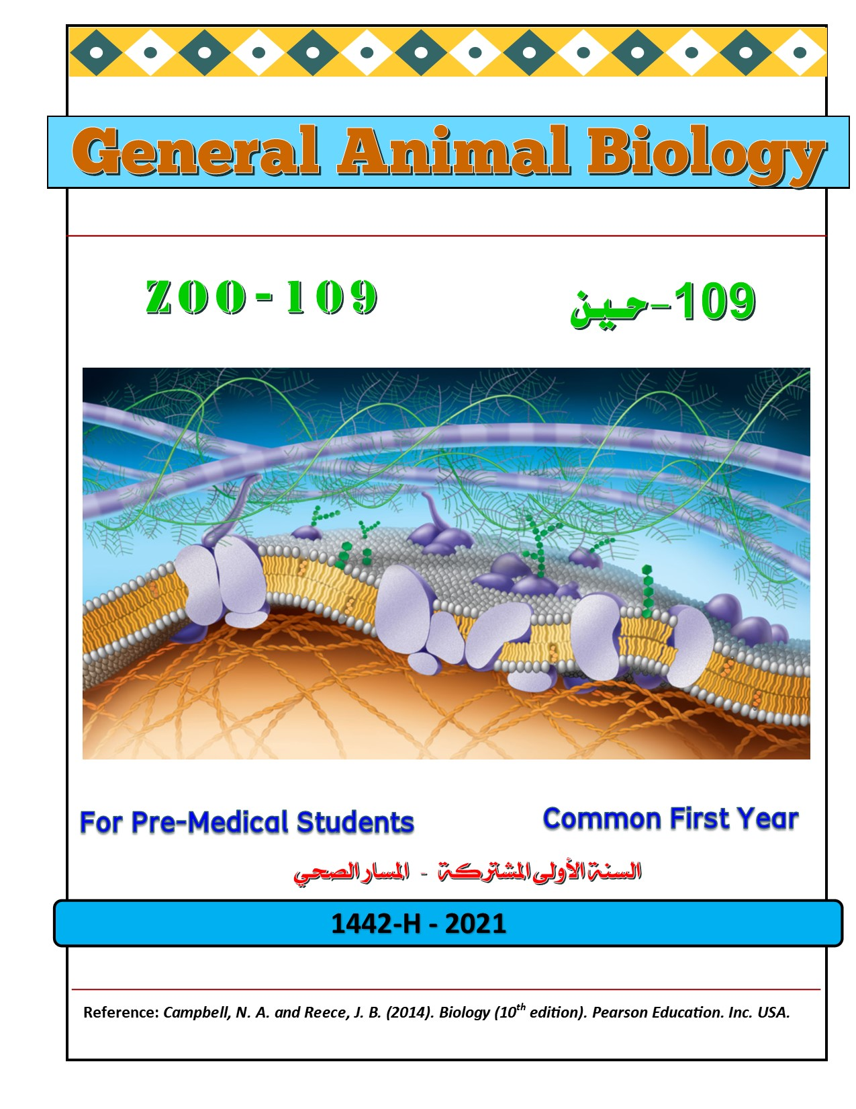



College of Science,
Zoology Department

Slide 2



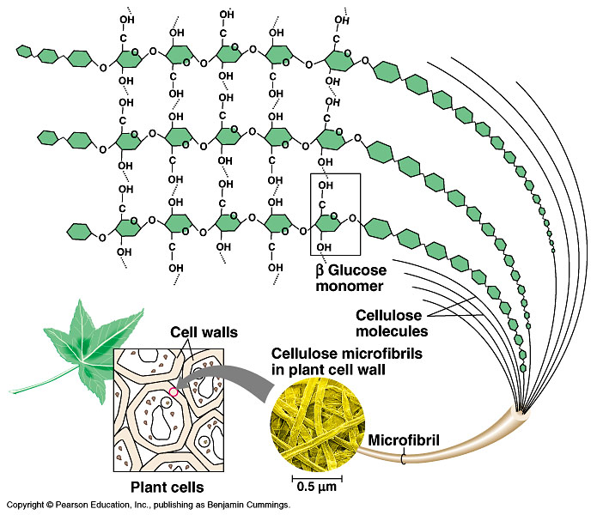
Macromolecules
Continuo….
Copyright © 2002 Pearson Education, Inc., publishing as Benjamin Cummings

Slide 3


Objectives
Proteins (Polypeptides)
  The functions of proteins.
  The amino acids.
  The peptide Bond.
Lipids
  The functions of lipids.
  The structure of fat molecule.
  The types of fats.

Slide 4
2-Proteins (Polypeptides)
Proteins are polymers of amino acids (constructed from 20 amino acids).
There are six functions of proteins:
1. Storage: albumin (egg white)
2. Transport: hemoglobin
3. Regulatory: some hormones
4. Movement: muscles
5. Structural: membranes, hair, nails
6. Enzymes: cellular reactions
Copyright © 2002 Pearson Education, Inc., publishing as Benjamin Cummings

Slide 5
Amino acids الأحماض الأمينية
- The components of amino acid include a hydrogen atom, a carboxyl group, an amino group, and a variable متغيرة R group (or side chain).
H
H
O
General Formula of the Amino Acid:
N
C
C
H
OH
Amino group
R
Carboxyl group
Tyapes of Amino acids الأحماض الأمينية
Side chain
- Differences in the R groups produce the 20 different amino acids.
Hydrophobic: the amino acids that have hydrophobic R groups (non-polar).
Hydrophilic: the amino acids that have polar R groups, making them hydrophilic.
Ionized: the amino acids with functional groups that are charged (ionized) at cellular pH (7). So, some R groups are bases, others are acids.

Slide 6
The Peptide Bondالرابطة البيبتيدية
The peptide bond is formed between the carboxyl group of one amino acid and the amino group of the other by dehydration.
H
O
H
H
H
O
N
C
C
N
C
C
H
OH
H
OH
R
R
Dehydrationنزع الماء
Peptide bond
Amino acids Peptide
Polypeptide (Protein)

Slide 7
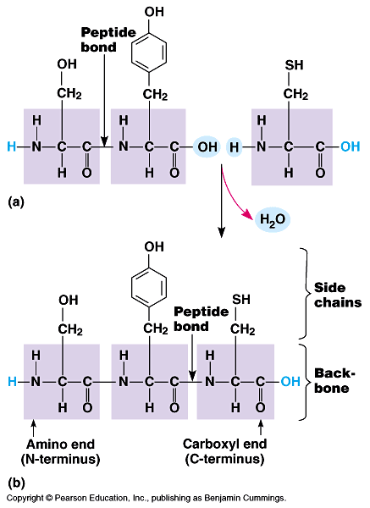
The Peptide Bond
Amino acids are joined together when a dehydration reaction removes a hydroxyl group from the carboxyl end of one amino acid and a hydrogen from the amino group of the other. The resulting covalent bond is called “peptide bond”.
The repeated sequence (N-C-C) is the polypeptide backbone.
Attached to the backbone are the various R groups.
Polypeptides range in size from a few monomers to thousands.

Slide 8

Summary
Hydrophobic (non-polar R group)
Amino acids
Hydrophilic (polar R group)
Ionized (charged functional groups)
Peptide bonds
Summary
Dehydration
Peptides
Polypeptides
Proteins
There are four levels of protein structure:
Primary Structure أولي (بسيط)
Secondary Structure ثنائي
Tertiary Structure ثلاثي
Quaternary Structure رباعي

Slide 9


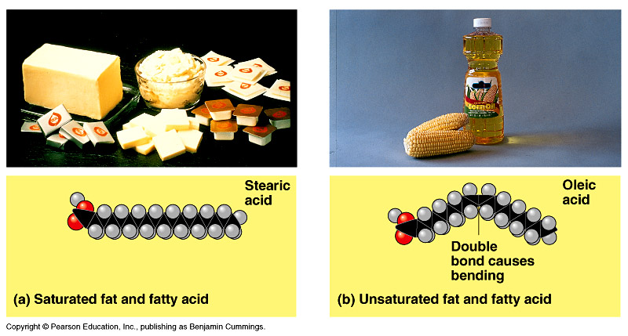
3-Lipids
It is the general term for compounds which are not soluble in water.
1. Fats store large amounts of energy
Phospholipids are major components of cell membranes
Steroids include cholesterol and certain hormones

Slide 10
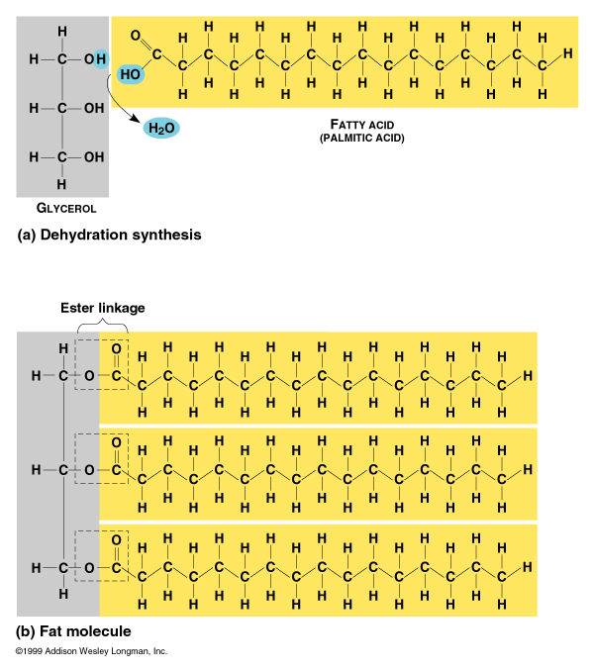
Functions and structure of lipids:
1. Long term energy storage
2. Protection against heat loss (insulation)
3. Protection against physical shock
4. Protection against water loss
5. Chemical messengers (hormones)
6. Major component of membranes (phospholipids)
Structure of Fatty Acids
Long chains of mostly carbon and hydrogen atoms with a -COOH group at one end.
When they are part of lipids, the fatty acids resemble long flexible tails.
Notes:
10

Slide 11
A)- Fats: Structure of fat molecule
Glycerol
H
H
Fatty Acid
O
H
H
H
H
C
C
H
C
C
C
C
H
C
O
H
OH
H
H
H
Ester link
H
H
H
C
OH
H
C
OH
Dehydration
H
In a fat, three fatty acids are joined to a single glycerol by an ester linkage, رابطة إستيرية creating a triacylglycerol.
Thus, the fat molecule is constructed from two kinds of smaller molecules: glycerol and fatty acids (so, it is not a true polymer)
Hence, lipids are the one class of large biological molecules that does not include true polymers.

Slide 12
Structure of Fat molecule

Slide 13
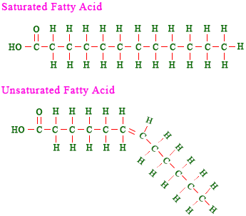
1)- Saturated Fats الدهون المشبعة
Types of fats
The Fatty acid components are saturated when there is no double bond between the carbons. All Carbn are linked with Hydrogen .
  The Fatty acid components are saturated (i.e. there is no double bonds between the carbons (all C are linked with H).
  They have only single C-C bonds in their fatty acids.
  They solid at room temp
  Include most animal fats
Most animal fats are saturated.
The double bonds are formed by the removal of H atoms.
2)- Un-saturated Fats الدهون الغير مشبعة
  Are liquid at room temperature.
  There is one or more double bonds between carbons in their fatty acids allows for “kinks” in the tails
  Include most plant fats
Most plant fats are unsaturated.
They can be synthetically converted to saturated (solid) by adding H (Hydrogenation الهَدْرَﭽـَة).

Slide 14
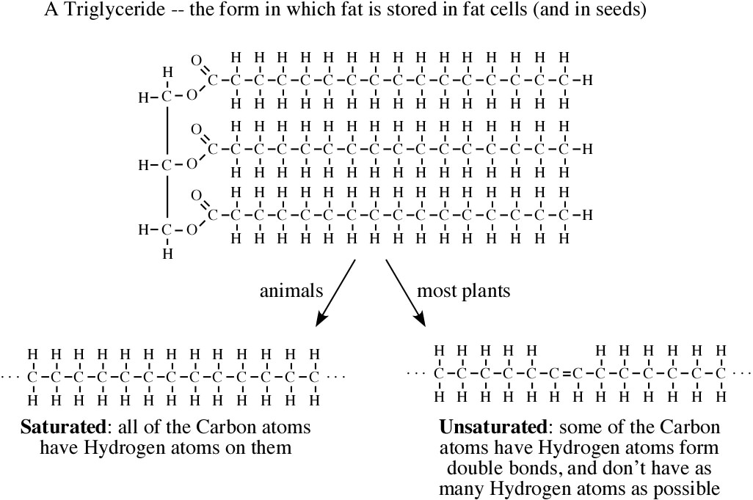
Types of fats

Slide 15
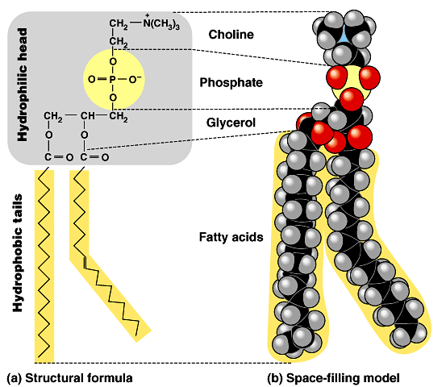
1- Phospholipids: are the major components of cell membranes
B)- Other lipids: have structural, hormonal, or protective functions
Phospholipids have two fatty acids attached to a glycerol molecule and a phosphate group at the third position.
  The phosphate group carries a negative charge.
The 2 fatty acid tails are HYDROPHOBIC, but the phosphate group and its attachments form a HYDROPHILIC head.
Thus, it is AMPHIPATHIC: has both hydrophobic and hydrophilic regions
Steroids: (e.g. Cholesterol) are hydrophobic molecules. Some of them are forming hormones (Sex Hormones)
Waxes: are hydrophobic molecules used for waterproofing (protection).

Slide 16
Summary
Lipids
Include
Fats
Phospholipids
Steroids
Waxes
The major component of the cell membrane
Sex Hormones & Cholesterol
Saturated
Unsaturated
Animal Fats
Vegetable Fats
Hydrogenation
هَـدْرَﭽـَــــــــة

Slide 17

College of Science,
Zoology Department
General Animal Biology
(Zoo-109)
Zoology Department

