Slide 1
LECTURE 2: Cryptography
Dr. Esam A. Alwagait
alwagait@ksu.edu.sa

Slide 2
Module 2: Elementary Cryptography
Concepts of Encryption
Cryptanalysis: how encryption systems are broken
Symmetric (secret key) encryption and the DES and AES algorithms
Asymmetric (public key) encryption and the RSA algorithm
Key exchange protocols and certificates
Digital signatures
Cryptographic hash functions

Slide 3
Concepts of Encryption
Cryptography is rooted in higher mathematics:
group and field theory
computational complexity
E.g. the question of the extent to which a problem is solvable on a computer
real analysis
the theory of functions of a real variable
In addition to probability and statistics

Slide 4
Concepts of Encryption
Consider the steps involved in sending messages from a sender, S, to a recipient, R
If S entrusts the message to T, who then delivers it to R, T then becomes the transmission medium.
If an outsider, O, wants to access the message (to read, change, or even destroy it), we call O an interceptor or intruder

Slide 5
Concepts of Encryption
O might try to access the message in any of the following ways:
Block it, by preventing its reaching R, thereby affecting the availability of the message.
Intercept it, by reading or listening to the message, thereby affecting the confidentiality of the message.
Modify it, by seizing the message and changing it in some way, affecting the message's integrity.
Fabricate an authentic-looking message, arranging for it to be delivered as if it came from S, thereby also affecting the integrity of the message
A message's vulnerabilities reflect the four possible security failures we identified earlier.

Slide 6
Terminology
Encryption is the process of encoding a message so that its meaning is not obvious
Decryption is the reverse process, transforming an encrypted message back into its normal, original form
Alternatively, the terms encode and decode or encipher and decipher are used instead of encrypt and decrypt
We say that we encode, encrypt, or encipher the original message to hide its meaning
We decode, decrypt, or decipher it to reveal the original message
A system for encryption and decryption is called a cryptosystem

Slide 7
Terminology
Slight difference (not significant in this course):
encoding is the process of translating entire words or phrases to other words or phrases
enciphering is translating letters or symbols individually
encryption is the group term that covers both encoding and enciphering

Slide 8
Terminology
The original form of a message is known as plaintext
The encrypted form is called ciphertext
We denote a plaintext message P as a sequence of individual characters P = <p₁, p₂, …, p_{n}>
Similarly, ciphertext is written as C = <c₁, c₂, …, c_{m}>
Encryption

Slide 9
Terminology
Example:
The plaintext message "I want cookies" can be denoted as the message string <I, ,w,a,n,t, , c,o,o,k,i,e,s>
It can be transformed into ciphertext <c₁, c₂, …, c₁₄>, and the encryption algorithm tells us how the transformation is done
Encryption

Slide 10
Terminology
We use this formal notation to describe the transformations between plaintext and ciphertext
We write C = E(P) and P = D(C), where
C represents the ciphertext
E is the encryption rule
P is the plaintext, and D is the decryption rule
What we seek is a cryptosystem for which P = D(E(P))
In other words, we want to be able to convert the message to protect it from an intruder, but we also want to be able to get the original message back so that the receiver can read it properly

Slide 11
Terminology
The cryptosystem involves a set of rules for how to encrypt the plaintext and how to decrypt the ciphertext
The encryption and decryption rules, called algorithms, often use a device called a key, denoted by K, so that the resulting ciphertext depends on the original plaintext message, the algorithm, and the key value
We write this dependence as C = E(K, P)
This process is similar to using mass-produced locks in houses!
Expensive if every lock is designed separately
Few well-known companies produce standard locks that differ according to the key!

Slide 12
Terminology
Cryptography means hidden writing using encryption to conceal text
A cryptanalysis is studying encryption and encrypted messages, hoping to find the hidden meanings
Both a cryptographer and a cryptanalyst attempt to translate coded material back to its original form
But, a cryptographer normally works on behalf of a legitimate sender or receiver,
whereas a cryptanalyst works on behalf of an unauthorized interceptor
Cryptology is the research into and study of encryption and decryption
it includes both cryptography and cryptanalysis

Slide 13
Concepts
Cryptography – hidden writing
Encryption – encode or encipher
Decryption – decode or decipher
Cryptosystem – a system for encryption and decryption
Cryptographer – anyone who invents encryption algorithms
Cryptanalyst – anyone who attempts to break encryption algorithms
Cryptology – research of encryption and decryption, including both cryptography and cryptanalysis

Slide 14
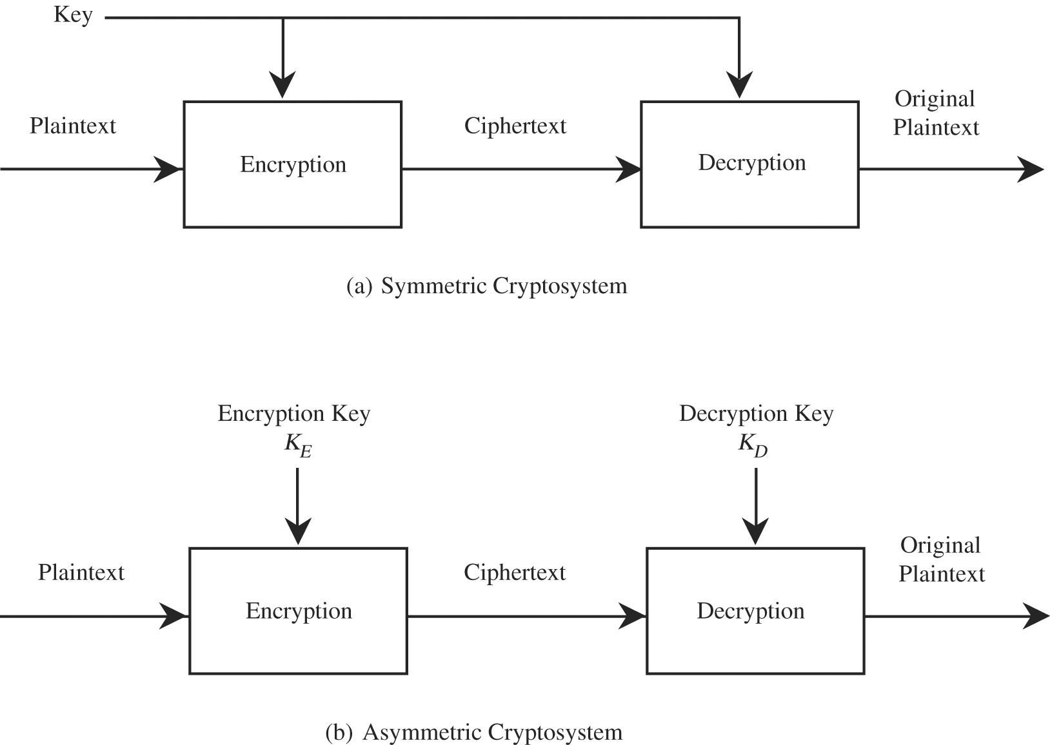
Concepts of symmetric and asymmetric encryption
Symmetric : the encryption and decryption keys are the same, so
P = D(K, E(K,P)).
D and E are mirror-image processes
Asymmetric: encryption and decryption keys come in pairs. Then, a decryption key, K_{D}, inverts the encryption of key K_{E} so that
P = D(K_{D}, E(K_{E},P))
converting C back to P involves a series of steps and a key that are different from the steps and key of E

Slide 15
Why using a key?
We can create different encryptions of one plaintext message just by changing the key
Using a key provides additional security
If the encryption algorithm should fall into the interceptor's hands, future messages can still be kept secret because the interceptor will not know the key value

Slide 16
What can a cryptanalyst attempt to do?
Break a single message
Recognize patterns in encrypted messages
to be able to break subsequent ones by applying a straightforward decryption algorithm
Infer some meaning without even breaking the encryption
such as noticing an unusual frequency of communication or determining something by whether the communication was short or long
Deduce the key
to break subsequent messages easily
Find weaknesses in the implementation or environment of use of encryption
Find general weaknesses in an encryption algorithm, without necessarily having intercepted any messages

Slide 17
What can a cryptanalyst attempt to do?
Cryptanalyst cannot be expected to try only the hard, long way!
analyst can use educated guesses combined with careful analysis to generate all or most of an important message
Example: WWII 1942 (AF for Midway island between US and Japanese)
Estimates of breakability are based on current technology, not future!
Things that were infeasible in 1940 became possible by the 1950s
Remember "Moore's Law"
the speed of processors doubles every 1.5 years, and this conjecture has been true for over two decades

Slide 18
Representing Characters
Use the mathematical form below
The letter A is represented by a zero, B by a one, and so on
We can perform simple modular arithmetic on letters using the corresponding code numbers
A + 4 = E, K - 2 = I, Y + 3 = B

Slide 19
Substitutions & transpositions
Two simple forms of encryption:
Substitutions
in which one letter is exchanged for another
Transpositions
in which the order of the letters is rearranged

Slide 20
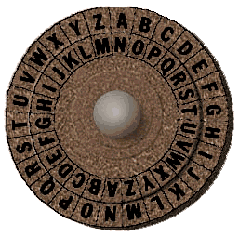
Substitutions: The Caesar Cipher
The Caesar Cipher
Each letter is translated to the letter a fixed number of places after it in the alphabet.
Caesar used a shift of 3, so plaintext letter p_{i} was enciphered as ciphertext letter c_{i} by the rule
c_{i} = E(p_{i}) = (p_{i} + 3) mod (26)
In the general form, using K as a key
c_{i} = E(p_{i}) = (p_{i} + k) mod (26)
p_{i} = D(c_{i}) = (c_{i} – k) mod (26)
Example:
INFO SECURITY → ?
Was it good enough?

Slide 21
Substitutions: The Caesar Cipher
Cyphertext: wklv phvvdjh lv qrw wrr kdug wr euhdn
Cryptanalysis:
Blank is translated to itself?
How about English small words? (digrams and trigrams)
am, is, to, be, he, we, and, are, you, she, and so on
Any clue in the repeated r of wrr?
Xyy: see, too, odd, add
wklv phvvdjh lv qrw wrr kdug wr euhdn
T--- ------- -- -OT TOO ---- TO -----
How about OT?
Could be got, dot, hot, etc.

Slide 23
To be continued next lecture!
Other symmetric cryptography
Asymmetric cryptography

