Slide 1
Chapter 12+13
Entity-Relationship Modeling & Enhanced Entity-Relationship Modeling

Slide 2
Chapter 12 - Objectives
How to use Entity–Relationship (ER) modeling in database design.
Basic concepts associated with ER model.
How to identify and resolve problems with ER models called connection traps.
How to build an ER model from a requirements specification.

Slide 3
Chapter 13 - Objectives
Limitations of basic concepts of the ER model and requirements to represent more complex applications using additional data modeling concepts.
Most useful additional data modeling concept of Enhanced ER (EER) model is called specialization/generalization.
A diagrammatic technique for displaying specialization/generalization in an EER diagram using UML.

Slide 4
Database design
Steps in building a database for an application:
Understanding real-world domain being captured
Specify it using a database conceptual model (ER/OO)
Translate specification to model of DBMS (relational)
Create schema using DBMS commands (DDL)
Load data(DML)
Real World Domain
Conceptual model (ERD)
Relational Data Model
Create schema
(DDL)
Load Data
(DML)

Slide 5
Second Phase of Database Design
ER Diagram is used.
Does not include implementation details.
Users and developers can easily understand and discuss.
Used to ensure all user requirements are met.
Enables designers to concentrate on specifying the properties of the data, without being concerned about storage details.

Slide 6
Entity-Relationship Model (ER) Overview
Entity-Relationship (ER) model is a popular high-level description of the structure of the DB.
graphical model for representing the conceptual model for the data.
Based on a perception of a real world that consists of a collection of basic objects, called entities, and of the relationships among these objects.
The ER model can be directly translated into relational tables.

Slide 7
Concepts of the ER Model
Entity types
Relationship types
Attributes

Slide 8
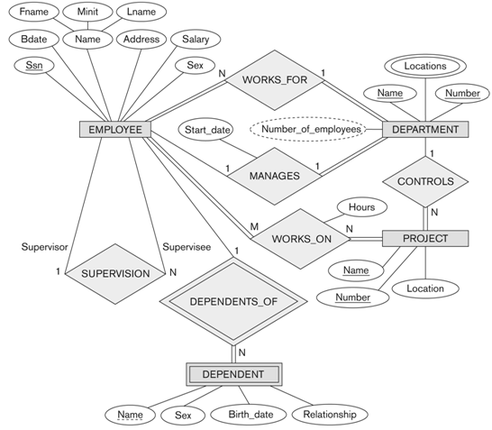
Example of ER Diagram

Slide 9
Entities and Attributes
The ER Model describes data as entities, relationships and attributes.
Entity:
The basic object that the ER model represents is an entity, which is a “thing” in the real world with an independent existence.
Could be an object with a physical existence (person, car) or conceptual existence (company, course).
Each entity has attributes.
Major
Student

Slide 10
Entity ,Entity Type and entity occurrence
Entity type is a group of objects with same properties, identified by enterprise as having an independent existence.
e.g. set of all persons, companies, courses
Entity occurrence: a uniquely identifiable object of an entity type.
STUDENT
COURSE

Slide 11
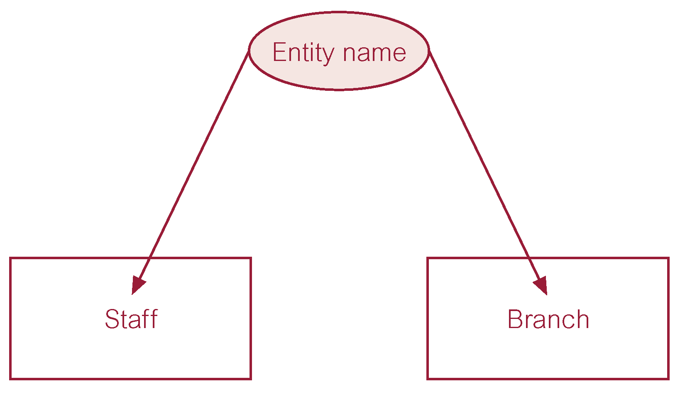
ER diagram of Staff and Branch entity types

Slide 12
Entity Type
Strong Entity Type
Entity type that is not existence-dependent on some other entity type.
Weak Entity Type
Entity type that is existence-dependent on some other entity type.

Slide 13
Weak Entity Type
The existence of a weak entity type depends on the existence of a strong entity set; it must relate to the strong entity type via a relationship type called identifying relationship.
The PK of a weak entity set is formed by the PK of its strong entity type, plus a weak entity type discriminator attribute.
LName
FName
dep_no
FName
emp_no
DOB
EMPLOYEE
has
DEPENDENT

Slide 14
Attributes
Attribute
Property of an entity or a relationship type
All entities in one type have the same attributes
Attribute domain:
name
DOB
St_no
Tel_no
STUDENT

Slide 15
Attributes - Simple Versus Composite
Simple Attribute
Attribute composed of a single value with an independent existence.
e.g. salary, age, gender
name
DOB
St_no
Tel_no
STUDENT

Slide 16
Attributes - Simple Versus Composite
Composite Attribute
Attribute composed of multiple components, each with an independent existence.
e.g. address (street, area, city, post code)
name (first name, initial, last name)
initial
FName
LName
Area_cd
name
DOB
no
St_no
Tel_no
EX
STUDENT

Slide 17
Attributes Single-Valued Versus Multivalued
Single-valued Attribute
Attribute that holds a single value for a single entity type.
e.g. student_no, age, gender

Slide 18
Attributes Single-Valued Versus Multivalued
Multi-valued Attribute
Attribute that holds multiple values for each occurrence of an entity type.
initial
FName
LName
name
DOB
St_no
Mobile
STUDENT

Slide 19
Attributes Stored Versus Derived
DOB
Stored:
E.g. Birth_date.
Derived Attribute
Attribute that represents a value that is derivable from value of a related attribute, or set of attributes, not necessarily in the same entity type.
e.g. age id derived from DOB
Some attribute values can be derived from related entities;
e.g. an attribute Number_of_employees of a DEPARTMENT entity can be derived by counting the number of employees related to that department.
name
age
St_no
STUDENT

Slide 20
Keys
Candidate Key
Minimal set of attributes that uniquely identifies an entity. It cannot contain null.
e.g. student_no, NID, branch_no
There could be more than one candidate key; if so, we select one of them as the primary key and the other will be an Alternate Key
Primary Key
Candidate key selected to uniquely identify each entity
Element ( Symbol , name , atomic_no)
Candidate Key
Primary Key
Alternate Key

Slide 21
TYPES of PRIMARY KEY
Primary Key
PK’s may be
simple PK (single attribute)
CUSTOMER (custno, ….)
composite PK (multiple attributes)
ORDERLINE (orderno, prodno, quantity,…)

Slide 22
Drawing Entities and Attributes
stu_id
name
Rectangles represent entities
Oval represent attributes
derived attributes use dotted line
multi-valued attributes use double line
primary key attribute indicated with underline
dob
age
student
phone
address
street
city

Slide 23
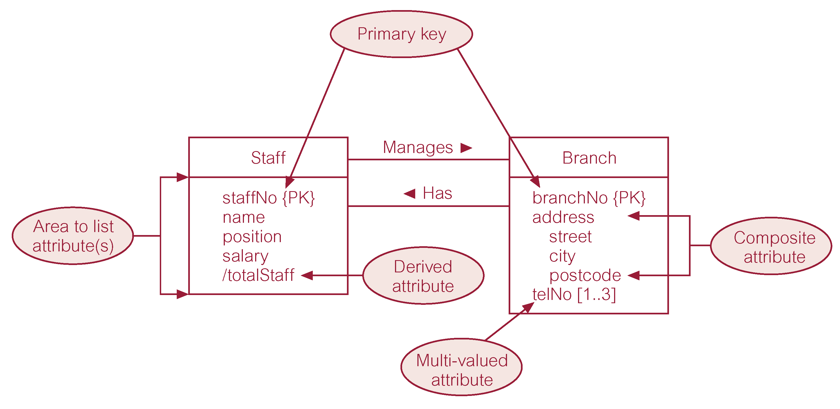
ER diagram of Staff and Branch entities and their attributes

Slide 24
Relationship
association between two (or more) entities
relationships represented by diamond
Examples
Students Register for Subjects
School Has Staff
Driver Commits Traffic Offence
Customer Orders Product
Supplier Supplies Parts To Projects
Relationship
ENTITY
ENTITY
primary key
attribute
attribute

Slide 25
Relationship & Relationship Types
Relationship associate two or more entities.
Relationship type is a set of meaningful associations among entity types.
relationship occurrence: A uniquely identifiable association ,which includes one occurrence from each participating entity type
study
STUDENT
COURSE

Slide 26
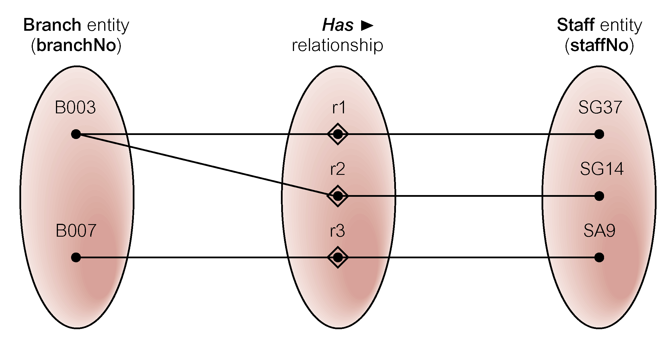
Semantic net of Has relationship type

Slide 27
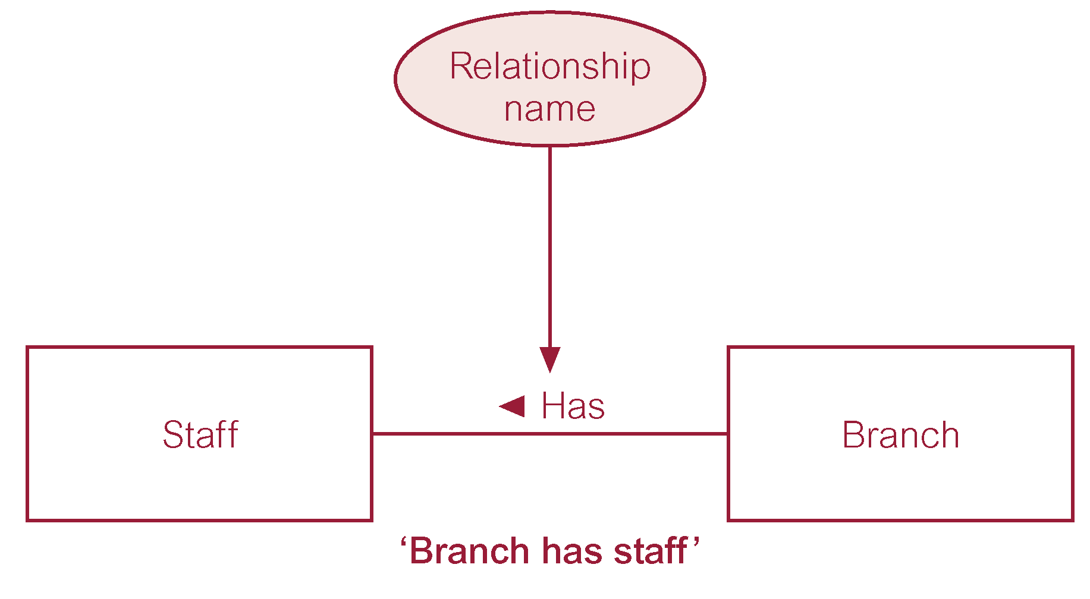
ER diagram of Branch Has Staff relationship

Slide 28
Relationship Types
Degree of a Relationship
Number of participating entities in relationship.
Relationship of degree :
One is unary ( 1 entity type)
two is binary ( 2 entity types)
three is ternary ( 3 entity types)

Slide 29
Binary relationship called POwns

Slide 30
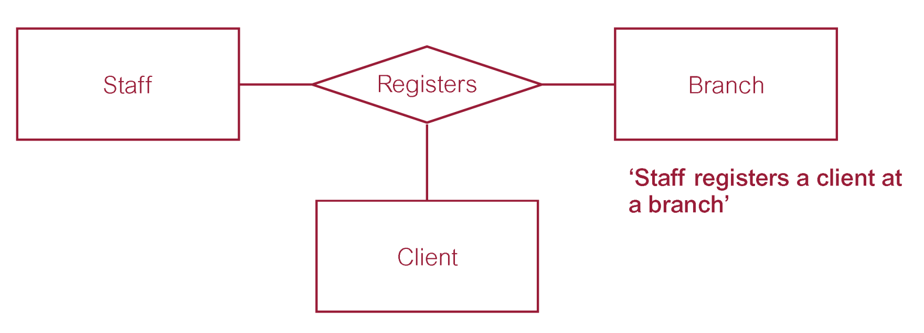
Ternary relationship called Registers

Slide 31
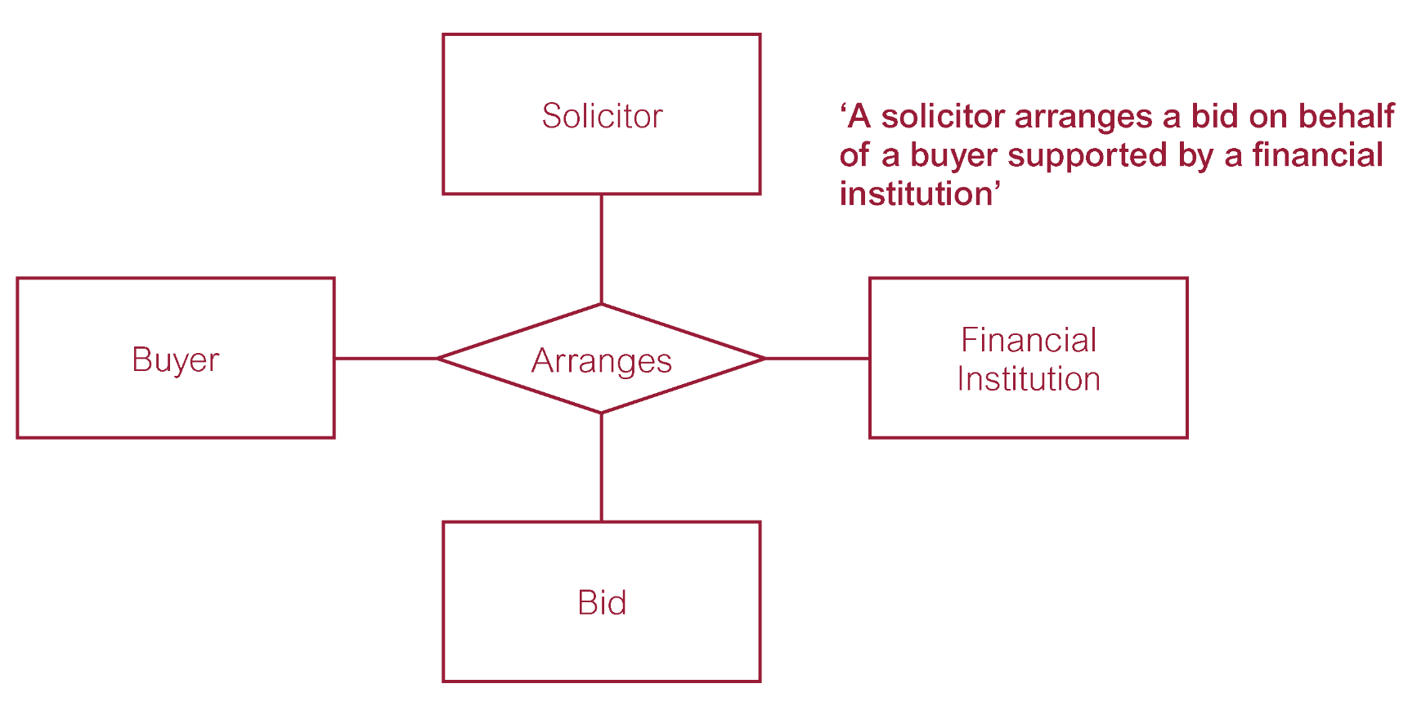
Quaternary relationship called Arranges

Slide 32
Relationship Types
Recursive Relationship
Relationship type where same entity type participates more than once in different roles. It is a Unary relationship.
Role
Role indicates purpose that each participating entity type plays in a relationship.
Role can be used when two entities are associated through more than one relationship to classify the purpose of each relation.

Slide 33
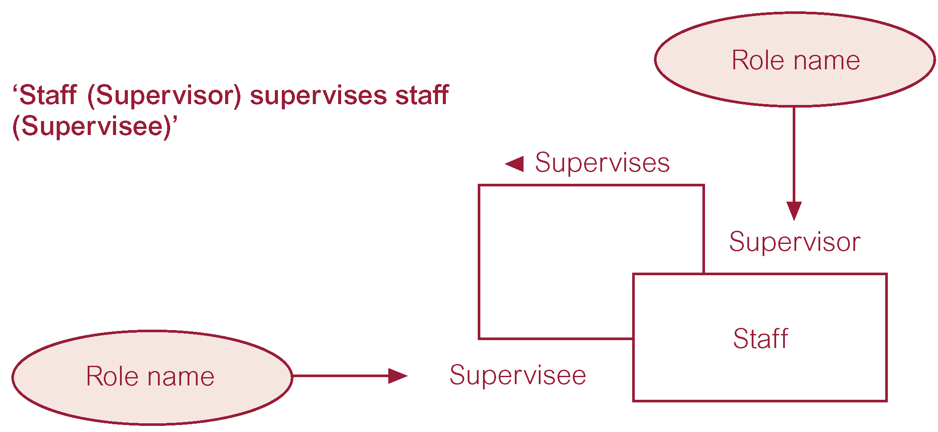
Recursive relationship called Supervises with role names

Slide 34
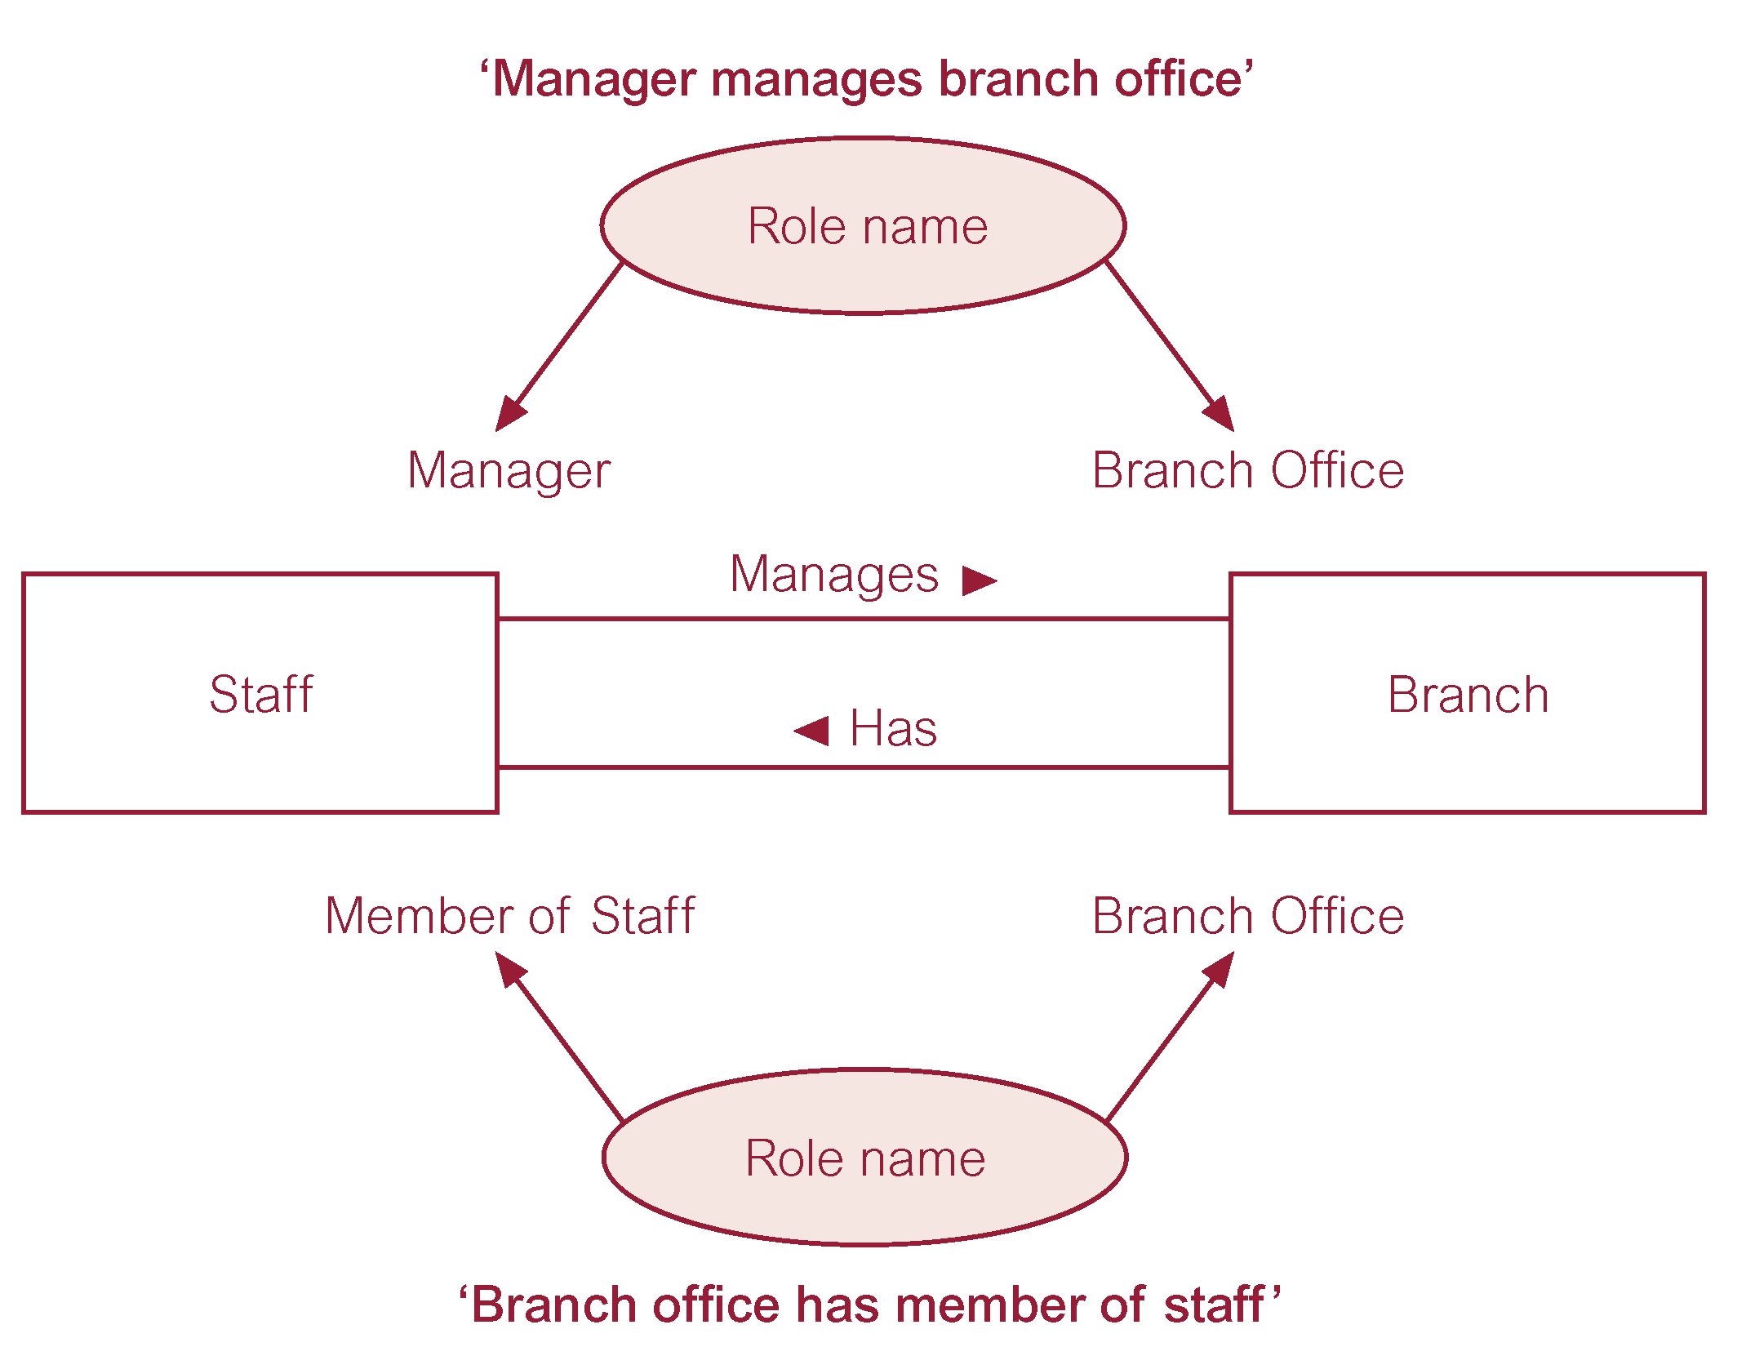
Entities associated through two distinct relationships with role names

Slide 35
Attributes of Relationship Types
Relationship types can also have attributes.
E.g. customer orders a product
quantity is attribute of orders relationship
E.g. Employee WORKS-ON Project
To record the number of hours per week that an employee works on a particular project. The attribute Hours can be included to the WORKS-ON relationship type.
customer
product
orders
quantity
Employee
works-on
Project
Hours

Slide 36
Types of Relationships
Degree of relationship: is the number of entity types that participate in it
UNARY – between entities from one entity set
BINARY – between entities from two entity sets
N-ARY – among entities from more than two entity sets

Slide 37
Relationship Degree - Unary relationship
EMPLOYEE
SUPERVISION
r
e
●
2
1
1
e
1
●
r
2
2
2
e
1
●
3
2
r
e
3
●
1
4
e
2
r
●
1
4
5
1
e
●
r
6
2
5
e
1
●
:
7
r
2
6
:

Slide 38
Relationship Degree - Binary relationship
EMPLOYEE
WORKS_FOR
DEPARTMENT
r
1
e
●
●
d
1
r
1
2
e
●
2
r
e
3
d
●
●
2
3
r
e
●
4
4
e
r
●
d
●
5
:
3
5
e
●
r
6
6
e
●
r
7
:
7
:

Slide 39
Relationship Degree - Ternary relationship
SUPPLIER
SUPPLY
PROJECT
s
r
●
1
1
j
●
1
s
●
r
2
2
:
r
j
3
●
2
r
4
PART
●
j
r
3
5
:
p
r
1
●
6
p
2
●
r
7
p
3
:
●
:

Slide 40
Relationship Degree
M
prerequisite
SUBJECT
UNARY : One entity set, recursive.
N
BINARY : Two entity sets linked (mostly used).
enrols in
STUDENT
SUBJECT
M
N
TERNARY :Three entity sets linked.
owns
RENTAL SHOP
VIDEO
M
N
1
BORROWER

Slide 41
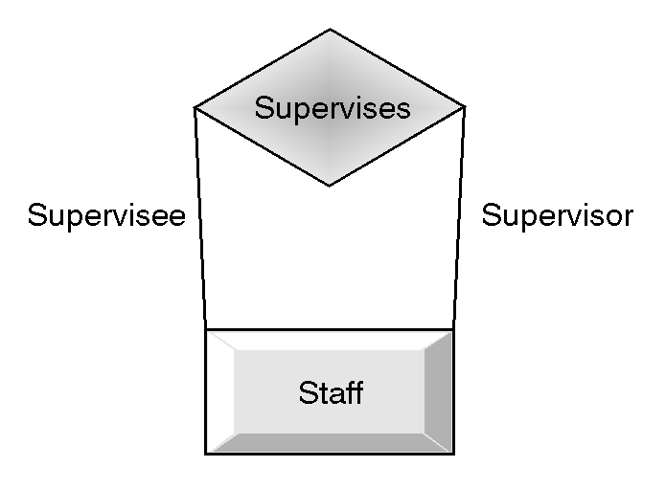
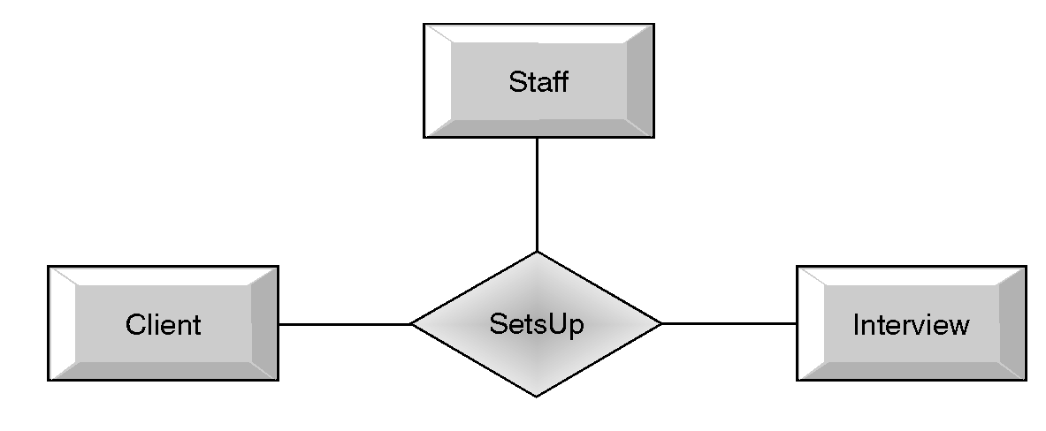
Example Relationships

Slide 42
Multiplicity
Multiplicity is the number (range) of possible entities that may relate to a single association through a particular relationship.
It is best determined using sample data.
Takes the form (min#,max#).

Slide 43
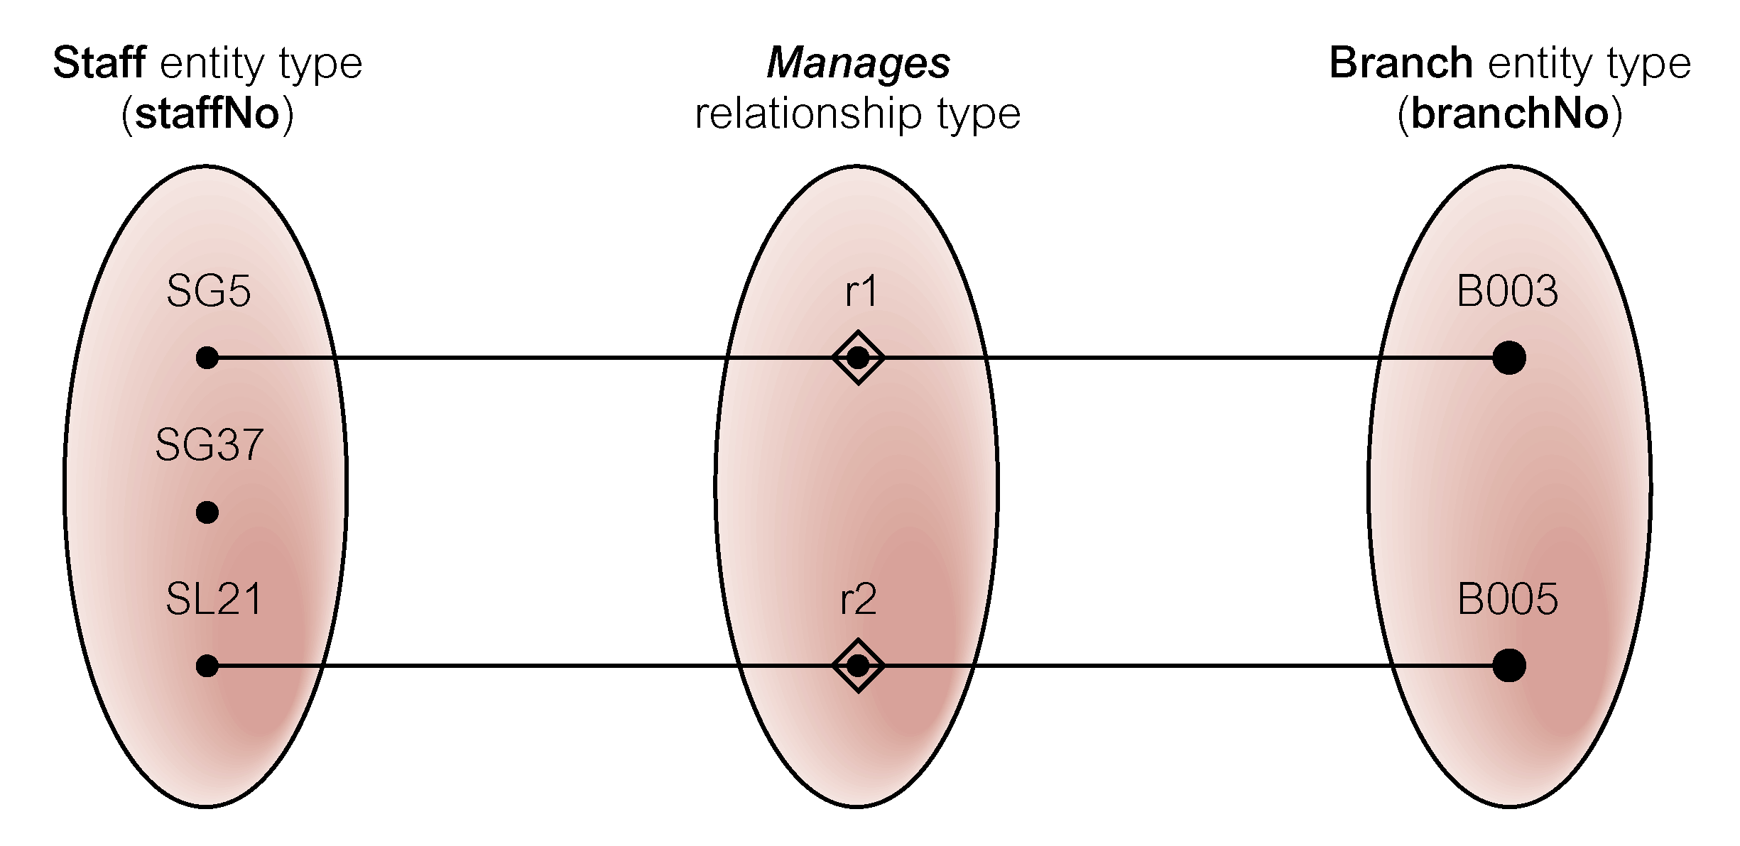
Semantic net of Staff Manages Branch relationship type

Slide 44
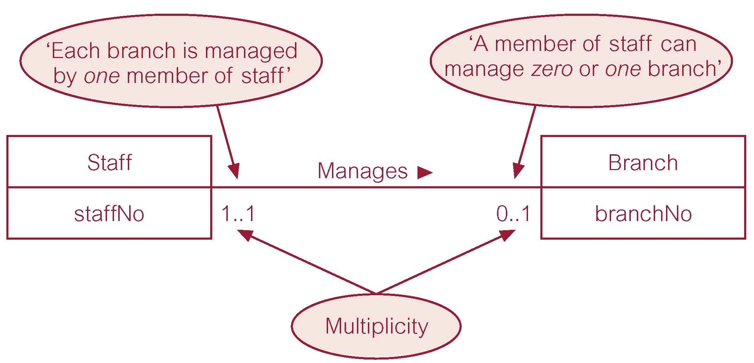
Multiplicity of Staff Manages Branch (1:1) relationship

Slide 45
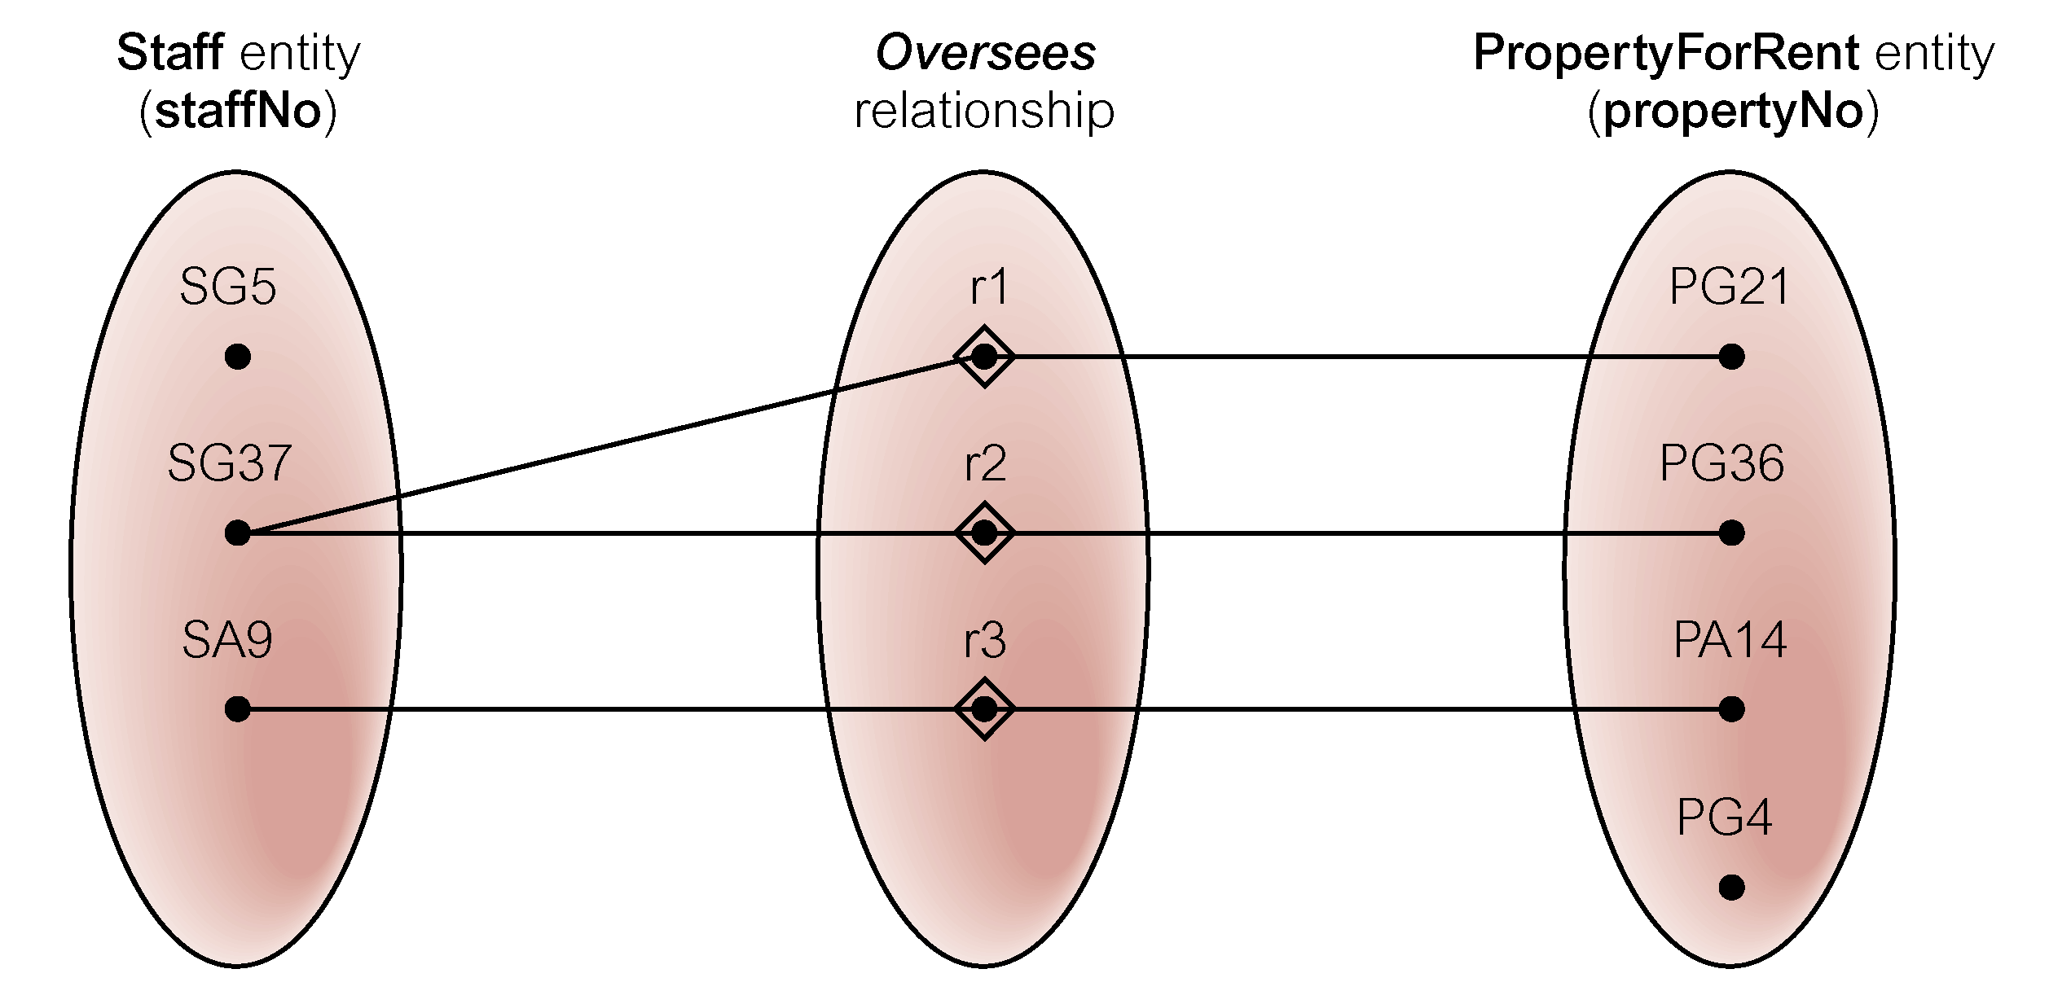
Semantic net of Staff Oversees PropertyForRent relationship type

Slide 46
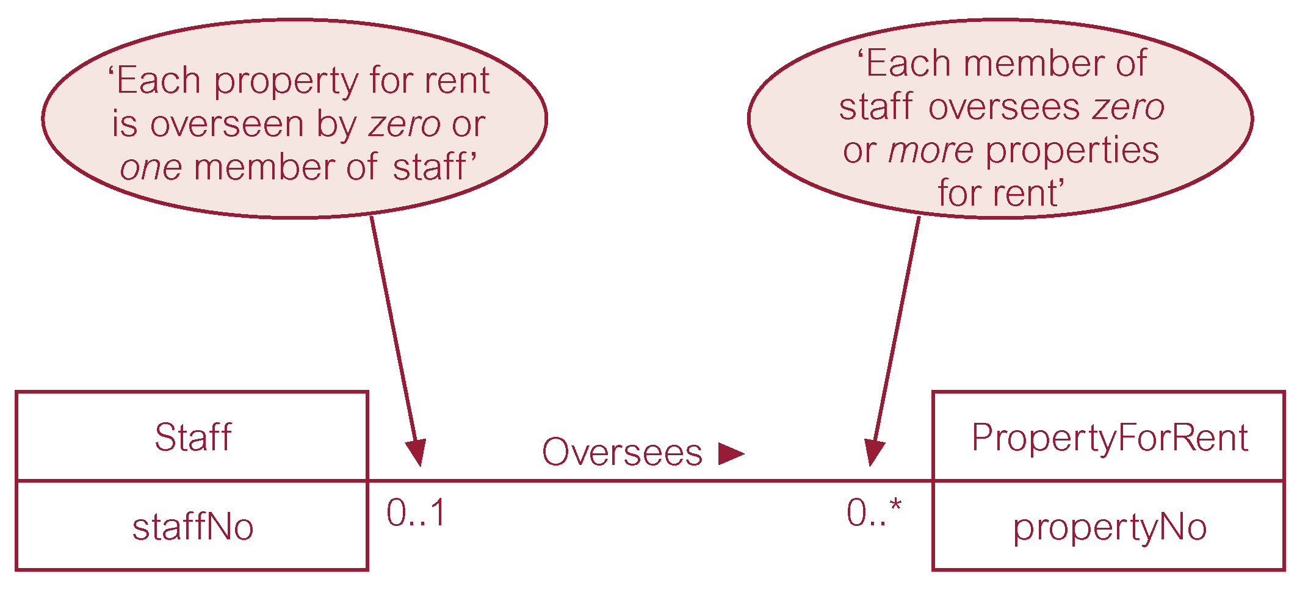
Multiplicity of Staff Oversees PropertyForRent (1:*) relationship type

Slide 47
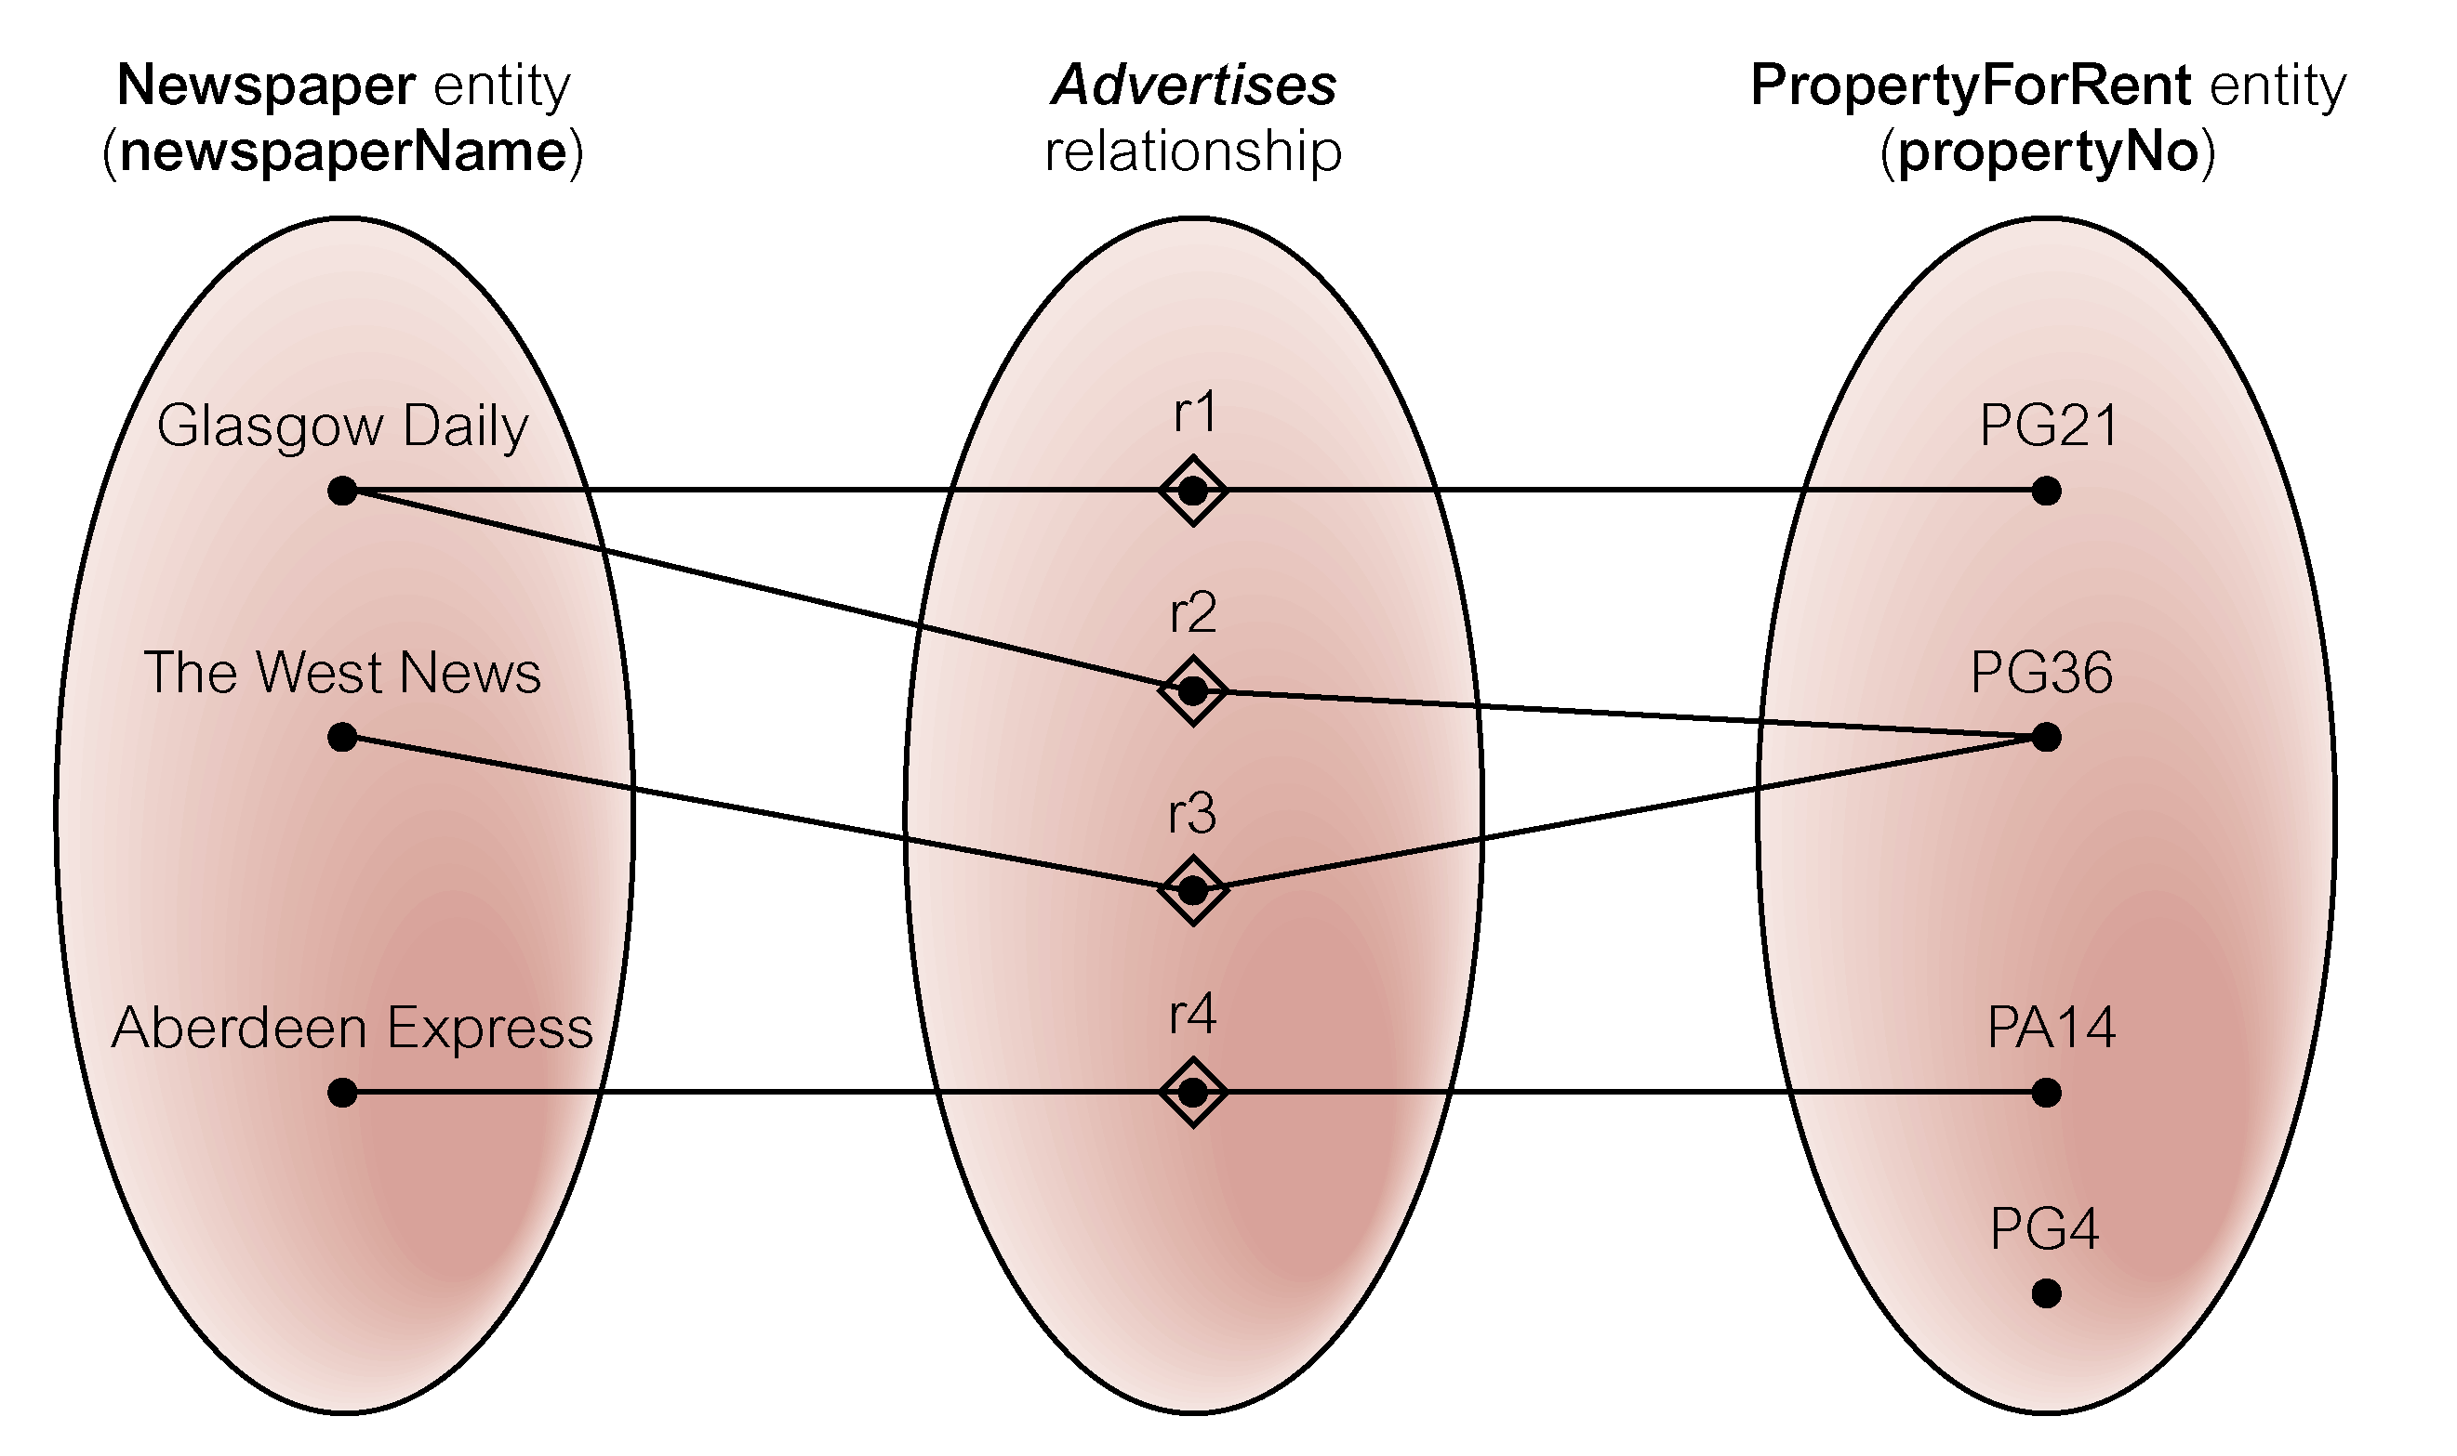
Semantic net of Newspaper Advertises PropertyFoRrent relationship type

Slide 48
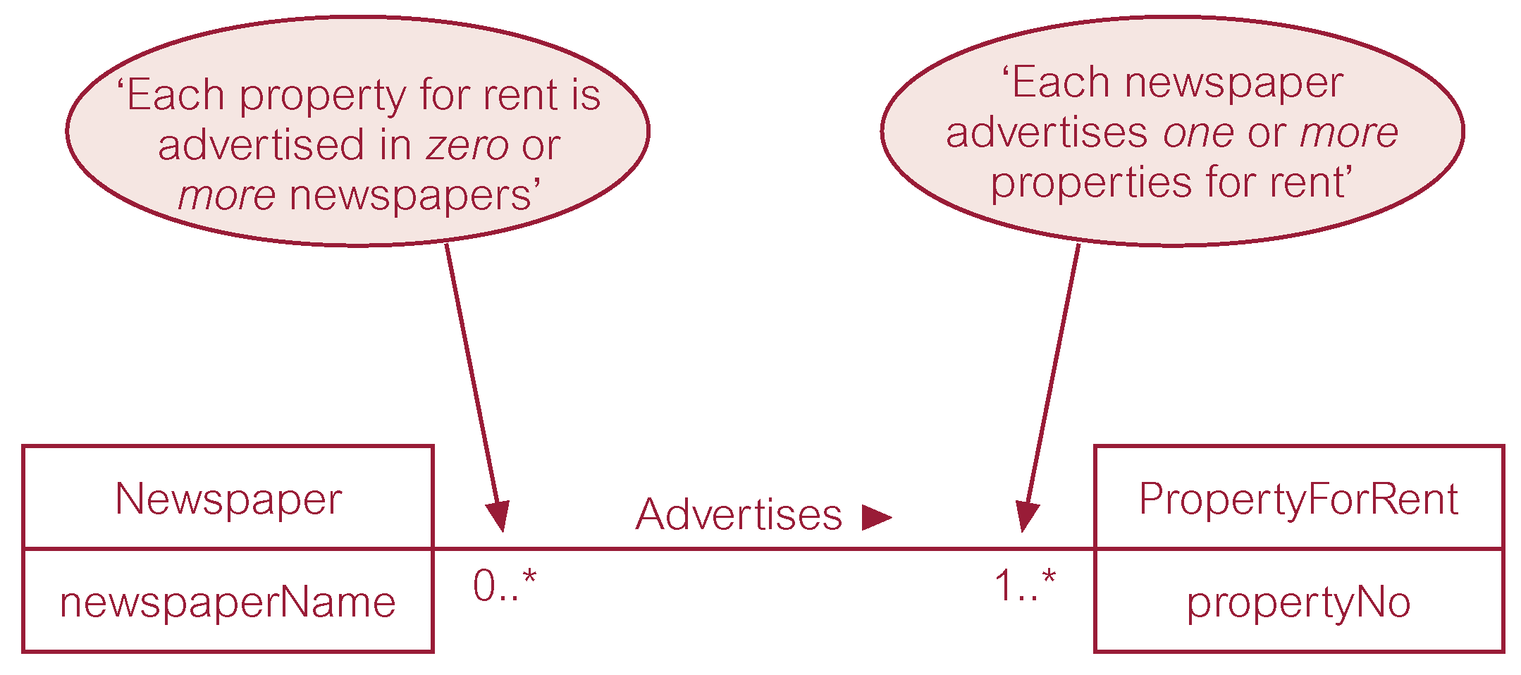
Multiplicity of Newspaper Advertises PropertyForRent (*:*) relationship

Slide 49
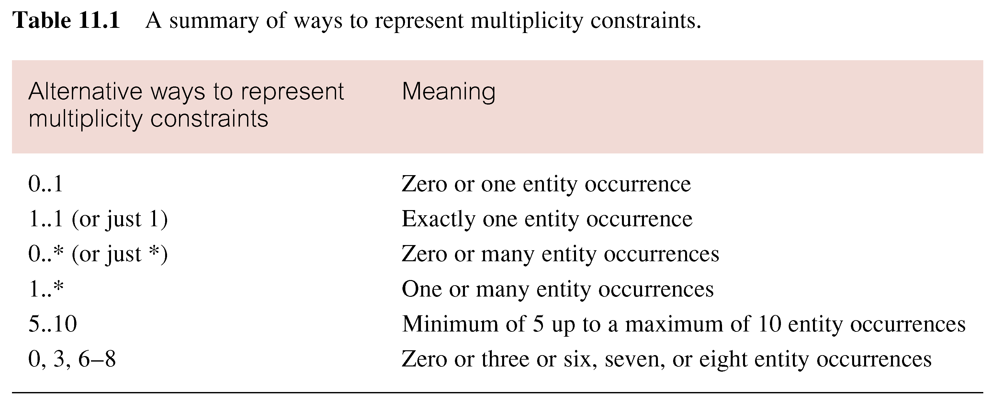
Summary of multiplicity constraints

Slide 50
Structural Constraints
Multiplicity is made up of two types of restrictions on relationships: cardinality and participation.
Cardinality
Describes maximum number of possible relationship occurrences for an entity participating in a given relationship type.
Participation
Determines whether all or only some entity occurrences participate in a relationship.

Slide 51
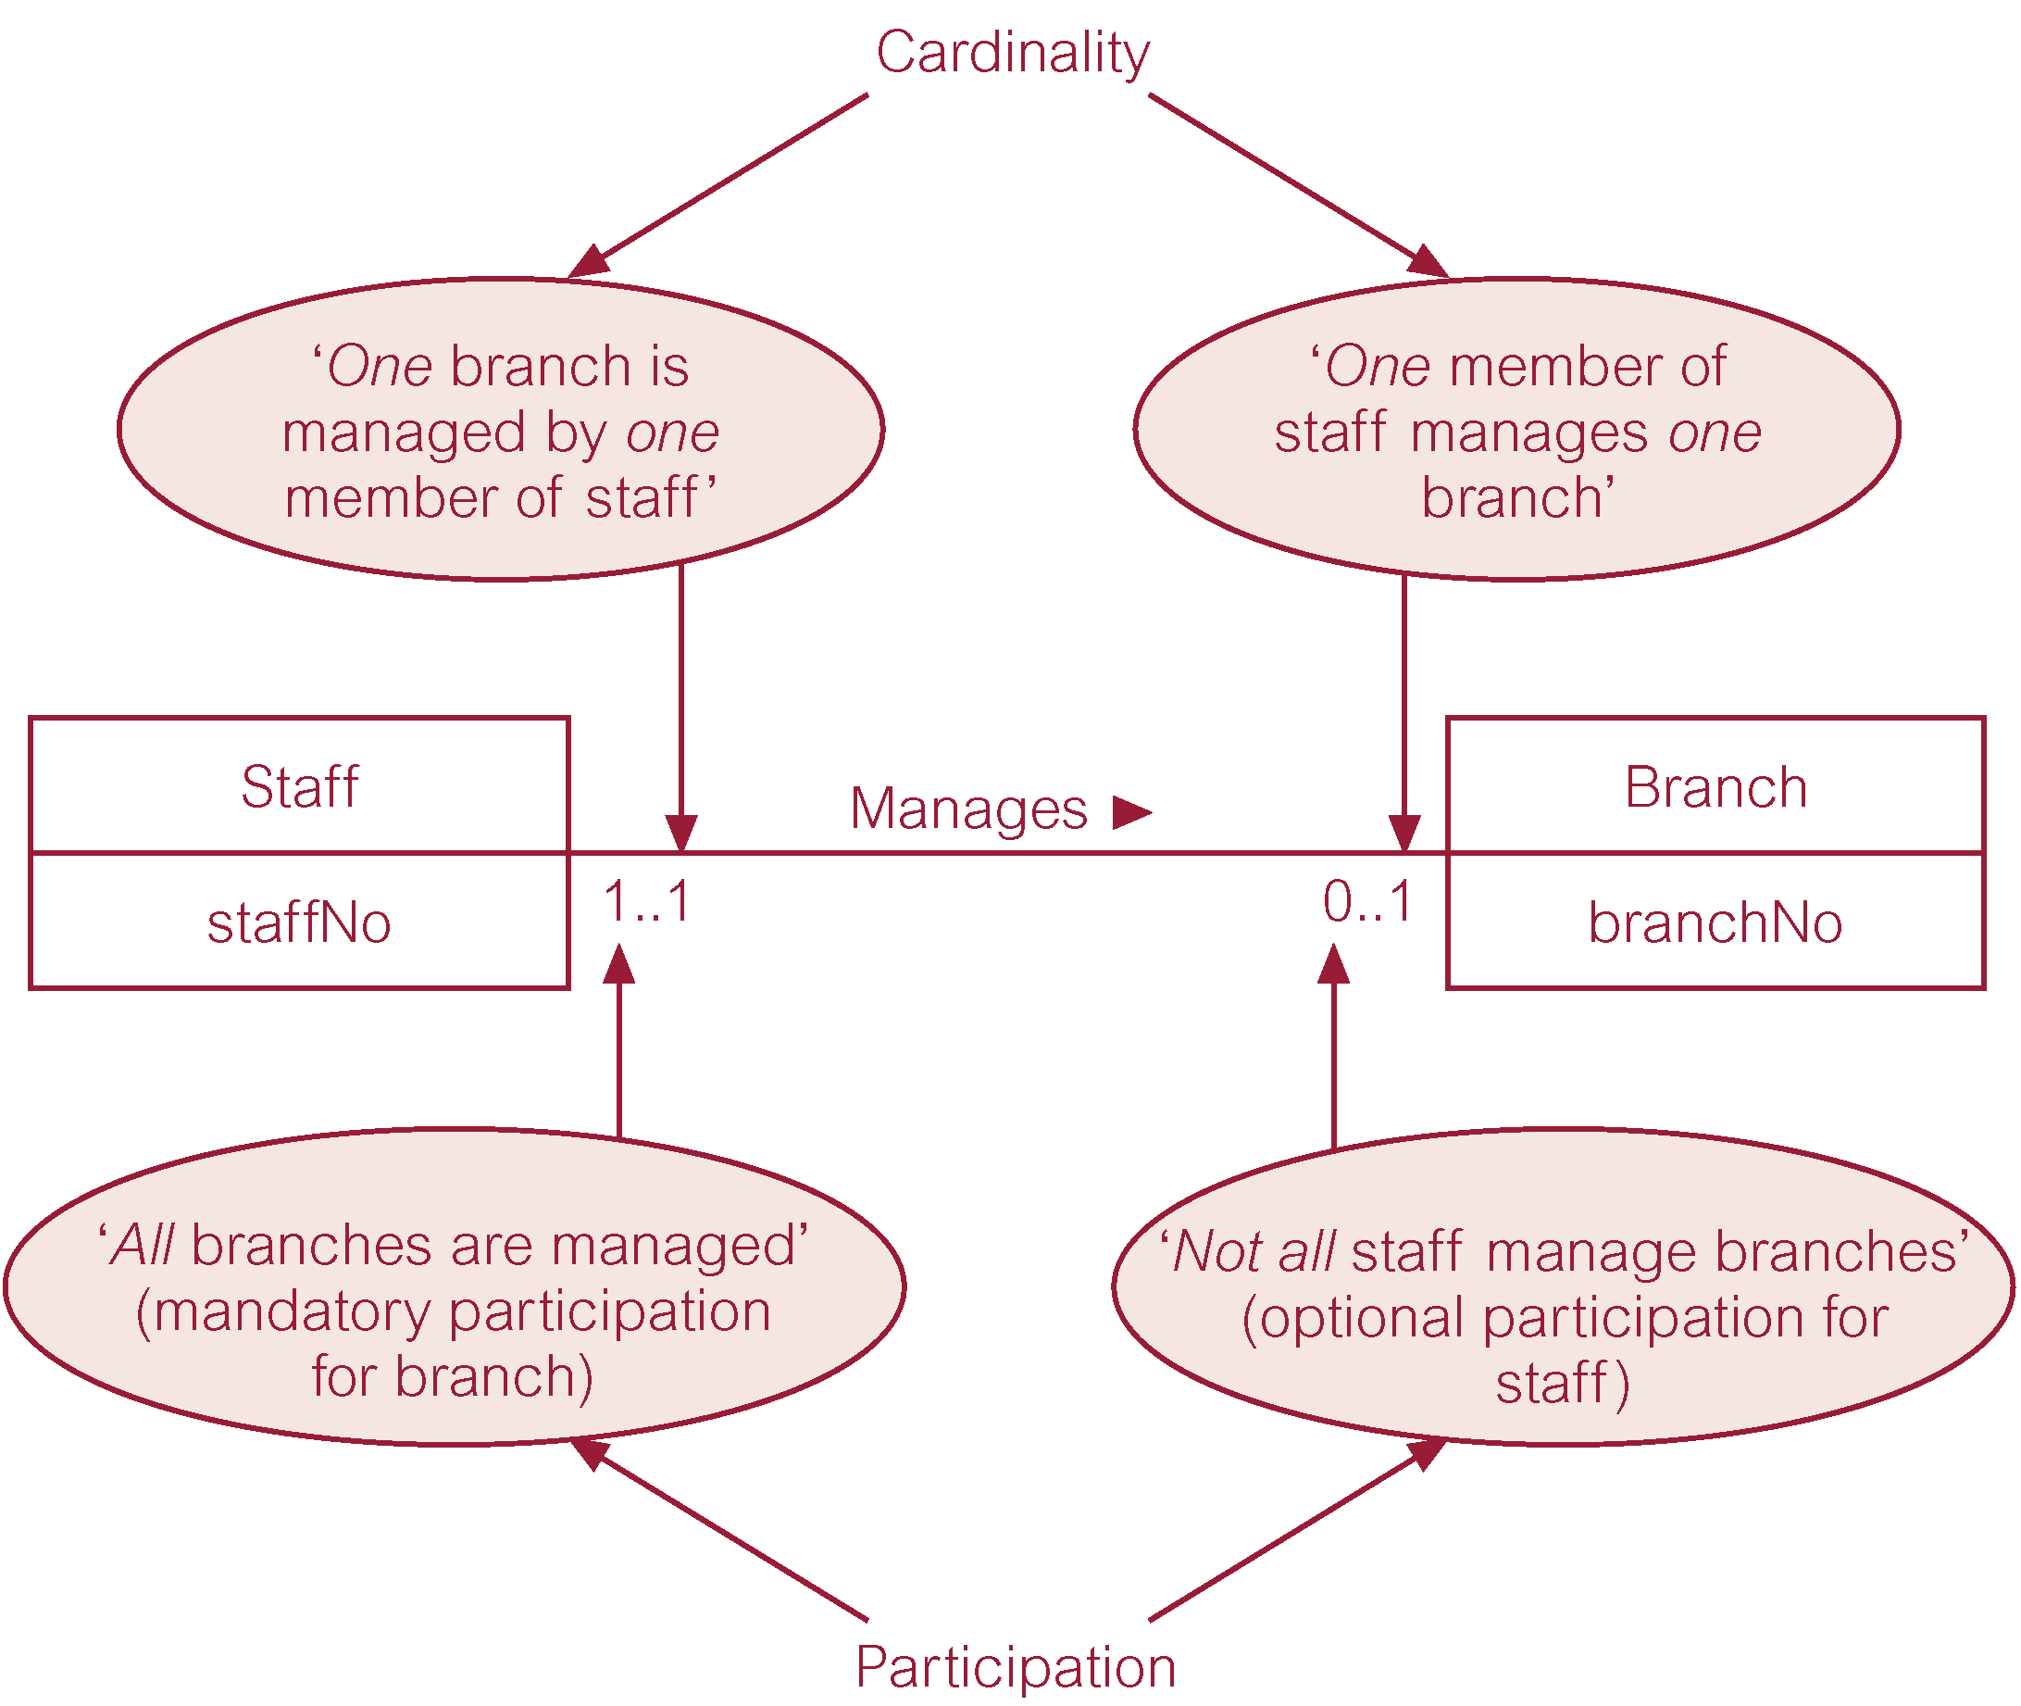
Multiplicity as cardinality and participation constraints

Slide 52
Participation Constraints
Participation constraints determine whether all or only some entities participate in a relationship.
Two types of participation:
Mandatory (total)
Optional (partial)

Slide 53
Participation Constraints
Mandatory (total) (1:*): if an entity’s existence requires the existence of an associated entity in a particular relationship (existence-dependent)
(e.g. CLASS taught-by PROFESSOR)
CLASS is a total participator in the relation
A weak entity always has a mandatory participation constraints but the opposite not always true.

Slide 54
Participation Constraints
Optional (partial) (0:*): if an entity’s existence does not require a corresponding entity in a particular relationship. (Not existence-dependent)
(e.g. PROFESSOR teach CLASS)
PROFESSOR is a partial participator in the relation

Slide 55
ER Case Study
Design s database for a bank with the following description:
Each bank has a unique name.
Each branch has a number, name, address (number, street, city), and a set of phones.
Customer includes their name, set of address (P.O. Box, city, zip code, country), set of phones, and social security number.

Slide 56
ER Case Study cont.
Accounts have numbers, types (e.g. saving, checking) and balance. Other branches might use the same designation for accounts. So to name an account uniquely, we need to give both the branch number to which this account belongs to and the account number.
Not all bank customers must own accounts.
An account must have only one customer.
A customer may have many accounts and in different branches.
A customer may have at most 5 accounts in the bank.

Slide 57
Problems with ER Models
Problems may arise when designing a conceptual data model called connection traps.
Often due to a misinterpretation of the meaning of certain relationships.
Two main types of connection traps are called fan traps and chasm traps.

Slide 58
Problems with ER Models
Fan Trap
Where a model represents a relationship between entity types, but pathway between certain entity occurrences is ambiguous.
Chasm Trap
Where a model suggests the existence of a relationship between entity types, but pathway does not exist between certain entities.

Slide 59
An Example of a Fan Trap
Exists where 2 or more 1:M relationships fan out from the same entity.

Slide 60
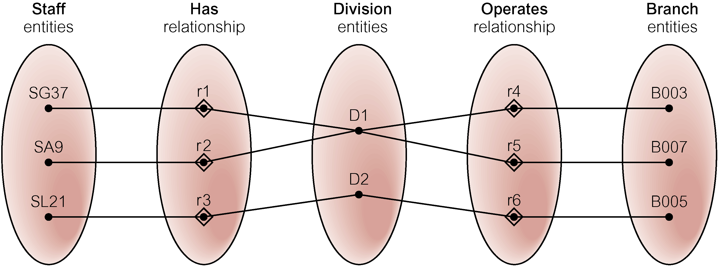
Semantic Net of ER Model with Fan Trap
At which branch office does staff number SG37 work?

Slide 61
Restructuring ER model to remove Fan Trap

Slide 62
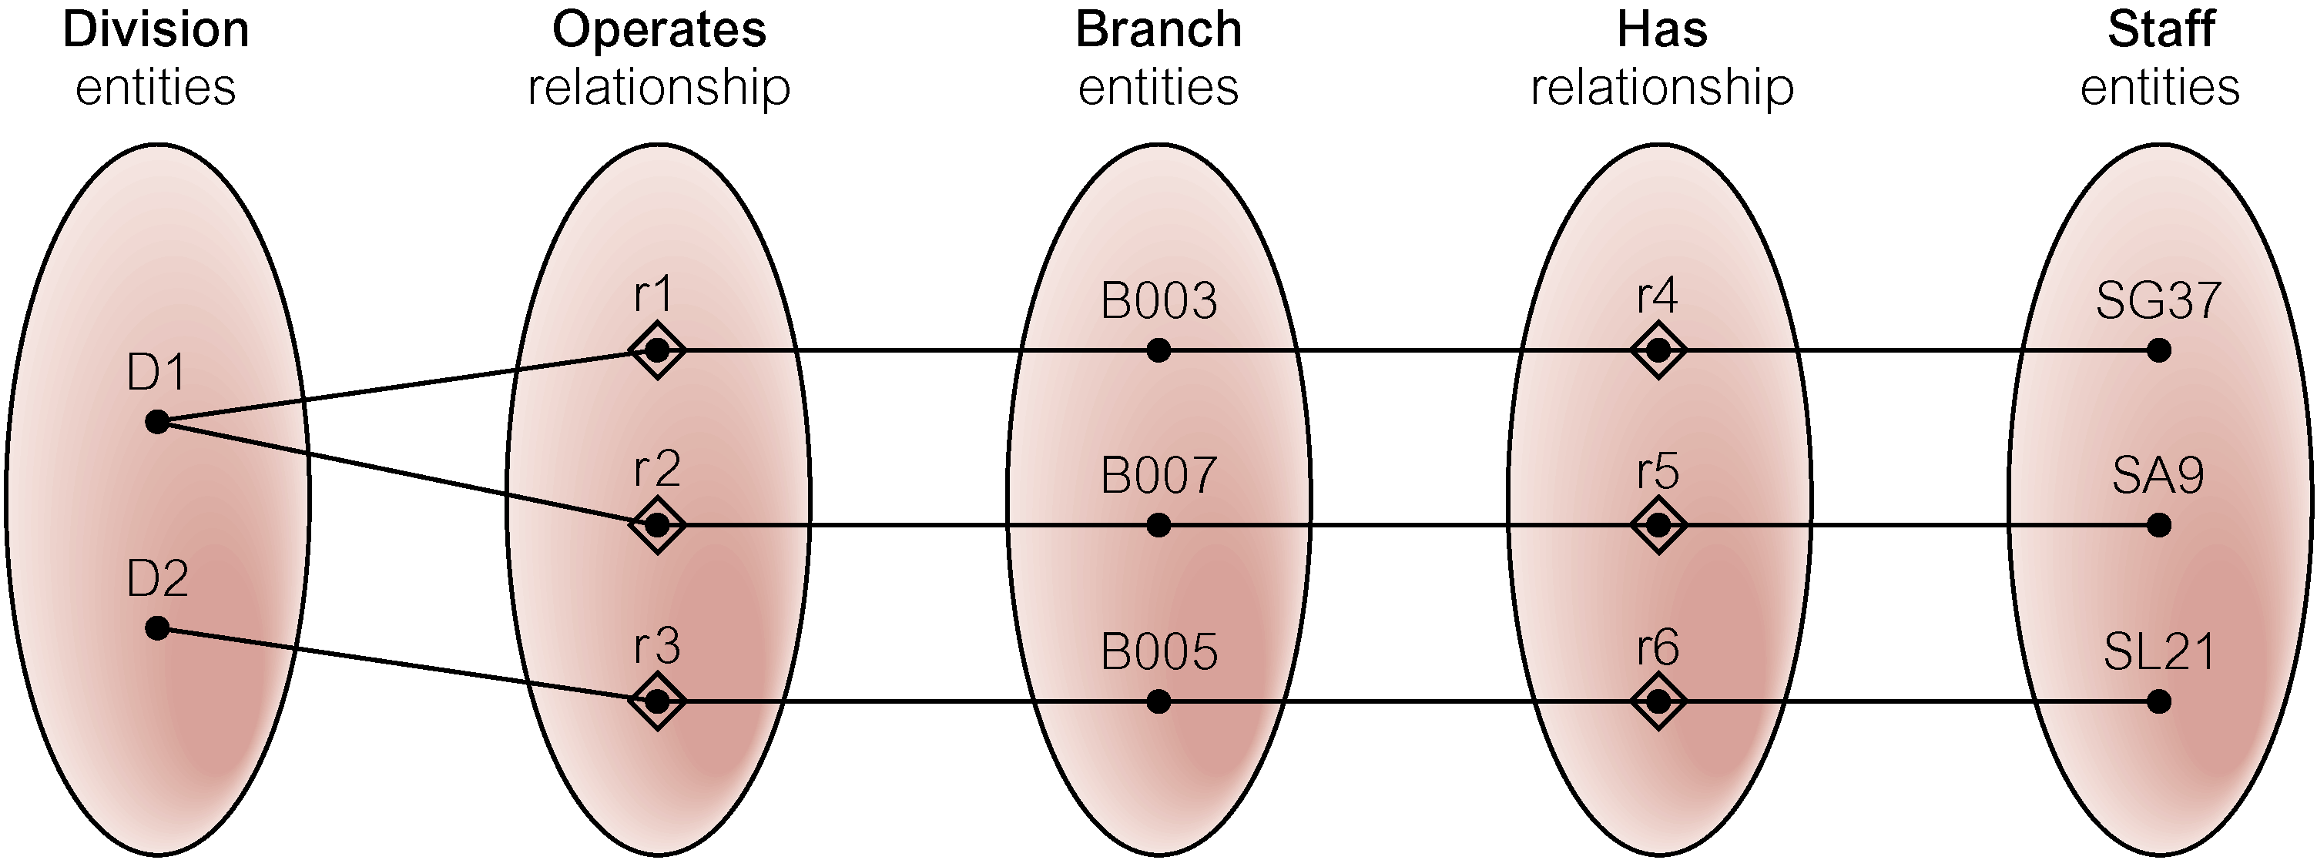
Semantic Net of Restructured ER Model with Fan Trap Removed
SG37 works at branch B003.

Slide 63
An Example of a Chasm Trap
Exists when partial participating entity is part of the pathway between related entities.

Slide 64
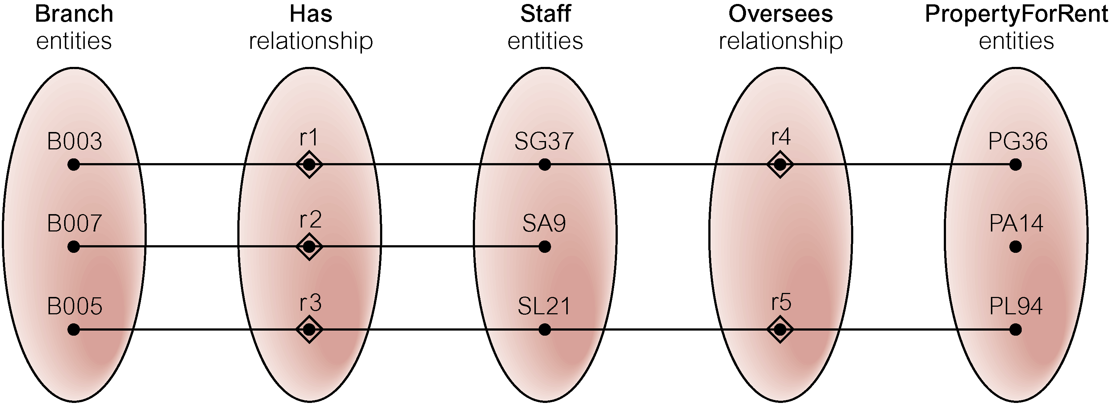
Semantic Net of ER Model with Chasm Trap
At which branch office is property PA14 available?

Slide 65
ER Model restructured to remove Chasm Trap

Slide 66
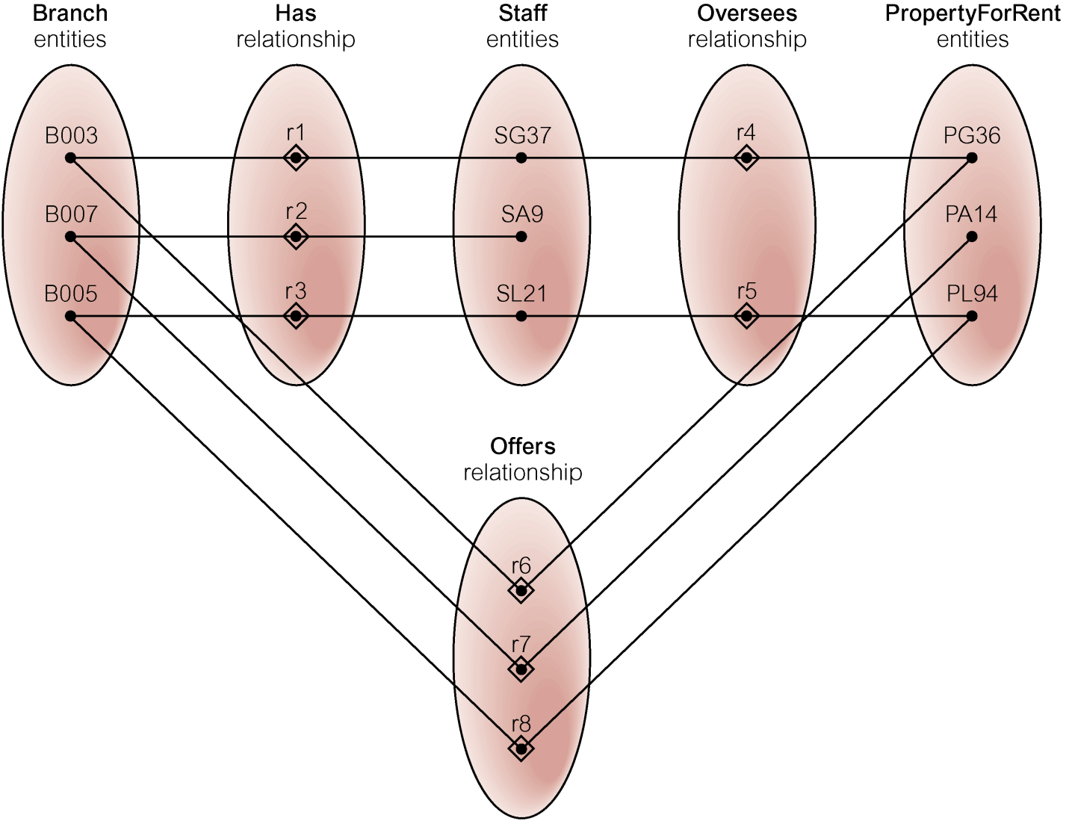
Semantic Net of Restructured ER Model with Chasm Trap Removed

Slide 67
Summary of ERD notations
ATTRIBUTE
ENTITY
KEY ATTRIBUTE
WEAK ENTITY
MULTI-VALUED
RELATIONSHIP
COMPOSITE
IDENTIFYING
RELATIONSHIP
DERIVED

Slide 68
Summary of ERD notations
1
M
CARDINALITY
RATION
(min,max)
PARTICIPATION
CONSTRAINTS

Slide 69
The Enhanced Entity-Relationship Model
EER is an ER model supported with additional semantic concepts.
Semantic concepts supported:
Specialization
Generalization

Slide 70
Specialization / Generalization
Superclass
An entity type that includes one or more distinct subgroupings of its occurrences.
Subclass
A distinct subgrouping of occurrences of an entity type.

Slide 71
Specialization / Generalization
Superclass
STAFF
Subclass
MANAGER
SECRETARY
SALES
PERSONNEL

Slide 72
Specialization / Generalization
Superclass/subclass relationship is one-to-one (1:1).
Superclass may contain overlapping or distinct subclasses.
Not all members of a superclass need be a member of a subclass.

Slide 73
Inheritance
Inheritance
A subclass entity type inherits all the attributes and relationships participation of the superclass entity type to which it is linked.

Slide 74
Inheritance
Shared
relationship
shared
attributes
name
DOB
address
STAFF
contract
COMPANY
require
CAR
SALES
PERSONNEL
Subclass
Unshared
attributes
Car
allowance
Sales
area
Unshared
relationship

Slide 75
Specialization / Generalization
Specialization
Process of maximizing differences between members of an entity by identifying their distinguishing characteristics.
Generalization
Process of minimizing differences between entities by identifying their common characteristics.

Slide 76
Constraints on Specialization / Generalization
Two constraints that may apply to a specialization/generalization:
participation constraints
disjoint constraints.

Slide 77
Constraints on Specialization / Generalization
Participation constraint
Determines whether every member in superclass must participate as a member of a subclass.
Two types of participation:
Mandatory (total)
Optional (partial)

Slide 78
Participation constraint
Mandatory (total) participation where every member in the superclass must also be a member of a subclass.
STAFF
FULL-TIME
STAFF
PART-TIME
STAFF
Hourly_rate
Salary

Slide 79
Participation constraint
Optional (partial) participation where a member in the superclass need not belong to any of its subclass.
STAFF
MANAGER
SECRETARY
SALES
PERSONNEL

Slide 80
Constraints on Specialization / Generalization
Disjoint constraint
Describes relationship between members of the subclasses and indicates whether member of a superclass can be a member of one, or more than one, subclass.
Two types of disjoint contains:
Disjoint
Nondisjoint

Slide 81
Disjoint constraint
Disjoint constraint when an entity can be a member of only one of the subclasses of the specialization.
STAFF
d
FULL-TIME
STAFF
PART-TIME
STAFF
Hourly_rate
Salary

Slide 82
Disjoint constraint
Non-disjoint constraints an entity is a member of more than one subclass of specialization. Entity types may overlap.
STAFF
o
MANAGER
SECRETARY
SALES
PERSONNEL

Slide 83
Summary of ERD notations
d
Disjoint constraint
o
Non-Disjoint constraint
Total Participation
Partial Participation

Slide 84
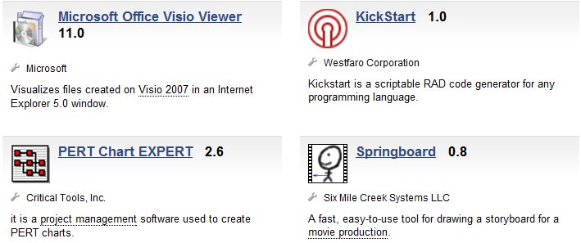
Tool For Drawing ER Diagrams In Oracle software

Slide 85
Example (Company)
The COMPANY database keeps track of a company’s employees, departments and projects.
The company is organized into departments. Each department has a unique name, a unique number, and a particular employee who manages the department. We keep track of the start date when that employee began managing the department.
A department may have several locations.
A department controls a number of projects, each of which has a unique name, a unique number, and a single location.

Slide 86
Example (Company)
We store each employee’s name, social security number, address, salary, sex, and birth date. An employee is assigned to one department but may work on several projects, which are not necessarily controlled by the same department. We keep track of the number of hours per week that an employee works on each project. We also keep track of the direct supervisor of each employee.
We want to keep track of the dependents of each employee for insurance purposes. We keep each dependent’s first name, sex, birth date, and relationship to the employee.

Slide 87
Example (Company Example)- ER Diagram

