Slide 1
Joint Probability Distributions
In general, if X and Y are two random variables, the probability distribution that defines their simultaneous behavior is called a joint probability distribution.

Slide 2
Note:
If X and Y are 2 discrete random variables, this distribution can be described with a joint probability mass function. If X and Y are continuous, this distribution can be described with a joint probability density function.

Slide 3
Two Discrete Random Variables:
If X and Y are discrete, with ranges $R_{X}$ and $R_{Y}$ , respectively, the joint probability mass function is
p(x, y) = P(X = x and Y = y), x ∈ $R_{X}$ , y ∈ $R_{Y}$.

Slide 4
in the discrete case,

Slide 5
Two Continuous Random Variables:
If X and Y are continuous, the joint probability density function is a function f(x,y) that produces probabilities:
$$P\left[\left(X,Y\right)∈A\right]=\iint{f\left(x,y\right)dydx}$$
A

Slide 6
in the continuous case,

Slide 7
Example:
Suppose we have the following joint mass function
Y
 | -2 | 0 | 5
1 | 0.15 | K | 0.20
3 | 0.20 | 0.05 | 0.15
X
Find the value of k?

Slide 8
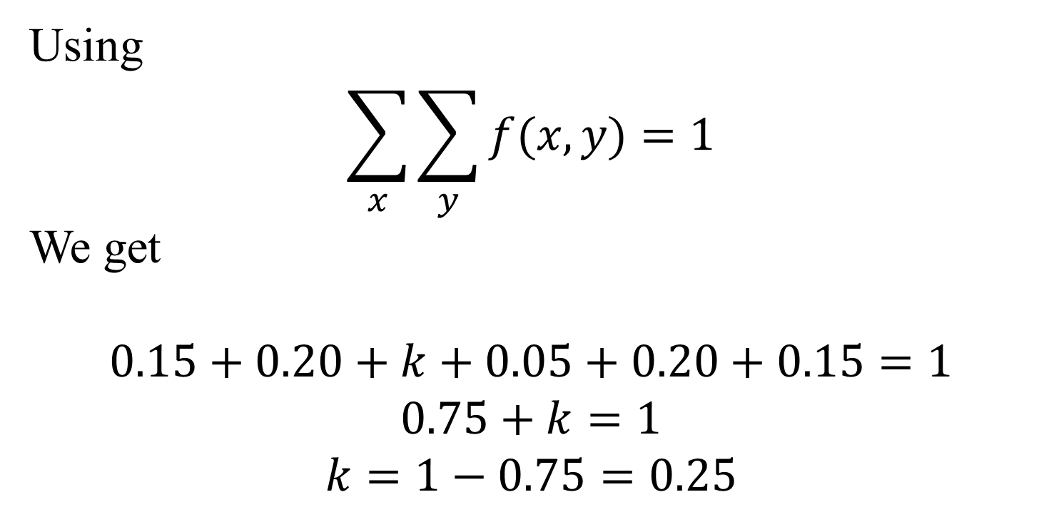
Answer:
Using
$$\sum_{x}{\sum_{y}{f(x,y)}=1}$$
We get
$$0.15+0.20+k+0.05+0.20+0.15=1$$
$$0.75+k=1$$
$$k=1−0.75=0.25$$

Slide 9
Example:
Suppose we have the following joint density function
Prove that $f(x,y)$ is a joint probability function?
Calculate $P\left(X≤\frac{2}{3},Y≤\frac{5}{2}\right)$

Slide 10
Answer:

Slide 11
Prove that?
Another example see Ex 3.15 on page 96

Slide 12
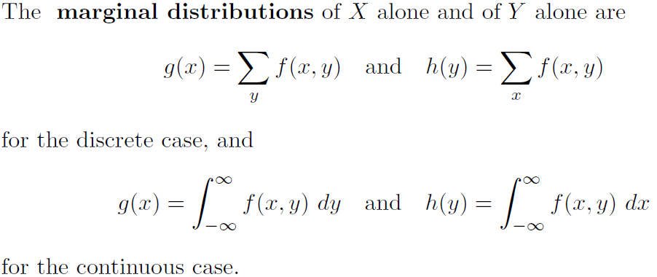
The marginal distributions

Slide 13
Example:
Suppose we have the following joint mass function
Y
 | -2 | 0 | 5
1 | 0.15 | 0.25 | 0.20
3 | 0.20 | 0.05 | 0.15
X
Find the marginal distributions of X and Y?

Slide 14
Answer:
Sum | 5 | 0 | -2
0.6 | 0.20 | 0.25 | 0.15 | 1
0.4 | 0.15 | 0.05 | 0.20 | 3
1 | 0.35 | 0.30 | 0.35 | Sum
Y
X

Slide 15
So
The marginal distribution of X
The marginal distribution of Y
Sum | 3 | 1
1 | 0.4 | 0.6
Sum | 5 | 0 | -2
1 | 0.35 | 0.30 | 0.35

Slide 16
Example:
Suppose we have the following joint density function
Find the value of c ?
Find the marginal distributions of X and Y?

Slide 17
Answer:

Slide 18
conditional probability distribution

Slide 19
Example:

Slide 20
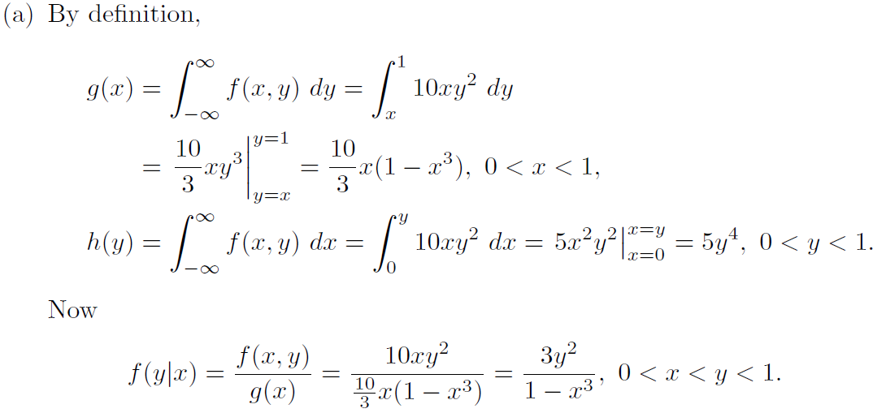
Solution:

Slide 21
Another example see Ex 3.20 on page 100

Slide 22
Statistical Independence

Slide 23
Example:
Suppose we have the following joint distribution
Prove that X and Y are independent?

Slide 25
Notes: if X and Y are independent, then

Slide 26
Example:
Suppose we have the following joint distribution
Find:
The value of k

Slide 27
Solution:

