Slide 1


Slide 2



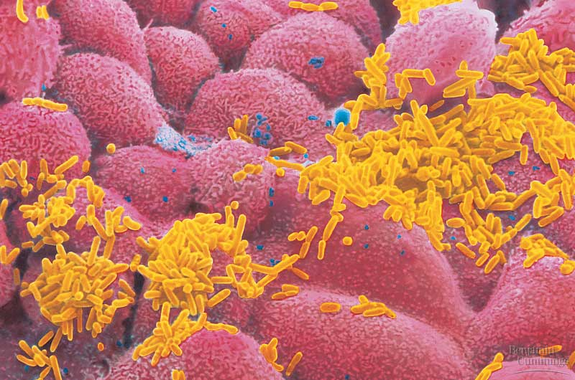
The Cell
Copyright © 2002 Pearson Education, Inc., publishing as Benjamin Cummings

Slide 3
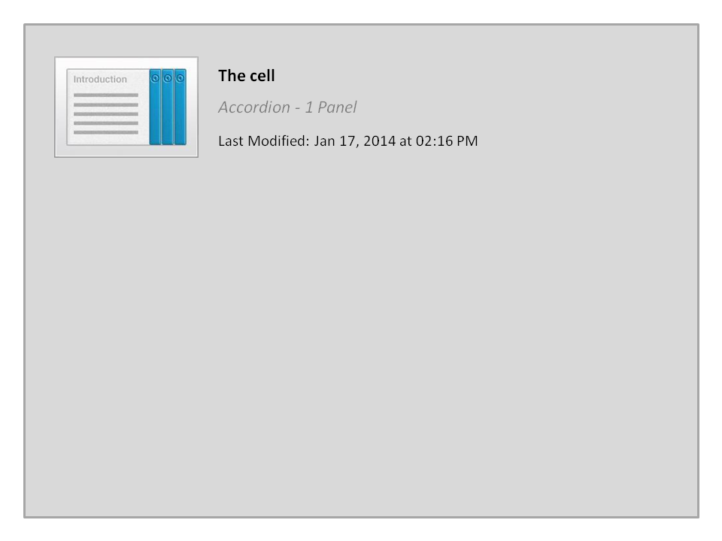
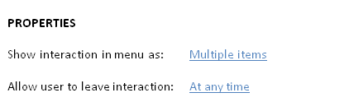


The cell

Slide 4
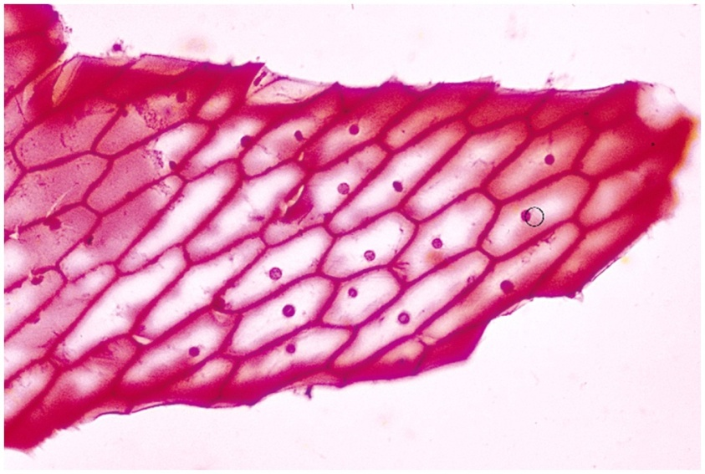
The Cell: Discovery of the Cell
The first person to see cells was Robert Hooke in 1665.
He was looking at a thin slice of cork through a microscope
and he found what he described as "tiny rooms" that he called cells
Copyright © 2002 Pearson Education, Inc., publishing as Benjamin Cummings

Slide 5


The Cell Theory
In 1838, the German botanist Matthias Schleiden concluded that all plants were composed of cells
In 1839, Theodor Schwann concluded the same thing for animals
In 1855, Rudolf Virchow noted that all cells come from other cells
The cell theory states that:
all living organisms are made of one or more cells,
cells are the basic units of structure and function, and
cells come only from pre-existing cells.
A cell is the smallest unit that can carry on all of the processes of life

Slide 6
Living
Cells
Types of cells
عديمة/بدائية النواة
حقيقية النواة
Prokaryotic
Eukaryotic
Bacteria and related micro-organisms
All other forms of life
البكتيريا وكائنات دقيقة شبية بها
6

Slide 7
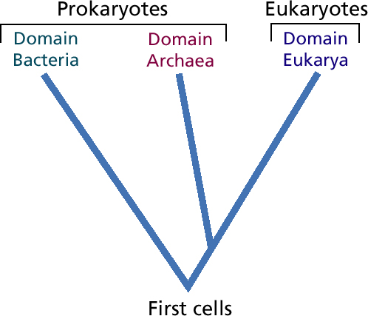
Three Domains of Living Organisms

Slide 8
Domains of lifeمجالات الحياه
A)- Prokaryota بدائيات النواة
Contains 2 Kingdoms:
Archaea, مملكة البدائيات وتضم البكتيريا البدائية
Bacteria (Eubacteria), مملكة االبكتيريا الحقيقية
B)- Eukaryota حقيقيات النواة
Contains 4 Kingdoms:
Fungi مملكة الفطريات
Protesta مملكة الطلائعيات
Plantae مملكة النباتات
Animalia مملكة الحيوانات

Slide 9
Prokaryotic and eukaryotic cells differ in size and complexity
Similarities أوجه التشابه
All cells are surrounded by a plasma membrane غشاء بلازمى.
The semi-fluid substance المادة شبه السائلة within the cell is called “cytosol”, السيتوبلازم containing the cell organelles عِضيات الخلية.
All cells contain chromosomes which have genes in the form of DNA.
All cells have tiny organelles عضيات صغيرة called “Ribosomes” that make proteins.

Slide 10
Prokaryotic and eukaryotic cells
differ in size and complexity
Differences أوجه الإختلاف
Eukaryotes have a nucleus, while prokaryotes do not.
Eukaryotes have membrane-bound organelles, while prokaryotes do not.
Eukaryotic cells are, on average, ten times the size of prokaryotic cells.
The DNA of eukaryotes is much more complex and therefore much more extensive than the DNA of prokaryotes.
Prokaryotes have a cell wall composed of peptidoglycan,. Many types of eukaryotic cells also have cell walls, but none made of peptidoglycan.
The DNA of prokaryotes floats freely inside the cell; the DNA of eukaryotes is held within its nucleus and associated with histones (proteins)
Eukaryotes undergo mitosis and meiosis; prokaryotes divide by binary fission (simple cell division)

Slide 11
Comparison and Contrast
Prokaryotes
Eukaryotes
Nucleus
Endoplasmic reticulum
Golgi apparatus
Lysosomes
Vacuoles
Mitochondria
Cytoskeleton
Cell membrane
Ribosomes
Cell wall

Slide 12
A)- Prokaryotes: What are Prokaryotes?
It includes two Major Domains: Archaea and Bacteria
Prokaryotes are single-celled organisms that do not have a membrane-bound nucleus, and can live in nearly every environment on Earth.
Although tiny, prokaryotes differ greatly in their genetic traits, their modes of nutrition, however, their habitats are similar.
Based on genetic differences, prokaryotes are grouped into two domains: Domain Archaea and Domain Bacteria.
Copyright © 2002 Pearson Education, Inc., publishing as Benjamin Cummings

Slide 13
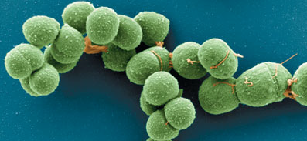
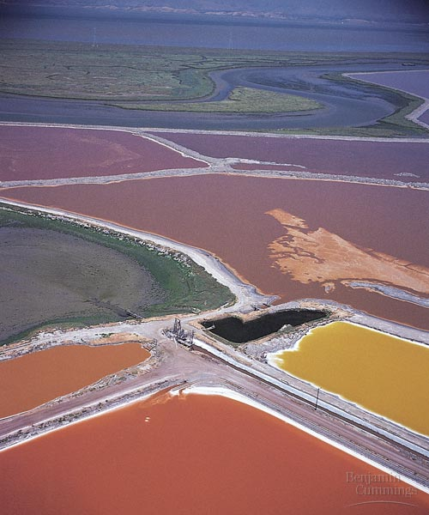
1. Domain: Archaea
Archaea are extremophiles, “مُحب للظروف القاسية” of extreme environments and can be classified into:
a)- Extreme halophilesمُحب للملوحة :
live in such saline places as the Great Salt Lake and the Dead Sea.
Some species require an extremely saltyشديدة الملوحة environment to grow.
b)- Extreme thermophilesمُحب للحرارة live in hot environments.
The optimum temperatures for most thermophiles are 60 - 80°C.

Slide 14



Quiz1

Slide 15




College of Science,
Zoology Department
General Animal Biology
(Zoo-145)
Prof. Ashraf M. Ahmed
aalii@ksu.edu.sa

