Slide 1
Chapter 6
SQL – Data Manipulation
Pearson Education © 2014

Slide 2
Database design
Steps in building a database for an application:
Understanding real-world domain being captured
Specify it using a database conceptual model (ER/OO)
Translate specification to model of DBMS (relational)
Create schema using DBMS commands (DDL)
Load data(DML)
Real World Domain
Conceptual model (ERD)
Relational Data Model
Create schema
(DDL)
Load Data
(DML)
2

Slide 3
Chapter 6 - Objectives
How to retrieve data from database using SELECT statement
How to build SQL statements that :
Use compound WHERE conditions.
Sort query results using ORDER BY.
Use aggregate functions.
Group data using GROUP BY and HAVING.
Use subqueries.
Join tables together.
Perform set operations (UNION, INTERSECT, EXCEPT).
How to update database using INSERT, UPDATE, and DELETE.
Pearson Education © 2014

Slide 4
Objectives of SQL
Ideally, database language should allow user to:
create the database and relation structures;
perform insertion, modification, deletion of data from relations;
perform simple and complex queries.
SQL is a transform-oriented language with 2 major components:
A DDL for defining database structure.
A DML for retrieving and updating data.
Pearson Education © 2014
4

Slide 5
DDL statements
The main SQL data manipulation language statements are:
SELECT
INSERT INTO
UPDATE
DELETE FROM

Slide 6
Writing SQL Commands
Notations to define SQL statements:
UPPER-CASE letters represent reserved words.
Lower-case letters represent user-defined words.
| indicates a choice among alternatives. (e,g a| b| c)
{ } indicate a required element.
[ ] indicate an optional element.
… indicates optional repetition (0 or more).
Underlined words represent default values.
Pearson Education © 2014
6

Slide 7
DREAMHOME TABLES
We illustrate the SQL statements using the instance of the DreamHome case study shown in Figure 3.3, which consists of the following tables:
Branch (branchNo, street, city, postcode)
Staff (staffNo, fName, lName, position, sex, DOB, salary, branchNo)
PropertyForRent (propertyNo, street, city, postcode, type, rooms, rent, ownerNo, staffNo, branchNo)
Client (clientNo, fName, lName, telNo, prefType, maxRent)
PrivateOwner (ownerNo, fName, lName, address, telNo)
Viewing (clientNo, propertyNo, viewDate, comment)

Slide 8
SELECT Statement
SELECT [ DISTINCT | ALL ] { * | [ columnExpression [ AS newname ] ] [,...] }
FROM TableName [alias] [, ...]
[ WHERE condition ]
[ GROUP BY columnList ] [ HAVING condition]
[ ORDER BY columnList ]
Pearson Education © 2014
8

Slide 9
SELECT Statement
COLUMN represent a column name
Column_expression represents an expression on a column.
Table_name is the name of an existing database tables or view
FROM Specifies table(s) to be used.
WHERE Filters rows to some condition.
GROUP BY Forms groups of rows with same column value.
HAVING Filters groups subject to some condition.
SELECT Specifies which columns are to appear in output.
ORDER BY Specifies the order of the output.\
Pearson Education © 2014
9

Slide 10
SELECT Statement
Order of the clauses cannot be changed.
Only SELECT and FROM are mandatory.
Pearson Education © 2014
10

Slide 11
Example 6.1 All Columns, All Rows
List full details of all staff.
SELECT staffNo, fName, lName, address, position, sex, DOB, salary, branchNo
FROM Staff;
Can use * as an abbreviation for ‘all columns’:
SELECT *
FROM Staff;
Pearson Education © 2014
11

Slide 12
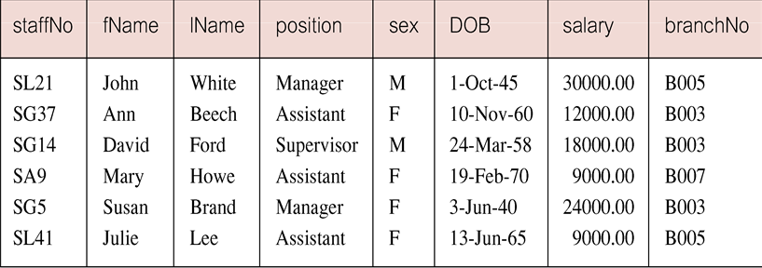
Example 6.1 All Columns, All Rows
Pearson Education © 2014
12

Slide 13
Example 6.2 Specific Columns, All Rows
Produce a list of salaries for all staff, showing only staff number, first and last names, and salary.
SELECT staffNo, fName, lName, salary
FROM Staff;
Pearson Education © 2014
13

Slide 14
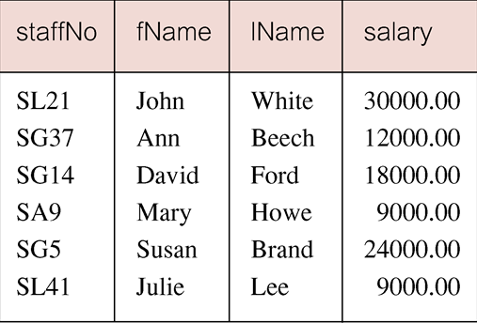
Example 6.2 Specific Columns, All Rows
Pearson Education © 2014
14

Slide 15
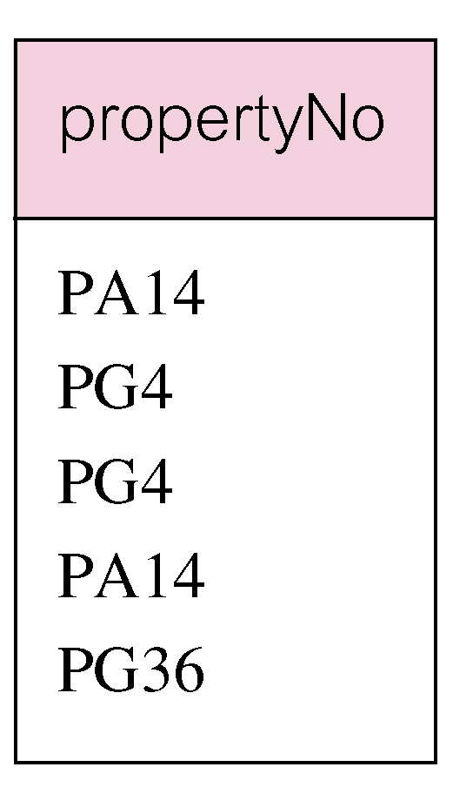
Example 6.3 Use of DISTINCT
List the property numbers of all properties that have been viewed.
SELECT propertyNo
FROM Viewing;
Pearson Education © 2014
15

Slide 16
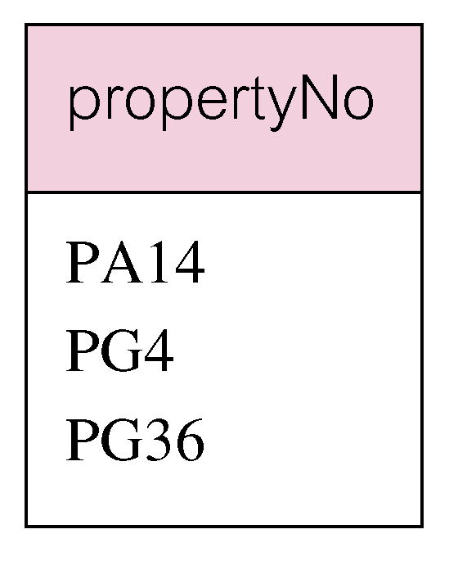
Example 6.3 Use of DISTINCT
Use DISTINCT to eliminate duplicates:
SELECT DISTINCT propertyNo
FROM Viewing;
Pearson Education © 2014
16

Slide 17
Example 6.3 Use of DISTINCT
position
position
Manager
Manager
Assistant
Assistant
Supervisor
Supervisor
Assistant
SELECT DISTINCT position
FROM staff;
Manager
SELECT position
FROM staff;
Pearson Education © 2014
17

Slide 18
Calculated Fields
The SQL expression in the SELECT list specifies a derived field.
Columns referenced in the arithmetic expression must have a numeric type.
SQL expression can involve + , - , * , / , ( , ).
AS clause is used to name the derived column.

Slide 19
Calculated Fields
Syntax
SELECT {* | column | column_expression [AS new_name] [,…]}
FROM table_name;
19
Pearson Education © 2014

Slide 20
Example 6.4 Calculated Fields
Produce list of monthly salaries for all staff, showing staff number, first/last name, and salary.
SELECT staffNo , fName , lName , salary/12 AS monthlySalary
FROM Staff;
StaffNo
FName
LName
MonthlySalary
SL21
John
White
2500
SG37
Ann
Beech
1000
SG14
David
Ford
1500
SA9
Mary
Howe
750
SG5
Susan
Brand
2000
Pearson Education © 2014
20

Slide 21
Row Selection (Where clause)
WHERE clause consists of five basic search conditions:
Comparison: Compare the value of one expression to the value of another expression (= , <, >, <=, >=, <>).
Range: Test whether the value of an expression falls within a specified range of values (BETWEEN/ NOT BETWEEN).
Set membership: Test whether the value of an expression equals one of a set of values (IN/ NOT IN).
Pattern match: Test whether a string matches a specified pattern (LIKE/ NOT LIKE).
NULL: Test whether a column has null value (IS NULL/ IS NOT NULL).

Slide 22
Comparison Search Condition
Comparison operators: = , < , > , <= , >= , <>
Syntax
SELECT [ DISTINCT | ALL ] { * | column | [ column_expression [ AS new_name] ] [,…] }
FROM table_name
[WHERE condition];

Slide 23
Example 6.5 Comparison Search Condition
List all staff with a salary greater than 10,000.
SELECT staffNo, fName, lName, position, salary
FROM Staff
WHERE salary > 10000;
Pearson Education © 2014
23

Slide 24
Compound Comparison Search Condition
Compound comparison operators: AND , OR , NOT , ( )
Order of evaluation:
Expression is evaluated left to right
Between brackets
NOT
AND
OR

Slide 25
Example 6.6 Compound Comparison Search Condition
List addresses of all branch offices in London or Glasgow.
SELECT *
FROM Branch
WHERE city = ‘London’ OR city = ‘Glasgow’;
Pearson Education © 2014
25

Slide 26
Example 6.7 Range Search Condition
List all staff with a salary between 20,000 and 30,000.
SELECT staffNo, fName, lName, position, salary
FROM Staff
WHERE salary BETWEEN 20000 AND 30000;
BETWEEN test includes the endpoints of range.
Pearson Education © 2014
26

Slide 27
Example 6.7 Range Search Condition
Pearson Education © 2014
27

Slide 28
Example 6.7 Range Search Condition
Also a negated version NOT BETWEEN.
BETWEEN does not add much to SQL’s expressive power. Could also write:
SELECT staffNo, fName, lName, position, salary
FROM Staff
WHERE salary >= 20000 AND salary <= 30000;
Useful, though, for a range of values.
Pearson Education © 2014
28

Slide 29
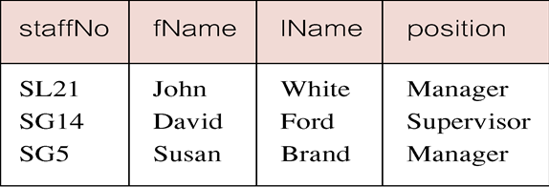
Example 6.8 Set Membership
List all managers and supervisors.
SELECT staffNo, fName, lName, position
FROM Staff
WHERE position IN (‘Manager’, ‘Supervisor’);
Pearson Education © 2014
29

Slide 30
Example 6.8 Set Membership
There is a negated version (NOT IN).
IN does not add much to SQL’s expressive power. Could have expressed this as:
SELECT staffNo, fName, lName, position
FROM Staff
WHERE position =‘Manager’ OR
position=‘Supervisor’;
IN is more efficient when set contains many values.
Pearson Education © 2014
30

Slide 31
Pattern Matching
SQL has special pattern matching symbol:
% represents any sequence of zero or more character (wildcard)
_ (Underscore) represents any single character
Example:
Address LIKE ‘H%’ means that the first character must be H, but the rest can be anything.
Address LIKE ‘H_ _ _’ means that there must be exactly four characters in the string, the first of which must be H.
Address LIKE ‘%e’ means any sequence of characters, of length at least 1, with the last character an e.
Address LIKE ‘%Glasgow%’ means a sequence of characters of any length containing Glasgow.
Address NOT LIKE ‘H%’ means the first character can not be H.

Slide 32
Example 6.9 Pattern Matching
Find all owners with the string ‘Glasgow’ in their address.
SELECT ownerNo, fName, lName, address, telNo
FROM PrivateOwner
WHERE address LIKE ‘%Glasgow%’;
Pearson Education © 2014
32

Slide 33
Example 6.10 NULL Search Condition
List details of all viewings on property PG4 where a comment has not been supplied.
There are 2 viewings for property PG4, one with and one without a comment.
Have to test for null explicitly using special keyword IS NULL:
SELECT clientNo, viewDate
FROM Viewing
WHERE propertyNo = ‘PG4’ AND comment IS NULL;
Pearson Education © 2014
33

Slide 34
Example 6.10 NULL Search Condition
Negated version (IS NOT NULL) can test for non-null values.
Pearson Education © 2014

Slide 35
Question
Assume the following relational schema:
EMPLOYEE(Fname, Lname, SSN, DOB, Address, Sex, salary, DeptNo)
DEPARTMENT(Dname, DNo )
PROJECT(PName, PNo, PLocation, Dno)
WORKS_ON(SSN, PNo, Hours)
List all employees in department 5 whose salary is between $30,000 & $40,000.
SELECT *
FROM employee
WHERE deptno = 5 AND (salary BETWEEN 30000 AND 40000)

Slide 36
ORDER BY Clause
Allows the retrieved records to be ordered in ascending (ASC) or descending order (DESC) on any column or combination of columns.
Syntax
SELECT {* | [column_expression] [,…]}
FROM table_name
[ORDER BY column_list [ASC|DESC] ]

Slide 37
Example 6.11 Single Column Ordering
List salaries for all staff, arranged in descending order of salary.
SELECT staffNo, fName, lName, salary
FROM Staff
ORDER BY salary DESC;
Pearson Education © 2014
37

Slide 38
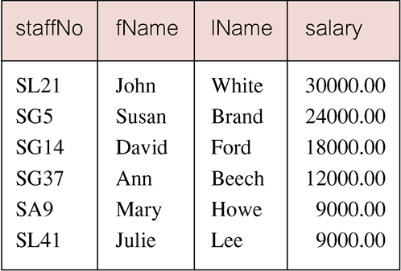
Example 6.11 Single Column Ordering
Pearson Education © 2014
38

Slide 39
Example 6.12 Multiple Column Ordering
Produce abbreviated list of properties in order of property type.
SELECT propertyNo, type, rooms, rent
FROM PropertyForRent
ORDER BY type;
Pearson Education © 2014
39

Slide 40
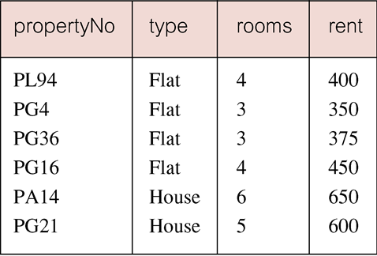
Example 6.12 Multiple Column Ordering
Pearson Education © 2014
40

Slide 41
Example 6.12 Multiple Column Ordering
Four flats in this list - as no minor sort key specified, system arranges these rows in any order it chooses.
To arrange in order of rent, specify minor order:
SELECT propertyNo, type, rooms, rent
FROM PropertyForRent
ORDER BY type, rent DESC;
Pearson Education © 2014
41

Slide 42
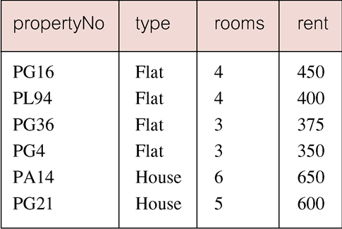
Example 6.12 Multiple Column Ordering
Pearson Education © 2014
42

Slide 43
SELECT Statement - Aggregates
Functions that operate on a single column of a table and return a single value.
can be used only in the SELECT list and in HAVING clause,
Five aggregation functions defined in SQL:
COUNT returns number of values in specified column.
SUM returns sum of values in specified column.
AVG returns average of values in specified column.
MIN returns smallest value in specified column.
MAX returns largest value in specified column.
Pearson Education © 2014
43

Slide 44
SELECT Statement - Aggregates
COUNT, MIN, and MAX apply to numeric and non-numeric fields, but SUM and AVG may be used on numeric fields only.
Apart from COUNT(*), each function eliminates nulls first and operates only on remaining non-null values
COUNT(*) counts all rows of a table, regardless of whether nulls or duplicate values occur.
To eliminate duplicates before the function applied we can use the keyword DESTINCT before the column name in the function.
DESTINECT has no effect with the MIN and MAX but it may have an effect on the result of SUM OR AVG
Pearson Education © 2014
44

Slide 45
SELECT Statement - Aggregates
Aggregate functions can be used only in SELECT list and in HAVING clause.
If SELECT list includes an aggregate function and there is no GROUP BY clause, then no item in the SELECT list can include any reference to a column unless that column is the argument to an aggregation function. For example, the following is illegal:
SELECT staffNo, COUNT(salary)
FROM Staff;
Pearson Education © 2014
45

Slide 46
Example 6.13 Use of COUNT(*)
How many properties cost more than £350 per month to rent?
SELECT COUNT(*) AS myCount
FROM PropertyForRent
WHERE rent > 350;
Pearson Education © 2014

Slide 47
Example 6.14 Use of COUNT(DISTINCT)
How many different properties viewed in May ‘13?
SELECT COUNT(DISTINCT propertyNo) AS myCount
FROM Viewing
WHERE viewDate BETWEEN ‘1-May-13’
AND ‘31-May-13’;
Pearson Education © 2014

Slide 48
Example 6.15 Use of COUNT and SUM
Find number of Managers and sum of their salaries.
SELECT COUNT(staffNo) AS myCount,
SUM(salary) AS mySum
FROM Staff
WHERE position = ‘Manager’;
Pearson Education © 2014

Slide 49
Example 6.16 Use of MIN, MAX, AVG
Find minimum, maximum, and average staff salary.
SELECT MIN(salary) AS myMin, MAX(salary) AS myMax, AVG(salary) AS myAvg
FROM Staff;
Pearson Education © 2014

Slide 50
SELECT Statement - Grouping
Use GROUP BY clause to get sub-totals.
SELECT and GROUP BY closely integrated: each item in SELECT list must be single-valued per group, and SELECT clause may only contain:
column names
aggregate functions
constants
expression involving combinations of the above.
Pearson Education © 2014
50

Slide 51
SELECT Statement - Grouping
All column names in SELECT list must appear in GROUP BY clause unless name is used only in an aggregate function.
If WHERE is used with GROUP BY, WHERE is applied first, then groups are formed from remaining rows satisfying predicate.
Pearson Education © 2014
51

Slide 52
Example 6.17 Use of GROUP BY
Find number of staff in each branch and their total salaries.
SELECT branchNo,
COUNT(staffNo) AS myCount,
SUM(salary) AS mySum
FROM Staff
GROUP BY branchNo
ORDER BY branchNo;
Pearson Education © 2014
52

Slide 53
Example 6.17 Use of GROUP BY
Pearson Education © 2014
53

Slide 54
Example 6.17 Use of GROUP BY
bno
sno
salary
B003
SG37
12000
count
sum
B003
SG14
18000
B003
SG5
24000
3
54000
B005
SL21
30000
2
39000
B005
SL41
9000
1
9000
B007
SA9
9000

Slide 55
Restricted Groupings – HAVING clause
HAVING clause is designed for use with GROUP BY to restrict groups that appear in final result table.
Similar to WHERE, but WHERE filters individual rows whereas HAVING filters groups.
Column names in HAVING clause must also appear in the GROUP BY list or be contained within an aggregate function.
Pearson Education © 2014
55

Slide 56
Example 6.18 Use of HAVING
For each branch with more than 1 member of staff, find number of staff in each branch and sum of their salaries.
SELECT branchNo,
COUNT(staffNo) AS myCount,
SUM(salary) AS mySum
FROM Staff
GROUP BY branchNo
HAVING COUNT(staffNo) > 1
ORDER BY branchNo;
Pearson Education © 2014
56

Slide 57
Example 6.18 Use of HAVING
Pearson Education © 2014
57

Slide 58
Question
Assume the following relational schema:
EMPLOYEE(Fname, Lname, SSN, DOB, Address, Sex, salary, DeptNo)
DEPARTMENT(Dname, DNo )
PROJECT(PName, PNo, PLocation, Dno)
WORKS_ON(SSN, PNo, Hours)
For each project on which more than two employees work, retrieve the project number and the number of employees who work on the project.
SELECT pno , count(ssn)
FROM works_on
GROUP BY pno
HAVING count(ssn) > 2

Slide 59
Subqueries
A complete SELECT statement can be embedded (subselect) within another SELECT statement.
A subselect can be used in WHERE and HAVING clauses of an outer SELECT, where it is called a subquery or nested query.
Subselects may also appear in INSERT, UPDATE, and DELETE statements.
Subquery always enclosed in parentheses.
Types of subquery:
A scalar subquery return a single column and a single row (singlevalue)
A row subquery returns multiple columns , but a single row.
A table subquery returns one or more coulmns and multiple rows
Pearson Education © 2014
59

Slide 60
Example 6.19 Subquery with Equality
List staff who work in branch at ‘163 Main St’.
SELECT staffNo, fName, lName, position
FROM Staff
WHERE branchNo =
(SELECT branchNo
FROM Branch
WHERE street = ‘163 Main St’);
Pearson Education © 2014
60

Slide 61
Example 6.19 Subquery with Equality
Inner SELECT finds branch number for branch at ‘163 Main St’ (‘B003’).
Outer SELECT then retrieves details of all staff who work at this branch.
Outer SELECT then becomes:
SELECT staffNo, fName, lName, position
FROM Staff
WHERE branchNo = ‘B003’;
Pearson Education © 2014
61

Slide 62
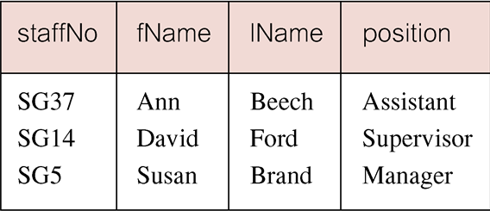
Example 6.19 Subquery with Equality
Pearson Education © 2014
62

Slide 63
Example 6.20 Subquery with Aggregate
List all staff whose salary is greater than the average salary, and show by how much.
SELECT staffNo, fName, lName, position,
salary – (SELECT AVG(salary) FROM Staff) As SalDiff
FROM Staff
WHERE salary >
(SELECT AVG(salary)
FROM Staff);
Pearson Education © 2014
63

Slide 64
Example 6.20 Subquery with Aggregate
Cannot write ‘WHERE salary > AVG(salary)’
Instead, use subquery to find average salary (17000), and then use outer SELECT to find those staff with salary greater than this:
SELECT staffNo, fName, lName, position,
salary – 17000 As salDiff
FROM Staff
WHERE salary > 17000;
Pearson Education © 2014
64

Slide 65
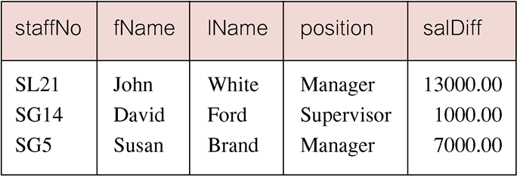
Example 6.20 Subquery with Aggregate
Pearson Education © 2014
65

Slide 66
Subquery Rules
ORDER BY clause may not be used in a subquery.
Subquery SELECT list must consist of a single column name or expression, except for subqueries that use EXISTS.
By default, column names refer to table name in FROM clause of subquery. Can refer to a table in FROM using an alias.
When subquery is an operand in a comparison, subquery must appear on right-hand side.
A subquery may not be used as an operand in an expression.
Pearson Education © 2014
66

Slide 67
Example 6.21 Nested subquery: use of IN
List properties handled by staff at ‘163 Main St’.
SELECT propertyNo, street, city, postcode, type, rooms, rent
FROM PropertyForRent
WHERE staffNo IN
(SELECT staffNo
FROM Staff
WHERE branchNo =
(SELECT branchNo
FROM Branch
WHERE street = ‘163 Main St’));
Pearson Education © 2014
67

Slide 68
Example 6.21 Nested subquery: use of IN
Pearson Education © 2014
68

Slide 69
ANY and ALL
ANY and ALL may be used with subqueries that produce a single column of numbers.
With ALL, condition will only be true if it is satisfied by all values produced by subquery.
With ANY, condition will be true if it is satisfied by any values produced by subquery.
If subquery is empty, ALL returns true, ANY returns false.
SOME may be used in place of ANY.
Pearson Education © 2014
69

Slide 70
Question
Assume the following relational schema:
EMPLOYEE(Fname, Lname, SSN, DOB, Address, Sex, salary, DeptNo)
DEPARTMENT(Dname, DNo )
PROJECT(PName, PNo, PLocation, Dno)
WORKS_ON(SSN, PNo, Hours)
Show the resulting salaries if every employee working on ‘X’ project is given all %10 raise.
SELECT salary * 1.1 as resulting
FROM employee
WHERE SSN IN
( SELECT SSN
FROM WORKS_ON
WHERE pno = ( SELECT pno
FROM project
WHERE pname = ‘X’) );

Slide 71
Subqueries ALL/ANY
Used with subqueries that produce a single column of numbers.
If the subquery is preceded by the keyword ALL, the condition will only be true if it is satisfied by all values produced by the subquery.
If the subquery is preceded by the keyword ANY or SOME, the condition will be true if it is satisfied by any (one or more) values produced by the subquery.

Slide 72
Example 6.22 Use of ANY/SOME
Find staff whose salary is larger than salary of at least one member of staff at branch B003.
SELECT staffNo, fName, lName, position, salary
FROM Staff
WHERE salary > SOME
(SELECT salary
FROM Staff
WHERE branchNo = ‘B003’);
Pearson Education © 2014
72

Slide 73
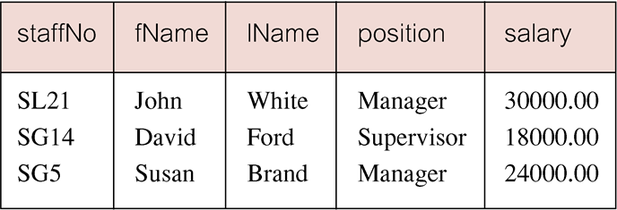
Example 6.22 Use of ANY/SOME
Inner query produces set {12000, 18000, 24000} and outer query selects those staff whose salaries are greater than any of the values in this set.
Pearson Education © 2014
73

Slide 74
Example 6.23 Use of ALL
Find staff whose salary is larger than salary of every member of staff at branch B003.
SELECT staffNo, fName, lName, position, salary
FROM Staff
WHERE salary > ALL
(SELECT salary
FROM Staff
WHERE branchNo = ‘B003’);
Pearson Education © 2014
74

Slide 75
Example 6.23 Use of ALL
Pearson Education © 2014
75

Slide 76
Multi-Table Queries
So far, the columns that are to appear in the result table must all come from a single table.
To combine columns from several tables into a result table, we need to use a join operation.
To perform join, include more than one table in FROM clause.
Use comma as separator and typically include WHERE clause to specify join column(s).
Pearson Education © 2014
76

Slide 77
Multi-Table Queries
Also possible to use an alias for a table named in FROM clause.
Alias is separated from table name with a space.
Alias can be used to qualify column names when there is ambiguity.
Pearson Education © 2014
77

Slide 78
Example 6.24 Simple Join
CLIENT(ClientNo, Fname, Lname, telNo, Type, Rent)
VIEWING(ClientNo, PropertyNo, Date, Comment)
List names of all clients who have viewed a property along with any comment supplied.
SELECT c.clientNo, fName, lName, propertyNo, comment
FROM Client c, Viewing v
WHERE c.clientNo = v.clientNo;
Pearson Education © 2014
78

Slide 79
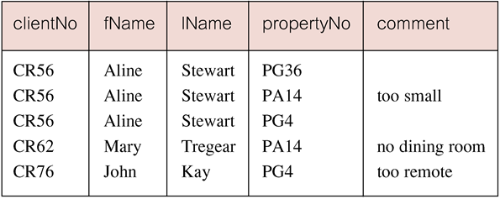
Example 6.24 Simple Join
Only those rows from both tables that have identical values in the clientNo columns (c.clientNo = v.clientNo) are included in result.
Pearson Education © 2014
79

Slide 80
Alternative JOIN Constructs
SQL provides alternative ways to specify joins:
FROM Client c JOIN Viewing v ON c.clientNo = v.clientNo
FROM Client JOIN Viewing USING clientNo
FROM Client NATURAL JOIN Viewing
In each case, FROM replaces original FROM and WHERE. However, first produces table with two identical clientNo columns.
Pearson Education © 2014
80

Slide 81
Example 6.25 Sorting a join
PROPERTYFORRENT(pno, street, area, city,pcode, type, rooms,rent,sno)
STAFF(sno, fname, lname, position, sex, DOB, salary, bno)
BRANCH(bno, street, city, postcode)
For each branch, list numbers and names of staff who manage properties, and properties they manage.
SELECT s.branchNo, s.staffNo, fName, lName, propertyNo
FROM Staff s, PropertyForRent p
WHERE s.staffNo = p.staffNo
ORDER BY s.branchNo, s.staffNo, propertyNo;
Pearson Education © 2014
81

Slide 82
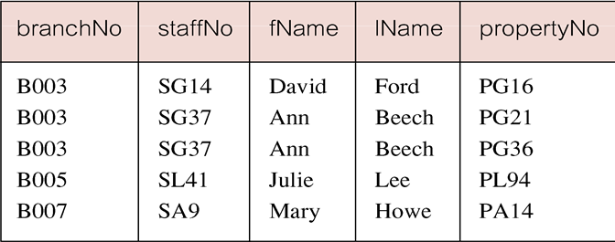
Example 6.25 Sorting a join
Pearson Education © 2014
82

Slide 83
Question
Assume the following relational schema:
EMPLOYEE(Fname, Lname, SSN, DOB, Address, Sex, salary, DeptNo)
DEPARTMENT(Dname, DNo )
PROJECT(PName, PNo, PLocation, Dno)
WORKS_ON(SSN, PNo, Hours)
List all employees and projects they are working on, ordered by department and, within each department, ordered alphabetically by last name, first name.
SELECT fname , lname , Pno
FROM employee e , WORKS_ON w
WHERE e.SSN = w.SSN
ORDER BY deptno , lname,fname
Alternative solutions :
SELECT fname , lname , Pno
FROM employee e NATURAL JOIN WORKS_ON w
ORDER BY deptno , lname, fname
SELECT fname , lname , Pno
FROM employee e JOIN WORKS_ON ON e.SSN = w.SSN
ORDER BY deptno , lname, fname
SELECT fname , lname , Pno
FROM employee e JOIN WORKS_ON USING SSN
ORDER BY deptno , lname, fname

Slide 84
Example 6.26 Three Table Join
PROPERTYFORRENT(pno, street, area, city,pcode, type, rooms,rent,sno)
STAFF(sno, fname, lname, position, sex, DOB, salary, bno)
BRANCH(bno, street, city, postcode)
For each branch, list staff who manage properties, including city in which branch is located and properties they manage.
SELECT b.branchNo, b.city, s.staffNo, fName, lName, propertyNo
FROM Branch b, Staff s, PropertyForRent p
WHERE b.branchNo = s.branchNo AND
s.staffNo = p.staffNo
ORDER BY b.branchNo, s.staffNo, propertyNo;
Pearson Education © 2014
84

Slide 85
Example 6.26 Three Table Join
Alternative formulation for FROM and WHERE:
FROM (Branch b JOIN Staff s USING branchNo) AS
bs JOIN PropertyForRent p USING staffNo
Pearson Education © 2014
85

Slide 86
Example 6.27 Multiple Grouping Columns
Find number of properties handled by each staff member.
SELECT s.bNo, s.sNo, COUNT(*) AS myCount
FROM Staff s, PropertyForRent p
WHERE s.sno = p.sno
GROUP BY s.bno, s.sno
ORDER BY s.bno, s.sno;
Pearson Education © 2014
86

Slide 87
Example 6.27 Multiple Grouping Columns
Pearson Education © 2014
87

Slide 88
Computing a Join
A join is a subset of the Cartesian product.
The Cartesian product of two tables is another table consisting of all possible pairs of rows from the two table.
The columns of the product table are all the columns of the first table followed by all the columns of the second table.
Format of SELECT statement for the Cartesian product:
SELECT [DISTICNT | ALL] {* | column_list }
FROM table_name1 CROSS JOIN table_name2;

Slide 89
Computing a Join
Procedure for generating results of a join are:
Form Cartesian product of the tables named in FROM clause.
If there is a WHERE clause, apply the search condition to each row of the product table, retaining those rows that satisfy the condition.
For each remaining row, determine value of each item in SELECT list to produce a single row in result table.
If DISTINCT has been specified, eliminate any duplicate rows from the result table.
If there is an ORDER BY clause, sort result table as required.
Pearson Education © 2014
89

Slide 90
Computing a Join
SQL provides special format of SELECT for Cartesian product:
SELECT [DISTINCT | ALL] {* | columnList}
FROM Table1 CROSS JOIN Table2
Pearson Education © 2014
90

Slide 91
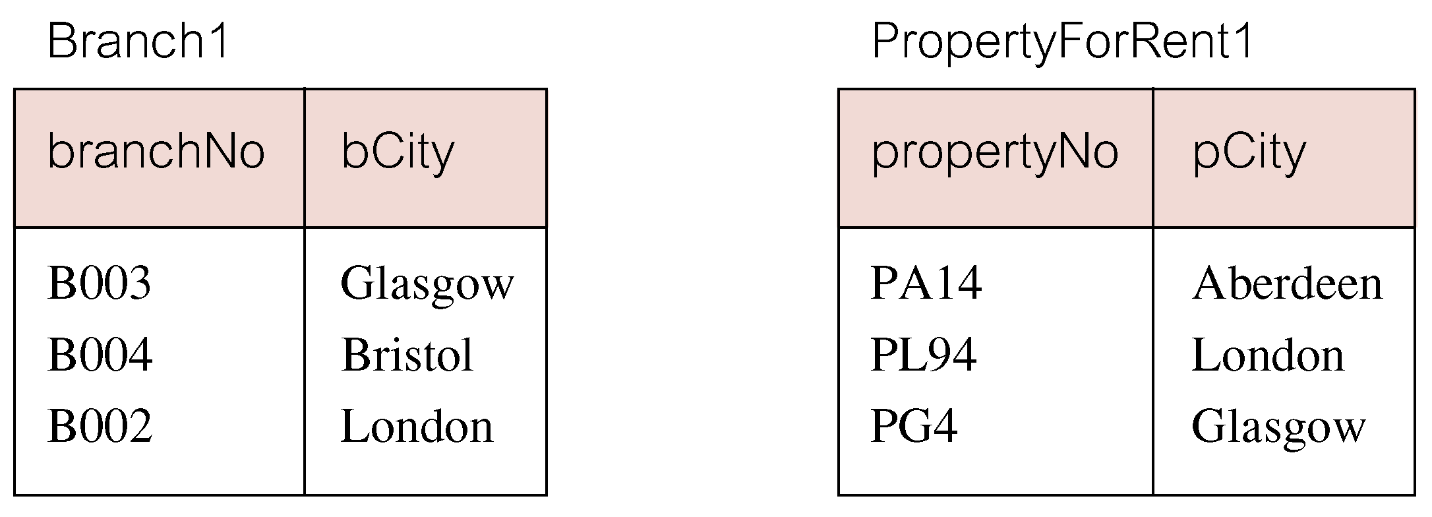
Outer Joins
If one row of a joined table is unmatched, row is omitted from result table.
Outer join operations retain rows that do not satisfy the join condition.
Consider following tables:
Pearson Education © 2014
91

Slide 92
inner Joins
The (inner) join of these two tables:
SELECT b.*, p.*
FROM Branch1 b, PropertyForRent1 p
WHERE b.bCity = p.pCity;
Pearson Education © 2014
92

Slide 93
inner Joins and outer joins
Result table has two rows where cities are same.
There are no rows corresponding to branches in Bristol and Aberdeen.
To include unmatched rows in result table, use an Outer join.
THERE are 3 types of outer join: left, right, and full
Pearson Education © 2014
93

Slide 94
Example 6.28 Left Outer Join
List branches and properties that are in same city along with any unmatched branches.
SELECT b.*, p.*
FROM Branch1 b LEFT JOIN
PropertyForRent1 p ON b.bCity = p.pCity;
Pearson Education © 2014
94

Slide 95
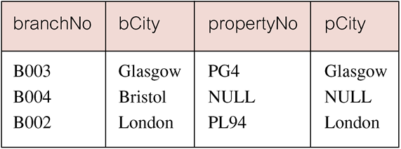
Example 6.28 Left Outer Join
Includes those rows of first (left) table unmatched with rows from second (right) table.
Columns from second table are filled with NULLs.
Pearson Education © 2014
95

Slide 96
Example 6.29 Right Outer Join
List branches and properties in same city and any unmatched properties.
SELECT b.*, p.*
FROM Branch1 b RIGHT JOIN
PropertyForRent1 p ON b.bCity = p.pCity;
Pearson Education © 2014
96

Slide 97
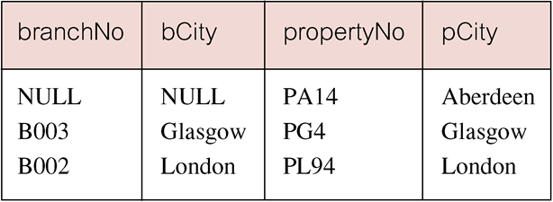
Example 6.29 Right Outer Join
Right Outer join includes those rows of second (right) table that are unmatched with rows from first (left) table.
Columns from first table are filled with NULLs.
Pearson Education © 2014
97

Slide 98
Example 6.30 Full Outer Join
List branches and properties in same city and any unmatched branches or properties.
SELECT b.*, p.*
FROM Branch1 b FULL JOIN
PropertyForRent1 p ON b.bCity = p.pCity;
Pearson Education © 2014
98

Slide 99
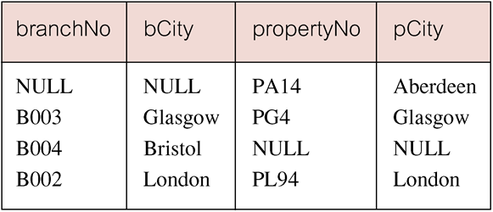
Example 6.30 Full Outer Join
Includes rows that are unmatched in both tables.
Unmatched columns are filled with NULLs.
Pearson Education © 2014
99

Slide 100
EXISTS and NOT EXISTS
EXISTS and NOT EXISTS are for use only with subqueries.
Produce a simple true/false result.
True if and only if there exists at least one row in result table returned by subquery.
False if subquery returns an empty result table.
NOT EXISTS is the opposite of EXISTS.
Pearson Education © 2014
100

Slide 101
Example 6.31 Query using EXISTS
Find all staff who work in a London branch.
SELECT sno, fName, lName, position
FROM Staff s
WHERE EXISTS
(SELECT *
FROM Branch b
WHERE s.bno = b.bno AND
city = ‘London’);
Pearson Education © 2014
101

Slide 102
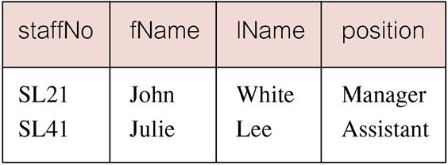
Example 6.31 Query using EXISTS
Pearson Education © 2014
102

Slide 103
Example 6.31 Query using EXISTS
Note, search condition s.branchNo = b.branchNo is necessary to consider correct branch record for each member of staff.
If omitted, would get all staff records listed out because subquery:
SELECT * FROM Branch WHERE city=‘London’
would always be true and query would be:
SELECT staffNo, fName, lName, position FROM Staff
WHERE true;
Pearson Education © 2014
103

Slide 104
Example 6.31 Query using EXISTS
Could also write this query using join construct:
SELECT staffNo, fName, lName, position
FROM Staff s, Branch b
WHERE s.branchNo = b.branchNo AND
city = ‘London’;
Pearson Education © 2014
104

Slide 105
NOT EXIST
Assume the following relational schema:
EMPLOYEE(Fname, Lname, SSN, DOB, Address, Sex, salary, DeptNo)
DEPARTMENT(Dname, DNo )
PROJECT(PName, PNo, PLocation, Dno)
WORKS_ON(SSN, PNo, Hours)
Retrieve the names of employees who works on no project.
Select e.ssn, fname,lname
FROM employee e
WHERE NOT EXIST ( SELECT *
FROM WORKS_ON w
WHERE e.ssn=w.ssn)

Slide 106
Union, Intersect, and Difference (Except)
Union of two tables, A and B, is table containing all rows in either A or B or both.
Intersection is table containing all rows common to both A and B.
Difference is table containing all rows in A but not in B.
Two tables must be union compatible ( have the same structure). And that their corresponding columns have the same data types and lengths
Pearson Education © 2014
106

Slide 107
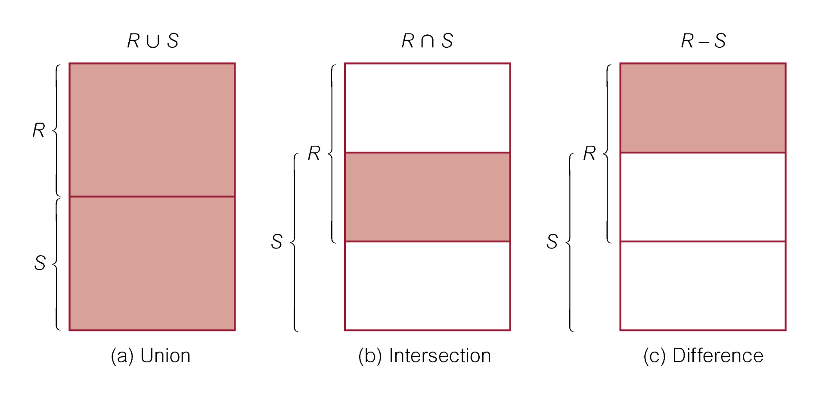
Union, Intersect, and Difference (Except)
Pearson Education © 2014
107

Slide 108
Example 6.32 Use of UNION
List all cities where there is either a branch office or a property.
(SELECT city
FROM Branch
WHERE city IS NOT NULL)
UNION
(SELECT city
FROM PropertyForRent
WHERE city IS NOT NULL);
Pearson Education © 2014
108

Slide 109
Example 6.32 Use of UNION
Or
(SELECT * FROM Branch WHERE city IS NOT NULL) UNION CORRESPONDING BY city (SELECT * FROM PropertyForRent WHERE city IS NOT NULL);
Pearson Education © 2014
109

Slide 110
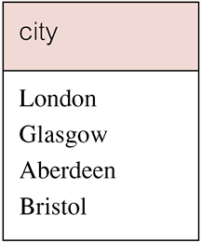
Example 6.32 Use of UNION
Produces result tables from both queries and merges both tables together.
Pearson Education © 2014
110

Slide 111
Example 6.33 Use of INTERSECT
List all cities where there is both a branch office and a property.
(SELECT city FROM Branch)
INTERSECT
(SELECT city FROM PropertyForRent);
Pearson Education © 2014
111

Slide 112
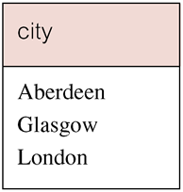
Example 6.33 Use of INTERSECT
Or
(SELECT * FROM Branch)
INTERSECT CORRESPONDING BY city
(SELECT * FROM PropertyForRent);
112
Pearson Education © 2014

Slide 113
Example 6.33 Use of INTERSECT
Could rewrite this query without INTERSECT operator:
SELECT b.city
FROM Branch b PropertyForRent p
WHERE b.city = p.city;
Or:
SELECT DISTINCT city FROM Branch b
WHERE EXISTS
(SELECT * FROM PropertyForRent p
WHERE p.city = b.city);
Pearson Education © 2014
113

Slide 114
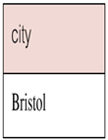
Example 6.34 Use of EXCEPT
List of all cities where there is a branch office but no properties.
(SELECT city FROM Branch)
EXCEPT
(SELECT city FROM PropertyForRent);
Or
(SELECT * FROM Branch)
EXCEPT CORRESPONDING BY city
(SELECT * FROM PropertyForRent);
Pearson Education © 2014
114

Slide 115
Example 6.34 Use of EXCEPT
Could rewrite this query without EXCEPT:
SELECT DISTINCT city FROM Branch
WHERE city NOT IN
(SELECT city FROM PropertyForRent);
Or
SELECT DISTINCT city FROM Branch b
WHERE NOT EXISTS
(SELECT * FROM PropertyForRent p
WHERE p.city = b.city);
Pearson Education © 2014
115

Slide 116
INSERT
INSERT INTO TableName [ (columnList) ]
VALUES (dataValueList)
columnList is optional; if omitted, SQL assumes a list of all columns in their original CREATE TABLE order.
Any columns omitted must have been declared as NULL when table was created, unless DEFAULT was specified when creating column.
Pearson Education © 2014
116

Slide 117
INSERT
dataValueList must match columnList as follows:
Number of items in each list must be same;
Must be direct correspondence in position of items in two lists;
Data type of each item in dataValueList must be compatible with data type of corresponding column.
Pearson Education © 2014
117

Slide 118
Example 6.35 INSERT … VALUES
Insert a new row into Staff table supplying data for all columns.
INSERT INTO Staff VALUES (‘SG16’, ‘Alan’, ‘Brown’, ‘Assistant’, ‘M’, Date‘1957-05-25’, 8300, ‘B003’);
Pearson Education © 2014
118

Slide 119
Example 6.36 INSERT using Defaults
Insert a new row into Staff table supplying data for all mandatory columns.
INSERT INTO Staff (staffNo, fName, lName,
position, salary, branchNo)
VALUES (‘SG44’, ‘Anne’, ‘Jones’,
‘Assistant’, 8100, ‘B003’);
Or
INSERT INTO Staff VALUES (‘SG44’, ‘Anne’, ‘Jones’, ‘Assistant’, NULL, NULL, 8100, ‘B003’);
Pearson Education © 2014
119

Slide 120
INSERT … SELECT
Second form of INSERT allows multiple rows to be copied from one or more tables to another:
INSERT INTO TableName [ (columnList) ]
SELECT ...
Pearson Education © 2014
120

Slide 121
Example 6.37 INSERT … SELECT
Assume there is a table StaffPropCount that contains names of staff and number of properties they manage:
StaffPropCount(staffNo, fName, lName, propCnt)
Populate StaffPropCount using Staff and PropertyForRent tables.
Pearson Education © 2014
121

Slide 122
Example 6.37 INSERT … SELECT
INSERT INTO StaffPropCount
(SELECT s.staffNo, fName, lName, COUNT(*)
FROM Staff s, PropertyForRent p
WHERE s.staffNo = p.staffNo
GROUP BY s.staffNo, fName, lName)
UNION
(SELECT staffNo, fName, lName, 0
FROM Staff
WHERE staffNo NOT IN
(SELECT DISTINCT staffNo
FROM PropertyForRent));
Pearson Education © 2014
122

Slide 123
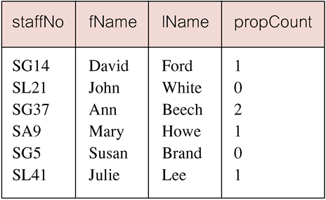
Example 6.37 INSERT … SELECT
If second part of UNION is omitted, excludes those staff who currently do not manage any properties.
Pearson Education © 2014
123

Slide 124
UPDATE
UPDATE TableName
SET columnName1 = dataValue1
[, columnName2 = dataValue2...]
[WHERE searchCondition]
TableName can be name of a base table or an updatable view.
SET clause specifies names of one or more columns that are to be updated.
Pearson Education © 2014
124

Slide 125
UPDATE
WHERE clause is optional:
If omitted, named columns are updated for all rows in table;
If specified, only those rows that satisfy searchCondition are updated.
New dataValue(s) must be compatible with data type for corresponding column.
Pearson Education © 2014
125

Slide 126
Example 6.38/39 UPDATE All Rows
Give all staff a 3% pay increase.
UPDATE Staff
SET salary = salary*1.03;
Give all Managers a 5% pay increase.
UPDATE Staff
SET salary = salary*1.05
WHERE position = ‘Manager’;
Pearson Education © 2014
126

Slide 127
Example 6.40 UPDATE Multiple Columns
Promote David Ford (staffNo=‘SG14’) to Manager and change his salary to £18,000.
UPDATE Staff
SET position = ‘Manager’, salary = 18000
WHERE staffNo = ‘SG14’;
Pearson Education © 2014
127

Slide 128
DELETE
DELETE FROM TableName
[WHERE searchCondition]
TableName can be name of a base table or an updatable view.
searchCondition is optional; if omitted, all rows are deleted from table. This does not delete table. If search_condition is specified, only those rows that satisfy condition are deleted.
Pearson Education © 2014
128

Slide 129
Example 6.41/42 DELETE Specific Rows
Delete all viewings that relate to property PG4.
DELETE FROM Viewing
WHERE propertyNo = ‘PG4’;
Delete all records from the Viewing table.
DELETE FROM Viewing;
Pearson Education © 2014
129

Slide 130
summary
SELECT/FROM clause.
Use compound WHERE conditions.
ORDER BY.
Aggregate functions.
Group data using GROUP BY and HAVING.
Subqueries.
Join tables together.
Perform set operations (UNION, INTERSECT, EXCEPT).
INSERT, UPDATE, and DELETE.

