Slide 1
Chapter 14
Normalization

Slide 2
Chapter 14 - Objectives
The potential problems associated with redundant data in base relations.
The concept of functional dependency, which describes the relationship between attributes.
How to undertake the process of normalization.
How to identify the most commonly used normal forms, namely First Normal Form (1NF), Second Normal Form (2NF), and Third Normal Form (3NF).
Pearson Education © 2014

Slide 3
normalization
Normalization is a bottom up approach to database design that begins by examining the relationships between attributes.
Normalization is often performed as a series of test on a relation to determine whether it satisfy or violates the requirements of a given normal form .
The process of normalization is a formal method that identifies relations base on their primary or candidate keys and the functional dependencies among their attributes.

Slide 4
Data Redundancy and Update Anomalies
Major aim of relational database design is to group attributes into relations to minimize data redundancy.
Relations that contain redundant information may potentially suffer from update anomalies.
Types of update anomalies include:
Insertion
Deletion
Modification
Pearson Education © 2014

Slide 5
Functional Dependencies
Important concept associated with normalization.
Functional dependency describes relationship between attributes.
For example:
If A and B are attributes of relation R, B is functionally dependent on A (denoted A → B), if each value of A in R is associated with exactly one value of B in R ( A and B may each consist of one or more attributes)
Pearson Education © 2014

Slide 6
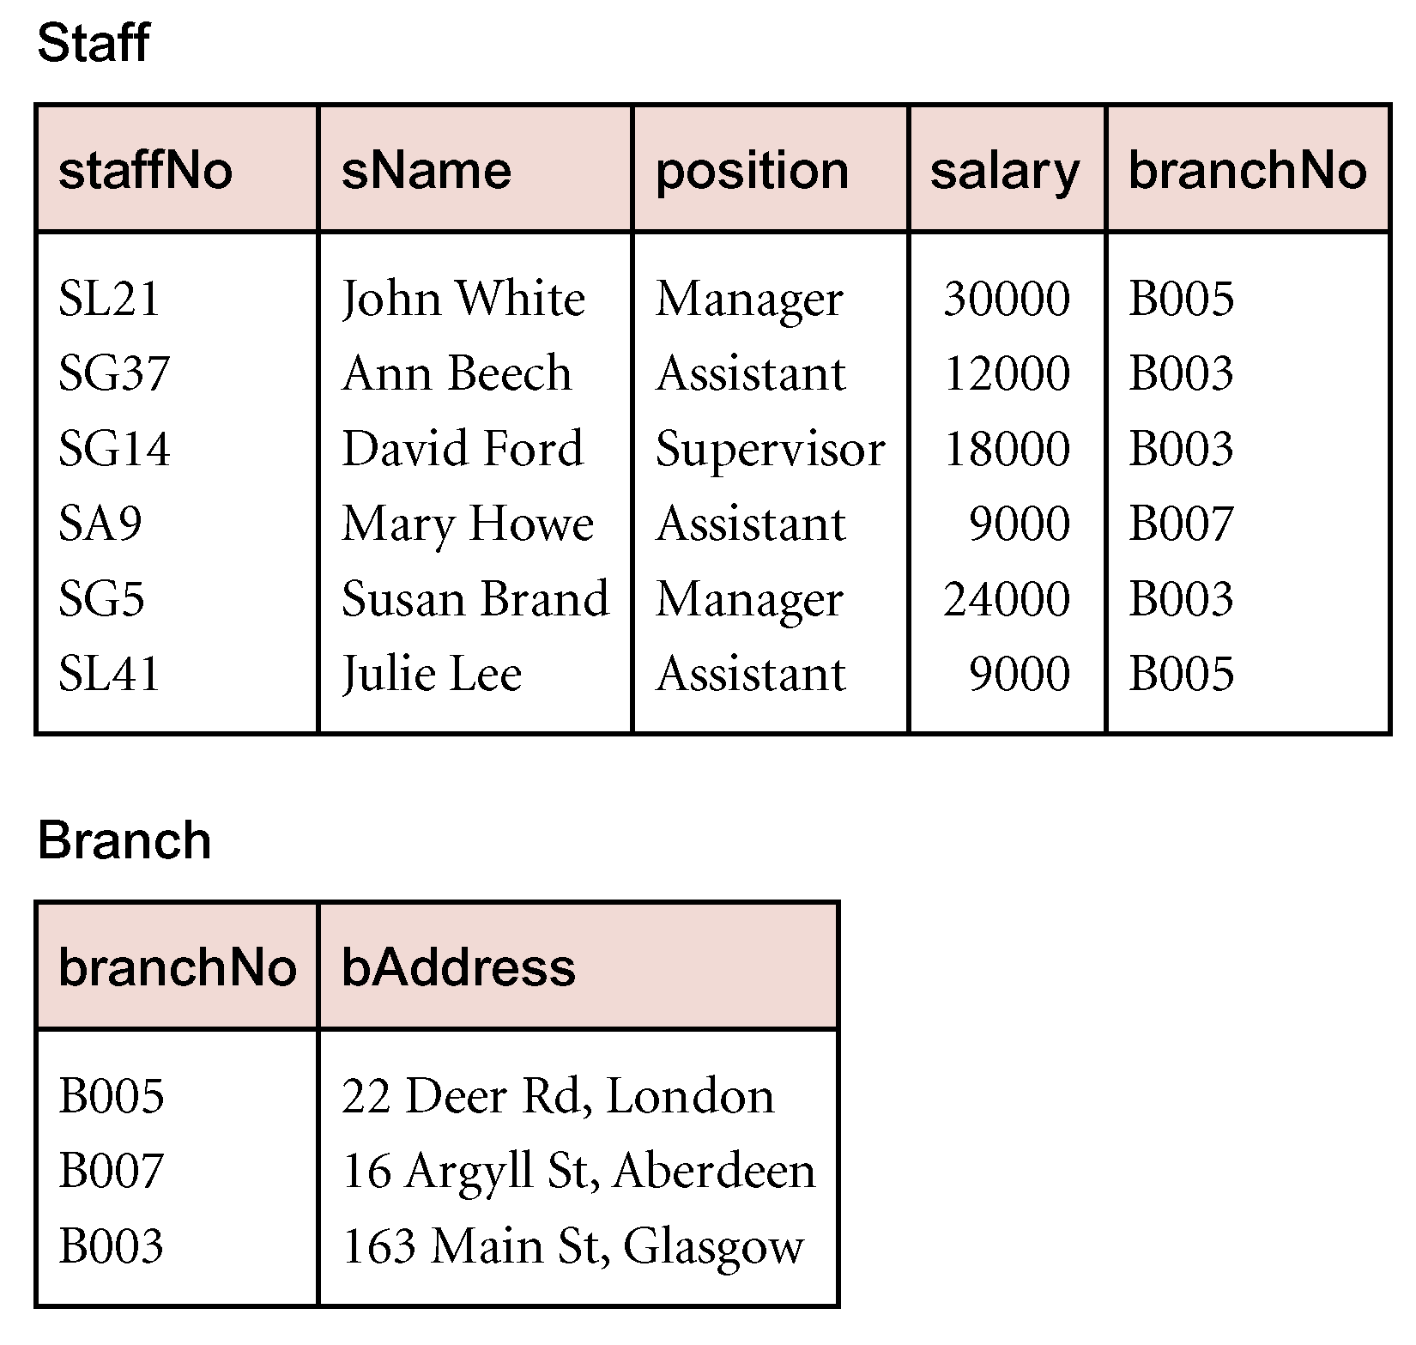
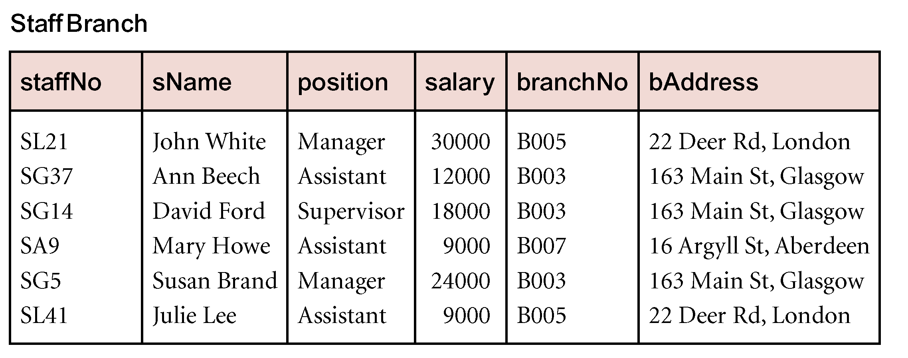
SAMPLE DATA
Pearson Education © 2014

Slide 7
Functional Dependencies
Diagrammatic representation.
The determinant of a functional dependency refers to the attribute or group of attributes on the left-hand side of the arrow.
Pearson Education © 2014

Slide 8
An Example Functional Dependency
Pearson Education © 2014

Slide 9
Characteristics of Functional Dependencies
Determinants should have the minimal number of attributes necessary to maintain the functional dependency with the attribute(s) on the right hand-side.
This requirement is called full functional dependency.
Full functional dependency indicates that if A and B are attributes of a relation, B is fully functionally dependent on A, if B is functionally dependent on A, but not on any proper subset of A.
Pearson Education © 2014

Slide 10
Example Full Functional Dependency
Exists in the Staff relation.
staffNo, sName → branchNo
True - each value of (staffNo, sName) is associated with a single value of branchNo.
However, branchNo is also functionally dependent on a subset of (staffNo, sName), namely staffNo. Example above is a partial dependency.
Pearson Education © 2014

Slide 11
Characteristics of Functional Dependencies
Main characteristics of functional dependencies used in normalization:
There is a one-to-one relationship between the attribute(s) on the left-hand side (determinant) and those on the right-hand side of a functional dependency.
Holds for all time.
The determinant has the minimal number of attributes necessary to maintain the dependency with the attribute(s) on the right hand-side.
All attributes that are not part of the primary key should be functionally dependent on the key.
Pearson Education © 2014

Slide 12
Transitive Dependencies
Important to recognize a transitive dependency because its existence in a relation can potentially cause update anomalies.
Transitive dependency describes a condition where A, B, and C are attributes of a relation such that if A → B and B → C, then C is transitively dependent on A via B (provided that A is not functionally dependent on B or C).
Pearson Education © 2014

Slide 13
Example Transitive Dependency
Consider functional dependencies in the StaffBranch relation (see Slide 5).
staffNo → sName, position, salary, branchNo, bAddress
branchNo → bAddress
Transitive dependency, branchNo → bAddress exists on staffNo via branchNo.
Pearson Education © 2014

Slide 14
The Process of Normalization
Formal technique for analysing a relation based on its primary key and the functional dependencies between the attributes of that relation.
The technique involves a series of rules that can be used to test individual relations so that a database can be normalized
to any degree.
When a requirement is not met, the relation violating the requirement must be decomposed into relations that individually meet the requirements of normalization.
Often executed as a series of steps. Each step corresponds to a specific normal form..
Pearson Education © 2014

Slide 15
Example
Examine semantics of attributes in StaffBranch relation. Assume that position held and branch determine a member of staff’s salary. With sufficient information available, identify the functional dependencies for the StaffBranch relation as:
staffNo → sName, position, salary, branchNo, bAddress
branchNo → bAddress
bAddress → branchNo
branchNo, position → salary
bAddress, position → salary
Pearson Education © 2014

Slide 16
The Process of Normalization
Normalization is a bottom-up approach to database design that begins by examining the relationships between attributes. It is performed as a serious of tests on a relation to determine whether it satisfies or violates the requirements of a given normal form.
Purpose: Guarantees no redundancy due to FDs
Normal Forms:
First Normal Form (1NF)
Second Normal Form (2NF)
Third Normal Form (3NF)
Pearson Education © 2014

Slide 17
The Process of Normalization
Pearson Education © 2014

Slide 18
Process of normalization
In the following sections describe the process of normalization in detail. Figure 13.8 page 402 provides an overview of the process and highlights the main actions taken in each step of the process.
The number of the section that covers each step of the process is also shown in that figure.

Slide 19
Process of normalization
With the exception of 1NF, all normal forms are based on functional dependencies among the attributes of a relation.
For the relational data model, it is important to recognize that it is only First Normal Form (1NF) that is critical in creating relations; all subsequent normal forms are optional.
to avoid the update anomalies discussed before, it is generally recommended that we proceed to at least Third Normal Form (3NF).

Slide 20
Unnormalized Form (UNF)
A table that contains one or more repeating groups.
To create an unnormalized table
Transform the data from the information source (e.g. form) into table format with columns and rows.
CLIENT_PROGRAM
ClientNo
Name
PrgramNo
CR76
John Key
PG4
PG16
Repeating group
CR56
Aline Stewart
PG4
PG36
PG16
Unnormalized table

Slide 21
First Normal Form (1NF)
A relation in which the intersection of each row and column contains one and only one value.
A repeating group is an attribute, or group of attributes, within a table that occurs with multiple values for a single occurrence of the nominated key attribute(s) for that table.
programNo | name | clientNo
PG4 PG6 | John Key | CR76
PG4 PG16 PG36 | Aline Stewart | CR56
Unnormalized table
Pearson Education © 2014

Slide 22
UNF to 1NF
There are three common approaches to removing repeating groups from unnormalized tables:
By entering appropriate data in the empty columns of rows containing the repeating data. (fill in the blanks by duplicating the nonrepeating data, where required.) This approach is commonly referred to as ‘flattening’ the table.
If the maximum number of values is known for the attribute, replace repeated attribute with a number of atomic attributes.
By placing the repeating data, along with a copy of the original key attribute(s), in a separate relation.
For all approaches, the resulting tables are now referred to as 1NF relations containing atomic (or single) values at the intersection of each row and column

Slide 23
UNF to 1NF – Approach 1
Expand the key so that there will be a separate tuple in the original relation for each repeated attribute(s).
Primary key becomes the combination of primary key and redundant value
1NF relation
Disadvantage: introduce redundancy in the relation
CLIENT_PROGRAM
ClientNo
Name
propertyNo
CR76
John Key
PG4
CR76
John Key
PG16
CR56
Aline Stewart
PG4
CR56
Aline Stewart
PG36
CR56
Aline Stewart
PG16
Pearson Education © 2014

Slide 24
UNF to 1NF – Approach 2
If the maximum number of values is known for the attribute, replace repeated attribute (ProgramNo) with a number of atomic attributes (ProgramNo1, ProgramNo2, ProgramNo3)
1NF relation
Disadvantage: introduce NULL values in the relation
CLIENT_property
ClientNo
Name
PropertyNo1
propertyNo2
propertyNo3
CR76
John Key
PG4
PG16
NULL
CR56
Aline Stewart
PG4
PG36
PG16
Pearson Education © 2014

Slide 25
UNF to 1NF – Approach 3
Remove the attribute that violates the 1NF and place it in a separate relation.
Primary key of the new relation becomes the combination of primary key and redundant value
CLIENT
PROGRAM
ClientNo
Name
ClientNo
propertyNo
CR76
John Key
CR76
PG4
CR76
PG16
CR56
Aline Stewart
CR56
PG4
1NF relation
CR56
PG36
CR56
PG16
1NF relation
Pearson Education © 2014

Slide 26
Second Normal Form (2NF)
Based on the concept of full functional dependency.
Second Normal Form applies to relations with composite
keys, that is, relations with a primary key composed of two or more attributes.
A relation with a single-attribute primary key is automatically in at least 2NF.
A relation that is not in 2NF may suffer from the update anomalies
Full functional dependency indicates that if:
A and B are attributes of a relation,
B is fully dependent on A if B is functionally dependent on A but not on any proper subset of A.
Pearson Education © 2014

Slide 27
Second Normal Form (2NF)
A relation that is in 1NF and every non-primary-key attribute is fully functionally dependent on the primary key.
CLIENT_RENTAL
ClientNo
propertyNo
cName
Address
ProgStart
ProgFinish
Cost
OwnerNo
OName
1NF relation
Pearson Education © 2014

Slide 28
1NF to 2NF
Identify the primary key for the 1NF relation.
Identify the functional dependencies in the relation.
If partial dependencies exist on the primary key remove them by placing then in a new relation along with a copy of their determinant.
Pearson Education © 2014

Slide 29
1NF to 2NF
CLIENT_RENTAL
ClientNo
propertyNo
cName
Address
ProgStart
ProgFinish
Cost
OwnerNo
OName
(ClientNo, propertyNo) PK
ClientNo, ProgramNo → ProgStart, ProgFinish Full Dependency
ClientNo → CName Partial Dependency
propertyNo → Paddress, Cost, OwnerNo, Oname Partial Dependency
Pearson Education © 2014

Slide 30
1NF to 2NF
Remove partial dependencies by placing the functionally dependent attributes in a new relation along with a copy of their determinants
2NF relation 2NF relation
2NF relation
CLIENT
RENTAL
ClientNo
cName
ClientNo
propertyNo
ProgStart
ProgFinish
property_OWNER
ProgramNo
pAddress
Cost
OwnerNo
OName
Pearson Education © 2014

Slide 31
Third Normal Form (3NF)
Based on the concept of transitive dependency.
Transitive Dependency is a condition where
A, B and C are attributes of a relation such that if A → B and B → C,
then C is transitively dependent on A through B. (Provided that A is not functionally dependent on B or C).
Pearson Education © 2014

Slide 32
Third Normal Form (3NF)
A relation that is in 1NF and 2NF and in which no non-primary-key attribute is transitively dependent on the primary key.
CLIENT
RENTAL
ClientNo
cName
ClientNo
propertyNo
ProgStart
ProgFinish
3NF relation 3NF relation
property_OWNER
propertyNo
pAddress
Cost
OwnerNo
OName
2NF relation
Pearson Education © 2014

Slide 33
2NF to 3NF
Identify the primary key in the 2NF relation.
Identify functional dependencies in the relation.
If transitive dependencies exist on the primary key remove them by placing them in a new relation along with a copy of their dominant.
OWNER
PROGRAM
OwnerNo
OName
ProgramNo
pAddress
Cost
OwnerNo
3NF relation 3NF relation
Pearson Education © 2014

Slide 34
The decomposition of the ClientRental
Client (clientNo, cName)
Rental (clientNo, propertyNo, rentStart, rentFinish)
PropertyForRent (propertyNo, pAddress, rent, ownerNo)
Owner (ownerNo, oName)

Slide 35
summary
Redundant data problems in base relations.
Functional dependency concept.
Normalization process.
First Normal Form (1NF), Second Normal Form (2NF), and Third Normal Form (3NF).

