Slide 1
The structure of a dictionary:
Macrostructure – overall structural organization of volume, typically:
Front matter, introduction, user guidelines; (before the “A” letter)
Body – entries and definitions, typically organized alphabetically; (from A-z)
End matter – appendices and additional information, e.g. personal names, place names, loan items etc. (after the z)

Slide 2
The structure of a dictionary:
Microstructure – internal structure of dictionary entry blocks, typically:
Headword- the word you are looking up. It is always in bold type.
Entry- the information on the word you are looking up.
Pronunciation- tells you how to say the word. Found in (parentheses).

Slide 3
Stress: stress is very important, because it is hard to understand a word pronounced with the wrong stress.
Part of speech- tells you how the word is used in a sentence (n=noun, v=verb, adj=adjective, adv=adverb).
British and American vocabulary or pronunciation: the British word (labelled BrE) and the American (labelled NAmE or (US to distinguish between American and Canadian words).

Slide 4
Spelling
Semantic specification
Synonyms and opposites: some dictionary entries also provide a list of synonyms (syn), words with similar meanings; and opposite meanings (opp).

Slide 5
Cross-references: to related items: some dictionary entries contain cross-references. Within the entry, you will find the word see, compare, or var (variation) of that directs you to another dictionary entry which will give you more information about the word you first looked up.
Collocations, co-occurrence strings: certain words that are typically used with other words. For example, we say ‘ a tall tree’ but ‘a high mountain’. These words are called collocates.
Register: the dictionary contains a number of labels which tell you about how formal a word is, and in what situations you can use it. Here are some of these words:
technical informal disapproving ironic formal taboo
Usage with examples
Etymological: this tells you the history of the word, and what language it came from.

Slide 6
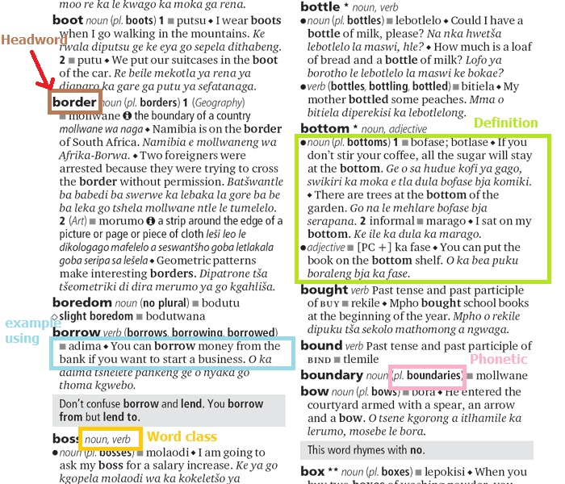

Slide 7
What is a Word
https://youtu.be/iEsYD4yVSBA

Slide 8
What is actually a WORD
A word is a group of characters placed together with spaces or punctuation marks before or after.
But what about an expression like: air mail
Is it two words?
Is airline one word
What about air-bed
The user will have to look in two or three different places in the dictionary to find the word as the user cannot know in advance whether a word like air mail is entered under air or under mail.

Slide 9
Nature of Headwords
What is a word: are the following words? want, wanting, wanted, war chest, war crime, courthouse, wannabe, half-baked
Orthographic word – (relating to spelling) written word surrounded by spaces; but what about compounds, hyphenated forms etc.
Phonological word – sequence of sounds that forms phonological unit (determined by rules of syllable structure, stress, etc)
Lexeme – item of vocabulary that may occur as dictionary headword. Lexemes can be more than one orthographic word i.e. a word or several words that have a meaning that is not expressed by any of its separate parts

Slide 10
Lexeme is an abstract concept – it is the set of word forms that comprise a paradigm of related words forms, eg. sing – sings – singing - sang – sung (cf. talk – talks – talking – talked – talked) – regular and irregular paradigms;
A lexeme can have many different forms.
Word-form is inflectional variant of lexeme i.e. word forms have the same lexeme e.g. runs, ran, running are forms of the same lexeme (run). However, the derivative (runner ) has a different lexeme.
* A headword is typically a citation form of a lexeme i.e. represents a lexeme.

Slide 11
The Lemma
The lemma functions as a representative of a linguistic sign; in a dictionary, it represents the lexical item described in the individual dictionary entry.
In a dictionary having an alphabetical macrostructure, the lemma also has the function of determining the position of the entry in the lemma list.
The lemma helps users to find the information provided about the lemma sign. In some cases the information is given as a cross reference to another lemma.

Slide 12
A lexeme Vs A Lemma
A lexeme is a unit of meaning, and can be more than one word. A lexeme is the set of all forms that have the same meaning, while lemma refers to the particular form that is chosen by convention to represent the lexeme. In English, for example, run, runs and running are forms of the same lexeme, but run is the lemma.

Slide 13
Entry Order
Dictionaries of alphabetic languages list words in alphabetical order.
With non-alphabetic languages, it may be different. The order in a dictionary with ideographic entries i.e. graphic symbols that represent an idea rather than a group of letters; such as Chinese character is often troublesome and controversial because each character has different readings.

Slide 15
Spelling and word division
Spelling is one of the most frequent reasons for consulting a dictionary.
Information about spelling is conveyed by the lemma.
A user who is not sure about the spelling of a certain word may need help to find the right entry in the dictionary.
In electronic dictionaries, there is no need to search in various places in order to find the correct spelling since the dictionary automatically displays a list of suggestions if an incorrect or incomplete spelling is given.

Slide 16
Word Division
Information about word division may serve different purposes. In most cases it is a matter of showing where the word can be divided at the end of a line of writing (orthographic word division), but there are also cases where word division is concerned not only with orthography but with word formation as well.
Word division information is useful in L1 dictionaries as they are intended for production.
Word division information may promote vocabulary building.

Slide 17
There are several types of word-division marker; e.g. cap·​i·​tal·​i·​za·​tion
Dictionaries do not always agree on the position of word-division points. For example, in English there is a disagreement not only between British and American dictionaries, but also between different British dictionaries.

Slide 18
Pronunciation
The need for pronunciation information in dictionaries varies between languages.
In Finnish, there is a complete one -to-one correspondence between spelling and pronunciation and the stress is always on the first syllable.
The pronunciation of English is very little in agreement with the spelling.
The need for pronunciation information varies between different types of dictionaries. Pronunciation is usually shown in monolingual dictionaries.
In L1 (object language is the user’s native language)dictionaries, pronunciation information is needed only for words that may cause difficulties.
In L2 (object language is not the user’s native language) dictionaries, pronunciation must be shown for all words.

Slide 19
Types of pronunciation information:
Which sounds occur?
What is the length of the sounds?
What is the position of the stress?
What is the tone used?
This information is conveyed to the user in two main types:
Visually, by means of written characters on a book page or a computer screen.
Auditorily, this feature is offered by some electronic dictionaries.

Slide 20
Equivalents
The purpose of the bilingual dictionary is to provide lexical items in one language( the source language) with counterparts (equivalents) in another language (the target language) that are as near as possible with regard to meaning and usage.
In bilingual lexicography, there are certain restriction and problems originating from the differences between the two linguistic systems.

Slide 21
Different concept formation in different languages
The conceptual world evolves differently in different languages as a result of cultural and other differences between the areas where the languages are used.
The number of concepts within a certain conceptual field may differ. For example,in the Eskimo language, there is a large stock of concepts relating to snow while Arabic has a wide range of concepts relating to camels.

Slide 22
Some Snow Terms
Artificial Snow: Snow manufactured by snow cannons or guns, which create tiny granules like hair or grits. These machines are becoming cheaper with increased technology.
Ball Bearings: Little firm balls of snow that form around or under skis.
Blowing Snow: Grounded snow that has been moved around by the wind.
Blue: Clear ice, the ground is visible underneath it.
Breakable Crust: The top is frozen solid, but underneath there is soft powder.
Brown Snow: Mud showing through, often during springtime.
Bulletproof: White, but so densely packed it is hard to put dents through it.
California Concrete: Heavy wet snow that is created by a Pacific storm.
Chokable: Powder that is so fine and deep you could drown or "choke."
Chop: Freshly fallen powder that has been skied on enough to be chopped up, but there are few bumps.
Chopped Powder: Powder snow that has been "cut up" by other skiers/snowboarders.
Chowder: Heavy, wet, lumpy snow.
Colorado Super Chunk: Heavy wet snow about two days after a spring storm.
Cornice: A formation of windblown snow, also known as an overhang. It is important to recognize cornice in alpine skiing and climbing because it is often unstable and hard to see from the windward side.

Slide 23
يُقال إنّ للجمل زهاء ألف اسم مختلف يعبّر كلّ اسم عن حالة معيّنة دقيقة تصفه في وضع محدّد أو زمن محدّد أو عمر محدّد ومن هذه الأسماء ما يلي:
الإبل – البعير: هاتان الكلمتان تدلان على الإبل بصفة عامة.
الجَمَل: تعني ذَكَر البعير.
الناقة: تعني أُنثى البعير.
الطبز – دهامج: تعني الإبل ذات السنامان.
ضائل: تشير إلى ذكر البعير القوي.
حفض: تشير إلى الإبل التي تحمل الأمتعة.
الغب: هي الإبل التي تشرب الماء كل يومين.
الغب الطل: تعني الإبل التي تذهب للشرب من حوض المياه خلال اليوم.
الربع: الإبل التي تشرب الماء كل ثلاثة أيام.
الظاهرة: الإبل التي تشرب الماء مرة كل يوم.
الرفة: الإبل التي تشرب في أي وقت.
القصريد: الإبل التي تشرب كمية قليلة من الماء.
العرجاء: الإبل التي تشرب الماء مرة صباحاً ومرة مساءً.
التندية: الإبل التي تعود لحوض المياه للشرب مرة أخرى.
السلوف: الناقة التي تقود البعير الأخرى إلى حوض المياه للشرب.
الدفون: الناقة الموجودة في منتصف قطيع من الإبل.
الهافة – الملواح: الناقة التي تعطش بسرعة.
عيوف: الناقة التي تشم الماء، ولكنها غالباً لا تشربه.
مقامح: الناقة التي لا تشرب حتى تتغلب على آلامها.
رقوب: الناقة التي لا تشرب من حوض المياه عندما يكون مشغولاً (مزدحماً)، بل تنتظر وتراقب.
ملحاح: الناقة التي لا تكاد تبرح مكان حوض المياه.
ميراد: الناقة التي تستعجل الوصول إلى حوض المياه.
الهيام: الإبل العطشى.

