Slide 1
Magnetic Method
211

Slide 2
Lectures Structure
In these lectures we explore the magnetic methods of geophysical exploration.
The first part covers the fundamental concepts of magnetic force field, the Earth’s magnetic field and its relationship with gravity field.
The second part deals with the measurement procedures and treatment of the magnetic field data,
while the third part covers the magnetic effects of simple geometric bodies, processing and interpretation of magnetic data and ending it with treatment, analysis and interpretation of real field data.

Slide 3
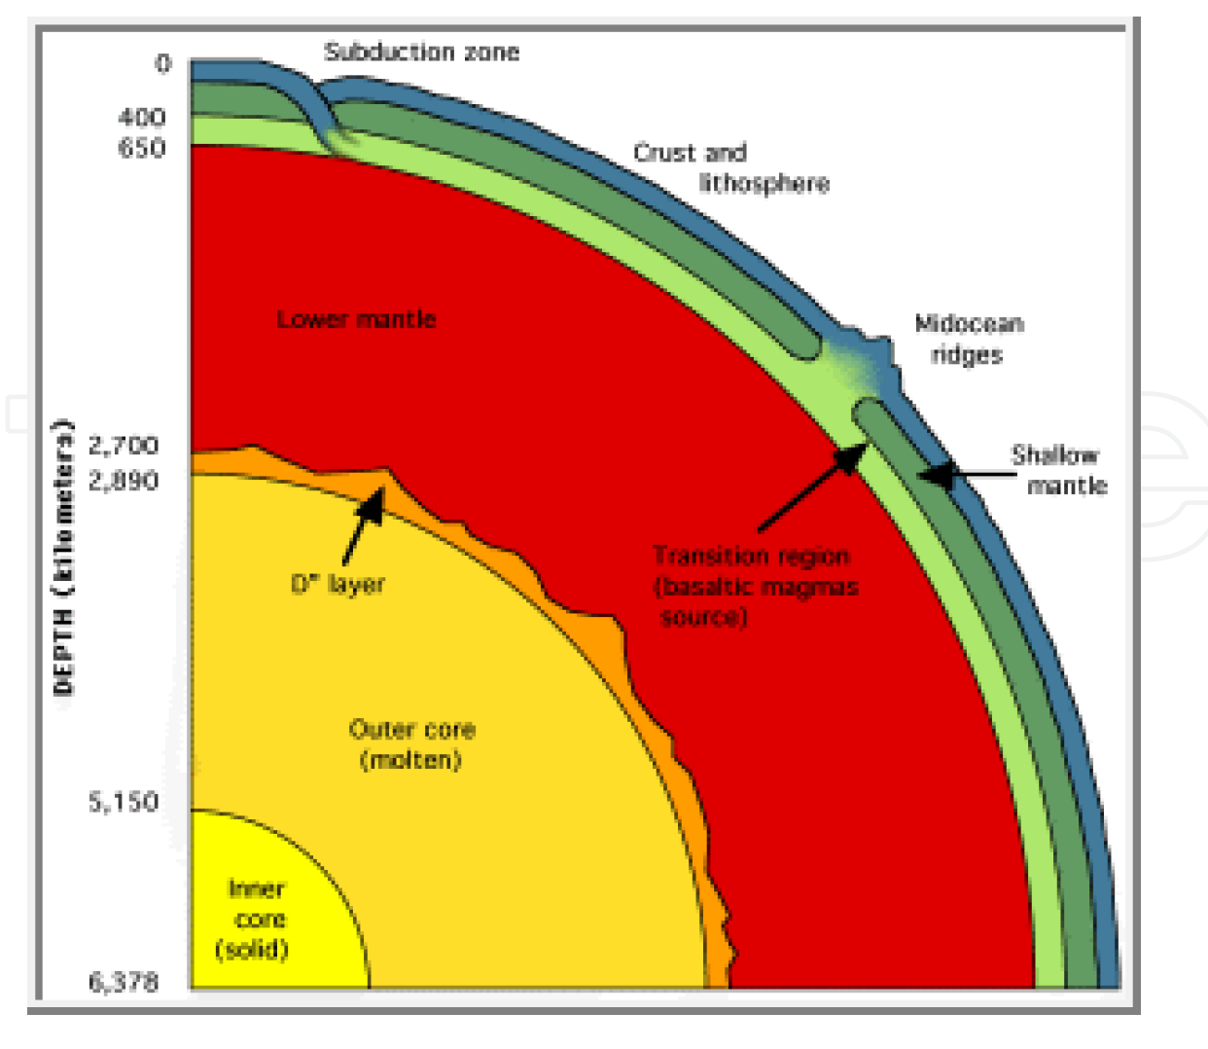
Introduction
The Earth is principally made up of three parts: core, mantle and crust (Fig. 1). As understood today, right at the heart of the Earth is a solid inner core composed primarily of iron. At 5, 700°C, this iron is as hot as the Sun’s surface, but the crushing pressure caused by gravity prevents it from becoming liquid. Surrounding this is the outer core, a nearly 2, 000 km thick layer of iron, nickel, and small quantities of other metals. Lower pressure than the inner core means the metal here is fluid. Differences in temperature, pressure and composition within the outer core cause convection currents in the molten metal as cool, dense matter sinks while warm, less dense matter rises.

Slide 6
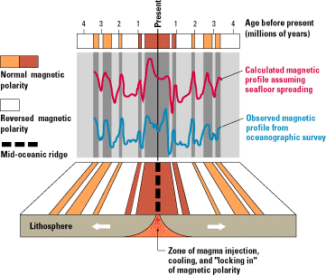

Slide 7
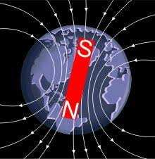
This flow of liquid iron generates electric currents,
which in turn produce magnetic fields (Earth’s field).
These convection processes in the liquid part of core (outer core) give rise to a dipolar geomagnetic field that resembles that of a large bar magnet aligned approximately along the Earth’s rotational axis
The mantle plays little part in the Earth’s magnetism,
while interaction of the past and present geomagnetic field with the rocks of the crust produces magnetic anomalies recorded in detailed when surveys are carried out on or above the Earth’s surface.
The magnitude of the Earth’s magnetic field averages to about 5x10-5 T (50, 000 nT).
Magnetic anomalies as small as 0.1 nT can be measured in continental magnetic surveys and may be of geological significance.

Slide 9
Applications of magnetic method
As is well known today, magnetic methods are used to solve various problems such as:
1. Mapping the basement surface and sediments in oil/gas exploration
2. Detecting different types of ore bodies in mining prospecting
3. Detecting metal objects in engineering geophysics
4. Mapping basement faults and fractures
5. Determining zones with different mineralization in logging as well as inspecting casing parameters
6. Studying the magnetic field of the Earth and its generators
7-And A variety of other purposes such as natural hazards assessment, mapping impact structures and environmental studies

Slide 10
Fundamental magnetic theories
Any magnetic grain is a dipole. That is, it has two poles, P1 and P2 of opposite signs diametrically linked. Charles Augustin de Coulomb in 1785 showed that the force of attraction or repulsion between electrically charged bodies and between magnetic poles obeys an inverse square law similar to that derived for gravity by Newton. The mathematical expression for the magnetic force, F_{m} experienced between two magnetic monopoles is given by:
(1)
Where μ is a constant of proportionality known as the magnetic permeability, P1 and P2 are the ‘strengths’ of the magnetic monopoles and r is the distance between the poles. We note that the expression in equation (1) is identical to the gravitational force,

Slide 11
and electrical force,
expressions. Here m1, m2 and q1, q2 are respectively masses and electrical charges separated by distance r, G is the universal gravitational constant while k is the Coulomb’s law constant for the medium.
However, unlike the gravitational constant, G, the magnetic permeability, μ is a property of the material medium in which the two monopoles P1 and P2 are situated. If they are placed in a vacuum, then μ is for the free space. Also, unlike m1 and m2, P1 and P2 can be either positive or negative in sign. If P1 and P2 have the same sign, the force, Fm between the two monopoles is repulsive. If P1 and P2 have opposite signs, Fm is attractive.
We may seem to easily compare the gravitational force between masses m1 and m2 separated by r to that of either the attractive or repulsive magnetic force between two monopoles

Slide 12
-However, the magnetic monopoles have never existed! Rather the fundamental magnetic element appears to consist of two magnetic monopoles: one positive and the other negative, separated by a distance.
-Thus the fundamental magnetic element consisting of two monopoles is called a magnetic dipole.
-Every magnetic grain is therefore a dipole.
-We can therefore determine the force produced by a dipole by considering a force produced by two monopoles. Since the dipole is simply two monopoles each of strength P1 and P2, we expect that the force generated by a dipole is simply the force generated by one monopole added vectorially to the force generated by the second monopole.

Slide 13
The Earth’s magnetic field https://www.youtube.com/watch?v=FYriCZOVbFQ
1-Nearly 90% of the Earth’s magnetic field (geomagnetic field) looks like a magnetic field that
would be generated from a dipolar magnetic source located at the centre of the Earth and nearly
aligned with the Earth’s rotational axis.
The strength of the Earth’s field at the poles is about 60, 000 nT. (This is called the Main Field of the Earth) .
2-The remaining 10% of the Earth’s magnetic field cannot be explained in terms of simple dipolar sources.
a)-The larger component of this 10% of the Earth’s field originates in iron-bearing rocks
near the Earth’s surface where temperatures are sufficiently low (i.e. less than the Curie
temperature of the rocks). This region is confined to the upper 30 – 40 km of the crust and is
the source of the crustal field which is made up of induced field on magnetically susceptible
rocks and remanent magnetism of the rocks.
b)-The smaller portion of the 10% comes from the upper atmosphere (external source).

Slide 14
The external source field is believed to be produced by interactions of the Earth’s ionosphere with the solar wind. Hence some temporal variations (usually variable over hours at tens of nT or occasionally variable over a few hours at hundreds of nT: the magnetic storm) are correlated to solar activity. The external component (except for magnetic storm phenomenon) is usually regular and are corrected/removed appropriately from field measurements in a process similar to drift correction in gravity surveys. Where magnetic storm is detected, survey is most often discontinued until the phenomenon has passed.

Slide 16
The crustal field, its relation to the distribution of magnetic minerals within the crust are the primary subjects of the magnetic method in exploration.
In a magnetic survey, the magnetic induction, B whose magnitude is measured at a point is the vector sum of four field components:
1. The Earth’s main field which originates from dynamo action of conductive fluids in the Earth’s deep interior ;
2. An induced field caused by magnetic induction in magnetically susceptible earth materials polarized by the main field;
3. A field caused by remanent magnetism of earth materials;
4. Other (usually) less significant fields caused by solar, atmospheric and cultural influences

Slide 17
While we can handle the external features (source 4) component (like drift correction in gravity survey: for the solar/atmospheric sources) and divesting from such features or recognizing their transient effects and removing them (for cultural features)
the main field is examined from complex models that have been developed and are available. Our intent here is to characterize the global magnetic field (main field) in order to isolate the magnetic field caused by crustal sources (sources 2 and 3).

Slide 18
The magnetic properties of rocks
Geologic interpretation of magnetic data requires the knowledge of the magnetic properties of rocks in terms of magnetic susceptibility and remanent magnetization.
Magnetic properties of rocks can only exist at temperatures below the Curie point. The Curie temperature is found to vary within rocks but is often in the range 550 C to 600 C .

Slide 19
Indeed rock magnetism is a subject of considerable complexity. Clearly, all crustal rocks find
themselves situated within the geomagnetic field . These crustal rocks are therefore likely to display induced magnetization given by equation
,
where the magnitude of magnetization(Ji), is proportional to the strength of the Earth’s field (T) ,
The magnetic susceptibility(k), is actually the magnetic volume susceptibility that is encountered
in exploration.
Apart from the induced magnetization, many rocks also show a natural remanent magnetization (NRM) that would remain even if the present-day geomagnetic field ceases to exist. The simplest way in which NRM can be acquired is through the process of cooling of rocks in molten state. As the rocks cool past the Curie point (or blocking temperature) a remanent magnetization in the direction of the prevailing geomagnetic field will be acquired. The magnitude and direction of the remanent magnetization can remain unchanged regardless of any subsequent changes in the ambient field.

Slide 20
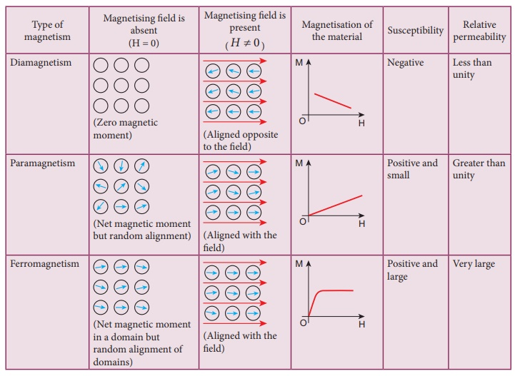
Classifications of Magnetic Susceptibility (how do materials behave in a magnetic field?)

Slide 21
Diamagnetic:
Electrons are paired, but orbits induce a small net magnetic moment
Very small negative χ (k)
Moment is near zero.
Examples: quartz & feldspar
Paramagnetic:
Unpaired electrons partially align
Positive χ typically very low
Moment is typically small.
Examples: pyroxene & olivine

Slide 23
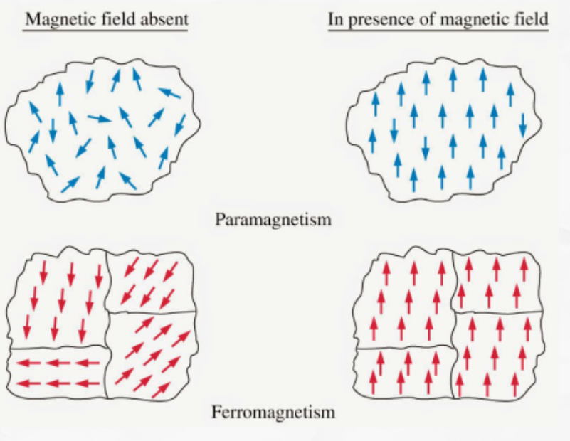
Magnetic Domains
1-Ferromagnetic and Ferrimagnetic materials generally made up of domains with uniform magnetic direction within domains the magnetic moments of atoms are aligned.
2- The domains form when cooled below the Curie Temperature.
Magnetism can be either permanent or induced
Permanent magnetism remains when the field is removed.
For surveys, magnetism induced by the Earth’s field is generally the most important during the surveys

Slide 24
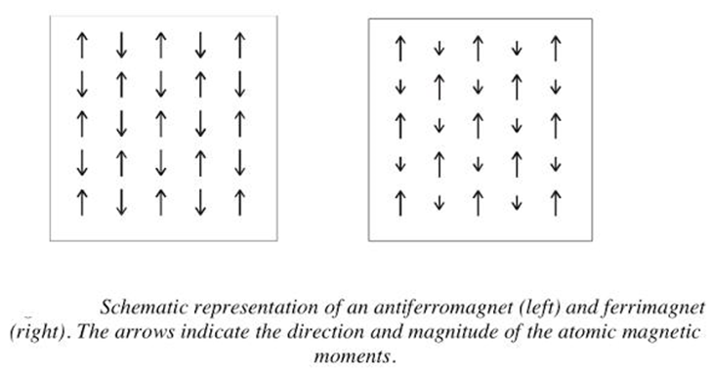
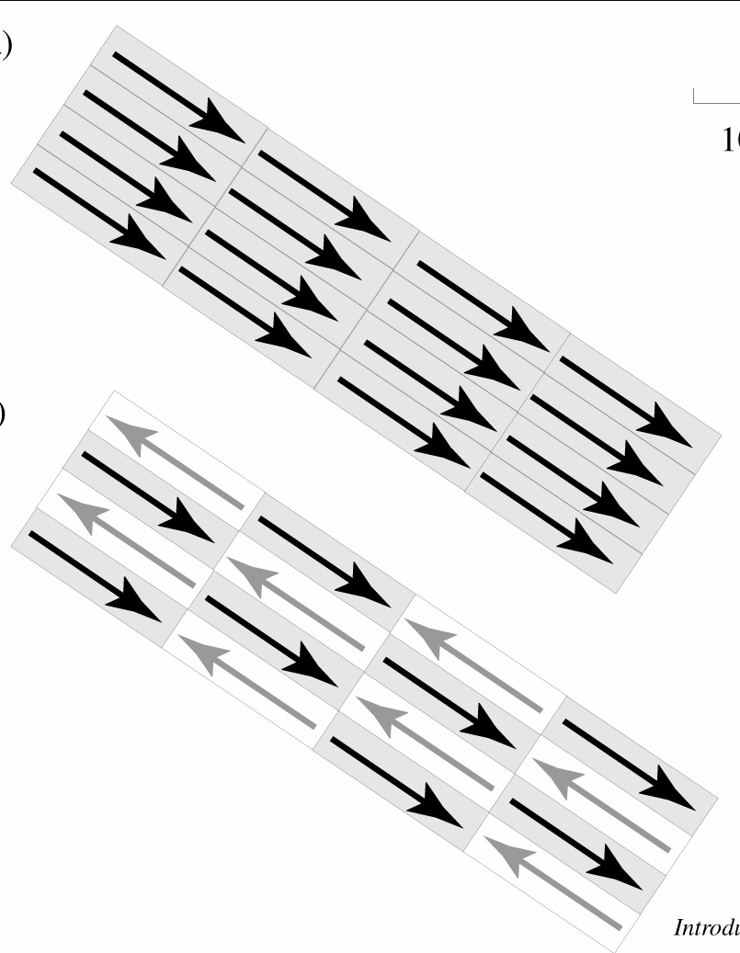
Classifications of Magnetic Susceptibility
Ferromagnetic:
Domains within the material are aligned.
Very high χ (k)
Common examples are pure iron, nickel
Do not occur naturally on Earth.
Anti-Ferromagnetic:
Domains within the material are both anti
-parallel and parallel , with both orientations
having the same strength.
χ is very low
Moment = 0
Common example is hematite.
Ferrimagnetic:
Domains within the material are both anti-
parallel and parallel, with one direction
being stronger than the other.
High χ
Common examples are magnetite*
and ilmenite.

Slide 25
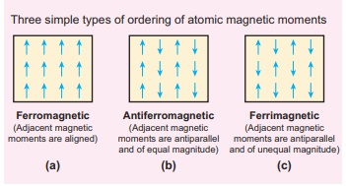

Slide 26
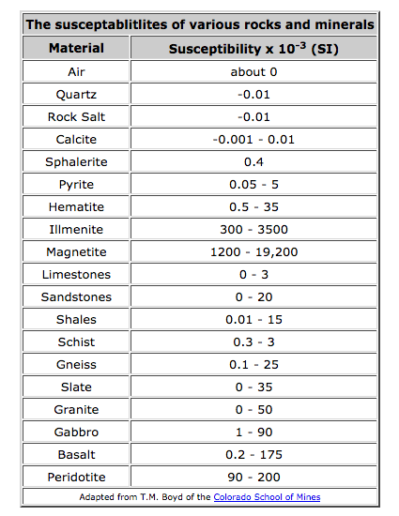
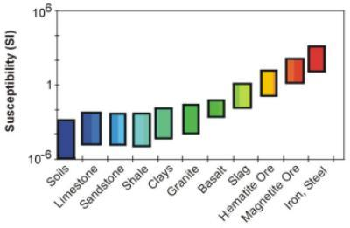
Magnetic Susceptibility of Naturally Occurring Materials
http://www.epa.gov/

Slide 27
Magnetic Field Nomenclature
As you can see, although we started by comparing the magnetic field to the gravitational field, the specifics of magnetism are far more complex than gravitation. Despite this, it is still useful to start from the intuition you have gained through your study of gravitation when trying to understand magnetism.
Before continuing, however, we need to define some of the relevant terms we will use to describe the Earth's magnetic field.
When discussing gravity, we really didn't talk much about how we describe gravitational acceleration. To some extent, this is because such a description is almost obvious; gravitational acceleration has some size (measured in geophysics with a gravimeter in mGals), and it is always acting downward (in fact, it is how we define down).
Because the magnetic field does not act along any such easily definable direction, earth scientists have developed a nomenclature to describe the magnetic field at any point on the Earth's surface.
https://www.youtube.com/watch?v=FYKWSErqFD8

Slide 29
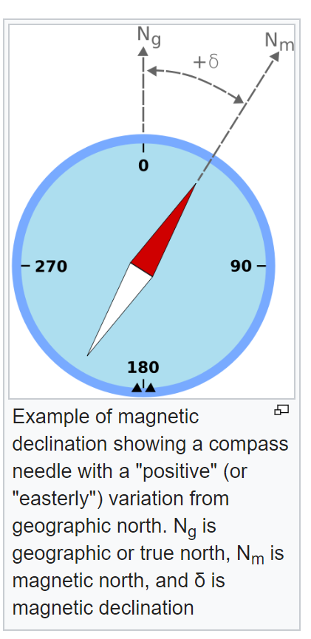
the magnetic field, F*, has some strength and points in some direction.
The following terms are used to describe the direction of the magnetic field.
• Declination :
Magnetic declination, or magnetic variation, is the angle on the horizontal plane between magnetic field lines (the direction the end of a magnetized compass needle points, corresponding to the direction of the Earth's magnetic field lines) and true north (the direction along a meridian towards the geographic North Pole). This angle varies depending on position on the Earth's surface and changes over time.

Slide 30
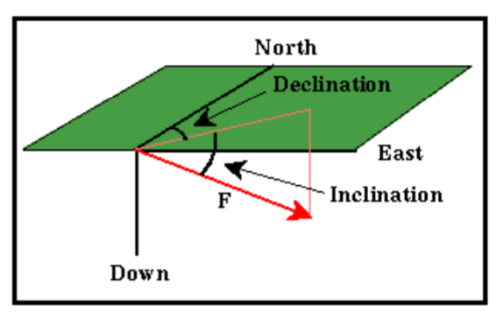

Slide 31
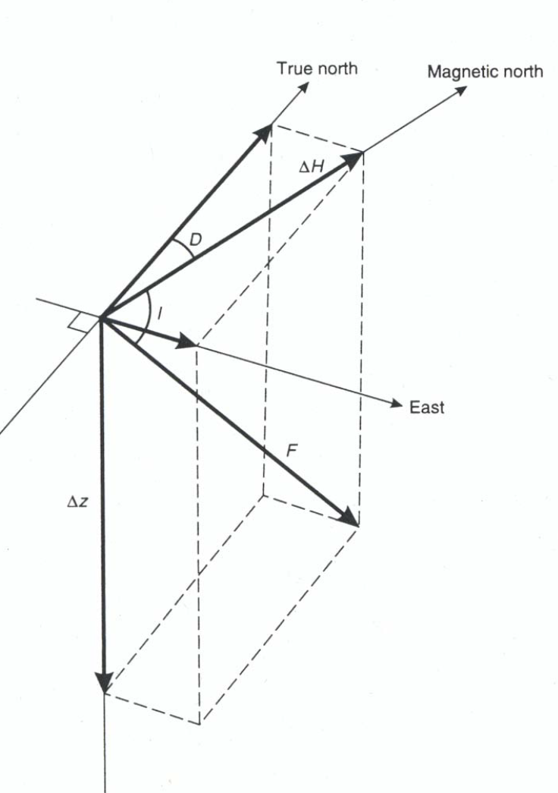
Inclination Is the angle made with the horizontal by the Earth's magnetic field lines. This angle varies at different points on the Earth's surface. Positive values of inclination indicate that the magnetic field of the Earth is pointing downward, into the Earth, at the point of measurement, and negative values indicate that it is pointing upward.

Slide 32
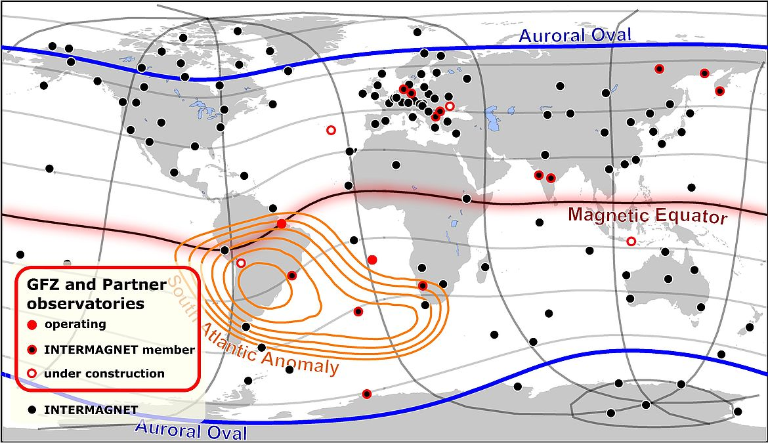
Magnetic Equator - The location around the surface of the Earth where the Earth's magnetic field has an inclination of zero (the magnetic field vector F is horizontal). This location does not correspond to the Earth's rotational equator.

Slide 33
Magnetic Poles - The locations on the surface of the Earth where the Earth's magnetic field has an inclination of either plus or minus 90 degrees (the magnetic field vector F is vertical). These locations do not correspond to the Earth's north and south poles.

Slide 34
Why does a magnetic compass point to the Geographic North Pole?
A magnetic compass does not point to the geographic north pole. A magnetic compass points to the earth's magnetic poles, which are not the same as earth's geographic poles. Furthermore, the magnetic pole near earth's geographic north pole is actually the south magnetic pole. When it comes to magnets, opposites attract. This fact means that the north end of a magnet in a compass is attracted to the south magnetic pole, which lies close to the geographic north pole. Magnetic field lines outside of a permanent magnet always run from the north magnetic pole to the south magnetic pole. Therefore, the magnetic field lines of the earth run from the southern geographic hemisphere towards the northern geographic hemisphere
https://www.wtamu.edu/~cbaird/sq/2013/11/15/why-does-a-magnetic-compass-point-to-the-geographic-north-pole/

