Slide 1
Nurs 425 Decision Making in Clinical Practice

Slide 2
Course Description
This course introduces the student to clinical decision-making in nursing.
The nursing process is presented, with the focus on making nursing diagnoses and identifying outcome criteria.
The social, legal, ethical and cultural context of decision making in nursing is explored.
Research is introduced as a method of inquiry and as a foundation for evidence based clinical decisions.
Clinical decision-making to promote patient adaptation is emphasized.
Students have the opportunity to practice decision making skills in simulated and actual patient settings.

Slide 3
Course Objectives : Upon completion of this course the student will be able to:
1. Clarify personal and professional values and recognize their impact on decision making and professional behavior. (C, ISR Domains )
2. Explain the importance of clinical decision making in nursing practice. (K, C Domains )
3. Analyze the fundamentals of the Code of Ethics and Standards of Nursing Practice.(C, ISR Domains).
4. Apply the Code for Nurses and other professional guidelines to clinical practice.
(P Domain)
5. Utilize the social, legal, ethical and cultural context of decision making.(CITN, P Domains)

Slide 4
Course Objectives : (continued)
6. Integrate the nursing process in each decision making.(C, CITN Domains )
7. Enumerate and analyze the nursing issues and problems along bedside care, leadership and management. (K, C Domains )
8. Incorporate the transcultural framework in the care of patient in different settings. (C, CITN Domains )
9. Integrate evidence-based researches and related clinical scenario through readings as a foundation of sound judgment that highlights the nurse’s responsibility along professional practice. (C, CITN Domains )
10. Describe the responsibility in the learning process. (K Domain )

Slide 5
Course Evaluation
Formative (60%) | Marks
Attendance and Active Participation | 10%
Group Activities | 10%
Quiz (1,2) | 10%
Requirements: Presentation & Submission | 10%
Midterm Exam | 20%
Summative (40%)
Final Exam | 40%
Total | 100%

Slide 6
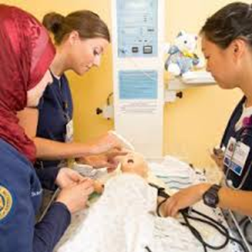
Unit 1 Importance of Clinical Decision Making

Slide 7
Learning Objectives:
After completion of lecture-discussions, students are expected to be able to:
Differentiate critical thinking, judgement, clinical reasoning, clinical decision, and clinical decision making
Analyze situations or cases demonstrating clinical thinking, judgement, clinical reasoning, clinical decision, and clinical decision making
Value the importance of learning the appropriate way of critically thinking, judgement, clinical reasoning, clinical decision and clinical decision making

Slide 8
Learning Objectives: (continued)
Understand the importance of clinical decision making
Discuss strategies to improve decision making
Examine factors that affect decision making
Explain the roles of nurses in making patient care decisions

Slide 9
Requirements from newly qualified nurses
To be critical thinkers
To have ability to critique evidence
To apply best evidence in clinical practice to inform judgement and decision making
(Dowding et al., 2012))

Slide 10
Requirements from beginning practitioners
to exhibit sound judgment and decision making skills through
developing knowledge or domain expertise in their field of practice
possessing the thinking skills to use that knowledge effectively
understanding what constitutes good decision making practice
(Dowding et al., 2012))

Slide 11
Critical thinking skills (definition)
refer to cognitive skills such as analysis, evaluation, inference, deductive reasoning, inductive reasoning, interpretation, explanation and self-regulation (Beckie et al., 2001, Hicks et al., 2003, Lyons, 2008).
purposeful, self-regulatory judgment: an interactive, reflective, reasoning process of making a judgment about what to believe or do (Beckie et al., 2001)
(Dowding et al., 2012))

Slide 12
Critical thinking skills (definition) (continued)
“a dynamic, purposeful, analytic process that results in reasoned decisions and judgments” (Lyons, 2008)
“a set of dispositions and skills that enhance decision-making processes through such cognitive abilities as analysis, inference and evaluation” (Hicks et al., 2003).
(Dowding et al., 2012))

Slide 13
Clinical reasoning (definition)
the process by which individuals make judgements and decisions, and incorporates the skills of critical thinking
The outputs of the reasoning process are judgements
(Dowding et al., 2012))

Slide 14
Clinical reasoning (definition) (Hoffman, 2007; Kraischsk & Anthony, 2001; Laurie et al., 2001)
process by which nurses (and other clinicians)
collect cues
process the information
come to an understanding of a patient problem or situation
plan and implement interventions
evaluate outcomes, and
reflect on and learn from the process
http://www.utas.edu.au/__data/assets/pdf_file/0003/263487/Clinical-Reasoning-Instructor-Resources.pdf

Slide 15
Why is Clinical Reasoning Important?
effective clinical reasoning skills have a positive impact on patient outcomes
poor clinical reasoning skills often fail to detect impending patient deterioration resulting in a “failure-to-rescue” (Aiken, Clarke, Cheung, Sloane, & Silber, 2003).
http://www.utas.edu.au/__data/assets/pdf_file/0003/263487/Clinical-Reasoning-Instructor-Resources.pdf

Slide 16
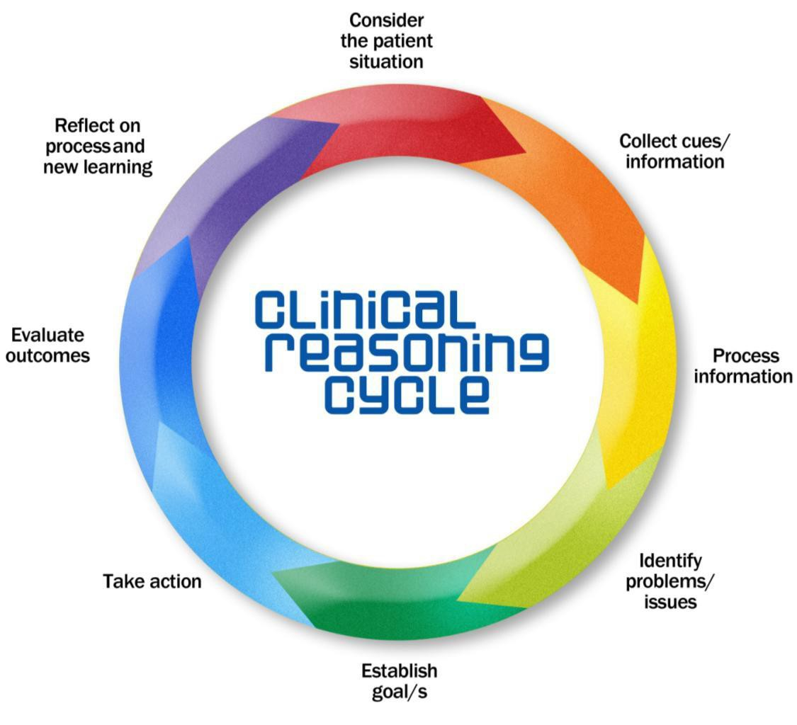
Clinical Reasoning Process
http://www.utas.edu.au/__data/assets/pdf_file/0003/263487/Clinical-Reasoning-Instructor-Resources.pdf

Slide 17
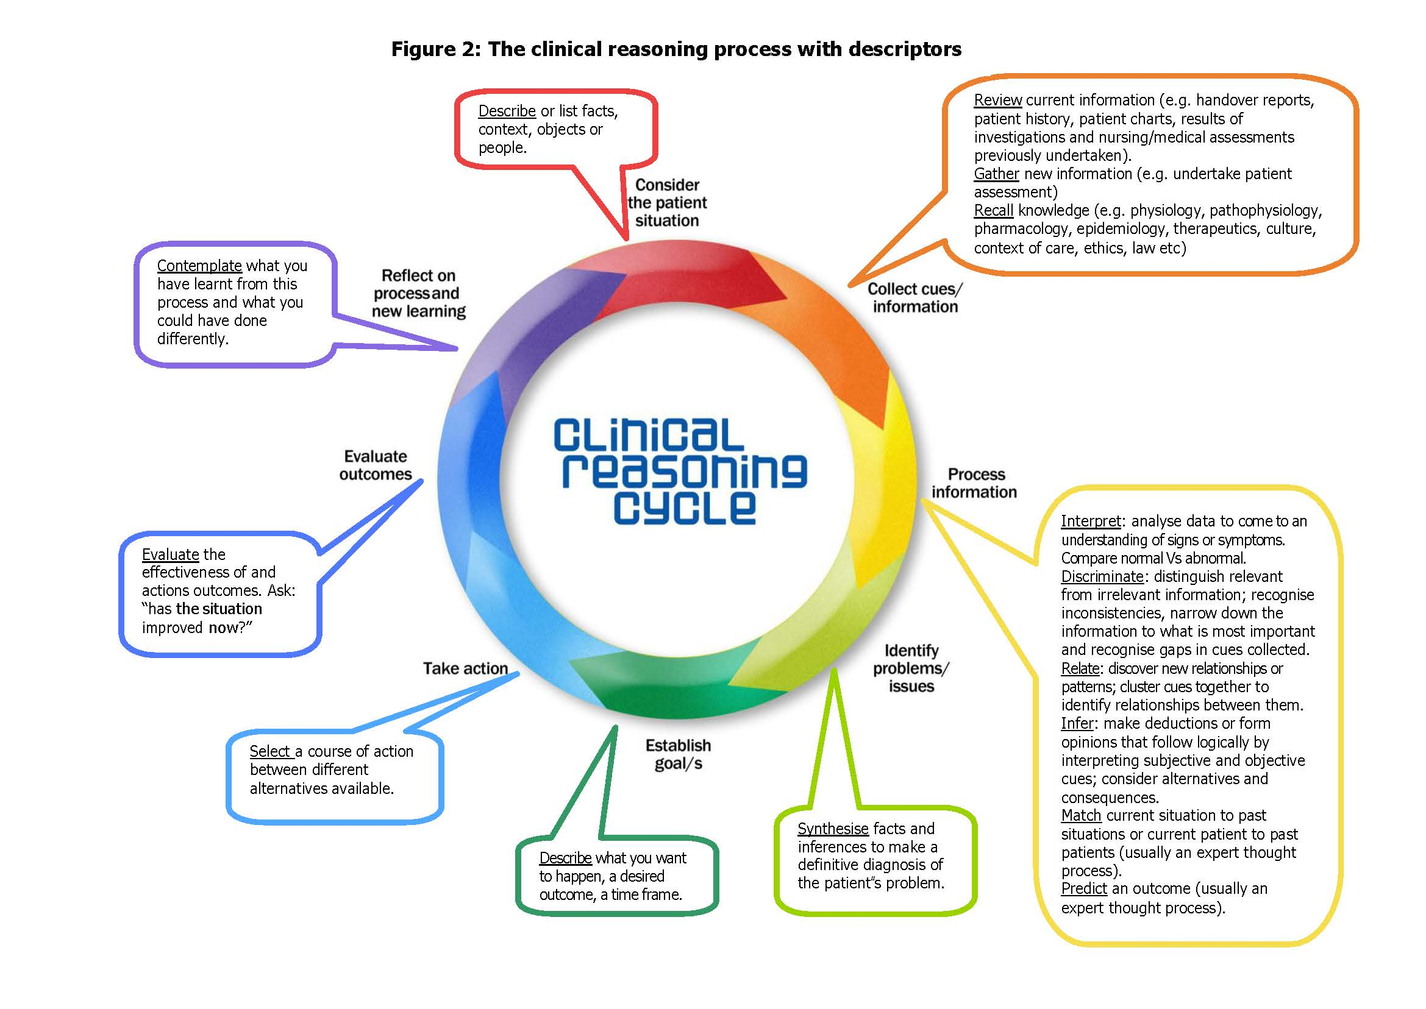
http://www.utas.edu.au/__data/assets/pdf_file/0003/263487/Clinical-Reasoning-Instructor-Resources.pdf

Slide 18
Difference between Judgement and Decisions
Judgement ‘an assessment between alternatives’ | Decisions ‘a choice between alternatives’ (Dowie, 1993)
(Dowding et al., 2012))

Slide 19
Types of reasoning process used to reach judgements and decisions (Thompson and Dowding, 2009a)
hypothetico- deductive reasoning
analytical reasoning using algorithms and decision support tools (such as decision analysis or Bayes’ theorem)
(Dowding et al., 2012))

Slide 20
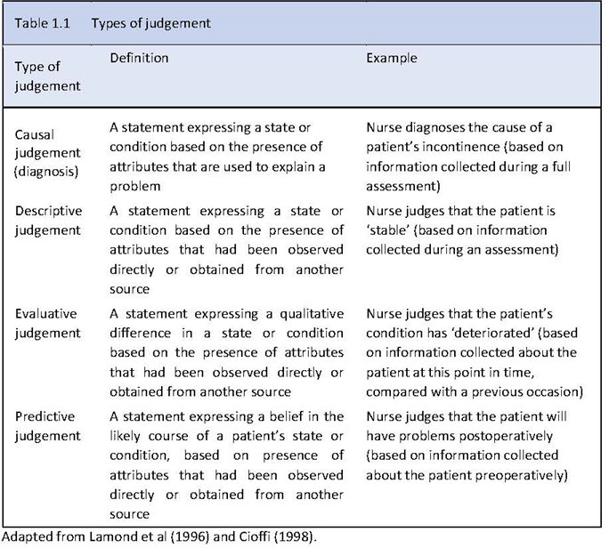
(Thomson & Dowding, 2009, p4)

Slide 21
Clinical decisions (definition)
Choice between alternatives (Dowie, 1993)
Produce some kind of outcome in the form of an action
Example: ‘To do’ or ‘not do’ something
Decisions in healthcare are usually made under conditions of uncertainty—we do not know (with certainty) what will happen because of our decision or action
(Thomson & Dowding, 2009, p3)

Slide 22
(Thomson & Dowding, 2009, p4)

Slide 23
Clinical decision making (definition)
The process that involve weighing up of potential costs and benefits associated with each option you are considering, before deciding on a course of action (Baron, 2000)
Decisions normally follow judgments (see case)
The nurse made a number of judgments
The patient is “unwell”, that his problem has ‘probably’ been caused by a ‘new event’.
On the basis of these judgments (as well as discussion with the consultant) the nurse decides that the best course of action (the decision) is to admit the patient to hospital.
(Thomson & Dowding, 2009, p3)

Slide 24
Importance of why nurses need to know ‘decision making’
to be recognized as autonomous decision making professionals
Develop nursing in ways that provide enough freedom to practice and exercise judgment with the minimum of interference in the relationship between patient and nurse
Opportunity to rethink the ways in which we
train, develop, and self-regulate the profession
establish and market our contribution to enhanced patient outcomes
(Thomson & Dowding, 2009, p3)

Slide 25
Factors that affect decision making
Knowing the Patient and Person:-
Knowing the patient's preferences, their experiences of illness and their current situation or care needs and what is normal for that patient in terms of observation, mobility and level of function.
Knowing the Environment:
Awareness and recognition of the approach to decision making and the wider team dynamics within your organization.

Slide 26
Limitations to Effective Decision Making
Bias and preconceived ideas
Inflexible values
Not gathering/analyzing enough information
Protecting the status quo
Making decisions to justify previous decisions
Ignoring evidence that does not support predetermined ideas
Presenting the issue in a biased manner
Inaccurately presenting alternatives

Slide 27
The Nurse’s Role in Patient Decision Making
Patients are increasingly knowledgeable about health care and involved in treatment decisions.
Nurses must be aware of patients’ rights in making decisions about their treatments and must assist patients in their decision making.
Nurses must recognize when patients are lacking information and implement teaching in such cases.
Nurses may need to collaborate with others to determine what information has been shared with the patient and family.

Slide 28
Strategies to Improve Decision Making
Make certain you have all necessary information to make a proper decision.
Consider alternatives.
Do not be afraid to revise a decision if circumstances change.
Anticipate questions and outcomes.
Keep notes and other information for reference.

Slide 29
Strategies to Improve Decision Making
Consider the pros and cons of the decision.
Consider how your decision will affect the people involved.
Do not get caught up in unnecessary details or issues.
Do not put off decision making out of fear.

Slide 30
Dowding, D.W., Gurbutt, R., Murphy, M., Lascelles, M., Pearman, A., & Summers, B. (2012). Conceptualising decision making in nursing education. Journal of Research in Nursing, 17(4), 348-360.
Thompson, C. & Dowding, D. (2009). Essential Decision Making and Clinical Judgement for Nurses. China: Churchill Livingstone Elsevier.
Clinical reasoning: Instructor resources. Available from http://www.utas.edu.au/__data/assets/pdf_file/0003/263487/Clinical-Reasoning-Instructor-Resources.pdf

