Slide 1
PARASITES
By:afnan bakhsh

Slide 2
Parasitology: the study of parasites.
Parasite: it is organism living in or on other organism.

Slide 3
Parasites can be divided to:
Protozoa. unicellular
Helminthes. Multicellular
Arthropods. Multicellular

Slide 4
Protozoa:
Single cell (unicellular) eukaryotes.
They can live as free organisms or parasites.
They transmitted by:
Blood sucking insect bites.
Accidental ingestion.
It have two stages:
Cyst: dormant stage outside the body.
Trophozoite: active stage inside the body.

Slide 5
Protozoa are classified into four classes according to their motility:
1-ameobsas
2-ciliates
3-flagellates
4-sporozoa

Slide 6
Amoebas: move by pseudo pods (Ex:Entamoeba histolotica).
Cyst
Trophozoite

Slide 7
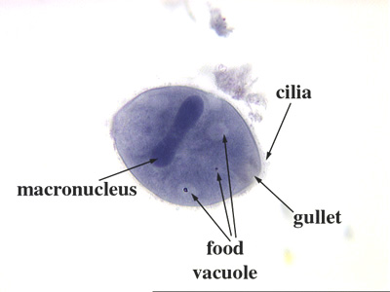
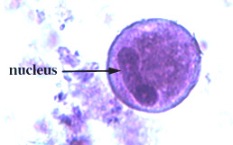
Ciliates: move by cilia (Ex:Balantidium coli).
Cyst
Trophozoite

Slide 8
Flagellates: move by flagella (Ex:Trypanosoma).

Slide 9
Sporozoa: intracellular parasite, doesn’t move it transmit through the blood (Ex:Plasmodium). Blood parasite.

Slide 10
Helminthes (worms):
Multicellular eukaryotic organisms.
- It has two stages:
Larval stage (egg): measure 100-200 Mm.
Adult worms: measure from cm to meters.

Slide 11
Adult worms: measure from cm to meters.
They can classify into:
Nematode: Ex. Ascaris.
Trematode: Ex. Schistosoma.
Cestode: Ex. Taenia.

Slide 12
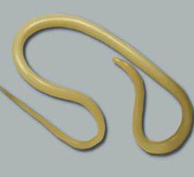
ascaris

Slide 13
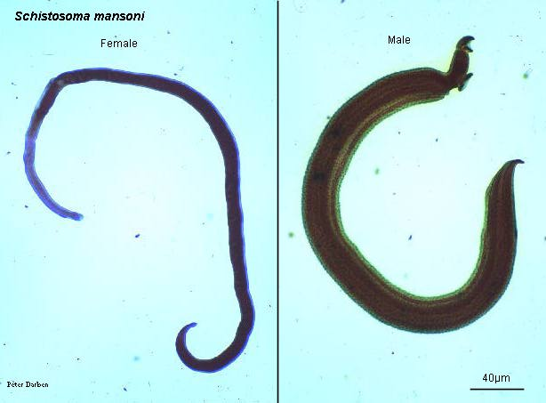
Schistosoma.

Slide 14
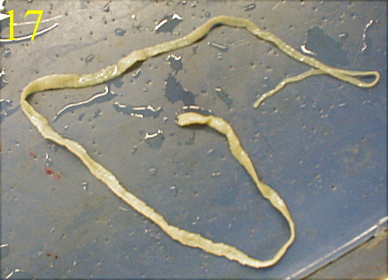
taenia

Slide 15
Arthropods (insects):
Ex: mosquitoes, bee, flea and flies.
Harmful effects of them:
Food poisoning.
Discomfort.
Cause diseases and transmit diseases.
Damage of crops.

Slide 16
Benefit of arthropods:
Bees produce honey.
Fertilization of plants and flowers.

