Slide 1
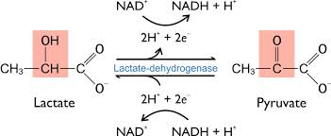
Lactate dehydrogenase reaction
Notes:
https://www.lahc.edu/classes/chemistry/arias/FlowChart101.pdf

Slide 2
Factors that Affect Enzymatic Analysis:

Slide 3
Enzyme activity is measured in vitro under conditions that often do not closely resemble those in vivo. The objective of measuring enzyme activity is normally to determine the amount of enzyme present under defined conditions, so that activity can be compared between one sample and another, and between one laboratory and another.
The factors that affect the activity of an enzyme include substrate concentrations(s), pH, inhibitors and temperature.

Slide 4
Reagent
For liver & kidney LDH
0.1 M Tris, pH 7.4,
1.5 mM sodium pyruvate - dilution range 0.05 to 0.5 mM
5 mM NADH (prepared fresh)
Enzyme extract
For muscle LDH,
0.1 M Tris, pH 7.4
0.1 M lactate stock solution - dilution range5 to 13 mM
5 mM NAD+ (Prepared fresh)
Enzyme extract

Slide 5
The effect of pH on enzyme activity:
1- Enzymes are active only within a limited range of PH e.g. pH 5 to 10
2- The optimum PH which is the maximum activity is attained.
3- Six different PH buffers ranged from 4 to 9 have been used:
PH 4, and 5 were Acetate buffers
PH 6, and 7 were potassium phosphate buffers
PH 8, and 9 Tris buffer for for preparation see appendix).

Slide 6
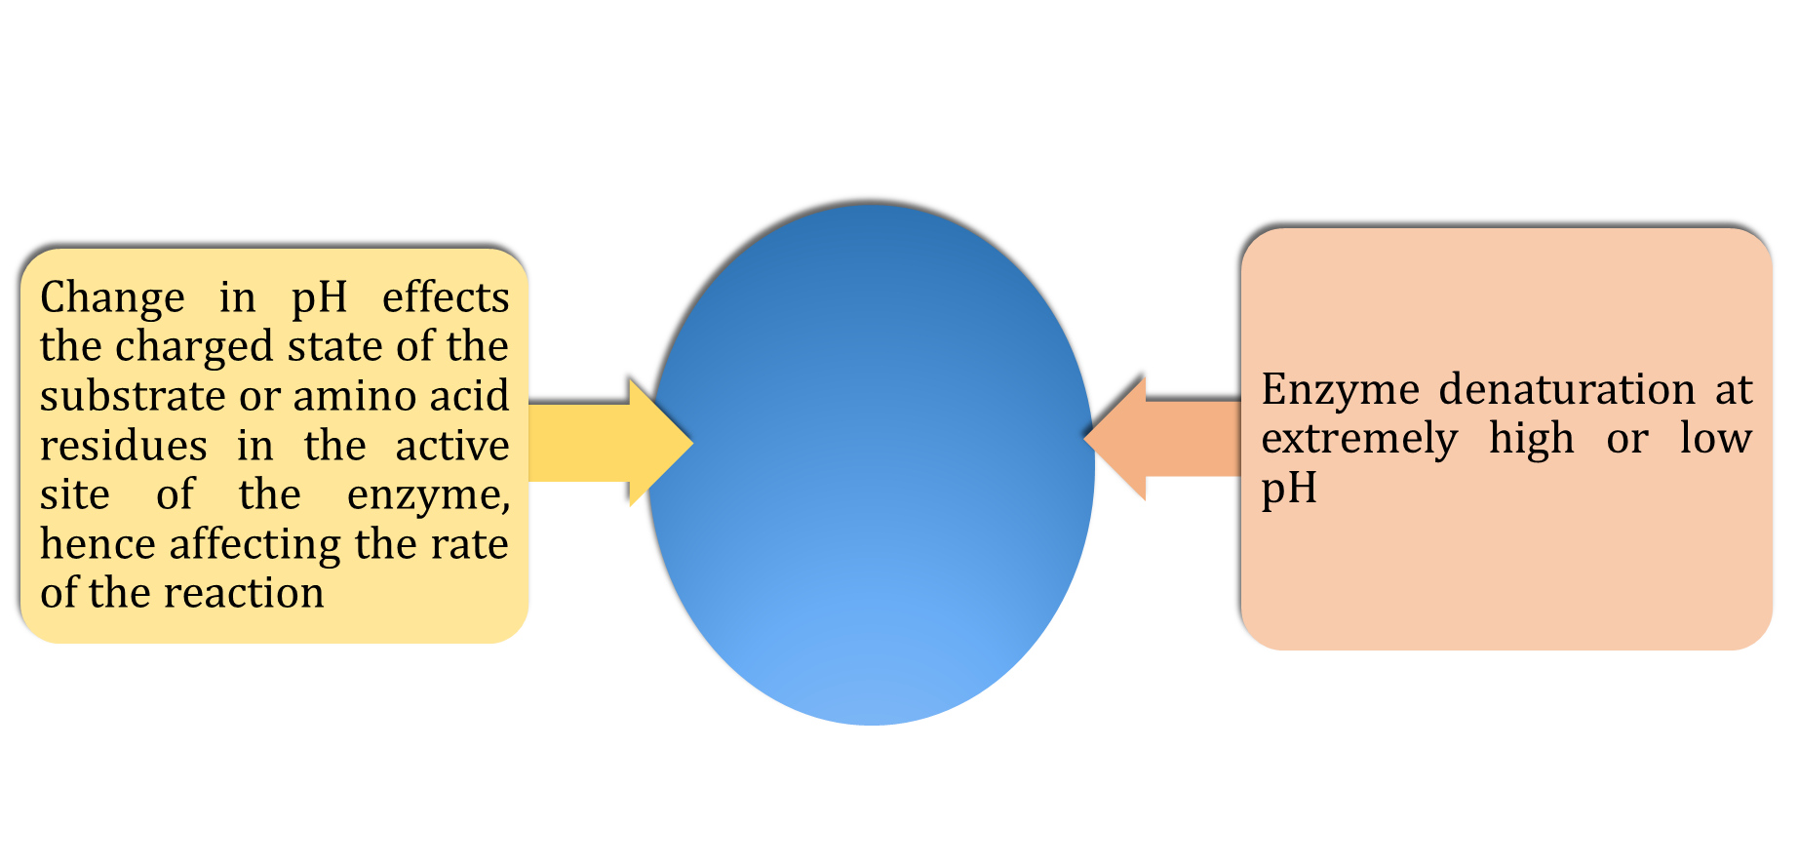
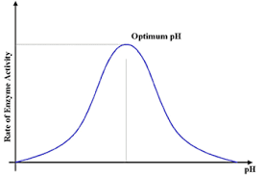
Bell-Shaped curve

Slide 8
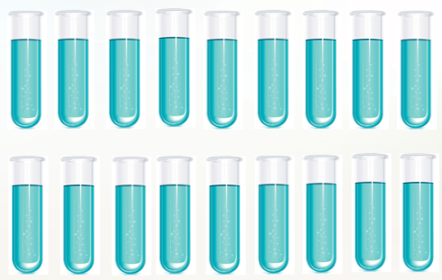
Method
B4
B5
B6
B7
B8
B10
In each 2.7 ml of buffer
0.1 ml substrate
0.1 ml of NADH
T4
T5
T6
T7
T8
T10
Read the absorbance at 340 nm

Slide 9
The effect of Temperature on enzyme activity:
Temperature affects enzyme activity in much the same way as it affects other chemical reactions. Thus it is important when carrying out an enzyme assay to ensure that the temperature remains constant, and also that you know exactly what it is. Enzyme activity has been studied at different temperature 20, 30, 40, 50, 60 and 70 °C.

Slide 10
Method
B20
B30
B40
B50
B60
B70
In each 2.7 ml of buffer
0.1 ml substrate
0.1 ml of NADH
T20
T30
T40
T50
T60
T70
Read the absorbance at 340 nm

