Slide 1
PHYS 111 1st semester 1439-1440 Dr. Nadyah Alanazi
Lecture 11

Slide 2
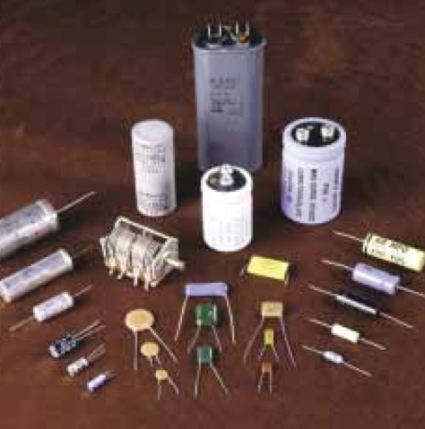
Chapter 26
Capacitance and Dielectrics

Slide 3
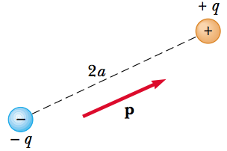
26.6 Electric Dipole in an Electric Field
The electric dipole consists of two charges of equal magnitude and opposite sign separated by a distance 2a,
The electric dipole moment of this configuration is defined as the vector p directed from -q toward +q along the line joining the charges and having magnitude 2aq :
p = 2aq

Slide 4
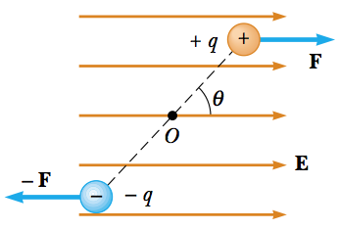
26.6 Electric Dipole in an Electric Field
Now suppose that an electric dipole is placed in a uniform electric field E,
The electric forces acting on the two charges are equal in magnitude (F=qE) and opposite in direction.
The two forces produce a net torque on the dipole; as a result, the dipole rotates.
This forces tend to produce a clockwise rotation.
The magnitude of the net torque about O is
Because F=qE and p=2aq, we can express τ as
Torque on an electric dipole in an external electric field

Slide 5
26.6 Electric Dipole in an Electric Field
The change in potential energy of the system
Potential energy of the system of an electric dipole in an external electric field

Slide 7
Problems
9. When a potential difference of 150 V is applied to the plates of a parallel-plate capacitor, the plates carry a surface charge density of 30.0nC/cm². What is the spacing between the plates?

Slide 8
13. An air-filled spherical capacitor is constructed with inner and outer shell radii of 7.00 and 14.0 cm, respectively.
Calculate the capacitance of the device.
What potential difference between the spheres results in a charge of 4.00 μC on the capacitor?

Slide 9
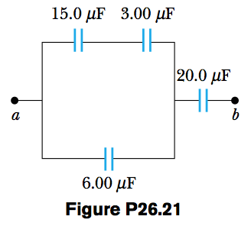
21. Four capacitors are connected as shown in Figure P26.21.
Find the equivalent capacitance between points a and b.
Calculate the charge on each capacitor if ΔV_{ab} =15.0 V.

Slide 10
