Slide 1
Chapter 4:
Project Initiation
Text Books:
Information Technology Project Management, (chapter#4)
Methods of IT Project Management, (chapter#4)

Slide 2
Objectives
Learn the tools and techniques of project selection, including:
1. The strategic planning process for the organization and IT department
2. Quantitative methods, including the following:
  1. Return on investment (ROI)
  2. Net present value (NPV)
  3. Internal rate of return (IRR)
  4. Payback analysis
3. Qualitative methods
4. The weighted scoring model (WSM)
5. Project charter
6. Stakeholder assessment matrix

Slide 3
Project Initiation
Before a project manager begins working on a project, he or she needs to understand how and why the organization decided to spend valuable resources-money and time-on the project.
You will understand the project management initiation process when you can

Slide 4
tools and techniques of project selection
1.The strategic planning

Slide 5
Strategic Planning
(determining long-term business objectives)
The first step before initiating projects is to look at the big picture “systems approach” or strategic plan of an organization
Strategic planning involves determining long-term business objectives (long-term?)
IT projects should support strategic and financial business objectives

Slide 6
Strategic Planning
(determining long-term business objectives)
The main goal of any project should be to deliver some form of business value:
  higher market share,
  new product or market,
  better customer support,
  higher productivity,
  lower operating costs,
  etc.
 All of these are typically defined in the company’s strategic plan as goals and objectives. Listed next to each goal or objective is a list of strategies which will fulfill the objective

Slide 7
Projects authorization
Why are projects authorized?
Internal business needs
External influences
Projects are initiated as a result of
Market Demand
Business Need
Customer Request
Technological Advance
Legal Requirement
Social Need

Slide 8
What Potential Projects Should be Selected by a Company? What to select? How to select?
Organizations should follow a documented consistent planning process for selecting IT projects
  Step # 1: Create a Strategic Plan -develop an IT strategic plan in support of the organization’s overall strategic plan.
  Step # 2: Analyze the area perform- a business area analysis
  Step # 3: Identify all relevant projects- define all potential projects, build the business case for those projects.
  Step # 4: Carefully select projects- select the most appropriate and doable project, and assign resources for identified projects.

Slide 9
Methods for Selecting Projects
In every organization, there are always more projects than available time and resources to implement them
Very important to follow a repeatable and complete process for selecting IT projects, to get the right mix (portfolio) for the organization
Business case – a document composed of a set of project characteristics (costs, benefits, risk, etc.) that aid organization decision makers in deciding what projects to work on
Business Value
Technology
Cost/Benefit questions
Risk
Four Key Issues Needing Answers for All Technology Projects:

Slide 10
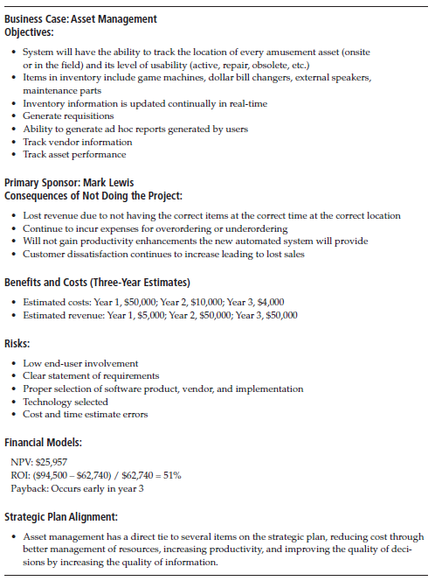
Business Case Example from Text Case Study

Slide 11
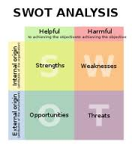
SWOT analysis
An often used tool to build the strategic plan is called SWOT analysis. An information gathering technique to evaluate external influences against internal capabilities
  Strengths
  Weaknesses
  Opportunities
  Threats

Slide 12
Example: SWOT
A group of four people want to start new business in film industry
They create SWOT analysis as follows:
Strengths:
  We have numerous contact in the film industry
  Two of us have strong sales and interpersonal skills
  Two has strong technical skills and familiar with SW tools
  We all have impressive samples of completed projects
Weakness
  No accounting/financial experience
  No clear marketing strategy for product and services

Slide 13
Example (cont.)
  Little money to invest in new projects
  No company website and limited use of technology
Opportunities
  Current client has mentioned a large project
  Film industry continues to grow
  Two major conferences this year where we could promote our company
Threats
  Other companies can provide services we provide
  Customers prefer well established organization
  High risk in film business

Slide 14
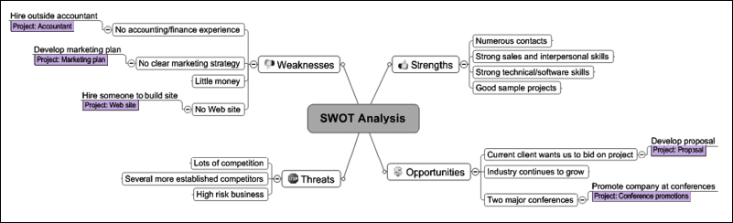
Mind Map of a SWOT Analysis to Help Identify Potential Projects

Slide 15
Selection Tools
Qualitative Models (based on SME’s knowledge + expertise)
  Subject matter expert judgments
  “Sacred Cow”
  Mandates
Quantitative Models (based on financial considerations that can be calculated)
  Net Present Value (NPV)
  Internal Rate of Return (IRR)
  Return on Investment
  Payback Period

Slide 16
tools and techniques of project selection
2.The Qualitative methods

Slide 17
Qualitative Models
Subject matter expert (SME) judgments
  Individuals either within the company or outside the company who possess expertise or unique knowledge in a particular facet of the business either by work experience, education, or a combination of both
  SME’s can be used to evaluate projects with or without more complex quantitative models and categorize projects with low, medium, and high priority rankings
“Sacred Cow”
  “Sacred Cow” decisions are made because someone – generally in upper management – really wants the project to get done

Slide 18
Qualitative Models
Mandates
  Generated from vendors, government agencies, industry sectors, or markets
Notes:
Examples: family leave act, Sarbanes Oxley, use

Slide 19
tools and techniques of project selection
3.The Quantitative methods

Slide 20
Quantitative Models
Financial considerations are often an important factor in selecting projects but not always!
Four primary methods for determining the estimated financial value of projects:
  Net present value (NPV) analysis
  Return on investment (ROI)
  Payback analysis
  Internal Rate of Return (IRR)

Slide 21
Time Value of Money
A sum of money is more valuable the sooner it is received. A dollar today is worth more than the promise of a dollar tomorrow
Due to: Inflation and risk
Before you invest money in a project you must compare its rate of return against other opportunities (other projects)

Slide 22
Time Value of Money
FV = PV(1 + i)^{n}
Where: FV = Future Value of an investment (project)
PV = Present Value of that same investment
i = Interest rate, discount rate or cost of capital
n = Number of years
Example: Invest $1000 today (PV) for 1 year(n) at an interest rate of 10% (i), the investment is worth $1000(1+.1)¹ or $1210 at the end of year one
What happens when you have two different investments with varying rates of return?
You must find a way to put both on equal terms.
<next slide>

Slide 23
Time Value of Money
You put both on equal terms by changing the formula slightly to evaluate all future cash flows at time zero or today
PV = FV
(1+i)^{n}
Example: You have a project that promises you $1000 of profit at the end of the first year with the discount rate at 10%
PV = $1,000 = $909
(1+0.1)¹
The project is worth only $909 today

Slide 24
Net Present Value Analysis
NPV is a method of calculating the expected net monetary gain or loss from an investment (project) by discounting all future costs and benefits to the present time
Projects with a positive NPV should be considered if financial value is a key criterion
Generally, the higher the NPV, the better

Slide 25
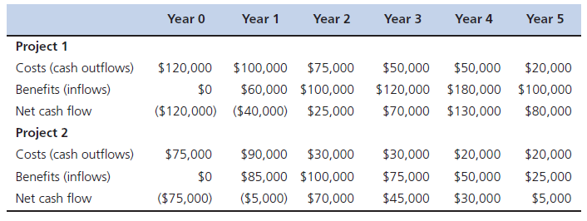
NPV Example
NPV is calculated using the following formula:
NPV = ∑_{t=0…n} CF/ (1+i)^{t}
Where t = the year of the cash flow
n = the last year of the cash flow
CF = the cash flow at time t
i = interest rate or discount rate

Slide 26
NPV Example Calculations
 | Do the Math | Discounted Cash Flow
Project 1
Year 0 | ($120,000) | ($120,000)
Year 1 | ($40,000) / (1 + .08)¹ | ($37,037)
Year 2 | $25,000 / (1 + .08)² | $21,433
Year 3 | $70,000 / (1 + .08)³ | $55,569
Year 4 | $130,000 / (1 + .08)⁴ | $95,553
Year 5 | $80,000 / (1 + .08)⁵ | $54,448
NPV | Add them up | $69,966
Project 2
Year 0 | ($75,000) | ($75,000)
Year 1 | ($5,000) / (1 + .08)¹ | ($4,630)
Year 2 | $70,000 / (1 + .08)² | $60,014
Year 3 | $45,000 / (1 + .08)³ | $35,723
Year 4 | $30,000 / (1 + .08)⁴ | $22,051
Year 5 | $5,000 / (1 + .08)⁵ | $3,403
NPV | Add them up | $41,561

Slide 27
Return on Investment (ROI)
Return on investment (ROI) is income divided by investment
  ROI = (total discounted benefits – total discounted costs) / total discounted costs
The higher the ROI or higher the ratio of benefits to costs, the better
Many organizations have a required rate of return or minimum acceptable rate of return on investment for projects

Slide 28
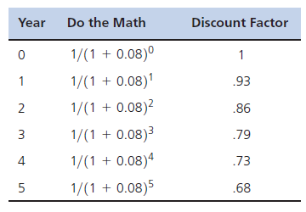
ROI Example
Step 1: determine discount factor for each year.
Step 2: calculate discounted benefits and costs

Slide 29
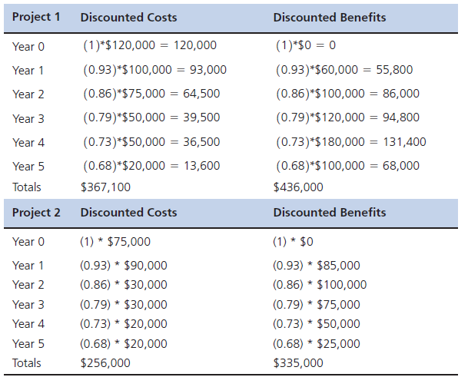
ROI Example

Slide 30
ROI Example
ROI Project 1 = ($436,000 - $367,100) / $357,100
= 19%
ROI Project 2 = ($335,000 - $256,000) / $256,000
= 31%

Slide 31
Payback Period
The payback period is the amount of time it will take a project before the accrued benefits surpass accrued costs, or how much time an investment takes to recover its initial cost.
A longer payback period generally infers a riskier project.
The longer it takes before a project begins to make money for the organization , the greater the chances that things can go wrong on the project

Slide 32
Payback Analysis
The payback period is the amount of time it will take a project before the accrued benefits surpass accrued costs or how much time an investment takes to recover its initial cost
track the net cash flow across each year to determine the year that net benefits overtake net costs (not discounted cash flows)
Many organizations want IT projects to have a fairly short payback period (< 1 year)

Slide 33
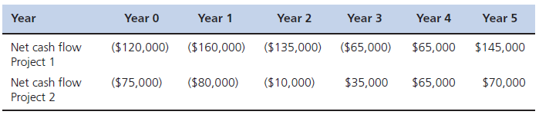
Payback Example
Same numbers as earlier examples. Table shows net cash flows
Project 1 payback occurs sometime during year 4
Project 2 payback occurs sometime during year 3

Slide 34
Selecting a Portfolio of Projects
WSM

Slide 35
Weighted Scoring Model (WSM)
The weighted scoring model (WSM) is a tool that provides a systematic process for selecting projects based on many criteria.
The first step in creating a weighted scoring model is to identify criteria important to the project selection process.
The criterion used to compare projects differs from one organization to another and may differ between types and classes of projects within the same organization

Slide 36
Weighted Scoring Model (WSM)
Some possible criteria for information technology projects include:
Supports key business objectives
Has strong internal sponsor
Has strong customer support
Uses realistic level of technology
Can be implemented in one year or less
Provides positive NPV
Has low risk in meeting scope, time, and cost goals

Slide 37
Steeps to get WSM:
First identify criteria important to the project selection process
Then assign weights (percentages) to each criterion so they add up to 100%
Then assign scores to each criterion for each project
Multiply the scores by the weights and get the total weighted scores

Slide 38
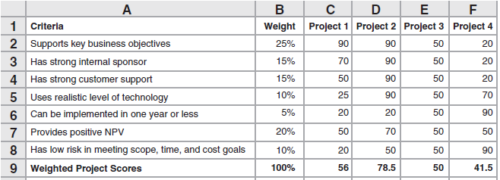
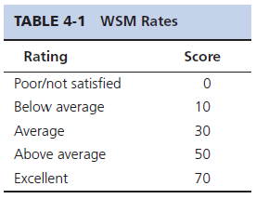
Weighted Scoring Model Example
For example, you calculate the weighted score for Project 1
Notes:
First identify criteria important to the project selection process
Then assign weights (percentages) to each criterion so they add up to 100%
Then assign scores to each criterion for each project
Multiply the scores by the weights and get the total weighted scores

Slide 39
Project Charter
Is the first tangible work product created in all projects, regardless of size and type
After deciding what projects to work on, it is important to formalize the project start
A project charter is a document (legal) which formally authorizes the work to begin on a project and provides an overview of objectives and resource requirements
Notes:
Remind students not to panic if they don’t understand some of the sections in the charter; the text has covered only a few of
its elements. During the next several chapters, the other elements will be explained, and they will learn exactly how to fill out each part of the charter.
“Should” is in quotes because this is something many projects don’t do even those that create a charter. Having the level of authority outlined for all stakeholders including the project manager from the start makes everything run much smoother throughout the project.

Slide 40
Project Charter
Key project stakeholders should sign a project charter to acknowledge agreement on the need and intent of the project
First project artifact placed under change control.
“Should” define Project Manager’s level of authority and responsibility
Notes:
Should not be created in isolation
It is not a novel, keep it short and to the point
Implementing an entire ERP application can be summarized in a project charter in 3 or 4 pages max
Tough to get stakeholder buy-in and understanding when the charter is 20 plus pages
Like the project selection process, the charter requires input from many sources to be accurate and encourage buy-in

Slide 41
Although the format of project charters can vary tremendously, they should include at least the following basic information:
The project s title and date of authorization
The project manager s name and contact information
A summary schedule, including the planned start and finish dates.
A summary of the project s budget or reference to budgetary documents
A brief description of the project objectives, including the business need or other justification for authorizing the project.
Project success criteria, including project approval requirements and who signs off on the project.
A summary of the planned approach for managing the project, which should describe stakeholder needs and expectations, important assumptions, and constraints, and refer to related documents, such as a communications management plan, as available.
A roles and responsibilities matrix
A sign-off section for signatures of key project stakeholders
A comments section in which stakeholders can provide important comments related to the project

Slide 42
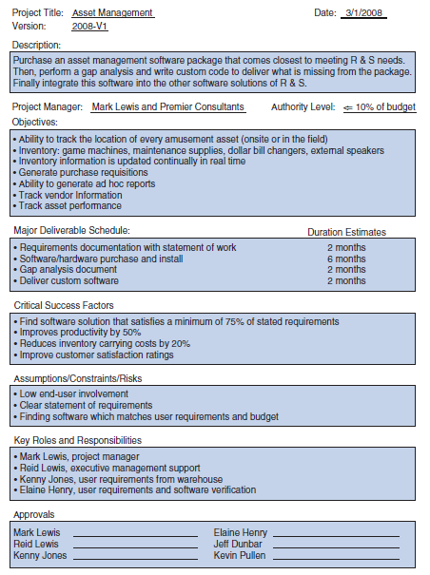
Sample Project Charter from Running Case Study
Notes:
Project title—Aproject charter needs a short, action-oriented title, usually starting with
an action verb. Many organizations like to create a short form of the title, using the first
letter of each word, such as Upgrade Project Software (UPS). The title needs to be long
enough for people to differentiate from others but short enough to be remembered.
Project date—This is the date the charter was completed and ready for authorized
signatures.
Version—Once signed, the project charter is under configuration version control. If
anything in the project changes and affects this document, a new version should be
created, and a new version number should be assigned.
Description—This includes business needs, project purpose, justification for the
project based on market demand, business need, customer request, technological advance,
legal requirement, social need, and information that will tie in with the organization’s
strategic plan.
Project manager—This is the name of the person assigned as the manager of the project,
who could be internal or external to the organization.
Authority level—The charter needs to specify the amount of authority the project
manager and others have to make project decisions without approval from others.
The authority level covers all aspects of the project, including scope, time, and cost.
For example, a certain authority level may allow the project manager to make decisions
that have an impact on cost of less than 10 percent of the entire budget and/or
less than a fixed dollar amount of, say, $1,000.
Objectives—Objectives are written at a high level and cover the major project objectives.
The template contains bullet points to reinforce the idea that these do not need
to be complete sentences. The key purpose in the objectives section is to clearly state
the boundaries of the project. It is just as important to state what is not included as it
is to state what is included. The objective statements should be future outcome based
(for example, “the update to the inventory control software will allow the warehouse
to cut overhead expenses by 25 percent”).
Major deliverable schedule—Each objective needs to be listed in this section, along
with a projected delivery date. Keep in mind that you are very early in the processand haven’t even begun the project, so coming up with a specific date will be difficult
or even impossible. If the sponsor or the organization’s management team requires a
date, you should try to use a month (April) or quarter (third quarter) and not get
locked into an exact date. This section also shows the order in which the objectives
will be worked on and completed. For some projects, customers have exact “need
by” dates for parts of the project due to government regulations, interdependencies
with other projects, or competitive pressures. In these cases, you need to make sure
these dates are noted and explained. The explanation should include the negative
consequences of not meeting the due dates.
Critical success factors—This is a list of metrics that will be tracked to measure
success. The metrics may be different on every project and need to be generated by
the project sponsor. Like the objectives, these need to be short and to the point.
They should be defined in the form of goals. George Doran coined the acronym
SMART (for specific, measurable, assignable [preferably to one person or at a minimum
one group], realistic, and time related) as a way to aid in the goal creation
process. When all the goals or success factors have been achieved, the project is
complete and successful.
Assumptions/constraints/risks—The project charter needs to contain a list of issues
that can affect the outcome of one or more of the objectives and thus the project and
need to be monitored or mitigated. These are items significant enough that they need
to be brought to the attention of the sponsor and upper management. Relevant regulatory
agency policies and procedures should be noted in this section. Any specific
security issues should be described in this section.
Key roles and responsibilities—The project charter needs to list the names, roles, and
responsibilities required to complete the project successfully
Approvals—Finally, a project charter needs a list of names and signatures of people
who agree with the stated objectives and critical success factors and who authorize
the start of the project

Slide 43
Kick-Off Meeting
With the completion of the stakeholder analysis and the signing of the project charter, it’s time to schedule and conduct the kickoff meeting
First step, use the stakeholder analysis to make sure to invite the right people
Everyone at the start of the project hears the same message
Get agreement from everyone on Project Charter

Slide 44
Summary
Organizations need to follow a disciplined project-selection process to ensure that they are working on the correct mix of projects.
IT professionals must understand the systems context in which the project they are working on exists.
Project selection techniques fall into two groups: qualitative models and quantitative models.
The WSM is used to compare the merits of projects based on the organization's specific priorities
This information of Stakeholder Analysis will form the basis of the scope statement
A project charter is the key deliverable of the initiation phase of every project, regardless of size.

