Slide 1
Problems Chapter 8
1,2, and 3

Slide 2
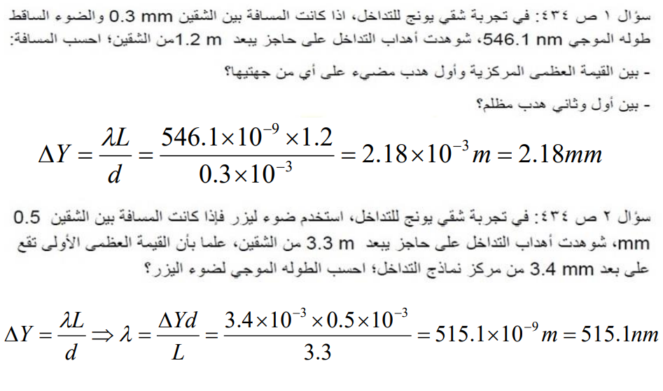

Slide 4
