Slide 1
Radiology of the abdomen
Radiology department
Dr. A. Alhawas

Slide 2
Outline:
Imaging modalities used to study the abdomen.
Anatomy and normal appearance of the abdomen.
Common pathological cases.

Slide 3
Imaging modalities:
Conventional X-Ray.
Barium studies ( flouroscopy )
US.
CT.
MRI.
Nuclear medicine.

Slide 4
Conventional Radiography (X-ray)
Often used as first imaging modality.
Cheap.
Useful for some radio-opaque stones and bowel obstruction and localization of the catheters.

Slide 5
Radiograph (X-ray)
Image features:
Projectional image.
Image contrast determined by tissue density.
Good evaluation for the bones, bowel distension and constipation.
Can be portable.
Disadvantages:
Radiation ( minimal ).
Poor soft tissue contrast

Slide 6
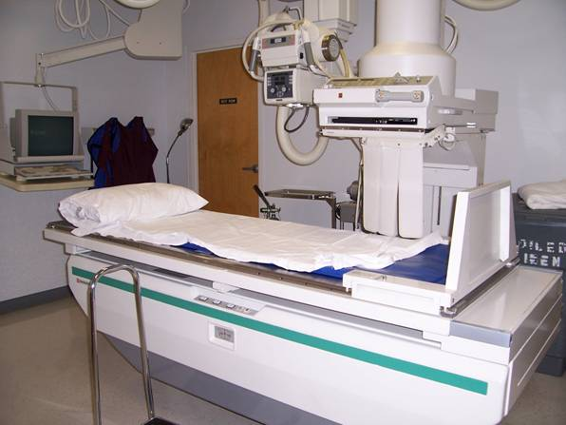
Barium studies ( fluoroscopy )
Often used in GIT abnormalities.
Cheap.
Use barium or gastrographin.
Recently replaced by endoscopy and colonscopy.
Useful in assessing esophageal motility and small bowel.

Slide 7
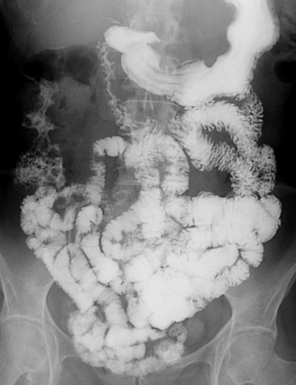
Image features:
Projectional image.
Image contrast determined by tissue density and oral contrast.
good evaluation of GIT.
Disadvantages:
Radiation.
Poor soft tissue contrast

Slide 8
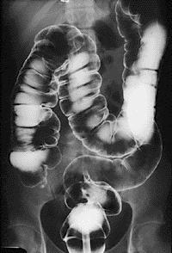
It has many procedures such as:
Barium swallow.
Barium meal.
Small bowel follow through.
Small bowel enema
Barium enema.

Slide 9
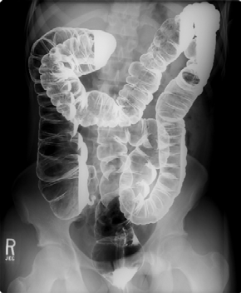

Slide 10
US
Ultrasound.
Use high frequency sound wave ( no radiation hazard ).
Contrast between tissue is determined by sound reflection, depend on nature of the organ and physical density.

Slide 11
US
Good resolution.
Used to assess the liver, GB, vascular structures, kidneys, UB, pancreas and spleen.
Real time imaging and fast scan
Can be done portable.
Disadvatages:
Operator dependant.

Slide 12
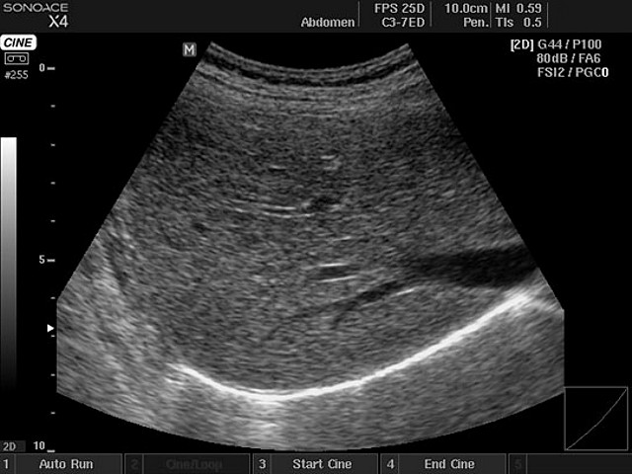
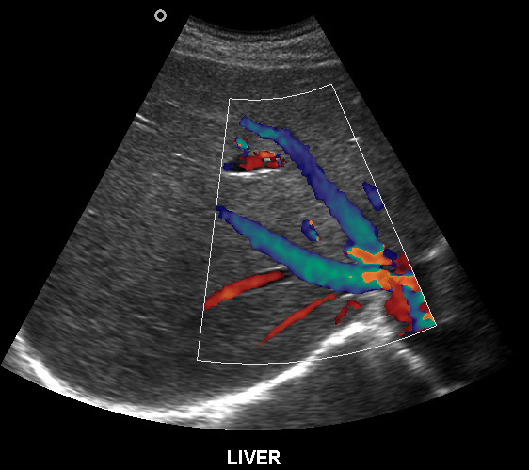
B mode:
C mode :

Slide 13
Computed Tomography ( CT )
Same basic principle of radiography
More precise
costly.
Can not be done portable.
Useful for trauma, stone, tumor, infection.
Scan time usually takes few minutes ( 1 – 7 minutes ).

Slide 14
CT:
Image features:
Cross sectional images.
Image contrast determined by tissue density +/- contrast.
Better evaluation of soft tissue.
Can assess vascular structures =) need I.V. contrast.
It is better than x- ray in assessment of ST and bones.

Slide 15
MRI
Magnetic resonant imaging.
Better evaluation of soft tissue.
Expensive.
Useful for soft tissue pathology:
Tumor, infection,

Slide 16
MRI
Use strong magnetic field.
Can not be done portable.
No radiation hazard.
The scan usually take long time ( 30 – 60 mins)
Very susibtible to motion and metallic objects.

Slide 18
Nuclear medicine
Gama camera.
Radioactive isotopes.
Functional test
(physiology).
very expensive.
Useful for:
Assessing the active tumors, bone involvement and renal functions.

Slide 19
Nuclear medicine
Image features:
Projectional image.
Image contrast by tissue uptake and metabolism.

Slide 20
Objectives:
Introduction.
Imaging modalities used to study the back.
Anatomy and normal appearance of the abdomen.
Common pathological cases.

Slide 22
CT

Slide 23
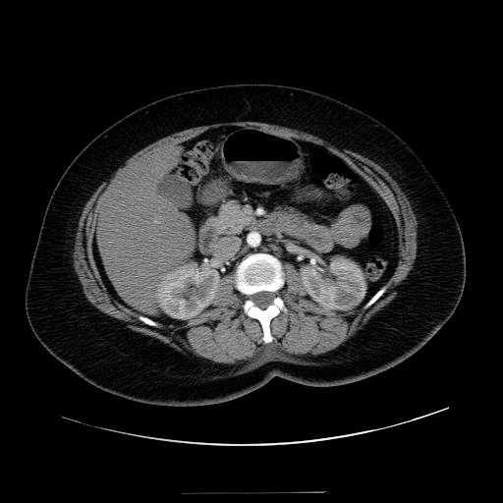

Slide 24
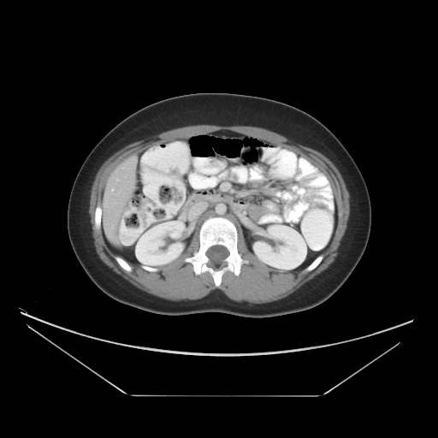

Slide 25
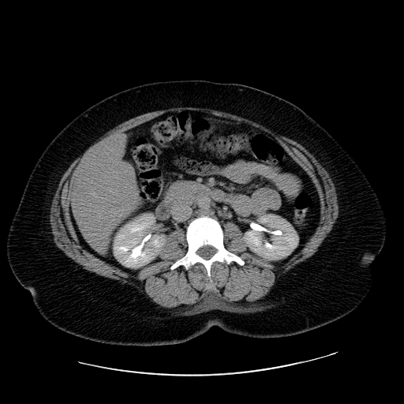

Slide 26
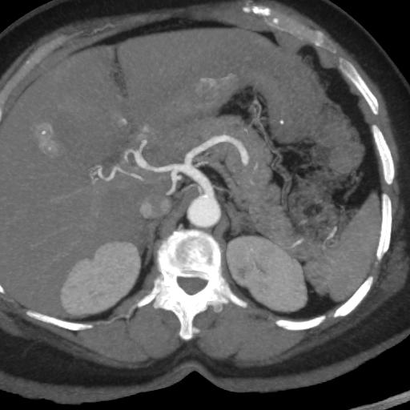

Slide 27
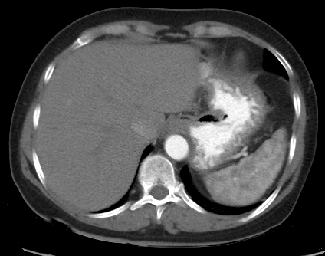

Slide 28
MRI

Slide 29
MRI

Slide 30
Objectives:
Introduction.
Imaging modalities used to study the back.
Anatomy and normal appearance of the abdomen.
Common pathological cases.

Slide 31
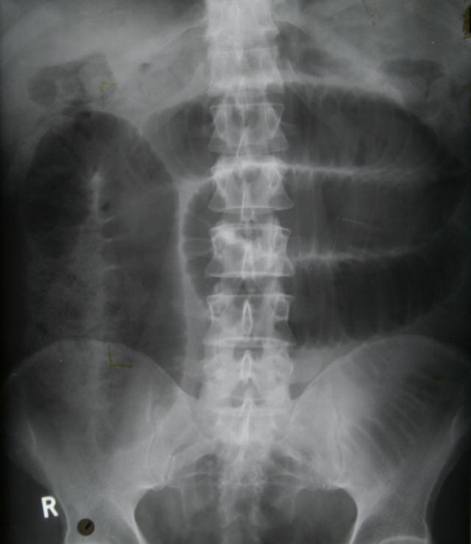
50 y/o male patient presented with gradual abdomen distension.

Slide 32
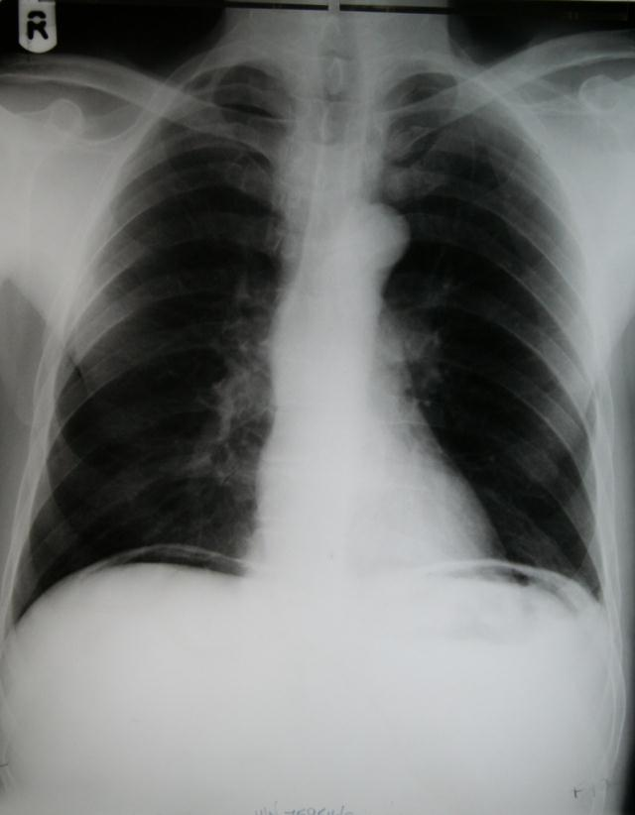
24 Y/O patient presented with sudden pain in the epi-gastric area and back.

Slide 33
30 Y/O female patient presented with right upper quadrant pain.
She had tendrness in the right subcostal margin.
Lab test showing leukocytosis.

Slide 34
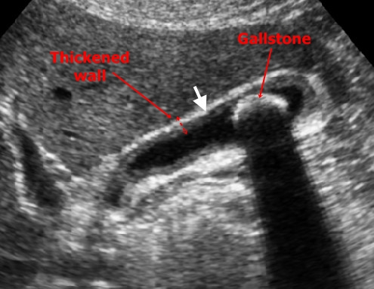
Thickned wall
Stone
Comet tail.

Slide 35
THANK YOU

