Slide 1
Population, Samples, and Sampling Descriptions

Slide 2
Objectives
To describe how the concepts of population, sample, and sampling are used in the research process.
To identify what discriminates populations from a sample.
To describe basic sampling techniques for qualitative and quantitative studies.

Slide 3
Population
An entire aggregation of cases that meet a designated set of criteria. – All persons with Diabetes.
All persons with Diabetes who are hospitalized.
Persons with newly diagnosed Diabetes who have had no prior Diabetic education.
Whatever the base unit, the population always comprises the entire aggregate of elements in which the researcher is interested.
– All possible candidates for the sample should be in the population

Slide 4
Population
• Target Population
Aggregate of cases about which the researcher would like to make generalizations.
Accessible Population
Aggregate of cases that conform to the designated criteria and that are accessible to the researcher as a pool of subjects for study

Slide 5
Approaches to Sampling
Quantitative
Seek to select samples that will allow them to generalize their results to much broader groups.
Qualitative
– Seek to select samples that allow for a in-depth understanding of the phenomenon of interest.

Slide 6
Sampling
The process of selecting a portion of the population to represent the population in its entirety.
The overriding consideration in assessing a sample in a quantitative study its representativeness.
A representative sample is one whose key characteristics closely approximates those of the population.

Slide 7
Basic Sampling Concepts in Quantitative Studies

Slide 8
Sampling Plan
Specifies in advance how study participants are to be selected.
How many study participants to include.

Slide 9
How the participants are to be selected:
Eligibility Criteria: The purpose of the eligibility criteria is to define a fairly homogeneous sample as a means of controlling extraneous variables.
Inclusion Criteria:
A list of the characteristics that all persons in the sample must have.
– Diabetics who on taking oral glucose lowering agents
• Data may or may not be collected in regards to subcategories.
Exclusion Criteria:
A list of characteristics that no person in the sample may have.
Diabetics who are taking insulin.

Slide 10
How the participants are to be selected:
Sampling Designs:
- Techniques and methods adopted for selecting a sample and obtaining estimates.
– Selecting a Sample:
Sampling Types:
Non-Probability Samples
• Probability Samples
Sample Size:
Obtaining Estimates
Power Analysis
Other sampling estimate techniques

Slide 11
Probability Samples
Involve a selection process in which each element in the population has an equal chance of being selected.
• The hallmark of probability selection is the random selection of elements from the population.

Slide 12
Random Selection VS Random Assignment
Random selection is NOT random assignment.
Random assignment refers to the process of allocating subjects to different treatment conditions on a random basis.

Slide 13
Types of Probability Samples
Simple Random Sample
• Stratified Random Sample
• Cluster Sampling
• K-Sampling

Slide 14
Simple Random Sample
All units in the population have an equal chance of being in the sample.
• Ensures that differences in the attribute of the sample and the population are purely a function of chance.
• The probability of selecting a markedly deviant samples decrease as the size of the sample increase.

Slide 15
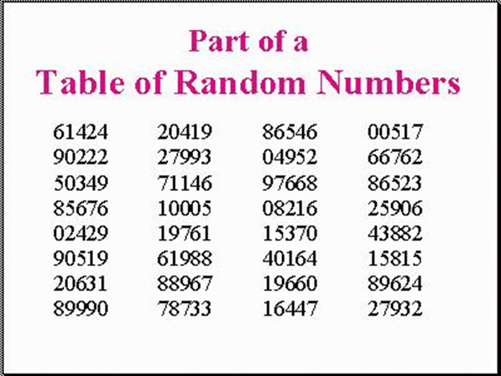
Simple Random Sample
Step One: Sampling Frame
– The technical name for the actual list of the sampling units or elements from which the sample will be chosen.
• Step Two: Listing of the Elements
– The elements are numbered consecutively.
• Step Three: Table of Random Numbers
– Starting blindly numbers from the table are matched to the number of elements.

Slide 16
Stratified Random Samples
Divide the population into homogeneous subsets from which an appropriate number of elements can be selected at random.
• Stratification may be based on age, gender, occupation, disease status, and so forth.
• Selecting subjects in proportion to the size of the stratum in the population being studied.
• HIV Population:
– 85% Male
– 15% Female

Slide 17
Cluster Sampling
A successive random sampling of units
• For example:
– Stage 1: All states in the US
– Stage 2: All counties in the states chosen.
– Stage 3: All hospitals in the counties
– Stage 4: All Surgical Patients admitted during a specific 24 hour time period.
• Also called “multistage sampling”

Slide 18
K Sampling
Also known as “Systematic Sampling”
• The first element is chosen from a table of random numbers.
• Then, each additional elements is chosen at a sampling interval or standard distance between the elements.
• Example: First randomly chosen number is 54, then every K or 200 subjects.

Slide 19
Non-Probability Samples
Every element does not have a chance for inclusion.
• Types:
– Convenience or Accidental
– Network or Snow-ball
– Theoretical or Purposive

Slide 20
Convenience or Accidental
The use of the most convenient elements as subjects for the sample.
• Most common sampling technique.

Slide 21
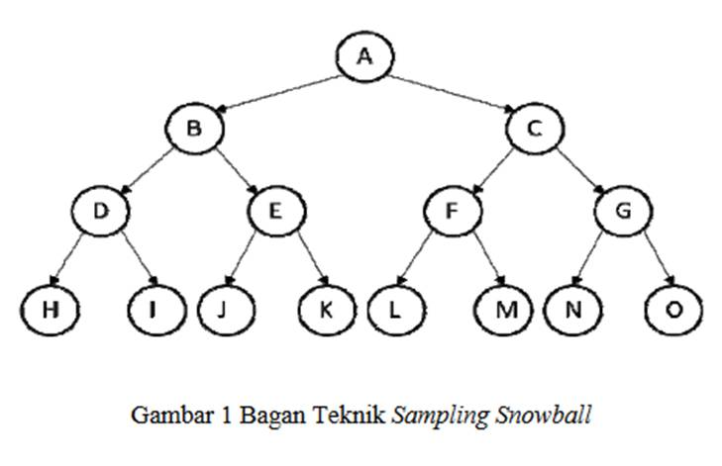
Network or Snowball Samples
Early sample members are asked to identify and refer other people who meet the same eligibility criteria.

Slide 22
Quota Samples
The researcher first identified strata of the population.
• Then, the researcher determines the proportion of elements needed from the various segments of the population.
• Then, convenience sampling is used until that proportion of the sample is determined.

Slide 23
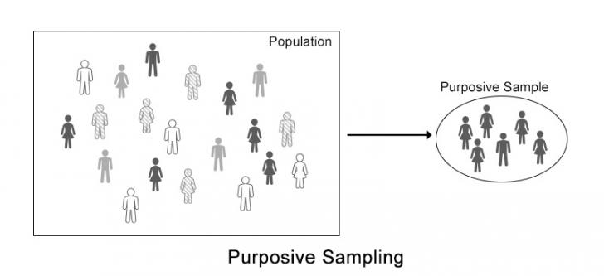
Theoretical or Purposive Samples
Based on the belief that the researcher’s knowledge about the population can be used to hand pick the cases to be included in the sample.
• Usually used to choose subjects who are either typical or expects in the issues/content under study.
• Frequently used in instrument development

Slide 24
Basic Sampling Concepts in Qualitative Studies

Slide 25
Sampling Agenda
To identify the elements which will contribute most to discover the meaning or understanding of the phenomenon under study.

Slide 26
Types of Qualitative Sampling
Volunteer Sampling
– Also known as convenience sampling
• Snowball Sampling
– The same as network sampling
• Theoretical Sampling
– a sampling strategy in which the selection of participants is guided by the ideas that are emerging from the data analysis.

Slide 27
Sample size
Sample Size Considerations:
Homogeneity of the Population
Attrition
Number of Variable
Subgroup Analysis
Sensitivity of the Measures

Slide 28
Strategies for Determining Sample Size in Quantitative Studies
Power Analysis
– Effect size
– Power
– Alpha
Multivariate Sampling Decision
– Subject per variable
– Subjects per questionnaire item

Slide 29
Power Analysis
A priori power analysis can be used to calculate the minimum sample size required to accept the outcome of a statistical test with a particular level of confidence (power).
Effect
– A measure of how wrong the null hypothesis is or how strong the effect of the independent variable is on the dependent variable.
• Power
– The probability of rejecting the null hypothesis, i.e., that it will detect a significant difference.
• Alpha
– The level of significance or the probability of a Type I error

Slide 30
Multivariate Sampling Decisions: Rule of Thumb
5-10 Elements/Variable
• 20-30 Elements/Variable
• 5-10 Elements/Item on a Questionnaire
• The larger the sample, the smaller the sampling error.

Slide 31
Strategies for Determining Sample Size in Qualitative Studies
The sample size should be determined on the basis of knowledge needs and study design requirements
Examples: – Eidetic Phenomenology: It is possible to do a study with an N of 1
– Grounded Theory: Data Saturation
• Sampling to the point at which no new information is obtained and redundancy is achieved.

Slide 32
Recruitment Strategies
Methods
– Face to face versus brochures, letters, etc
• Persistence – Persistence versus coercion
• Payments
– Financial
– Value of research to society
– Offers of research summary
• Integrity in Research
– Human Subjects Protection

Slide 33
Large sample sizes decrease confidence levels

Slide 34
Thanks
Any ?

