Slide 1
Scaling Big Data Mining Infrastructure:
The Twitter Experience
By:
Jimmy Lin & Dmitriy Ryaboy

Slide 2
Outline:
Introduction
The problem!
The big data mining cycle
where to find the data?
conclusion
future Exploration

Slide 3
Introduction
The analytics platform at Twitter has experienced tremendous growth over the past few years in terms of size, complexity, number of users, and variety of use cases.
The number of employees at twitter has change since 2010 working on thousands of Hadoop nodes across multiple datacenters!
Each day, ≈ 100 TB of raw data ingested into twitter’s main Hadoop data warehouse.
In this paper; they shared their experience in scaling twitter’s analytics infrastructure.

Slide 4
The problem
Schemas are important in helping data scientist understand big data, but schemas alone not enough.
Major challenge in building data-analytics platforms comes from heterogeneity of the component and their integration process. (i.e. impedance mismatch at the interfaces).

Slide 5
The problem
Where’s the data?
What’s in this dataset?
Clean the data !
Gathering
Moving
organizing

Slide 6
The problem
Sample questions to help scientist in precisely formulate the problem:
When do users typically log in and out?
How frequently?
What features of the product do they use?
Do different groups of users behave differently?
Do these activities correlate with engagement?
What network features correlate with activity?
How do activity profiles of users change over time?
Notes:
This Qs help to precise the problem !
-user behavioral change many time it’s result to feature change (add recommendation feature) !

Slide 7
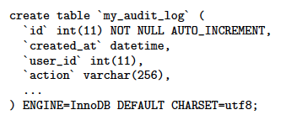
Methods
1- Log directly into a database !
Don’t use MySQL as a Log !!
Workload mismatch
Scaling challenges
Overkill with logging !
Schema changes

Slide 8
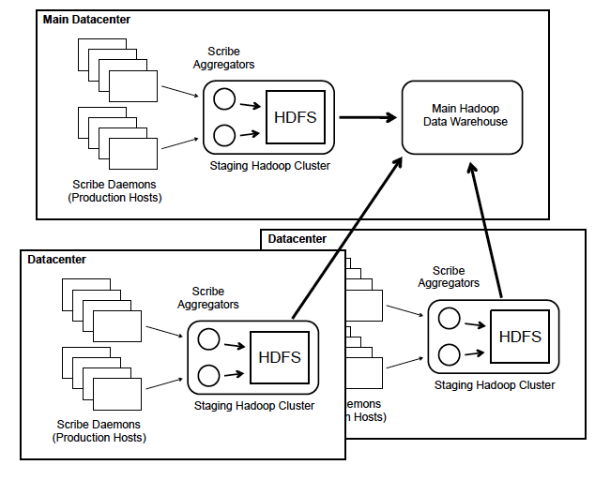
Methods
2- Use Scribe !
But it solves
log transport only !
Notes:
Scribe is :

Slide 9
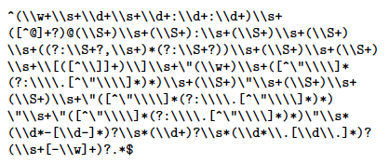
Methods
How should log messages be structured?
Plain-text log messages vs. JSON
An actual Java regular expression used to parse log messages at Twitter 2010
Notes:
Parsing and maintenance is night mare !!!!

Slide 10
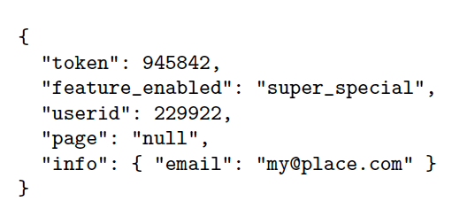
3- Use JSON to structure the data…
This should be a list
Is this a null or a string?
Problems??
-No fixed schemas
-unconstrained even if
standardized parsing is used
What keys? What values?

Slide 11
4- Structured Representation? Use Thrift !
Efficient serialization of all logged messages
Sane path for scheme migration
separation between logical & physical data representation !
- They developed “Elephant Bird” tools that hooks into the Thrift serialization compiler to automatically generate record readers, record writers, and code for both Hadoop, Pig, and other tools.

Slide 12
Scheme is not enough!
We need a data discovery service !
where’s the data?
How do I read it?
Who produce it?
Who consume it?
When was it last generated?

Slide 13
Where to find the data ?
Old way: hard coded partitioning scheme, path, format
New way (HCatalog project in Apache incubator) :
Nice UI for browsing
Same loader each time
Filters are pushed into the loader
No need to understand partitioning scheme

Slide 14
In Twitter :
They built tools around HCatolog to make it more suitable for their needs.
They plan on further development for integrating schemes

Slide 15
Scalable machine Learning
Not an easy task
Mahout: a popular toolkit for large-scale machine learning and data mining tasks.
Twitter & Mahout:
Some Mahout components are designed to run on a single machine, and other parts that scale to massive datasets using Hadoop.
Requires adaptors on both ends

Slide 16
Production consideration
Dependency management, Scheduling. Resource allocation, Monitoring, Error reporting, Alerting
They need :
1- Seamless scaling
2-integration with production workflows
Pig scripts
MADLib
SystemML

Slide 17
conclusion
Under explored questions :
visualization is important for Big data mining.
Real time interactions with large datasets to enable fast experimentations.

Slide 18
conclusion
The goal is achieving the right balance between: speed of developments, ease of analytics, flexibility, scalability and robustness.
How to provide useful tools while staying out of the way of developers is a difficult challenge.
As the organization grows; the analytical infrastructure will evolve!

Slide 19
Future Exploration
Are there prototypical evolutionary stages that data centric organizations go through?
how do we smoothly provide technology support that will help organizations grow and transition from stage to stage?

Slide 20
Thank you
Bayan Almuqhim,
433920231
19, Mar, 2014

