Slide 1
Plant Diversity
Section 8

Slide 2
Plantae
نباتات لاوعائية Nonvascular plants
نباتات وعائية Vascular plants (Tracheophyta)
الحزازيات Bryophyta
وعائية بذرية Spermatophyta
وعائية لابذرية Pteridophytes
حزازيات قائمة Musci (Mosses)
مثل: الفيوناريا Funaria
حزازيات منبطحة Hepaticae (Liverworts)
مثل: الماركنتيا Marchantia
مغطاة البذور Angiosperms
عاريات البذور Gymnosperms
المخروطيات
Coniferophyta
(male and female cones)
ثنائية الفلقة Dicotyledons
أحادية الفلقة Monocotyledons
النباتات اللايكوبودية Lycophyta
مثل: الرصن Selaginella
السراخس Pterophyta (Ferns)
مثل: كزبرة البئر Adiantum

Slide 3
Background
4 main groups of land plants :
Bryophytes – mosses
Pteridophytes – ferns
Gymnosperms – conifers
Angiosperms – flowering plants

Slide 4
Classification of Plants

Slide 5
Non vascular plants
Bryophytes

Slide 6
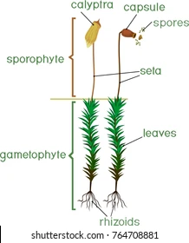
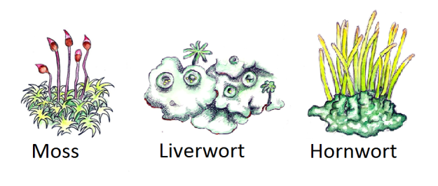
Bryophytes الحزازيات
Nonvascular plants
3 phyla:
Hepatophyta (liverworts)
Anthocerophyta (hornworts)
Bryophyta (mosses)
Most grow close to the ground, anchored by rhizoids

Slide 7
Bryophytes

Slide 8
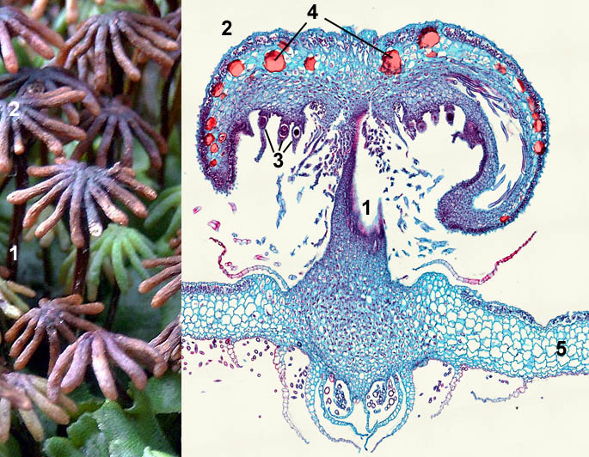
1- Liverworts (Marchantia)

Slide 9
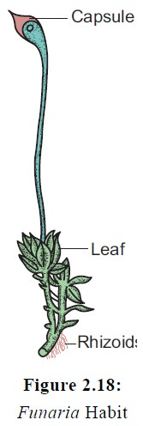
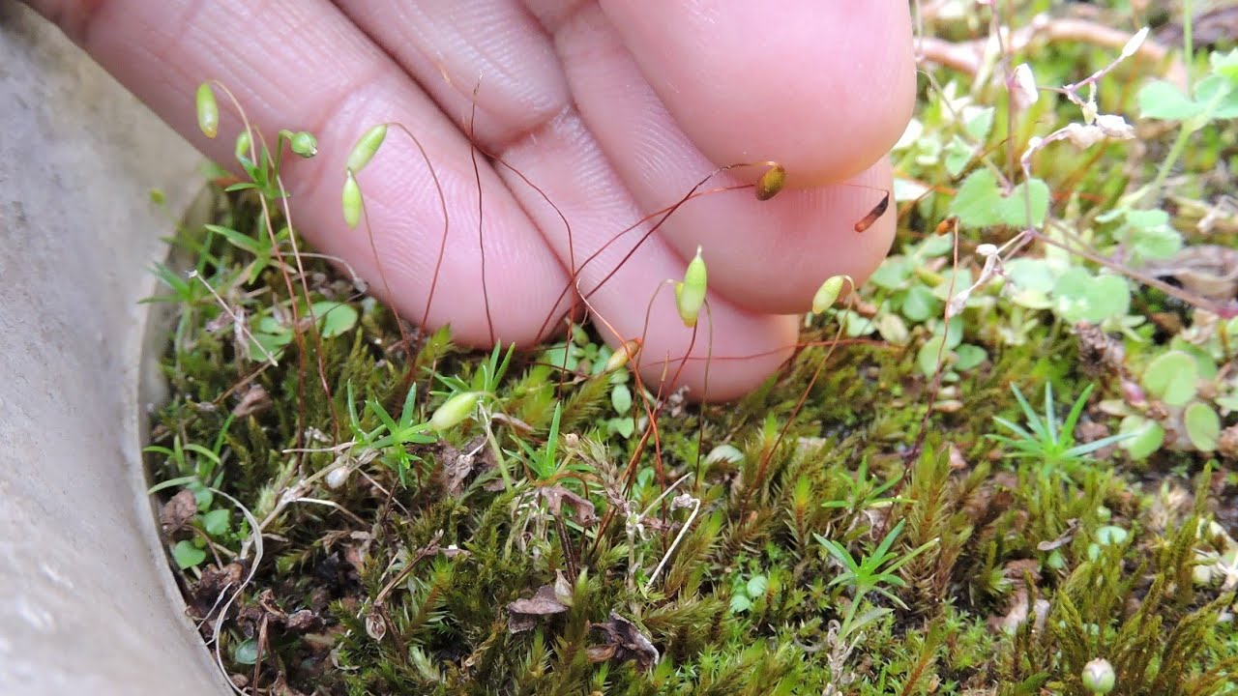
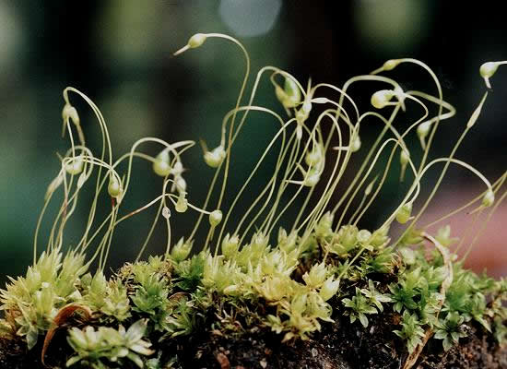
2- Mosses (Funaria)

Slide 10
Vascular plants
1- seedless
Pteridophytes

Slide 11
Pteridophytes السراخس
Seedless vascular plants
Two phyla:
Lycophyta (club mosses)
Pterophyta (ferns, whisk ferns, & horsetails)
Have true roots with lignified vascular tissue
Microphylls – small leaves with a single unbranched vein
Sporophyte is the dominant life cycle

Slide 12
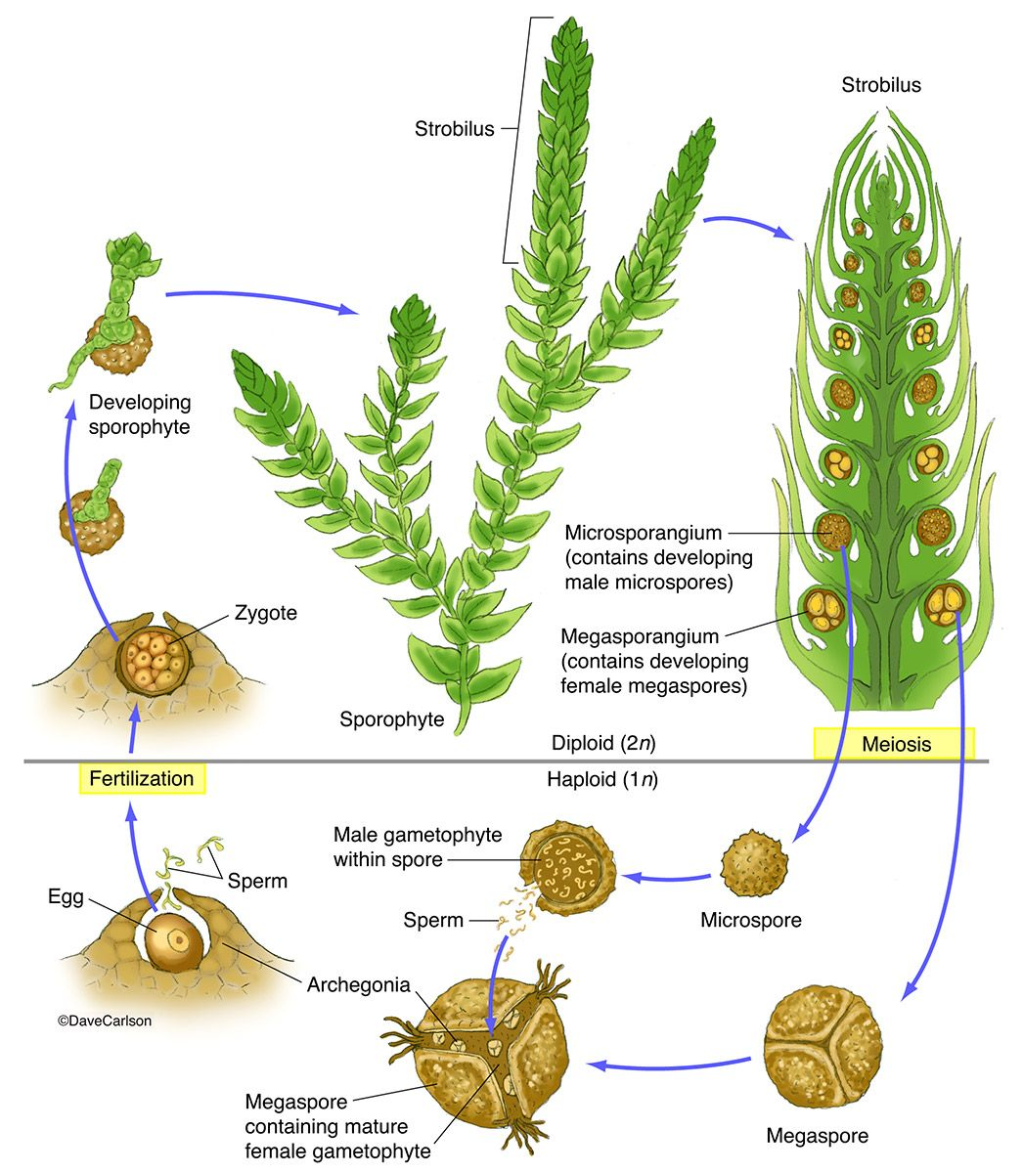
Lycophyta (selaginella)

Slide 13
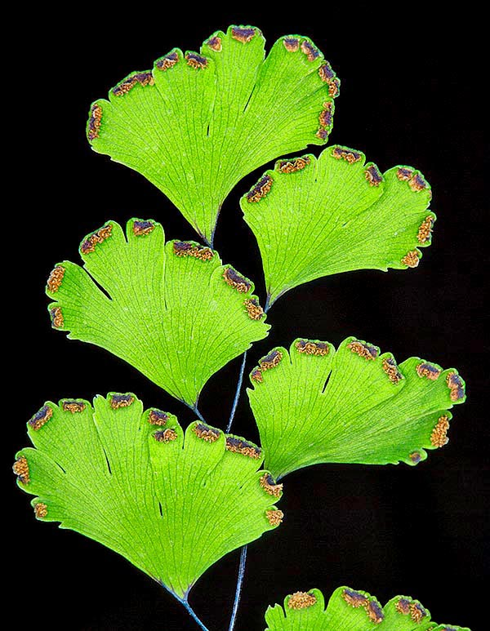
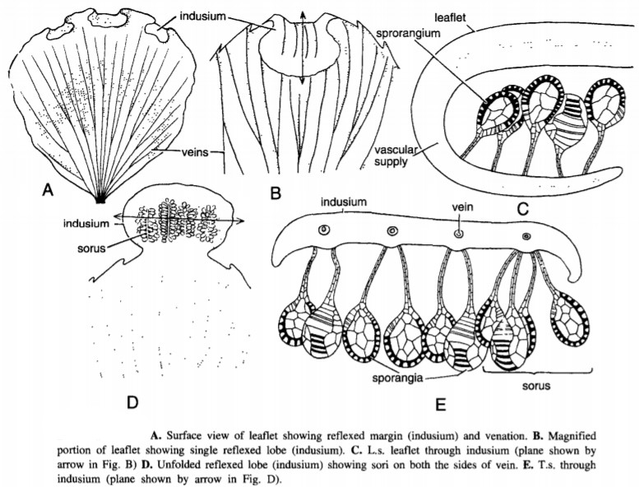
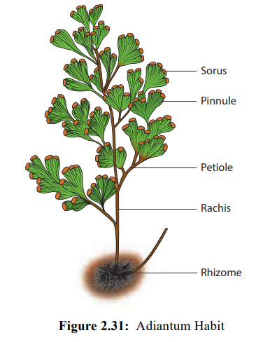
Pterophyta “ferns” (Adiantum)

Slide 14
Life Cycle of a Fern

Slide 15
Vascular plants
2- seed plants
Spermatophyta

Slide 16
Seed plants
Vascular plants that produce seeds
Includes the gymnosperms & angiosperms
Three important reproductive adaptations:
Continued reduction of the gametophyte (microscopic)
All seed plants are heterosporous
Development of seeds for dispersing offspring
Pollen eliminated the liquid-water requirement for fertilization

Slide 17
1- Gymnosperms
“naked seeds”
Seeds develop on the surface of specialized leaves called sporophylls
Most familiar are the conifers – the cone المخروط-bearing plants such as pines
Dominant plant life in the Mesozoic era
There are four phyla of gymnosperms

Slide 18
The 4 Gymnosperm Phyla
Ginkgophyta
Includes only one family and one species Ginkgo biloba
Cycadophyta
Includes the cycads, which resemble palms
Gnetophyta
Consists of 3 genera that are very different in appearance
Pinophyta (Coniferophyta)

Slide 19
Phylum Pinophyta (Coniferophyta)
The largest of the gymnosperm phyla
The cone is the reproductive structure
Examples: pines, junipers, cedars, and redwoods
Most are evergreens
Where we get much of our lumber and paper pulp
Among the largest & oldest organisms on Earth

Slide 20
Phylum Coniferophyta

Slide 21
Life Cycle of a Pine

Slide 22
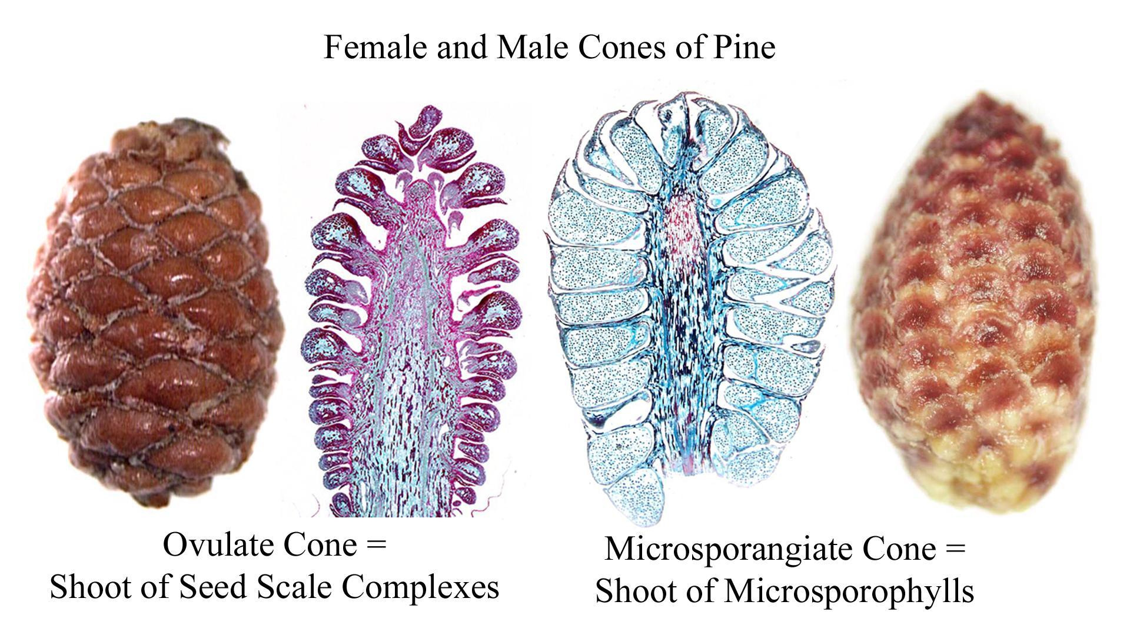

Slide 23
2- Angiosperms (monocot – dicot)
Flowering plants
Vascular seed plants that produce flowers and fruits (as reproductive structures)
All are in a single phylum, Anthophyta
Are the most diverse and geographically widespread of all plants
Marks the transition from the Mesozoic era to the Cenozoic era

Slide 24
Flower

Slide 25
Fruits
A mature ovary
Protect dormant seeds and aid in their dispersal

Slide 26
Life Cycle of an Angiosperm

Slide 27
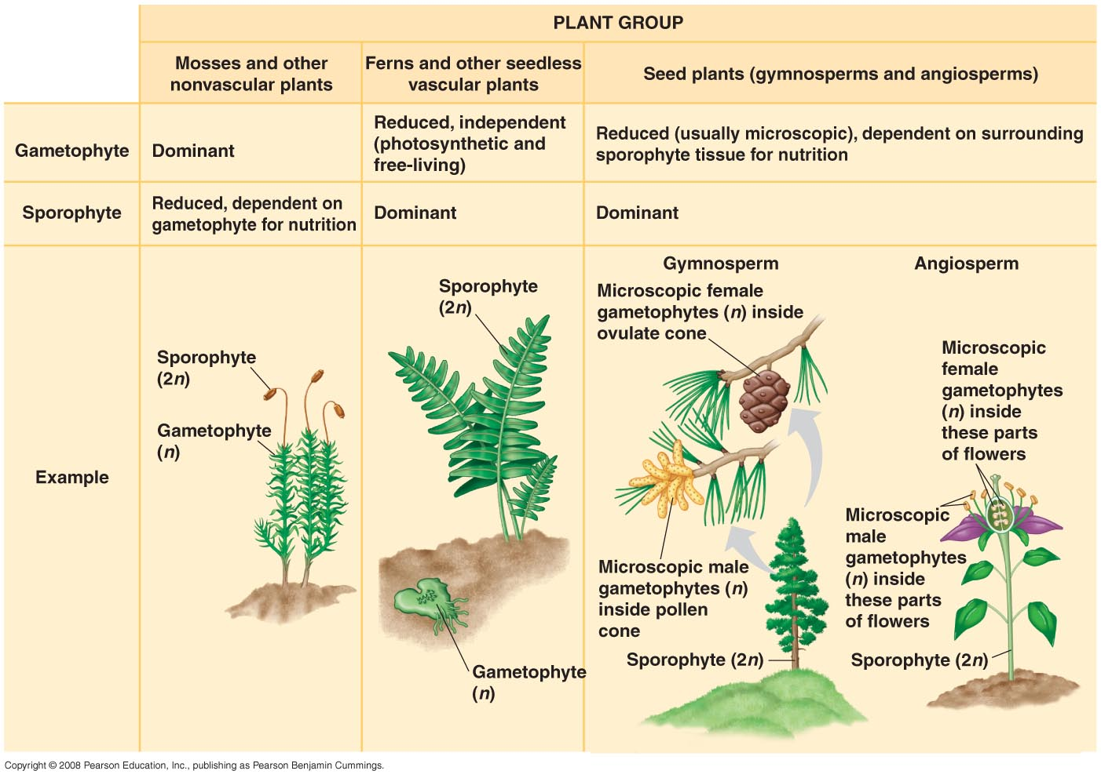

Slide 28
Any questions

