Slide 1

220 BCH
Separation of Plasma and Serum and Their Proteins from Whole Blood

Slide 2
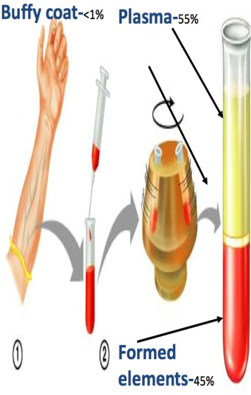

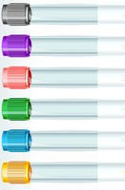

Separation of
Serum
Centrifuged to precipitate fibrinogen results in
Plasma
Blood has been clotted prior to centrifugation usually in a red top tube with no additives or anticoagulant.
Blood has been treated with anticoagulants to prevent clotting and permitted to stand or centrifuged in a container
Note: Serum is preferred for many tests (e.g. determination of lactate dehydrogenase) as the anticoagulants in plasma can sometimes interfere with the results.

Slide 3





Collection of Blood Specimens
If whole blood or plasma is desired, an anticoagulant must be added to the specimen.
Tube Cap Color | Additive | Function of Additive | Common Lab Tests
Green | Heparin | It inhibits the formation of thrombin from prothrombin and thus preventing the formation of fibrin. | -Routine Chemistry Tests -Cytogenetic
Purple | EDTA | It is a chelating agent, it binds calcium, which is essential for the clotting mechanism. | -Hematology -Molecular Tests
Light Blue | Sodium Citrate | It inhibits blood coagulation by converting calcium into a non-ionized form, and hence prevent clotting of blood. | Coagulation Test
Dark Gray | Potassium Oxalate | It inhibits blood coagulation by forming insoluble complexes with calcium ions. | -Preserve glucose in whole blood -Some Chemistry Tests.
Light Gray | Sodium Fluoride | It has been used chiefly as a preservative since it inhibits red cell metabolism and bacterial action.

Slide 4
Changes in Blood on Keeping
Loss of carbon dioxide.
Conversion of glucose to lactic acid (glycolysis).
Increase in plasma inorganic phosphate.
Formation of ammonia from nitrogenous substances.
Passage of substances through the red cell envelope.
Conversion of pyruvate into lactate.

Slide 5
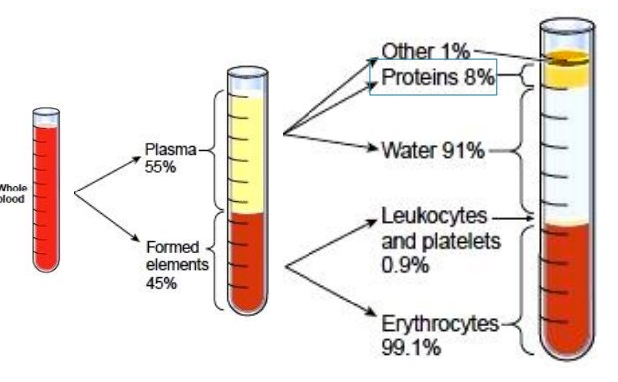
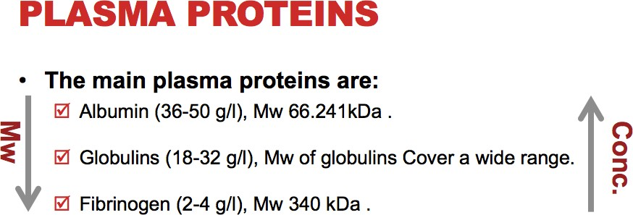
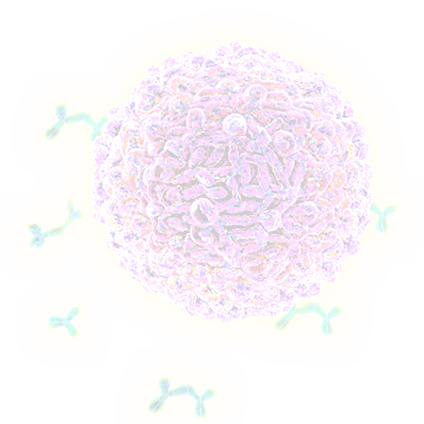
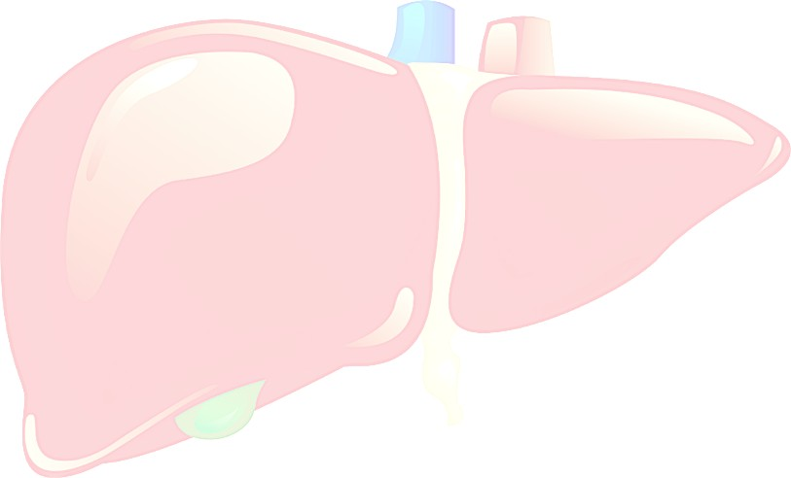


Site of synthesis
Gamma globulin (immunoglobulin) are made by B cells
All plasma proteins are synthesized in the liver
except
Note: All plasma proteins are water soluble

Slide 6
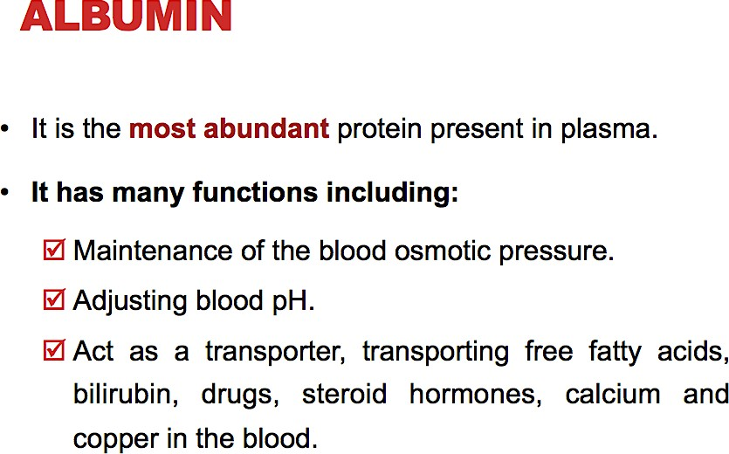

Slide 7
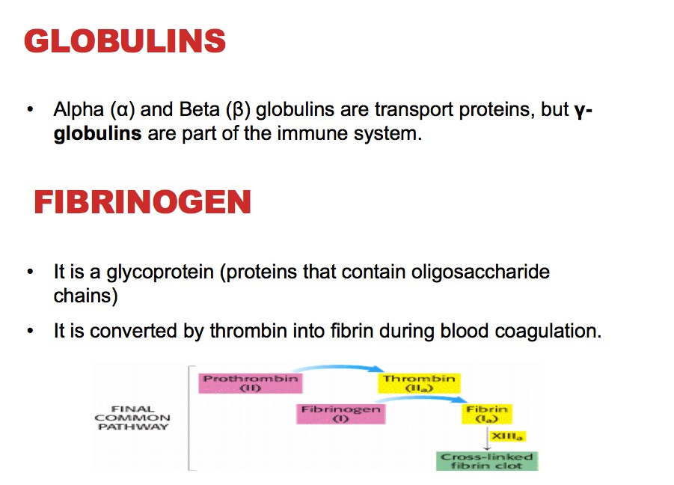
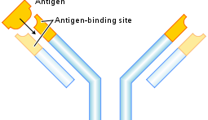
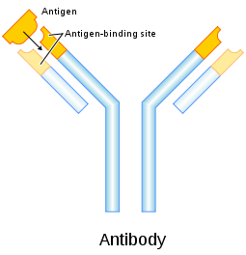

Slide 8
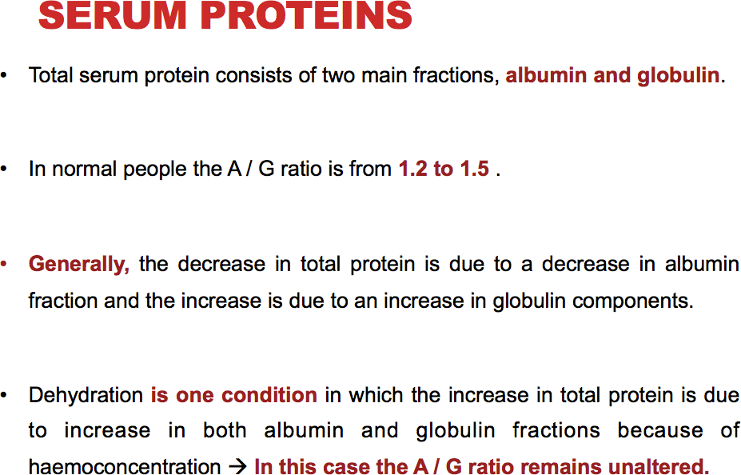

Slide 9
A low serum albumin may be due to:
A heavy loss of albumin in urine.
Loss or mal-absorption of protein from the digestive tract.
Decreased formation by the liver due to defective liver.
Increase catabolism of protein or due to insufficient intake of protein in diet.
A high serum globulin occurs commonly in:
Advanced liver disease.
multiple myeloma.
number of chronic infections.

Slide 10


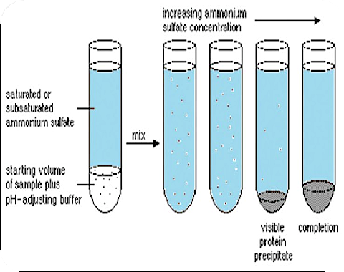
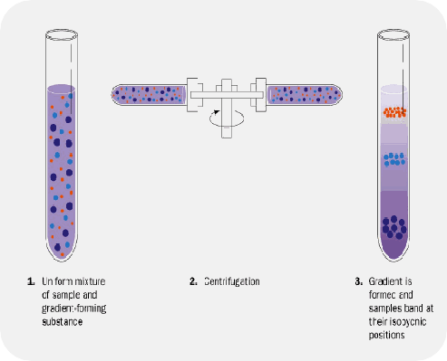





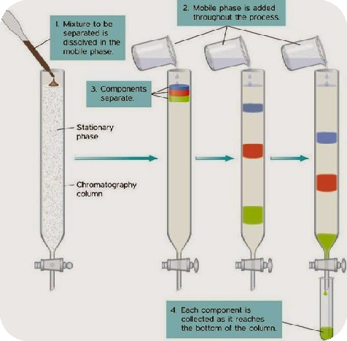
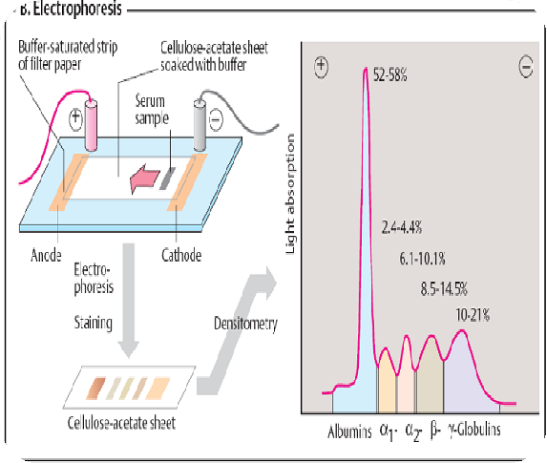

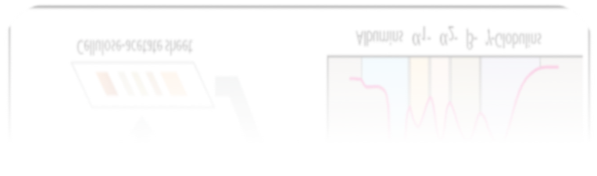
Serum and plasma proteins can be separated from each other by :
Salting out
Ultracentrifugation
Chromatography
Electrophoresis

Slide 11
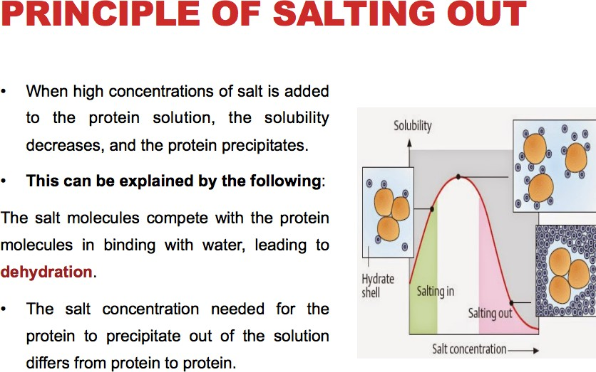

Slide 12
