Slide 1
مقدمة في الإحصاء الحيوي مع تطبيقات برنامج الحزم الإحصائية SPSS
د. أسامة عبدالحليم سمرقندي
المشرف على إدارة الإحصاء والمعلومات
جامعة الملك سعود

Slide 2
Introduction to Biostatistics with SPSS Application
Osama A Samarkandi, PhD

Slide 3
Session V

Slide 4
* Welcome Back *

Slide 5
Regression and Prediction
Simple Linear Regression, aim to study the impact of a two variables (Dependent Variable, and Independent Variable).

Slide 6
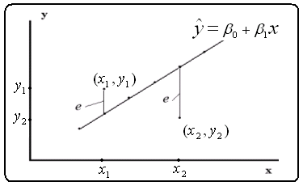

Slide 7
Regression and Prediction
A straight line is defined by two terms: Slope and Intercept
y = β_{o}+ β₁x +e
Where;
y; Dependent Variable,
x; Independent Variable,
β; Intercept (on Y-axis),
β₁; Slope, of: (β_{o}+ β₁x), shows the ratio of y when x ↑ or ↓.
e; Random Error, the deferent between the actual value of y, and the predictable value of ŷ, where; ŷ=β_{o}+ β₁x .

Slide 8
Regression and Prediction
A straight line is defined by two terms: Slope and Intercept
y = β_{o}+ β₁x +e
Where;
y; Dependent Variable,
x; Independent Variable,
β; Intercept (on Y-axis),
β₁; Slope, of: (β_{o}+ β₁x), shows the ratio of y when x ↑ or ↓.
e; Random Error, the deferent between the actual value of y, and the predictable value of ŷ, where; ŷ=β_{o}+ β₁x .

Slide 9
Regression and Prediction
Regression coefficients (β_{o} & β₁) can be determined decreasing the Sum of Squares of the random error;
$$Σe2=Σ(y−(\text{β}\text{o}+\text{β}\text{1}\text{x})2$$
e_{x}=y_{x}– ŷ_{x}
Then, by using the following equations:
$$\text{β}\text{1}=\frac{nΣxy −ΣyΣx}{nΣx2−\left(Σx\right)2}$$
β_{o}= $\overline{Y}$- β₁$\overline{X}$

Slide 10
Example
The following data represents the daily amount of protein (in Gram) that’s calf may consumed, and the weight that’s they may gain:
Protein intake | 10 | 11 | 14 | 15 | 20 | 25 | 46 | 50 | 59 | 70
Gain in weight | 10 | 10 | 12 | 12 | 13 | 13 | 19 | 15 | 16 | 20
Graph the mentioned relation,
Determine the simple linear regression equation on protein,
What would be the gain in weight when receive 50 gm of protein,
Find e.

Slide 11
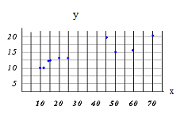
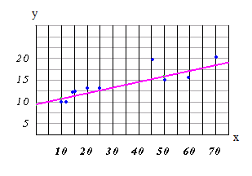
Solution

Slide 12
Solution
x² | xy | y | x
100 | 100 | 10 | 10 | A
121 | 110 | 10 | 11 | B
196 | 168 | 12 | 14 | C
225 | 180 | 12 | 15 | D
400 | 260 | 13 | 20 | E
625 | 325 | 13 | 25 | F
2,116 | 874 | 19 | 46 | G
2,500 | 750 | 15 | 50 | H
3,481 | 944 | 16 | 59 | I
4,900 | 1,400 | 20 | 70 | J
14,664 | 5,111 | 140 | 320 | SUM
 |  | 14 | 32 | Mean
$$\text{β}\text{1}=\frac{nΣxy −ΣyΣx}{nΣx2−\left(Σx\right)2}$$
$$=\frac{(10)(5111) −(320)(140)}{10 \left(14664\right)−\left(320\right)2}$$
= $\frac{(6310)}{(44240)}=$ 0.1426
By substitution β₁ in
β_{o}= $\overline{Y}$- β₁$\overline{X}$
β_{o}= $\overline{Y}$- β₁$\overline{X}=14$=(0.1426)(32) $=$9.4368
Then
ŷ $=$ 14 – (0.1426) x

Slide 13
Solution
ŷ=βo + β₁x
ŷ = 9.44 +0.143x
= 9.44 +0.143 (50)
= 16.59 gm
e_{x-50}=y_{x-50} – ŷ_{x-50}
=15 – 16.59
= -1.59

Slide 14
Example 2
The table in the side gives Ht= Height in centimeters an Wt=Weight in kilograms for a sample of ten 18-years old girls. The data was taken from a researcher that's predicting weight from height.
Graph the scatterplot for the data.
Determine the simple linear regression equation
What would be the weight for a girl that 166.6 cm tall
Gender | Ht | Wt
A | 169.6 | 71.2
B | 166.8 | 58.2
C | 157.1 | 56.0
D | 181.1 | 64.5
E | 158.4 | 53.0
F | 165.6 | 52.4
G | 166.7 | 56.8
H | 156.5 | 49.2
I | 168.1 | 55.6
J | 165.3 | 77.8
Mean | 165.5 | 59.5

Slide 15
SPSS Practice

Slide 17
* You are ready to go*
*All the best *

